Slide 1

KESHAV MEMORIAL INSTITUTE OF TECHNOLOGY
An Autonomous Institution · Accredited by NAAC with 'A' Grade · Narayanaguda, Hyderabad
AI-Based Student Engagement &
Collaboration Detection System
Deep Learning with a Swin Transformer — an honest, leakage-controlled study
Real-Time Research Project (RTRP) · II / II · 2026
Md Anas (24BD1A6655) · A. Nikhil (24BD1A6642) · Y. Lohith Reddy (24BD1A66K3) · Boru Tejaswini (24BD1A6646) · Kanak Kabra (24BD1A664T)
Mentor: Ms. Nidhi Srivastav · Domain Head: Ms. P. Sirisha · Group G1033 · RTRP II / II · 2025-26

Slide 2

KR24_RTRP_II-II_2026
Final Review Project Presentation
Date: 06-Jun-2026
Team Members
A.Nikhil (24bd1a6642)
Md Anas (24bd1a6655)
Y.Lohith reddy(24bd1a66k3)
Boru Tejaswini (24bd1a6646)
Kanak Kabra (24bd1a664t)
Mentor & Domain Head
Ms Nidhi Srivastav-Mentor
Ms P. Sirisha-Domain Head

Slide 3
Contents
1. Abstract
2. Objective, Domain & Beneficiaries
3. Stakeholders & Use Cases
4. Functional & Non-Functional Requirements
5. Technology Stack
6. System Architecture
7. Design — Data, Workflow & Evaluation
8. Implementation
9. Results — Phase 1 & Phase 2
10. Testing & Validation
11. Deployment
12. Conclusion & Future Work

Slide 4
Abstract
This project builds a system that reads a classroom from video to assess two things: how engaged each student is, and whether students are collaborating.
A Swin-Tiny Transformer with a temporal head (Phase 1) classifies per-student engagement; its frozen features then drive a collaboration model (Phase 2). The defining principle throughout is generalization without data leakage — every result is measured by holding out entire unseen classrooms (Leave-One-Video-Out).
Outcome — Engagement: held-out TEST macro-F1 0.73 / 76.7% acc (validation 0.90, audited). Collaboration (group level): signals 0.667 → 0.764 with head-pose / gaze (verified; ≈0.70–0.73 regularized).
Gaze is a real session-level collaboration signal — collaborative sessions show more mutual gaze (AUC 0.705). Within-scene pair-level remains an honest, documented negative.

Slide 5
Objective, Domain & Beneficiaries
Objective
Automatically assess student engagement and collaboration from ordinary classroom video — in a way that transfers to a new, unseen room rather than memorizing the rooms seen in training.
Domain
End beneficiaries
Deep Learning · Computer Vision · Educational Technology (EdTech). A core-tech project: video understanding with transformer backbones and honest model evaluation.
• Teachers / instructors — objective, real-time feedback on class engagement.
• Institutions — engagement & collaboration analytics across sessions.
• Students — better-tuned, more interactive learning environments.

Slide 6
Stakeholders & Use Cases
Stakeholders
Students
Teachers / Instructors
Institution / Admin
Key use cases
UC-1 Engagement monitoring Classify each tracked student as Engaged / Not Engaged over short clips.
UC-2 Collaboration detection Judge whether a session's group is collaborative, from per-pair interaction statistics.
UC-3 Class analytics Aggregate per-student and per-session results into a class-level summary.

Slide 7
Functional & Non-Functional Requirements
Functional requirements
Non-functional requirements
• Ingest classroom video and sample frames.
• Detect and track each student (stable IDs).
• Classify per-student engagement (Engaged / Not).
• Compute per-pair interaction signals.
• Classify group collaboration per session.
• Output verdicts & class-level analytics.
• Generalization — zero scene/data leakage (LOVO).
• Robustness to lighting, pose and noise.
• Reproducibility — deterministic, re-verifiable runs.
• Efficiency — trains on a single Colab GPU; numpy inference.
• Honesty — every metric backed by a shuffle control.

Slide 8
Technology Stack
Frontend
Next.js 14 (React + TypeScript), TailwindCSS, Framer Motion, Recharts / D3
Swin-Tiny Backbone (timm) + custom Temporal Transformer → 768-d clip feature + PyTorch
Model
Detection / Tracking
Ultralytics YOLOv8n + ByteTrack, OpenCV, InsightFace / SixDRepNet
Libraries
OpenCV · NumPy, Python
Backend
FastAPI, Pydantic, Uvicorn, SQLite (WAL), NumPy
Alternatives considered — ResNet/CNN vs Swin (chose Swin for global self-attention); frame-level vs temporal modelling (chose temporal);
ImageNet / DINOv2 features for collaboration (tested). Choices were validated empirically, not assumed.

Slide 9
System Architecture
Classroom
video
YOLOv8
detect + track
Per-person
clips (8 frames)
Swin-Tiny +
Temporal Transf.
768-d feature
Engagement head
Phase 1 · Engaged vs Not
Group-Collaboration head
Phase 2 · session verdict
The Swin backbone is fully frozen for Phase 2 (34.8M params). Read-outs are deliberately small — with only ~30 sessions, a heavy head would memorize rooms instead of generalizing.

Slide 10
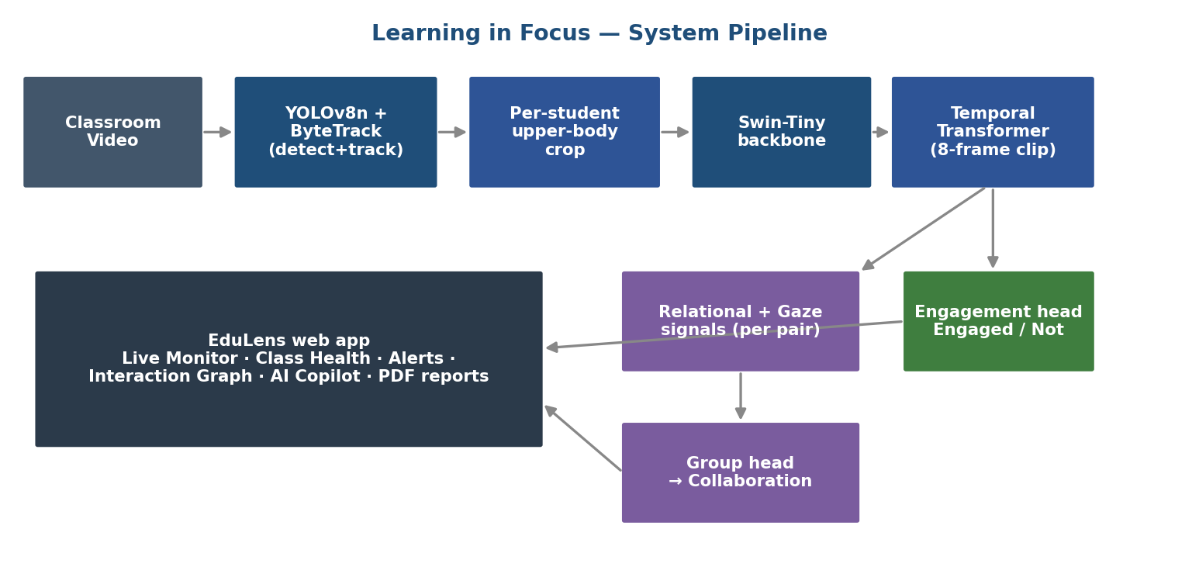

Slide 11
Design — Data, Workflow & Evaluation
Dataset
The core design decision
EduAction dataset clips + 30 custom videos for engagement (Phase 1).
33 custom classroom videos → 883 unique student pairs (452 collaborative / 431 not). Per-person clips, cached as 768-d features.
Collaboration here is ~83–90% explained by which video a pair is in — the scene confound. Any split that lets one room appear in train and test measures room recognition, not collaboration.
Data flow
So the evaluation is Leave-One-Video-Out: hold out an entire room each fold, train on the rest, predict the held-out room — the scene can never leak.
Every reported number is paired with a label-shuffle floor as a chance control.
video → detect & track → per-person clip features (.npy cache) → de-duplicated unique-pair dataset (.npz) → engagement & collaboration models.

Slide 12
Implementation
Phase 1 — Engagement
Engineering highlights
Swin-Tiny clip model trained bootstrap → align → calibrate; best generalization from minimal temporal training on ImageNet features. Frozen and reused as the Phase-2 backbone.
Genuine per-person feature extraction; unique-pair de-duplication; an honest LOVO trainer with built-in shuffle & per-video validation gates; a separate geometry re-detection branch.
Phase 2 — Collaboration
Coding considerations
Frozen backbone → per-pair relational signals + feature scalars → small group head (20-d), trained and evaluated under LOVO. Per-pair reasoning is aggregated into the group verdict.
Leakage checks at every step; deploy == train feature parity (the same signal function runs live and in training); deterministic, dependency-free numpy inference.

Slide 13
Results — Phase 1 · Engagement
0.73
76.7%
0.64
macro-F1
accuracy
Not-Engaged F1
Per-class F1 on the held-out TEST.
Honest number = held-out TEST on 5 unseen classrooms (video-level split): macro-F1 0.73 / 76.7% acc. Validation 0.90 / 92.4% was the epoch + 0.75-threshold selection set (audited).
Frozen and reused as the Phase-2 feature backbone — no Phase-1 weights updated.

Slide 14
Results — Phase 2 · Collaboration
0.764
macro-F1 (LOVO)
76.4% · vs 0.667 signals · 95% CI [.60–.90]
Session-level: signals 0.667 → signals + gaze 0.764 (verified; mutual-gaze AUC 0.705).
Coverage-confound analysis did not explain the gain. Mutual gaze emerged as the strongest collaboration signal (collaborative sessions: 0.34 vs 0.22, AUC 0.705). Regularized ≈ 0.70–0.73; 95% bootstrap CI [0.60, 0.90].
Within-scene pair-level (next slide) remains an honest negative — kept separate from this session-level claim.

Slide 15
Pair-Level — Honest Evaluation
Can we tell apart a collaborating pair and a non-collaborating pair inside the same room? We tested four independent signal families before concluding.
1 · Appearance
Per-person Swin features
2 · Relational signals
Turn-taking, trajectory, joint activity
3 · Geometry
Proximity, orientation, co-movement
4 · Gaze / head-pose
Mutual gaze, who-looks-at-whom
First three families: flat at chance.
Per-video median macro-F1 ≈ 0.40 for appearance, relational and geometry — equal to the 0.41 shuffle floor.
Gaze (4th, the strongest test) lifts the balanced room VID-4 0.56 → 0.60 — but its per-video median 0.42 ≈ the floor: real on one scene, not generalizing.
Why
Two students at a shared desk look geometrically identical whether collaborating or not. Gaze is the right cue — turn-taking and who-looks-at-whom were the strongest features — but with one balanced room it cannot be shown to generalize. The limit is data, not the idea.
→ Honestly ruled out, not overclaimed.

Slide 16
Testing & Validation
LOVO cross-validation — 33 folds, one entire room held out per fold; the headline numbers are these held-out scores.
Label-shuffle floors — every claim is checked against its own shuffled-label version; if it doesn't clearly beat chance, it isn't reported.
Per-video breakdown — pooled scores are decomposed per room to expose 'session-in-disguise' effects.
Reproducibility — every headline number independently re-verified from the saved artifacts.
Two real defects caught by this discipline
• A feature-extraction bug — cached 'per-person' features were actually whole-frame (identical for everyone in a shot); re-extracted genuinely per person.
• A stale-evaluation trap — a default path silently scored the old features; an exciting 0.79 'result' was an artifact, re-measured correctly.

Slide 17
Deployment
Deployable artifacts
How to run
group_collab.py + best_collab_group_gaze.npz (group head) and the frozen Swin engagement checkpoint. Inference is pure NumPy — no GPU required at run time.
python src/inference/group_collab.py --all → prints each session's Collaborative / Not verdict and reproduces the 0.667 LOVO headline.
Demo
Cloud-ready (next step)
Per-session collaboration verdict with the signals that drove it; per-student engagement over clips. Deterministic and re-runnable for review.
Package the inference path behind a lightweight app (Streamlit / Colab link) and host on a cloud platform for a one-click demo URL.

Slide 18
Conclusion & Future Work
A complete, honestly-evaluated system. Phase-1 engagement: held-out TEST macro-F1 0.73 / 76.7% (validation 0.90, audited); Phase-2 group collaboration improved to 0.764 with head-pose / gaze (verified; ≈0.70–0.73 regularized), up from the 0.667 signals baseline.
Honest, not overclaimed
Built on solid evaluation
Within-scene pair detection was ruled out across four signal families — with a diagnosis of why. Session-level gaze shows a consistent positive signal (0.667 → 0.764),supported by mutual-gaze evidence (AUC 0.705).
Leakage-controlled LOVO + shuffle floors throughout; two real bugs caught and fixed; every number reproduced.
Future work — more balanced, frame-annotated rooms to test the gaze signal at adequate power; audio (who-addresses-whom) cues; and a hosted cloud demo with a live video walkthrough.

Slide 19
Thank you!
AI-Based Student Engagement & Collaboration Detection · RTRP II/II 2026

