Slide 1


INF4101-Big Data et NoSQL
4. KAFKA BROKER
Dr Mouhim Sanaa

Slide 2
WHAT IS KAFKA
Apache Kafka is an open-source distributed event streaming platform used by thousands of companies for high-performance data pipelines, streaming analytics, data integration, and mission- critical applications.

Slide 3
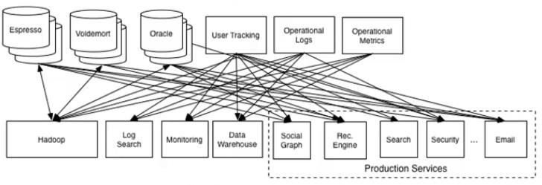
WHAT IS KAFKA
Why LinkedIn created KAFKA?
The LinkedIn website is a highly trafficked, very active site
LinkedIn grew to have dozens of data systems and data repositories.
LinkdIn described their point to point data pipelines like:
Notes:
Espresso : Base de données NoSQL de LinkedIn.
Voldemort : Autre système de stockage distribué clé-valeur.
Oracle : Base de données relationnelle.
User Tracking : Composant qui collecte les activités des utilisateurs.
Operational Logs : Journaux systèmes / opérationnels.
Operational Metrics : Données sur les performances / métriques des services.

Slide 4
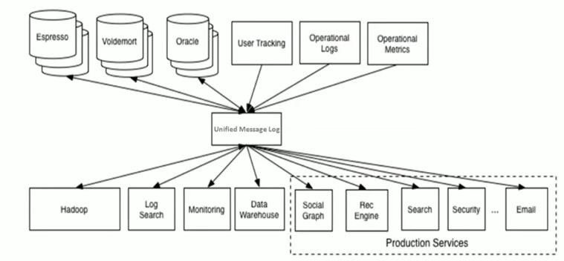
WHAT IS KAFKA
Why LinkedIn created KAFKA?
Kafka was created to serve as centralized online data pipeline system

Slide 5
KAFKA USE CASES
Messaging
Kafka works well as a replacement for a more traditional message broker such as ActiveMQ or
RabbitMQ.
In comparison to most messaging systems Kafka has better throughput, built-in partitioning, replication, and fault-tolerance which makes it a good solution for large scale message processing applications.
Producers
Cosumers
Producers
Message Broker
Consumers
Producers
Consumers

Slide 6
KAFKA USE CASES
Web site activity tracking
Track real time user activity
real-time processing, real-time monitoring, and loading into Hadoop or offline data warehousing systems for offline processing and reporting.
Log aggregation
Log aggregation typically collects physical log files off servers and puts them in a central place (a file server or HDFS perhaps) for processing.
Kafka abstracts away the details of files and gives a cleaner abstraction of log or event data as a stream of messages.

Slide 7
KAFKA USE CASES
Metrics
Kafka is often used for operational monitoring data. This involves aggregating statistics from distributed applications to produce centralized feeds of operational data.
Stream processing
Starting in 0.10.0.0, a light-weight but powerful stream processing library called Kafka Streams is available in Apache Kafka to perform such data processing
More! ….

Slide 8
MAIN KAFKA CONCEPTS
Topics
Feeds of messages are organized into topics
Producers
Cosumers
Producers
Kafka Cluster
Consumers
Brokers
Kafka runs on a cluster of servers
Producers
Consumers
Producers
Processes that publish messages to a Kafka topic
Consumers
Processes that subscribe to topics and process the feed of published messages

Slide 9
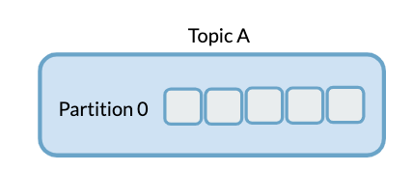
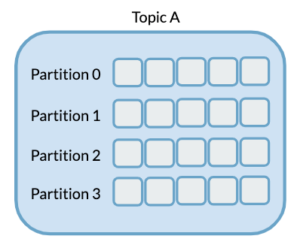
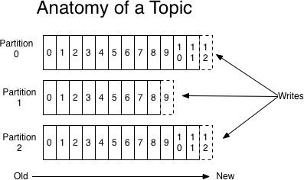
MAIN KAFKA CONCEPTS: TOPICS
Kafka topics are the user defined categories used to organize messages. Each topic has a name that is unique across the entire Kafka cluster.
Messages are sent to and read from specific topics.
Kafka topics are multi-subscriber.
Each topic consists of partitionned log. Partitions allow log to scale horizontally.
Partitions are ordered, immutable sequence of messages that are continually appended.
Each message in partitions assigned sequantial id number (‘offset’)
An offset is a unique identifier for a message in a Kafka partition.It is a sequential number that starts at 0 and increments with each new message in a partition.
Messages are retained for configurable period of time.

Slide 10
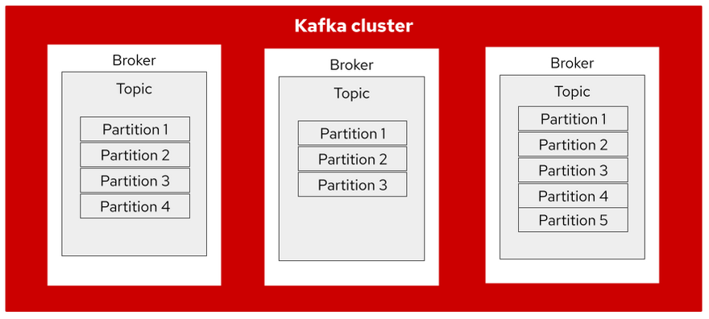
MAIN KAFKA CONCEPTS: BROKERS
Kafka cluster comprised of one or more servers called “brokers”.
The broker is the operational core of Kafka; It handles the transfer, storage, and distribution of messages within the cluster.
Each Kafka broker stores one or more partitions
Can spread a single topic’s partitions across multiple brokers
Kafka brokers are stateless
Consumers have to keep track of what offset position they would like to read.
Kafka also allows the topic's partitions to be replicated across the brokers.

Slide 11
MAIN KAFKA CONCEPTS: BROKERS
Replication
In Kafka, each partition can be replicated across a number of servers.
The number of servers a partition is replicated across, is called the ‘replication factor’ and it is
configurable.
Replicate partitions provide fault tolerance to the system.
Each partition has one server which acts as the "leader" and then depending on the replication factor there will be zero or more servers acting as "followers".
The leader handles all read and write requests for the partition.
The followers passively replicate the leader.
The leaders keep track of what is called the In Sync Replicas, which is abbreviated to "ISR".
The In Sync Replicas are a set of replicas that are alive and are fully caught up with the leader.
If one of the followers dies, gets stuck or falls behind, then it is removed from the list of In Sync Replicas.
A message is "committed" when all the In Sync Replicas for a partition have applied it to their log.
Only committed messages are given to consumers.
Producers on the other hand have the option of whether to wait for the commit or not.(acks p.24)

Slide 12
MAIN KAFKA CONCEPTS: BROKERS
Replication Exemple
Producer
Broker 1
Broker 2
Broker 3
Topic1 Partition 1
Topic1 Partition 1
Topic1 Partition 1
Topic1 Partition 2
Topic1 Partition 2
Topic1 Partition 2

Slide 13
MAIN KAFKA CONCEPTS: PRODUCERS
Producers
Cosumers
Processes that publish messages to a Kafka topic.
Producer decides which message goes to partitions.
witch
Kafka Cluster
Producers
Consumers
Producers write to a single leader.
Kafka comes with a command line producer client or
you can write your own using API.
Producers
Consumers

Slide 14
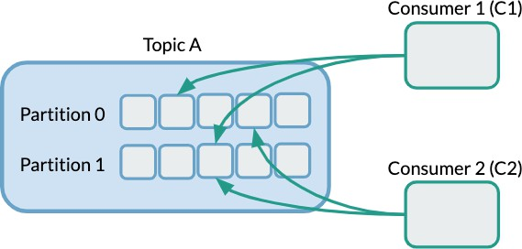
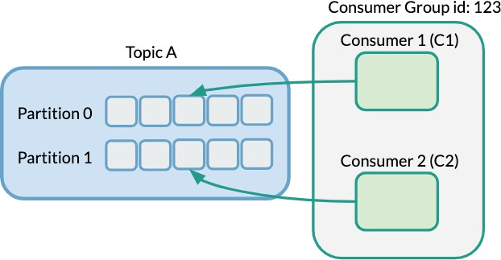
MAIN KAFKA CONCEPTS: CONSUMERS
Kafka consumers read from topics.
Kafka comes with a command line consumer client or you have the option to write your own using APIs.
Consumers belong to consumer groups.
Each message published to a topic is delivered to one consumer instance within each subscribing consumer group.
Each partition in a topic will be consumed by exactly one Consumer in a Consumer Group
Horizontal scalability: Add more consumers to speed up processing.
Fault tolerance: If a consumer fails, Kafka reassigns its partitions to the remaining ones.
Without Consumer Groups
With Consumer Groups

Slide 15

MAIN KAFKA CONCEPTS: ZOOKEEPER
Kafka requires Apache Zookeeper. This means that you first need a ZooKeeper server started in order to run Kafka.
There’s a script that comes with Kafka that starts a simple single-node ZooKeeper instance.
Kafka uses ZooKeeper for a variety of things:
Manage metadata and coordination between the different Kafka brokers
Elect a controller broker (the main broker responsible for making certain decisions)
Monitor node availability
Store the configuration of topics and partitions
Starting from Kafka 2.8, there is a KRaft mode (Kafka Raft Metadata mode) that allows Kafka to run without Zookeeper (Experimental introduction)
Kafka 4.0.0: Complete removal of ZooKeeper. KRaft becomes the sole mode of operation.

Slide 16

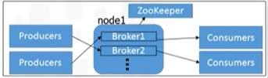
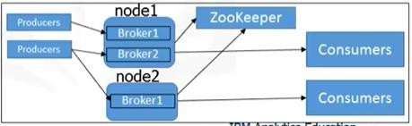
KAFKA CLUSTER CONFIGURATION
Single node, single broker
Single node, multiple brokers
Multiple nodes, multiple brokers

Slide 17
KAFKA : QUICK START
STEP 1: GET KAFKA
Download the latest Kafka release and extract it:
wget https://dlcdn.apache.org/kafka/3.1.0/kafka_2.12-3.1.0.tgz
tar -xzf kafka_2.12-3.1.0.tgz

Slide 18
KAFKA : QUICK START
STEP 2: START THE KAFKA ENVIRONMENT
Run the following commands in order to start all services in the correct order
Your local environment must have Java 8+ installed
Without zookeeper
1. Start Zookeeper
NOTE: Your local environment must have Java 17+ installed.
$ bin/zookeeper-server-start.sh config/zookeeper.properties
KAFKA_CLUSTER_ID="$(bin/kafka-storage.sh random-uuid)"
start bin\windows\zookeeper-server-start.bat config\zookeeper.properties
FOR /F "delims=" %i IN ('bin\windows\kafka-storage.bat random-uuid') DO SET KAFKA_CLUSTER_ID=%i
2. Open another terminal session and run:
$ bin/kafka-server-start.sh config/server.properties
start bin\windows\kafka-server-start.bat config/server.properties
Windows
Linux

Slide 19
KAFKA : QUICK START
STEP 3: CREATE A TOPIC TO STORE YOUR EVENTS
Run the following commands in order to start all services in the correct order
Your local environment must have Java 8+ installed
$ bin/kafka-topics.sh --create --topic quickstart-events --bootstrap-server localhost:9092
bin\windows\kafka-topics.bat --create --topic quickstart-events --bootstrap-server localhost:9092
You can also show details such as the partition count of the new topic
$ bin/kafka-topics.sh --describe --topic quickstart-events --bootstrap-server localhost:9092
bin\windows\kafka-topics.bat --describe --topic quickstart-events --bootstrap-server localhost:9092

Slide 20
KAFKA : QUICK START
STEP 4: WRITE SOME EVENTS INTO THE TOPIC
Run the console producer client to write a few events into your topic.
$ bin/kafka-console-producer.sh --topic quickstart-events --bootstrap-server localhost:9092
You can stop the producer client with Ctrl-C at any time.

Slide 21
KAFKA : QUICK START
STEP 5: READ THE EVENTS
Open another terminal session and run the console consumer client to read the events you just created
$ bin/kafka-console-consumer.sh --topic quickstart-events --from-beginning -- bootstrap-server localhost:9092
You can stop the consumer client with Ctrl-C at any time.

Slide 22
KAFKA : RUNNING MULTIPLE BROKERS ON A SINGLE MACHINE
To run multiple brokers on a single machine, each will need it's own configuration file. For ease, you can simply copy the default
config/server-1.properties
broker.id=1
port=9093
log.dirs=/temp/kafka-logs-1
config/server-2.properties
broker.id=2
port=9094
log.dirs=/temp/kafka-logs-2
$ bin/kafka-server-start.sh config/server-1.properties
$ bin/kafka-server-start.sh config/server-2.properties

Slide 23
Kafka APIs
In addition to command line tooling for management and administration tasks, Kafka has five core APIs for Java and Scala:
The Admin API to manage and inspect topics, brokers, and other Kafka objects.
The Producer API to publish (write) a stream of events to one or more Kafka topics.
The Consumer API to subscribe to (read) one or more topics and to process the stream of events produced to them.
The Kafka Streams API to implement stream processing applications and microservices.
The Kafka Connect API to build and run reusable data import/export connectors that consume (read) or produce (write) streams of events from and to external systems and applications so they can integrate with Kafka.

Slide 24
KAFKA PRODUCER JAVA API
Producer Configuration settings
bootstrap.servers
A list of host/port pairs to use for establishing the initial connection to the Kafka cluster. host1:port1,host2:port2
Client.id
An id string to pass to the server when making requests. The purpose of this is to be able to track the source of requests beyond just ip/port by allowing a logical application name to be included in server-side request logging.
acks
The number of acknowledgments the producer requires the leader to have received before considering a request
complete.
acks=0 If set to zero then the producer will not wait for any acknowledgment from the server at all.
acks=1 This will mean the leader will write the record to its local log but will respond without awaiting full acknowledgement from all followers.
acks=all This means the leader will wait for the full set of in-sync replicas to acknowledge the record.

Slide 25
KAFKA PRODUCER JAVA API
Producer Configuration settings
key.serializer, value.serializer
Serializer class for key that implements the org.apache.kafka.common.serialization.Serializer interface.
retries
Setting a value greater than zero will cause the client to resend any record whose send fails with a potentially transient error.
batch.size
The producer will attempt to batch records together into fewer requests whenever multiple records are being sent to the same partition.
buffer.memory
The total bytes of memory the producer can use to buffer records waiting to be sent to the server.
compression.type
The compression type for all data generated by the producer. The default is none (i.e. no compression). Valid values are none, gzip, snappy, lz4, or zstd.

Slide 26
KAFKA PRODUCER JAVA API
Configuration code exemple
Properties props = new Properties(); props.put("bootstrap.servers", "localhost:9092"); props.put("acks", "all");
props.put("retries", 0);
props.put("linger.ms", 1);
props.put("key.serializer", "org.apache.kafka.common.serialization.StringSerializer"); props.put("value.serializer", "org.apache.kafka.common.serialization.StringSerializer");

Slide 27
KAFKA PRODUCER JAVA API
Kafka producer contsructor
Constructor | Description
KafkaProducer(Map<String,Object> configs) | A producer is instantiated by providing a set of key- value pairs as configuration.
KafkaProducer(Map<String,Object> configs, Serializer<K> keySerializer, Serializer<V> valueSerializer) | producer is instantiated by providing a set of key- value pairs as configuration, a key and a value Serializer.
KafkaProducer(Properties properties) | A producer is instantiated by providing a set of key- value pairs as configuration.
KafkaProducer(Properties properties, Serializer<K> keySerializer, Serializer<V> valueSerializer) | A producer is instantiated by providing a set of key- value pairs as configuration, a key and a value Serializer.
Voir documentation
KafkaProducer<String, String> producer = new KafkaProducer<String,String>(props);

Slide 28
KAFKA PRODUCER JAVA API
Kafka ProducerRecord
ProducerRecord
Topic [Partition] [key] Value
ProducerRecord(String topic, Integer partition, Long timestamp, K key, V value)
ProducerRecord(String topic, Integer partition, Long timestamp, K key,
V value, Iterable<Header> headers)
ProducerRecord(String topic, Integer partition, K key, V value)
ProducerRecord(String topic, Integer partition, K key, V value, Iterable<Header> headers)
ProducerRecord(String topic, K key, V value)
ProducerRecord(String topic, V value)
Voir documentation

Slide 29
KAFKA PRODUCER JAVA API
Kafka ProducerRecord
ProducerRecord
Topic [Partition] [key] Value
Use the method send of the KafkaProdicer to send the message
send(ProducerRecord<K,V> record)
send(ProducerRecord<K,V> record, Callback callback)
Voir documentation

