Slide 1


6. SPARK aPPLICATION
INF4101-Big Data et NoSQL
Dr Mouhim Sanaa

Slide 2
Spark APPLICATION
A Spark Application is:
A complete distributed application, executed on a Spark cluster, that performs end-to-end data processing.
It contains everything needed to:
read data,
transform it (filters, groupings, sorting, etc.),
and produce a result (in a file, a database, or directly in memory).

Slide 3
steps to create a Spark application
1. Install the prerequisites
Java JDK (compatible with Spark, e.g., JDK 8 or 11)
Apache Maven
Apache Spark (prebuilt with Hadoop if needed)
An IDE (like Eclipse or IntelliJ)
2. Create a Maven project
Maven is a build automation and project management tool used primarily for Java projects. It helps manage project dependencies, compile code, run tests, and package applications into deployable formats (like JAR or WAR files). Maven uses a pom.xml file to define a project's structure, configuration, and external libraries.
Group ID: A unique name that identifies your project group or organization (like a namespace). Example: com.example.
Artifact ID: The name of your specific project or module. It will be the name of the generated file (e.g., my-app-1.0.jar if the artifact ID is my-app).

Slide 4
steps to create a Spark application
3. Add Spark dependencies in pom.xml
<dependency>
<groupId>org.apache.spark</groupId>
<artifactId>spark-core_2.13</artifactId>
<version>3.5.5</version>
</dependency>
<properties>
<maven.compiler.source>1.8</maven.compiler.source>
<maven.compiler.target>1.8</maven.compiler.target>
</properties>

Slide 5
steps to create a Spark application
4. Write your Spark application code
public class SparkWordCount {
public static void main(String[] args) {
}
private void run(String InputPath, String result) {}
}

Slide 6
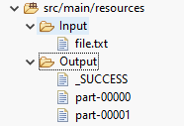
steps to create a Spark application
4. Write your Spark application code
private void run(String InputPath, String result) {
SparkConf conf=new SparkConf();
conf.setAppName(result).setMaster("local[*]");
JavaSparkContext sc = new JavaSparkContext(conf);
// Charger le fichier texte
JavaRDD<String> lines = sc.textFile(InputPath);
JavaRDD<String> words = lines.flatMap(line -> Arrays.asList(line.split(" ")).iterator());
words.mapToPair(w-> new Tuple2<>(w,1)).reduceByKey((a,b)->a+b).saveAsTextFile(result);
}
Before moving to production, we will test our application using files by specifying the input file path and the output path."
public static void main(String[] args) {
new SparkWordCount().run("src/main/resources/Input/file.txt", "src/main/resources/Output2");
}

Slide 7
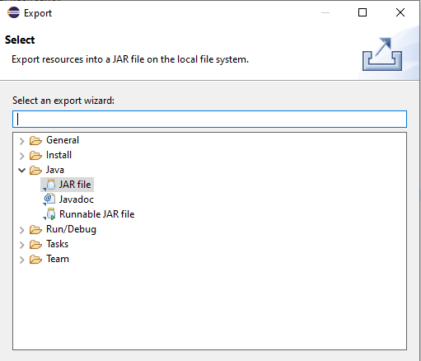
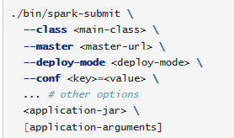
steps to create a Spark application
5. Create de jar file of the application
6. Run your application using spark-submit
spark-submit is a command-line tool provided by Apache Spark to run Spark applications on a cluster or locally.
It allows to:
Specify the JAR or Python file to execute.
Define the execution mode (local, yarn, spark://..., etc.).
Pass arguments to your program.
Configure memory, number of cores, configuration files, etc.

Slide 8
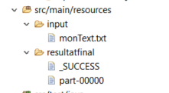
Spark maven APPLICATION
En production
Créer le fichier wc.jar
Spark-submit\
--class sparkwordcount\
--master local
Wc.jar test.txt resultat

