Slide 1

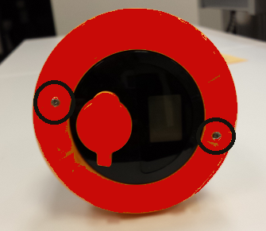
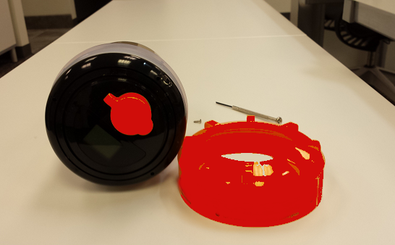
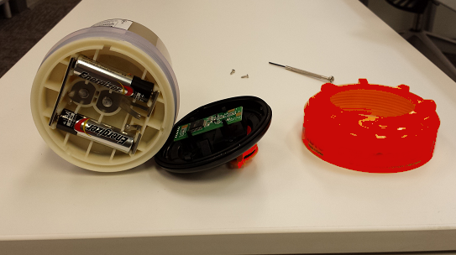
Technolube
Automatic Lubricators
Recycling the D (Digital) series when empty:
1) Remove (2) screws from top.
.
2) Unscrew the cap by turning clockwise.
3) Pry off the black cap with a screwdriver.
You can now remove the batteries.

