Slide 1
ESP Failure Prediction
& Optimal Frequency
Group-3 · Data Drillers
Notes:
ESP Failure Prediction & Optimal Frequency — Group-3, Data Drillers. Total 5 minutes: ~4 minutes speaking, 1 minute video on slide 9.

Slide 2
ESP Failure Prediction & Optimal Frequency
Unit 1. Problem & Approach
1.1. Problem Statement
1.2. Project Objective
Unit 2. Data & AI Development
2.1. Data Preparation
2.2. Modeling Workflow
2.3. Model Evaluation
Unit 3. Solution & Impact
3.1. ESP Failure Watch Platform
3.2. Live Demo
Notes:
Agenda — read quickly, do not dwell. (~10 sec)

Slide 3
Most ESP failures build up over hours
1.1
Problem Statement
UNIT
01
Existing protection reacts after the fact — it shuts the pump down, it does not warn anyone beforehand. But the fault itself develops slowly.
GAS LOCK
UNDERLOAD
HIGH TEMP
HIGH DISCHARGE
Gas collects at the pump intake and the pump stops moving fluid
The reservoir stops keeping the pump fed and the motor unloads
The motor runs hotter and hotter until its thermal limit trips
Scale narrows the discharge and pressure climbs against it
Those hours are the whole opportunity. In three wells over six months, the pumps stopped
69 times — and every one of them left traces in the data first.
Notes:
(~30 sec) An ESP is the pump that lifts oil to surface. When it trips the well earns nothing. Existing protection only reacts — it shuts the pump down after the fault. But these four failure modes build up over hours, and in our three test wells the pumps stopped 69 times.

Slide 4
Warn early enough to act, and say what to do
1.2
Project Objective
UNIT
01
Three questions, answered in order, using only the sensor data the well already produces every minute.
STAGE 1
STAGE 2
STAGE 3
Will this well trip within 30 minutes?
Which of the four failure modes is developing?
What should the operator change?
→ an alarm
→ a named cause
→ a frequency in Hz
Success criterion. A warning only counts if it arrives at least 30 minutes ahead — earlier than that is
detecting a failure, not predicting it — and at an alarm load a control room will keep trusting.
Notes:
(~30 sec) So we answer three questions in order: will it trip, why, and what to change. The key rule is the success criterion at the bottom — a warning under 30 minutes is useless operationally, so we do not count it as a catch.

Slide 5
16 wells, 4.19M minutes, three locked away
2.1
Data Preparation
UNIT
02
No public ESP dataset exists at this resolution, so we built one — giving every well its own equipment from real catalogue ranges.
WELLS SIMULATED
ROWS OF SCADA
SENSOR CHANNELS
SHUTDOWNS TO PREDICT
16
4.19M
7
69
13 train · 3 held out
6 months at 1-minute
pressure, current, temperature
in the held-out wells
Each well has its own safe frequency band. It is the intersection of that well's motor, protector and pump ratings — so a recommendation is never outside what the hardware allows.
Every feature is normalised against the well's own baseline. Wells sit at different absolute pressures and currents; without this the model learns which well it is looking at instead of what is happening to it.
Wells 8, 9 and 10 were never used for training, tuning or model selection. Every number in this presentation is measured on those three wells alone.
Notes:
(~35 sec) No public dataset exists at one-minute resolution, so we simulated 16 wells with real catalogue equipment. Two points matter: each well has its own safe Hz band, and three wells were locked away completely. Every number after this slide comes only from those three.

Slide 6
Two supervised stages, one parallel check
2.2
Modeling Workflow
UNIT
02
Raw sensors in, a recommended frequency out — with the model chosen the same way every time.
SCADA feed
Features
Stage 1 — Detect
Stage 2 — Cause
Stage 3 — Hz
1 reading per minute
rolling 15 / 60 / 240-min windows
trip within 30 minutes?
which of the four modes?
clipped to the safe band
Unsupervised branch — runs in parallel
K-Means and DBSCAN map operating regimes. Deliberately never fed into the supervised models.
Three models compared
Logistic Regression, Random Forest, XGBoost — each given its own tuned alarm policy before being measured.
The model is selected on validation event cost — never on the held-out wells.
A miss is weighted 200× a false alarm, because a missed shutdown costs far more than an interruption.
Notes:
(~35 sec) Sensors, features, then the three stages. The unsupervised branch runs alongside but is never fed in. The important line is at the bottom: we select the model on validation cost, never on the test wells — we made that mistake twice during development and corrected it both times.

Slide 7
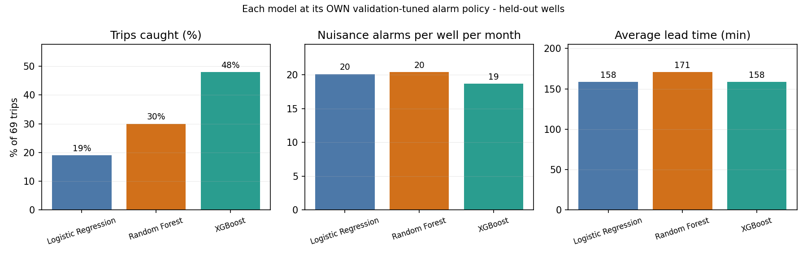
48% of shutdowns caught, three hours ahead
2.3
Model Evaluation
UNIT
02
SHUTDOWNS CAUGHT
MEDIAN WARNING
ALARMS / WELL / MONTH
ROOT-CAUSE ACCURACY
48%
180 min
18.7
68.6%
33 of 69 — was 19%
45% gave ≥30 min
under one per day
vs 36% majority baseline
Each model at its own tuned policy. XGBoost catches twice what logistic regression does, with fewer alarms.
Notes:
(~40 sec) The headline. 48% of shutdowns caught with a median three hours of warning, at under one nuisance alarm per well per day. Note 'was 19%' — the jump came from finding two physics errors in our own simulator, not from tuning the model. XGBoost wins on catches AND on alarms at once.

Slide 8
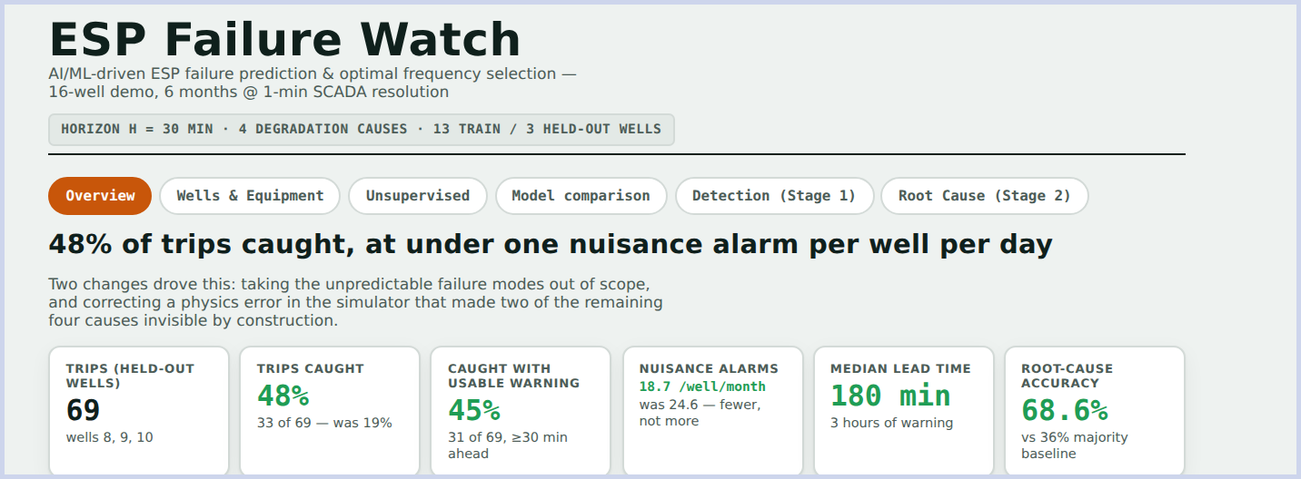
From a sensor feed to an actionable number
3.1
ESP Failure Watch Platform
UNIT
03
A risk score per well
The cause, named
A frequency to set
When not to use it
updated each minute, on that well's own scale
gas lock and high discharge at 1.00 precision
clipped to that well's rated equipment band
slow a well only if a trip costs > ~35 hours down
Worth about 99 hours of avoidable downtime across three wells in six months.
Notes:
(~40 sec) What an engineer actually sees: risk per well, the named cause, and a recommended frequency inside that well's rated band. The fourth point is the one we are proudest of — we also say when NOT to slow a well down, because slowing it costs production every minute.

Slide 9
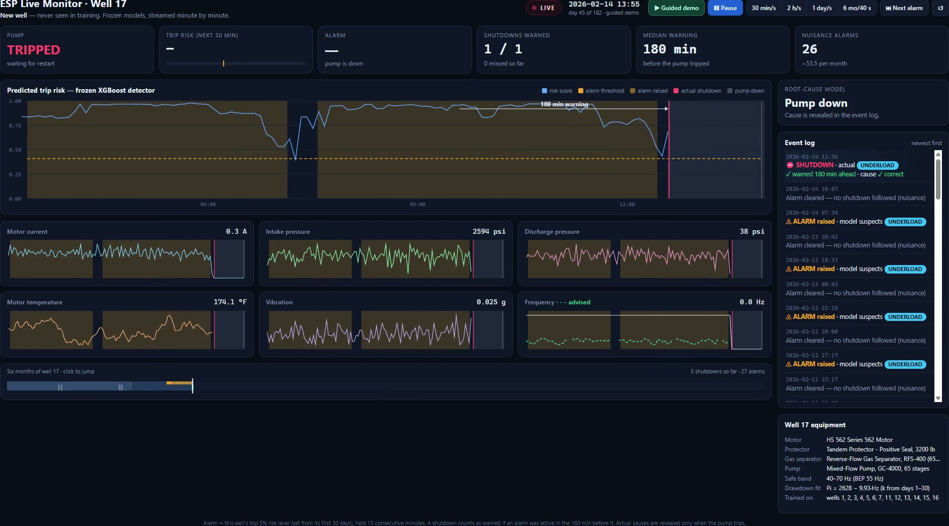
Adding a new well takes one line
3.2
Live Demo
UNIT
03
Notes:
(1 minute — play the video) Adding a well is one line in a config file. Everything else is automatic. The video shows a new data file going in and the trained models being tested on it.

Slide 10
Notes:
Thank you. Ready for questions.

