Slide 1

Regression
Instructor Ahmed El-Masry
Support Mohamed Farouk

Slide 2
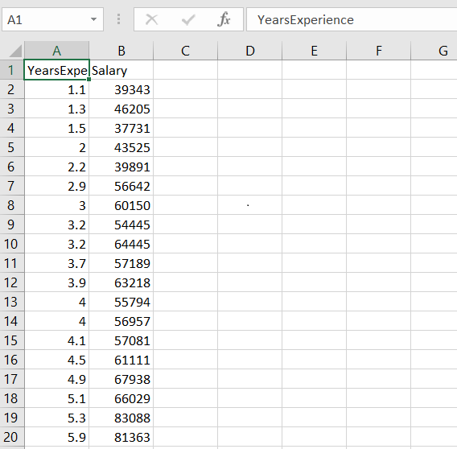
Introduction
Business problem Description

Slide 3
Welcome to Regression
Regression
Regression models (both linear and non-linear) are used for predicting a real value, like salary for example. If your independent variable is time, then you are forecasting future values, otherwise your model is predicting present but unknown values. Regression technique vary from Linear Regression to SVR and Random Forests Regression.
In this Session, we will understand and learn how to implement the following Machine Learning Regression models:
Simlpe Linear Regression
Multiple Linear Regression
Polynomail Regression

Slide 4
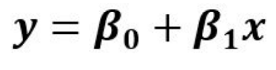


Coefficient
Constant(y-intercept)
Independent Variable
Simple Linear Regression
Dependent Variable
Salary ($)
$$B_{0}+B_{1}$$
Salary = *Experience
$$B_{0}$$
Experience

Slide 5




Simple linear Regression
y-actual
$$y_{i}$$
Salary ($)
$${\tilde{y}}_{i}$$
y-predict
$${\left(y−\tilde{y}\right)}^{2}$$
$$B_{0}$$
How to quantify error?
Experience

Slide 6
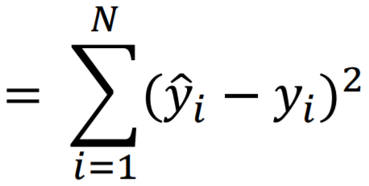


Residual Sum of Squares (RSS)
$${\text{RSS}\text{( }β}_{0,}B_{1})$$
1- Random weight initialization
2- Input the initialized weights into the linear equation and generate a prediction
Salary ($)
To get best model: Choose ${ β}_{0 ,}B_{1}$that give lowest RSS value = Find The Best Line
Experience

Slide 7
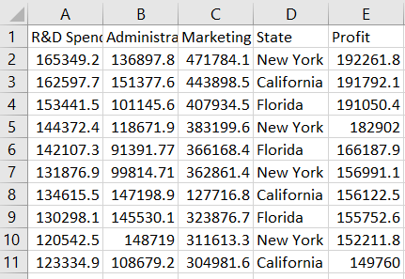


Multiple Regression
Multiple regression is like linear regression , but with more than one independent value, meaning that we try to predict a value based on two or more variables.
Take a look at the data set below, it contains some information about Startup Company.
Dependent Variable
$$y=B_{0}+B_{1}x_{1 }+$$
${B }_{2}x_{2}$ … $B_{n}x_{n}$
Independent Variables(features)

Slide 8
Polynomial Linear Regression
In the last section, we saw two variables or more in your data set were correlated but what happens if we know that our data is correlated, but the relationship doesn’t look linear? So hence depending on what the data looks like, we can do a polynomial regression on the data to fit a polynomial equation to it.
Linear Regression
Polynomial regression

Slide 9



Polynomial Linear Regression
To choose best model: Choose w0 and w1 that give lowest RSS value = Find The Best Line
Hence If we try to use a simple linear regression in the above graph then the linear regression line won’t fit very well. It is very difficult to fit a linear regression line in the above graph with a low value of error. Hence we can try to use the polynomial regression to fit a polynomial line so that we can achieve a minimum error or minimum cost function.
Polynomial Regression equation
$B_{0}$ +
${ B}_{1}x$+
$B_{2}x^{2}$ +${ B}_{3}x^{3}+…+B_{n}x^{n}$
Y=

Slide 10
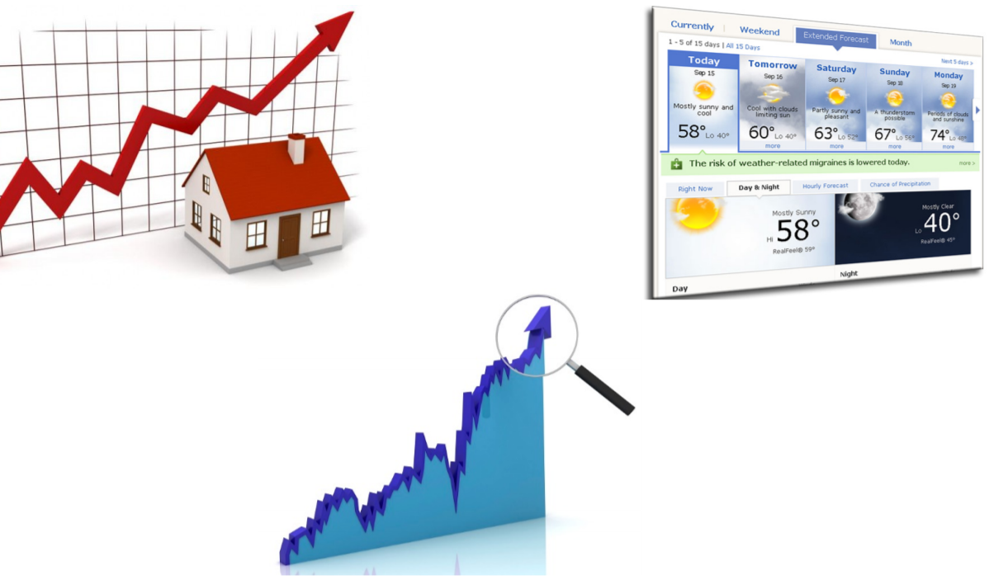
What are business applications of linear regression?
Predict future prices/costs.
Predict future revenue.
Compare performance

Slide 11
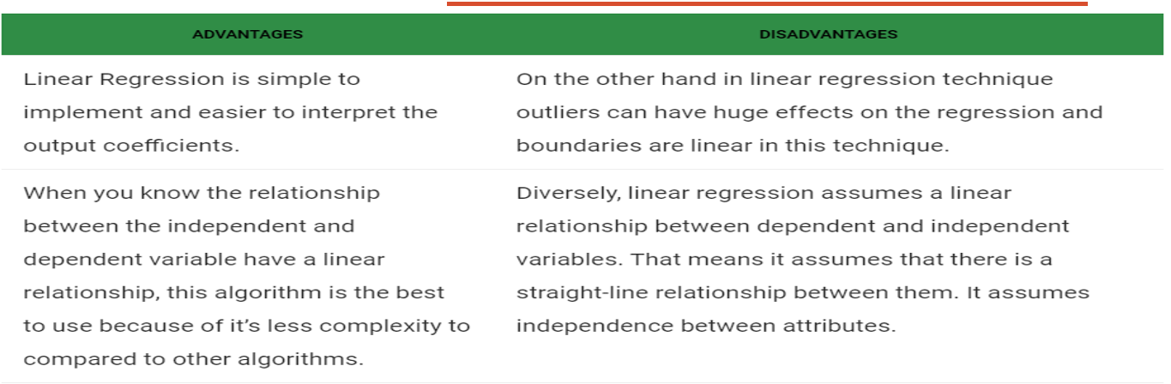
Advantages and Disadvantages of Linear Regression

Slide 12
Implement Lineae Regression in Python
Load Data
Split Into Train/Test
Count Betas
Count y_Predict

Slide 13
THANKS
Any questions?

