Slide 1

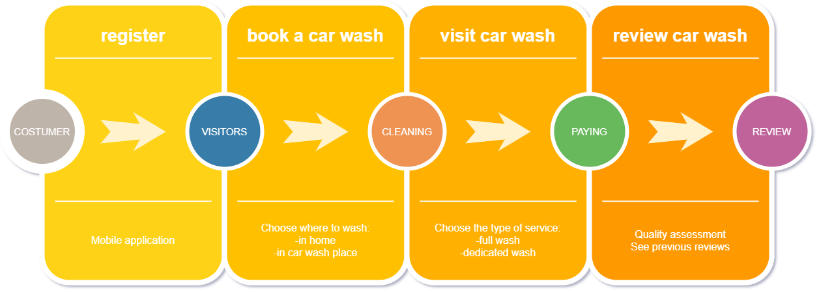






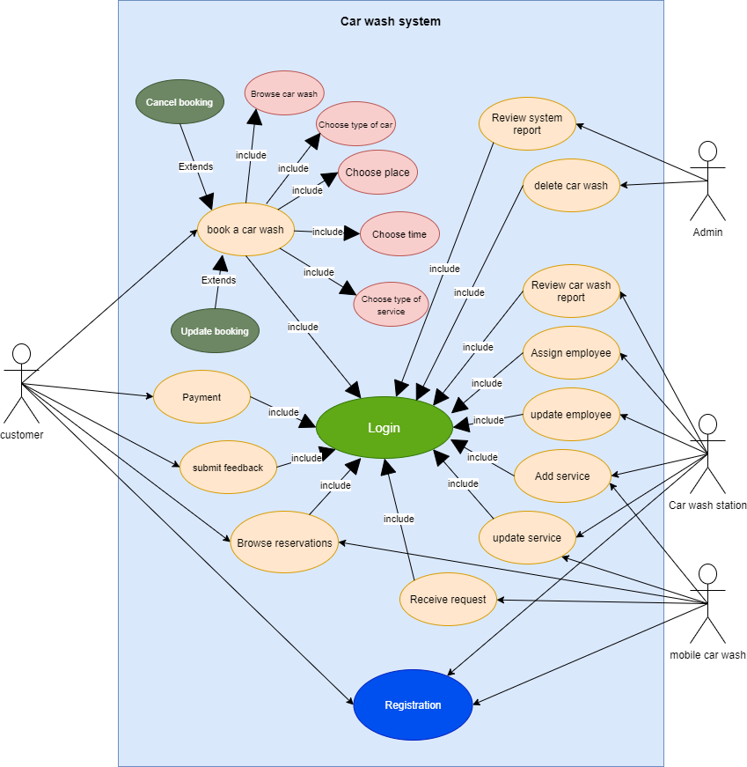
CAR WASH STATION
Anas Ahmed, Raslan Razoq , and Mohamed Gamal
Supervised: Dr. Yazed Alsaawy
Faculty of Computer and Information Systems, Islamic University in Madinah
First Semester, 2020-2021
Abstract
Framework
Nowadays, mobile and web applications are the best way to reach customers. Using applications to perform daily tasks is now prevalent. So, the developers always try to present the best app to make your life more comfortable. So, we thought to provide an application that would make it easier for customers to request a car wash service or book an appointment before going to the car wash station or provider, evaluate the service provided, and many advantages. We will use a flutter framework to program our application to ensure access to the largest segment of customers, and the control panel will be built using the Laravel framework. We first start with identify our aim, subject area, and argument, doing some literary analysis is the second step to read another research, journal, and conference to understand the area we are looking for after this identify the objective and the method must be the third step in the software system getting requirement, design the system, implement some code, testing, and training is the important thing for the objective, then we find a method for each objective.
Aim
Objective
An application that will allow the user (customer) to request service, to book the car washing service at a certain time of the day (along with other washing options). The car wash station will provide the real-time availability of the service and give the customer update on when he can reserve, and the nature of the service needed, and the mode of payment.
The main objective of the car wash system is making car wash service full automated form the customer reservation to paying and reviewing the service
Sub-objectives are:
Helpful
Provide an opportunity for freelancer services for on-site car wash service.
Satisfaction
Knowing and reviewing the evaluation of customers in the car wash application in terms of services provided and offers "feedback".
Literature Review
Comfortable Provide a car wash service at home (according to the customer's choice of the right place for him)
Multiplicity
Provide several payment methods for the user, and the ability to pay remotely (as per customer's choice).
0
Interface implementation
System Analysis
Functional Requirement
Login ID: Any user who uses the application shall have a Login ID and Password.
Appointment Booking: The app will allow the customer to book the most appropriate time and date to wash the car.
Appointment availability: The application should allow the user if there is any available appointment to wash the car and the name of the car wash laundries.
The information about car wash: The application should allow the user to view the car wash information and services.
Service type: Request a car wash service, whether in a car wash place or another place.
Payment method: The application should allow providing several payment methods for users.
The user review: The application should allow the user to write a review and report on the service provided and the available offers.
Independent work: The application should allow to enabling laundry workers to participate in free or independent work.
Non-functional Requirement
User Identification: The application requires the user to identify themselves and register with the application.
Modification: Any modification (insert, delete, and update) for the Database shall be synchronized and done only by the user in the ward.
Rights of car wash employees: Car wash personnel must be able to view all information but will not be able to modify any information in it.
Administrators' Rights: Administrators must be able to view and amend all information and add new services.
Response Time: The system shall give responses in 1 second after checking the user information and the information of car wash laundries.
User-interface: The user-interface screen shall respond within 5 seconds.
Availability: The system shall be available all the time.
Use Cases
Conclusions
References
0
Pollack, B., 2009. Mobile automated-hand car wash. U.S. Patent Application 12/150,339.
Kim, S. and Park, E., 2014. Integrated carwash client service management system with real-time work scheduling process and carwash order and reservation for a car parking facility-based hand carwash. U.S. Patent Application 14/306,232.
Z. Jiuru, "Comparative Study on the Service Pricing Strategy of Car Wash Industry," 2019 Chinese Control and Decision Conference (CCDC), Nanchang, China, 2019, pp. 6098-6103, doi: 10.1109/CCDC.2019.8833180.
Neuhofer, B., Buhalis, D., Ladkin, A., “Smart technologies for personalized experiences: a case study in the hospitality domain”, Journal Electronic Markets, vol. 25, Issue 3, pp. 243-254, September 2015. Springer.
D. Fisher, “Websites are being replaced,” ABA Banking Journal, pp. 21-25, January 2012 Pollack, B., 2009. Mobile.
Jantunen E., · Giordamlis C., · Adgar · A. and Emmanouilidis C., “Mobile devices and services maintenance”, in E-maintenance, Holmberg, K., Adgar, A., Arnaiz, A., Jantunen, E., Mascolo and J.,Mekid, S. Eds. Springer, 2010, pp. 227-246.
M. Esteves and A. Pereira, "Y.S.Y.D. - You Stay You Demand: User-centered design approach for mobile hospitality application," 2015 International Conference on Interactive Mobile Communication Technologies and Learning (IMCL), Thessaloniki, 2015, pp. 318-322,.
V. N. Inukollu, D. D. Keshamoni, T. Kang and M. Inukollu. Factors Influencing Quality Of Mobile Apps: Role Of Mobile App Development Life Cycle. International Journal of Software Engineering & Applications (IJSEA). Available: https://arxiv.org/pdf/1410.4537.pdf, 2014. 5(5): 15-34.
Fulenwider, G., “Web site creation for mobile devices”, Journal of Computing Sciences in Colleges, Vol. 28, Issue 5, pp. 132-133, May 2013.
Atawneh, S., Al-Kasasbeh, B. and Ben Rshed, M. (2019) ‘Android-Based Mobile Application for Door-to-Door Product Delivery’, International Journal of Interactive Mobile Technologies, 13(3), pp. 125–142.

