Slide 1


Slide 2


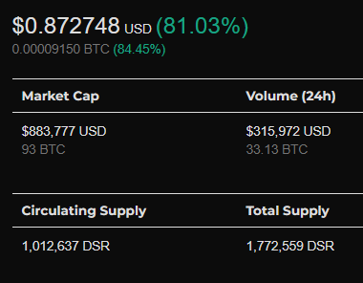

Slide 3
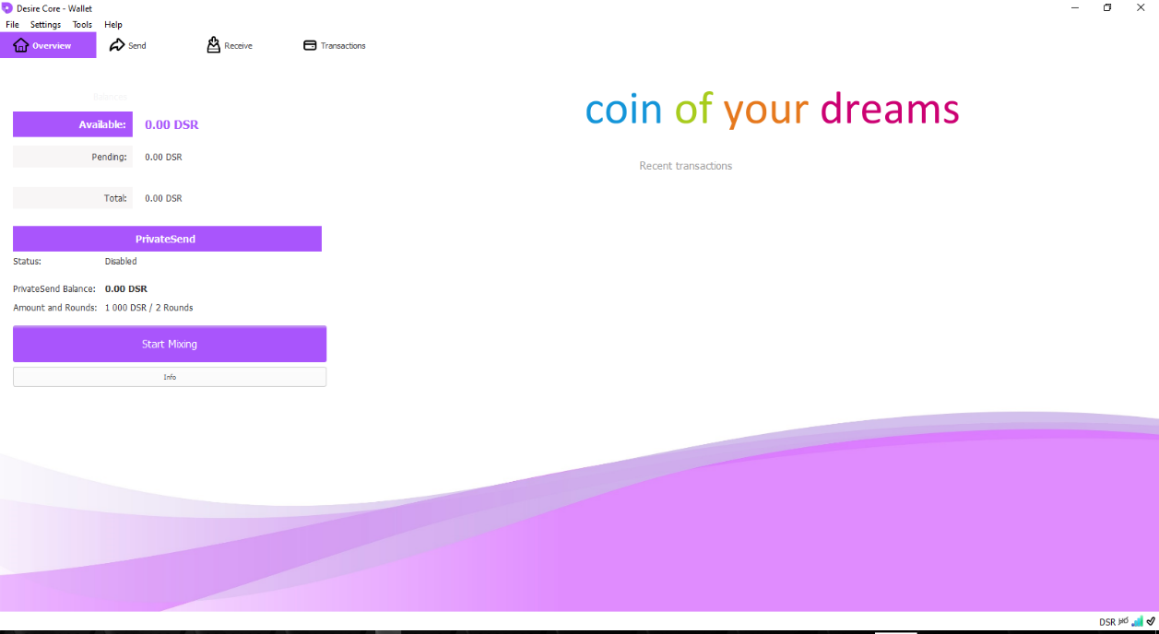
Desire core wallet

Slide 4
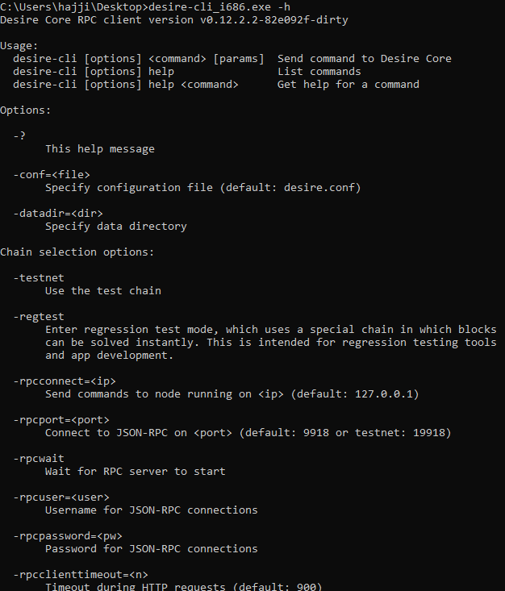
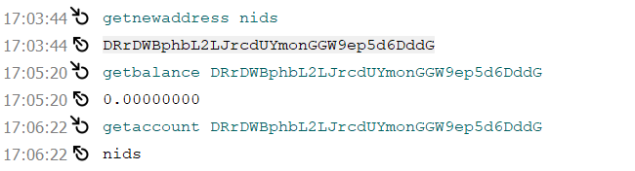
Desire core API
API TEST
Authentication in JAVA

Slide 5
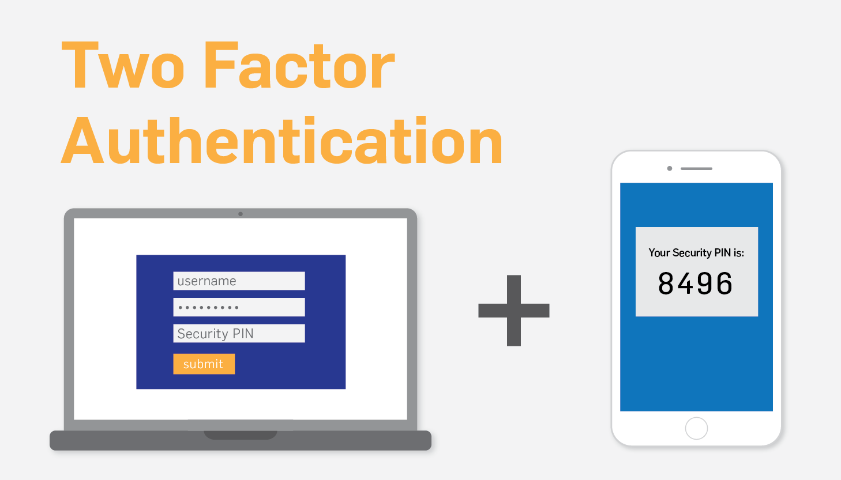

Slide 6

Two-factor authentication (2FA) adds an additional layer of protection beyond passwords.
With Authy’s multiple-device functionality, your 2FA tokens automatically sync to any new device you authorize.
Authy Authenticator has encrypted recovery backups.

Slide 7
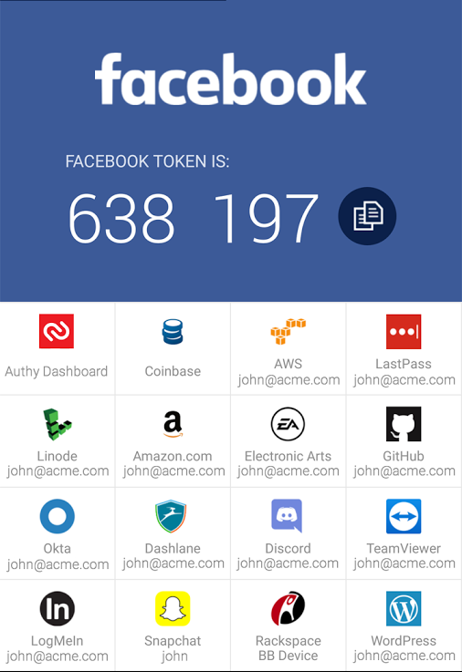
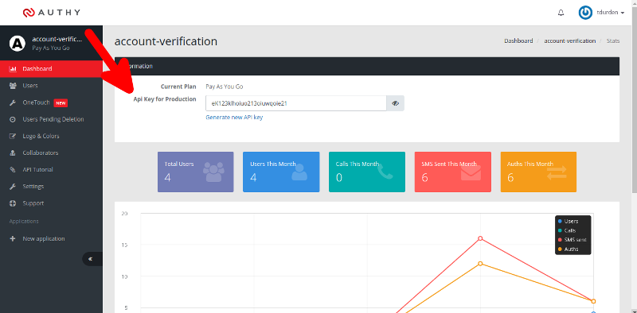
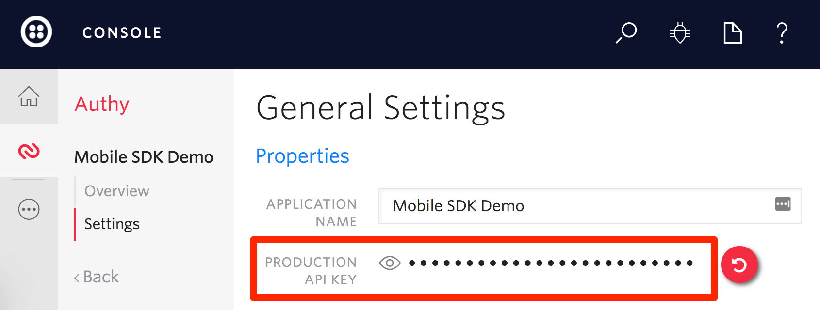

Slide 8

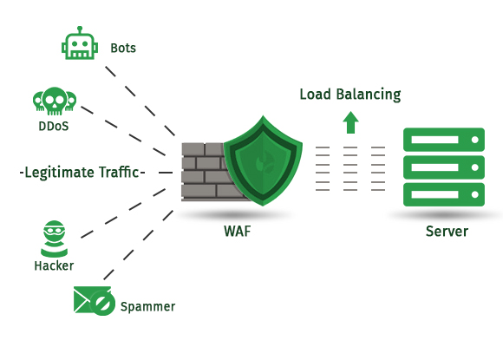

Slide 9

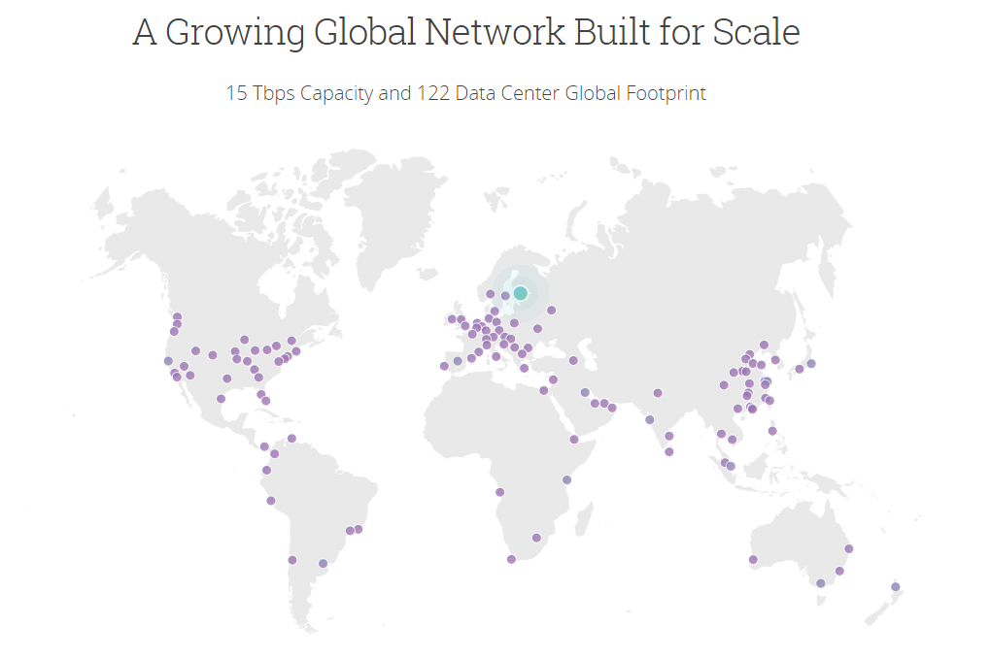
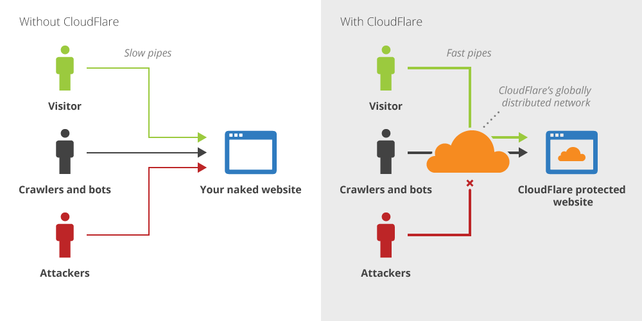


Slide 10
PERFORMANCE:
Improves website performance through our global CDN and web optimization features
SECURITY
Cloudflare’s WAF, DDoS protection, and SSL defend website owners and their visitors from all types of online threats

Slide 11
RELIABILITY
With over 35% market share, Cloudflare runs the largest, fastest, and most reliable managed DNS service in the world
INSIGHT
Cloudflare’s network helps identify visitor and bot behavior that isn’t accessible to conventional analytics technologies.

Slide 12
