Slide 1
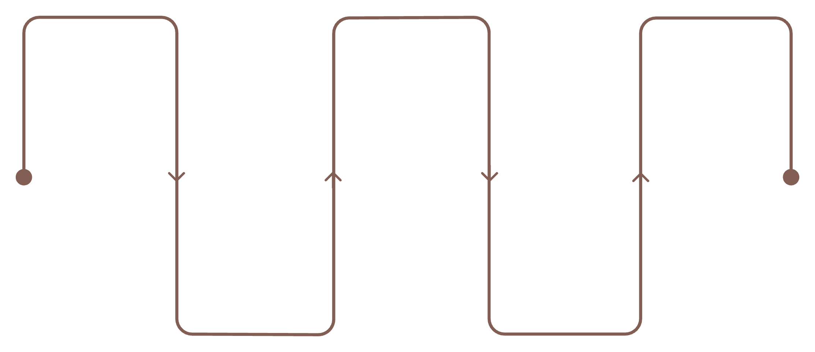
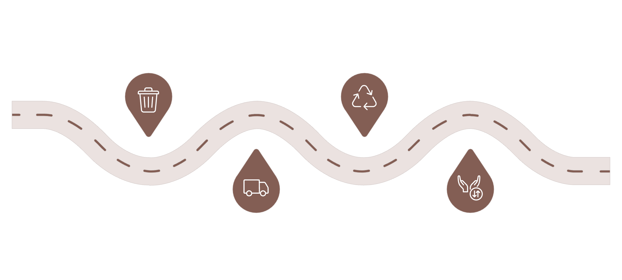
Business Workflows — Two Parallel Processes
Product traceability (linear roadmap)
Cultivation
Transport
Verification
Controlled orchard practices
Olive transfer with tracking
Lab tests for quality
Harvest
Milling
Timely picking and logging
Oil extraction and recording
Circular recovery (parallel roadmap created after milling)
Residue Generation
Valorization
Convert residues into recoverable resources
Identify and quantify post-milling residues
Transport & Custody
Output & Return
Manage movement and custody documentation
Deliver useful output; return or sell streams
Note: Recycling is a parallel branch that originates after milling; it is not an eighth step in the primary product flow.

