Slide 1
Risk Management

Slide 2
Terminology Review (1)
System: Collection of hardware, software, data, procedures, networks, people, etc. that “belong together”
Vulnerability, exploit, threat, threat agent
Victim impact (or cost): What happens to victim as the result of a successful attack
Damaged reputation
Lost sales
Replacement cost
Recovery cost (e.g., reinstall OS and applications)
Not limited to $$$

Slide 3
Terminology Review (2)
Attacker benefit: What attacker gains from successful attack, e.g., $$, status in 1337 h4x0r underground, spreading political message by website defacement, etc.
Attacker cost: What attacker “spends” to launch attack
Not limited to successful attacks
Not limited to $: could include special equipment, software, time, expertise, probability of getting caught and penalized
Risk: Product of likelihood and magnitude of loss (when “bad things” happen)

Slide 4
Introduction
Risk management: process of identifying and controlling risks facing an organization
Risk identification: process of examining an org.’s current IT security situation
Risk control: applying controls to reduce risks to org.’s data and information systems

Slide 5
Overview: Risk Management
“If you know the enemy and know yourself, you need not fear the result of a hundred battles. If you know yourself but not the enemy, for every victory gained you will also suffer a defeat. If you know neither the enemy nor yourself, you will succumb in every battle.” – Sun Tzu, The Art of War
This entails:
Knowing yourself: identifying and understanding existing information, systems in organization
Knowing the enemy: identifying and understanding threats
facing org.

Slide 6
Risk Identification
Assets: Anything that “has value” to organization
Includes people, data, computers, …
Attackers will target these (for various reasons)
Risk management: identifying org.’s assets and threats to them (including vulnerabilities)
Risk identification: need to specify org.’s assets, assessing their value

Slide 7
Identifying and Valuing Assets
“It’s all about the bookkeeping”:
People: Who works for the organization?
Procedures: How do employees access data?
Data: What data does the org. store and process?
Hardware: What computer hardware does org use?
Software, networks: Same questions
Assets are then classified and categorized
Business-critical? Moderate? Irrevelevant?
Database systems can help keep track of “stuff” (e.g., using inventory barcodes)

Slide 8
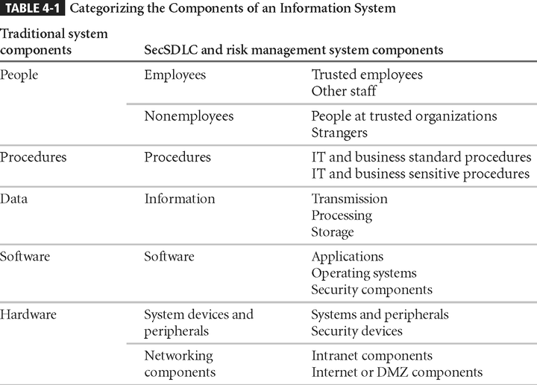
Classifying Info. Syst. Components (Table 4-1)

Slide 9
Identification: People, Procedures, and Data
Harder to track people, documentation, data than physical hardware, software licenses
People with experience should do so
Record assets via reliable data storage system

Slide 10
Questions
What information should we record for:
People?
Business processes?
Data?
What tools could we use to do so?
How should a company manage the process of identifying

Slide 11
Hardware, Software, and Network Asset Identification
What information attributes to track depends on:
Needs of organization/risk management efforts
Management needs of information security/information technology communities
Asset attributes to be considered are: name; IP address; MAC address; element type; serial number; manufacturer name; model/part number; software version; physical or logical location; controlling entity

Slide 12
Information Classification
Many organizations have data classification schemes (e.g., confidential, internal, public)
Info. classification approach: specific categories
Requirements:
Each category has specific meaning
Categories must “span the gamut” of info. sensitivity levels
Categories must not overlap
Need to determine info. protection priorities
Table metaphor: category columns, info. rows

Slide 13
Information Valuation
Info. has varying levels of importance
What information:
is most critical to organization’s success?
generates the most revenue/profitability?
would be most expensive to replace or protect?
would be the most embarrassing or cause greatest liability if revealed?
How would you suggest valuing information? How
often should we repeat valuation process?

Slide 14
Data Classification and Management
Military classification:
Top Secret
Secret
Classified/Internal use only
Public
Elaborate schemes: overkill for some orgs?

Slide 15
Threat Identification
Security budgets limited; we can only focus on practical threats
Threat assessment:
Which threats present danger to assets?
Which threats are the most dangerous to info.?
How much would it cost to recover from attack?
Which threat requires the most money to prevent?

Slide 16
Security Threats (Table 4.1)
Threat Category | Examples
Acts of human error or failure | Accidents, employee mistakes
Intellectual property compromise | Piracy, copyright infringement
Deliberate espionage or trespass | Unauthorized access, data collection
Deliberate information extortion | Blackmail of info. disclosure
Deliberate sabotage or vandalism | Destruction of systems or info.
Deliberate theft | Illegally taking equipment or info.
Deliberate software attacks | Viruses, worms, denial of service
Forces of nature | Fires, floods, earthquakes
Deviations in service from providers | Power and Internet provider issues
Technological hardware failures | Equipment failure
Technological software failures | Bugs, code problems, unknown loopholes
Technological obsolescence | Antiquated or outdated technologies
16

Slide 17
Vulnerability Identification
Vulnerability: specific approach threat agents exploit to attack valuable information
Questions to ask:
How could a threat be carried out?
What are the organization’s assets?
What are the org.’s vulnerabilities?
Recommendation: assemble people from diverse backgrounds in org., brainstorming meeting rounds
Result of this process: list of assets, their vulnerabilities

Slide 18
Risk Assessment Worksheet
Asset | Asset Value ($) | Vuln. | Loss From Attack ($) | Probability of Vuln. | Expected Loss | Risk Ranking
Sensitive data | 1,000,000 | Disclosure | 10,000,000 | 0.8 | 8,000,000 | High
 |  | Alien attack | 100,000,000 | 0.000001 | 1,000 | Low
Asset 1 | … | … | … | … | … | …
Asset 2 | … | … | … | … | … | …
… | … | … | … | … | … | …
Actual worksheet varies for each organization
Sort worksheet based on expected loss (high to low)
Worksheet: input for risk control process

Slide 19
Risk Control
Once ranked risk worksheet complete, choose one of four strategies to control each risk:
Apply safeguards (avoidance)
Transfer the risk (transference)
Reduce impact (mitigation)
Understand consequences and accept risk (acceptance)
Residual risk: risk “left over” after identification and control

Slide 20
Avoidance
Attempts to prevent vulnerability exploitation
Preferred approach; techniques include:
Removing vulnerabilities
Limiting access to assets
Applying safeguards
Three common methods of risk avoidance:
Impose policy
Educate people
Apply technology

Slide 21
Transference
Shift risk to other assets, processes, or companies
If lacking, organization should hire expert individuals, firms regarding security management
Org. then transfers risk associated with IT mgmt. to another org. experienced in dealing with risks
Residual risk: What happens if this org. hacked?

Slide 22
Mitigation
Attempts to reduce impact of vulnerability exploitation via planning, preparation
Approach includes three types of plans:
Incident response plan (IRP): What actions to take if there’s an incident in progress?
Disaster recovery plan (DRP): Most common procedure
Business continuity plan (BCP): What to do if catastrophe strikes the organization?

Slide 23
Acceptance
Doing nothing to protect a vulnerability, accepting outcome of its exploitation
Valid only when some function, service, information, or asset does not justify
protection cost
Risk appetite: degree to which organization will accept risk as trade-off vs. cost of controls

Slide 24
Selecting a Risk Control Strategy
Level of threat and value of asset play major role in selection of strategy
Rules of thumb that we can apply:
A vulnerability exists
Attackers can exploit a vulnerability
Attacker’s cost is less than potential gain
Substantial potential loss to organization

Slide 25
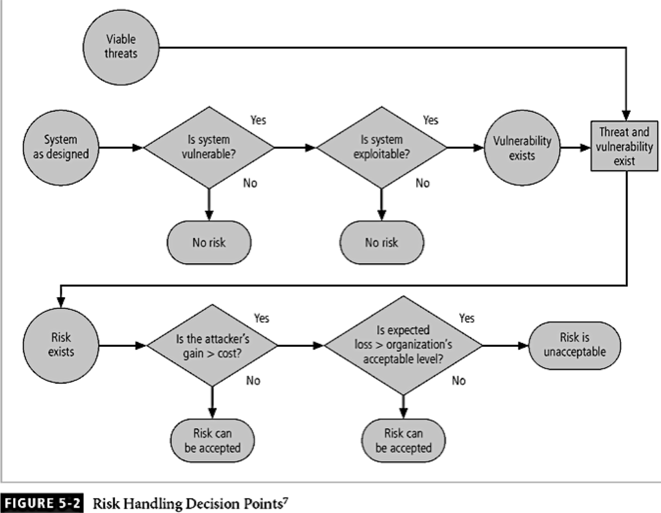

Slide 26
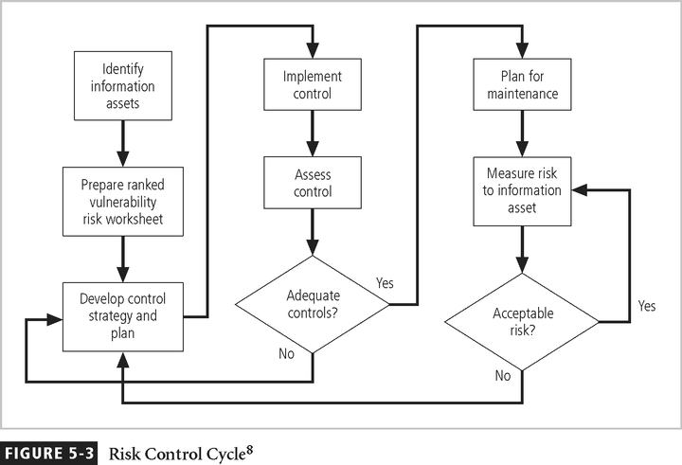

Slide 27
Cost-Benefit Analysis (CBA) (1)
Most common approach: economic feasibility of info. security controls
CBA: first value assets to be protected, loss if they are compromised
Formal process documenting this: cost-benefit analysis
Cost of controls impacted by:
Costs: Development, implementation, maintenance, …
Training fees
Benefit: value an organization realizes using controls to prevent losses from vulnerability
Asset valuation: process of assigning monetary value to each piece
of information (many parts)

Slide 28
Cost Benefit Analysis (CBA) (2)
SLE: Single Loss Expectancy ($$)
ARO: Annualized Rate of Occurrence (# times/yr.)
ALE: Annualized Loss Expectancy = SLE × ARO ($$/yr)
ACS: Annualized Cost of Safeguard ($$/year)
CBA = ALE_{prior} – ALE_{post} – ACS ($$/year)
If CBA is positive, that’s good
If CBA is negative, spend more for protection than expected loss
Higher CBA is more efficient
Problems:
“Garbage in garbage out” statistics
We don’t know how often some events occur (or the unknown)
Silo effect: focus on specific systems, miss common controls

Slide 29
Benchmarking (1)
Alternative approach to risk management: study practices in other organizations that your org. wants to duplicate
One of two measures typically used to compare practices: metrics-based and process-based
Benchmarking standards:
Due care: Show your org.’s security measures are similar to those of prudent org. (similar circumstances)
Due diligence: Show org. maintains security measures

Slide 30
Benchmarking (2)
Best business practices: security efforts that provide a superior level protection of information
When considering best practices for adoption in an organization, consider:
Does org. resemble target org. with best practice?
Are resources at hand similar?
Is org. in a similar threat environment?

Slide 31
Problems with Benchmarking and Best Practices
Organizations don’t talk to each other
No two orgs. are identical
Best practices are a moving target
Knowing recent events in security industry (benchmarking) may not prepare for future

Slide 32
Summary (1)
Risk identification: process of examining and documenting risk present in information systems
Risk management strategy enables identification, classification, and prioritization of organization’s information assets
Residual risk: risk that remains to the information asset even after the existing control is applied
Risk control: process of protecting confidentiality, integrity, and availability of aspects of org.’s information system

Slide 33
Summary (2)
Risk control: four strategies are used to control risks that result from vulnerabilities:
Apply safeguards (avoidance)
Transfer the risk (transference)
Reduce impact (mitigation)
Understand consequences and accept risk (acceptance)

