Slide 1
Firewalls and VPNs

Slide 2
Firewalls
Prevent specific types of information from moving between the outside world (untrusted network) and the inside world (trusted network)
May be separate computer system; a software service running on existing router or server; or a separate network containing supporting devices
A Roadmap
Firewall categorization
Firewall configuration and management

Slide 3
Firewall Categorization
①Processing mode
②Development era
③Intended deployment structure
④Architectural implementation

Slide 4
Firewall Categorization (1): Processing Modes
Packet filtering
Application gateways
Circuit gateways
MAC layer firewalls
Hybrids

Slide 5
Firewall Proc. Modes: Network Layers
Processing Mode | Network Layer (OSI) | Network Layer (TCP/IP)
Application gateways | 7: Application 6: Presentation 5: Session | 5: Application
Circuit gateways | 4: Transport | 4: Transport
Packet filtering | 3: Network | 3: Network
MAC address filtering | 2: Data Link | 2: Data Link
– 1: Physical |  | 1: Physical
Source: Adapted from Fig. 6-5 in the textbook

Slide 6
Packet Filtering (1)
Packet filtering firewalls examine header info. for data pkts
Most often based on combination of:
Internet Protocol (IP) source and destination address
Direction (inbound or outbound)
Transmission Control Protocol (TCP) or User Datagram Protocol (UDP), destination port requests
Simple firewall models enforce rules that prohibit packets with certain IP address ranges

Slide 7
Packet Filtering (2)
Three subsets of packet filtering firewalls:
Static filtering: requires manual configuration of firewall rules that determine which packets are allowed, denied
Dynamic filtering: firewall can react to emergent event, update/create rules to deal with it
Stateful inspection: firewalls track each network connection between internal and external systems using a state table

Slide 8
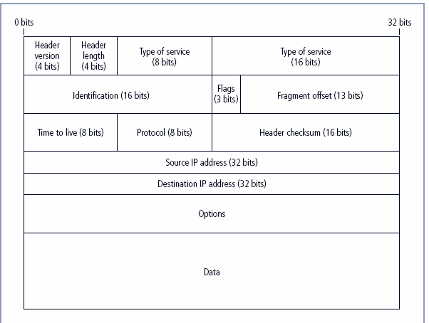
IPv4 Packet Structure (Fig. 6-1)

Slide 9
TCP, UDP Segment Structures
TCP Segment
32 bits
UDP Segment
32 Bits
Source port # |  |  |  |  |  |  |  | Dest port #
Sequence number
Acknowledgement number
Head Len | Not Used | U | A | P | R | S | F | Rcvr window size
Checksum |  |  |  |  |  |  |  | Ptr urgent data
Options (variable length)
Application data (variable length)
Source Port # | Dest Port #
Length | Checksum
Application data (message)
Source: J.F. Kurose and K.W. Ross,
Computer Networking: A Top-Down Approach,
7th ed., Addison-Wesley, 2013.
9

Slide 10
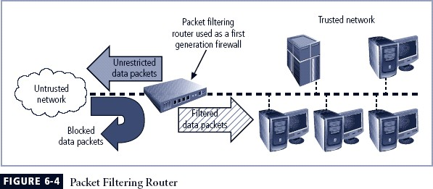
Packet Filtering Router (Fig. 6-4)

Slide 11
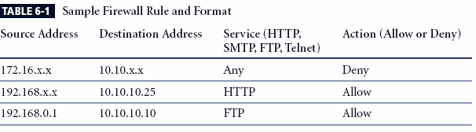
Sample Firewall Rules (Table 6-1)

Slide 12
Application Gateways
Frequently installed on a dedicated computer; also called proxy server
Proxy server is often placed in unsecured area of network (e.g., DMZ) ⇒ it faces higher levels of risk from attackers
We can place extra filtering routers behind the proxy server to protect internal systems

Slide 13
Circuit Gateways
Circuit gateway firewall: transport layer
Does not usually look at data traffic flowing between two networks; prevents direct connections between one network and another
Mechanism: create tunnels connecting specific processes/systems on each side of firewall; only allow authorized traffic in tunnels

Slide 14
MAC Layer Firewalls
Operates at data-link layer
Considers specific host computer’s identity in filtering decision
Only outbound traffic originating from MAC addresses of specific computers allowed
– Mechanism: link (MAC address, Ethernet port #), administered via switches

Slide 15
Hybrid Firewalls
Combine elements of multiple types of firewalls (e.g., packet filtering and proxy servers; packet filtering and circuit gateways)
Alternately, may consist of two separate firewall devices; separate firewall systems connected to work together

Slide 16
Firewall Categorization (2): Development Era
First generation: static packet filtering firewalls
Second generation: application-level firewalls or proxy servers
Third generation: stateful inspection firewalls
Fourth generation: dynamic packet filtering firewalls; allow only packets with particular source, destination and port addresses to enter
Fifth generation: kernel proxies; specialized form working under operating system kernel

Slide 17
Firewall Categorization (3): Deployment Structure
Most firewalls are appliances: stand-alone, self-contained systems
Commercial firewall systems: consists of firewall software running on general-purpose computer
Small office/home office (SOHO) or residential firewalls connect users’ LANs or specific computers to network devices
– Often, firewall software placed on user system

Slide 18
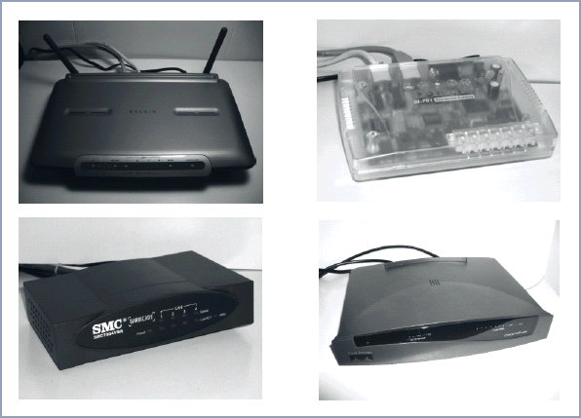
Sample Firewall Devices (Fig. 6-6)

Slide 19
Firewalls Categorization (4): Architectural Implementation
Firewall devices can be configured in a number of network connection architectures
Four common architectural implementations of firewalls:
Packet filtering routers
Screened host firewalls
Dual-homed firewalls
Screened subnet firewalls

Slide 20
Packet Filtering Routers
Most organizations with Internet connection have a router connecting to Internet
Routers can be configured to reject packets that org. forbids entering its network
Drawbacks: limited auditing, weak authentication

Slide 21
Packet Filtering Router (Fig. 6-4)

Slide 22
Screened Host Firewalls
Combines packet filtering router with stand- alone firewall (e.g., application proxy server)
Allows router to pre-screen packets to minimize load on internal proxy
Separate host is often referred to as bastion host; can be rich target for external attacks, needs to be secured carefully

Slide 23
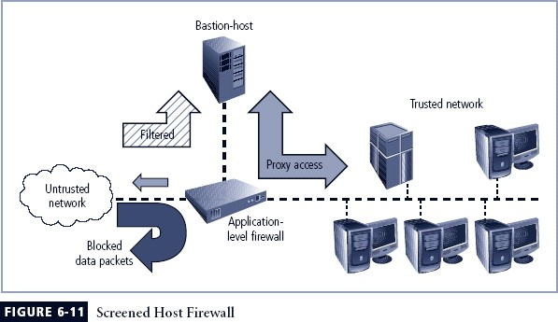
Screened Host Firewall (Fig. 6-11)

Slide 24
Dual-Homed Host Firewalls
Bastion host contains two network interface cards (NICs): one connected to external network, other connected to internal network
Architecture typically uses network address translation (NAT)
– Another barrier to intrusion from attackers

Slide 25
Non-Routable IP Address Ranges
Type | IP Address Range | CIDR Mask | IP Subnet Mask | # Addresses
Class A | 10.0.0.0 – 10.255.255.255 | /8 | 255.0.0.0 | 2²⁴ (> 16 M)
Class B | 172.16.0.0 – 172.31.255.255 | /12 or /16 | 255.240.0.0 or 255.255.0.0 | 2¹² (4,096) or 2¹⁶ (> 65K)
Class C | 192.168.0.0 – 192.168.255.255 | /16 or /24 | 255.255.0.0 or 255.255.255.0 | 2¹⁶ (> 65K) or 2⁸ (256)
Source: Adapted from Table 6-4 in textbook, RFC 1918
25

Slide 26
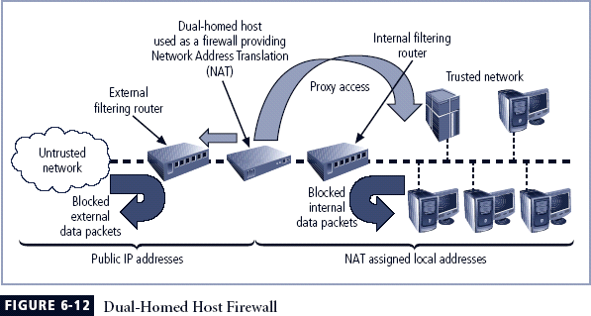
Dual-Homed Firewall (Fig. 6.12)

Slide 27
Screened Subnet Firewalls (DMZ) (1)
Dominant architecture used today
Typically has ≥ 2 internal bastion hosts behind
packet filtering router, each host protects trusted network:
Connections from outside (untrusted network) routed through external filtering router
Connections from outside (untrusted network) are
routed into, out of routing firewall to separate network segment: demilitarized zone (DMZ)
Connections into trusted internal network allowed only from DMZ bastion host servers

Slide 28
Screened Subnet Firewalls (DMZ) (2)
Screened subnet performs two functions:
Protects DMZ systems and information from outside threats
Protects the internal networks by limiting how external connections can gain access to internal systems
Another facet of DMZs: extranets

Slide 29
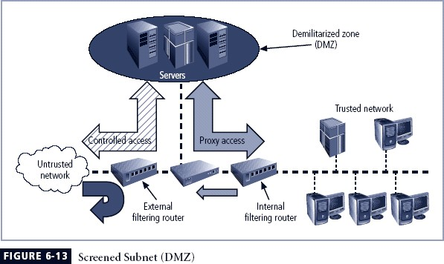
Screened Subnet Firewall (Fig. 6-13)

Slide 30
Selecting the Right Firewall
When selecting firewall, consider a number of factors:
Which is the best trade-off between protection, cost for needs of organization?
What’s included (and what’s not) in base price?
How easy is configuration? Are staff technicians available for this purpose?
How well firewall adapt to org.’s growing network?
Second most important issue: cost

Slide 31
Configuring and Managing Firewalls
Each firewall device must have own set of configuration rules regulating its actions
Firewall policy configuration is usually complex and difficult (“black art”)
When security rules conflict with business performance, security often loses!
Linux firewall

Slide 32
Best Practices for Firewalls
All traffic from trusted network is allowed out
Use MAC address filtering for Ethernet ports, authentication for wireless LANs
Firewall device never directly accessed from public network
Allow Simple Mail Transport Protocol (SMTP)
Deny Internet Control Message Protocol (ICMP)
Telnet access to internal servers should be blocked
If Web services offered outside firewall, block HTTP traffic from reaching internal networks

Slide 33
Firewall Rules
Operate by examining data packets and performing comparison with predetermined logical rules
Logic based on set of guidelines most commonly referred to as firewall rules, rule base, or firewall logic
Most firewalls use packet header information to determine whether specific packet should be allowed or denied

Slide 34
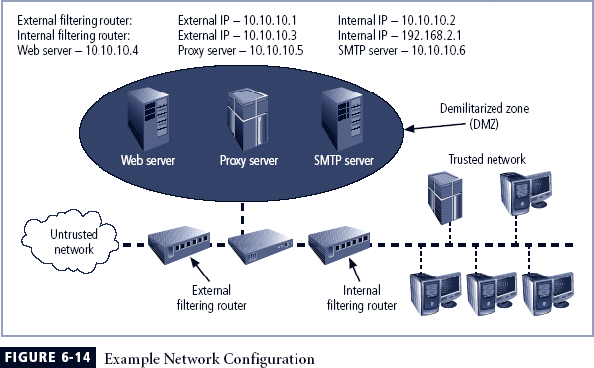
Example Network Config. (Fig. 6-14)

Slide 35
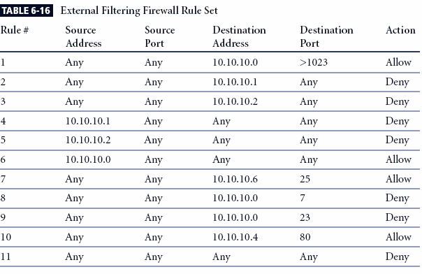
Firewall Rules (1) (Table 6-16)

Slide 36
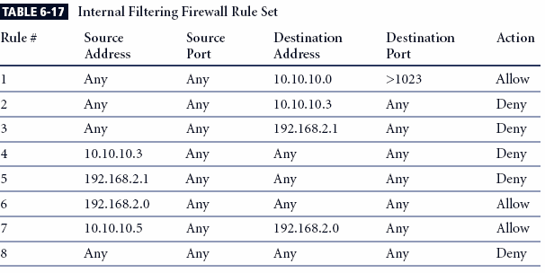
Firewall Rules (2) (Table 6-17)

Slide 37
Virtual Private Networks (VPNs) (1)
Private, secure network connection between systems over insecure, public Internet
Securely extends org.’s internal network connections to remote locations beyond its perimeter

Slide 38
Virtual Private Networks (VPNs) (2)
VPN must achieve three goals:
Encapsulate incoming, outgoing data
Encrypt incoming, outgoing data
Authenticate remote computer, user (?)

Slide 39
Transport Mode
IP packet data is encrypted, header info. is not
Lets user establish secure link directly with remote host easily
Two popular uses:
End-to-end transport of encrypted data
Remote worker connects to office network over Internet by connecting to VPN server at perimeter

Slide 40
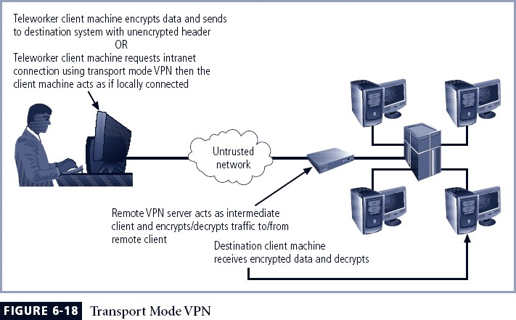
Transport Mode VPN (Fig. 6-18)

Slide 41
Tunnel Mode
Org. sets up two perimeter tunnel servers as
encryption points: all net traffic encrypted in transit
Main benefit to tunnel mode: intercepted packets reveal nothing about true destination
Examples of tunnel mode VPNs:
Pulse Secure appliance
Microsoft Internet Application Gateway

Slide 42
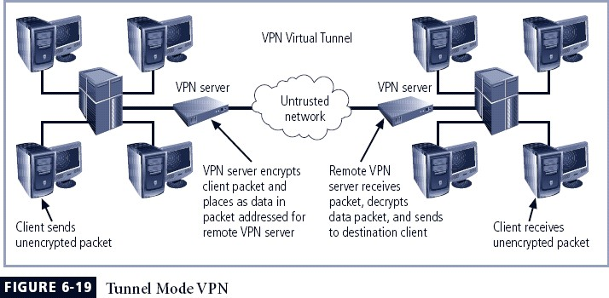
Tunnel Mode VPN (Fig. 6-19)

Slide 43
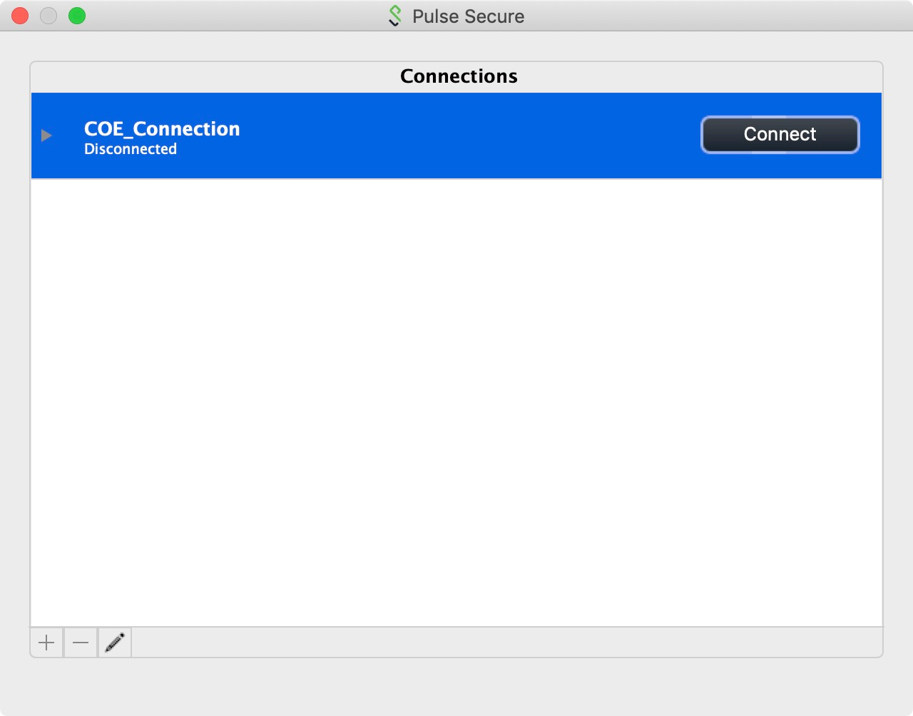

Example VPN: Pulse Secure
Source: Pulse Secure, LLC; https://www.pulsesecure.net/products/psa-series/ (PSA 5000)
– More VPN info: A. Marshall, Tech Radar, https://www.techradar.com/vpn/best-vpn, 16 May 2019.

Slide 44
Summary
Firewall technology
Four methods for categorization
Firewall configuration and management
Virtual Private Networks
Two modes

