Slide 1
Melanoma Detection Through Transfer Learning
By Anas Hamed
November 29th, 2019

Slide 2
Introduction

Slide 3
Skin Cancer
Most common form of cancer in the U.S.
Accounts for 40% of all cases of cancer worldwide
Three Types:
Basal-cell: not likely to spread
Squamous-cell: rarely results in any serious complications
Melanoma: most aggressive, most deadly, highest mortality rate
Melanoma accounts for 75% of cases that result in death
99% survival rate if detected early and treated
Only 7-14% survival rate for advanced stages
Source: https://en.wikipedia.org/wiki/Skin_cancer

Slide 4
Melanoma Detection Through Images
Indicators
ABCDEF mnemonic^{[3]}:
Asymmetry
Borders
Color
Diameter
Evolving
Funny-looking
Challenges
A lot of malignant lesions closely resemble a benign nevus (mole)
Not all characteristics can be captured in an image (e.g. firmness, elevation)

Slide 5
ISIC Challenge
Skin Lesion Analysis Towards Melanoma Detection^{[2]}
Hosted by International Skin Imaging Collaboration (ISIC)
Launched in 2018 and March 2019
159 participants (classification task)
~24,000 dermoscopic images across 3 tasks:
Disease classification
Lesion segmentation
Attribute detection

Slide 6
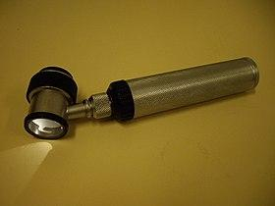
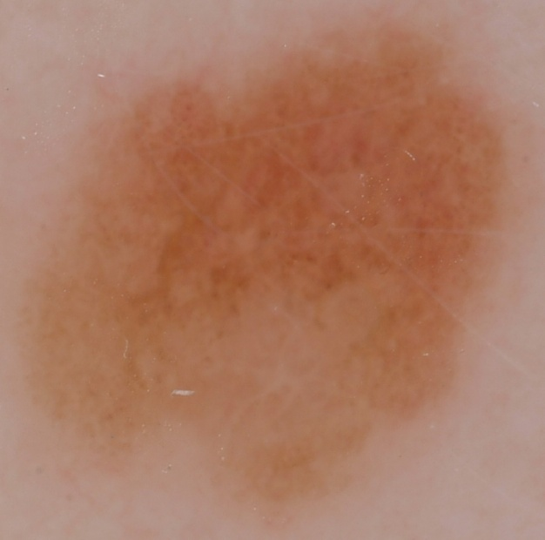
Dermoscopic Images
Produces an illuminated, magnified image of the lesion of interest
Provides for a more accurate classification compared to visual inspection by the naked eye

Slide 7
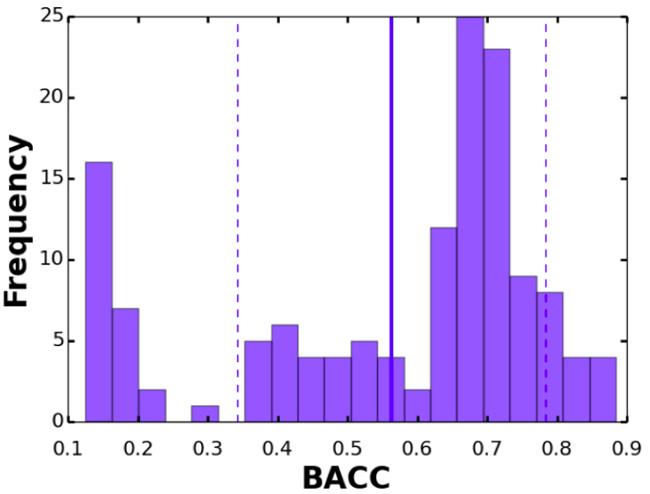
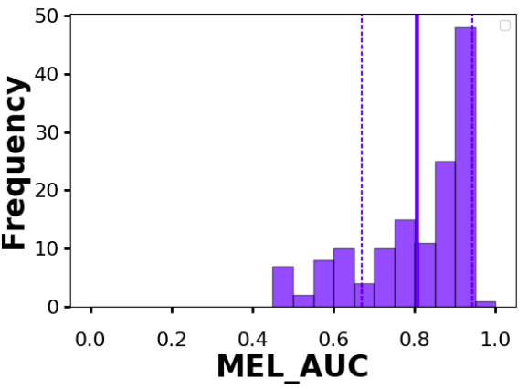
Evaluation^{[2]}
Balanced Accuracy
(TPR + TNR)/2
AUC: Measures how well the model distinguishes between classes
An AUC of 1 means the model perfectly classifies each sample
An AUC of 0 means the model misclassifies all the samples

Slide 8
Experiments

Slide 9
Goals
Demonstrate the effectiveness of state-of-the-art models and techniques
Provide a baseline for future work
Outline the challenges involved in melanoma detection through Deep Neural Networks

Slide 10
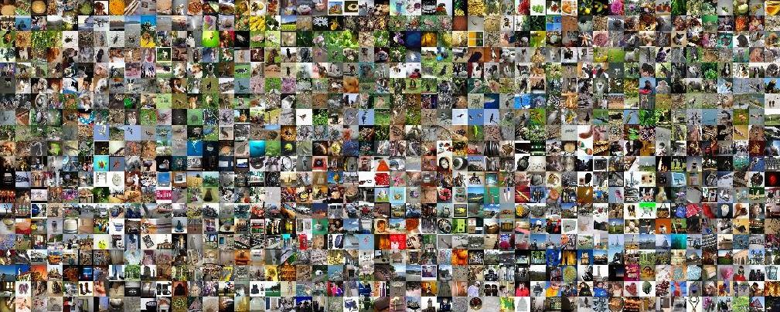

Transfer Learning
A pretrained model is used for tasks involving feature extraction
Two architectures (pretrained on ImageNet^{[4]})
ResNet-50^{[5]}
ResNext-50^{[6]}
Model
Train
Evaluate
ImageNet (1000 classes)
Dermoscopic Images

Slide 11
Dataset
~24,000 publicly available dermoscopic images + metadata
Images were chosen that meet the following criteria:
Image has corresponding metadata file
Diagnosis is known
Segmentation mask is available
End result: ~12,200 images
80% Training, 10% Validation and 10% Test

Slide 12
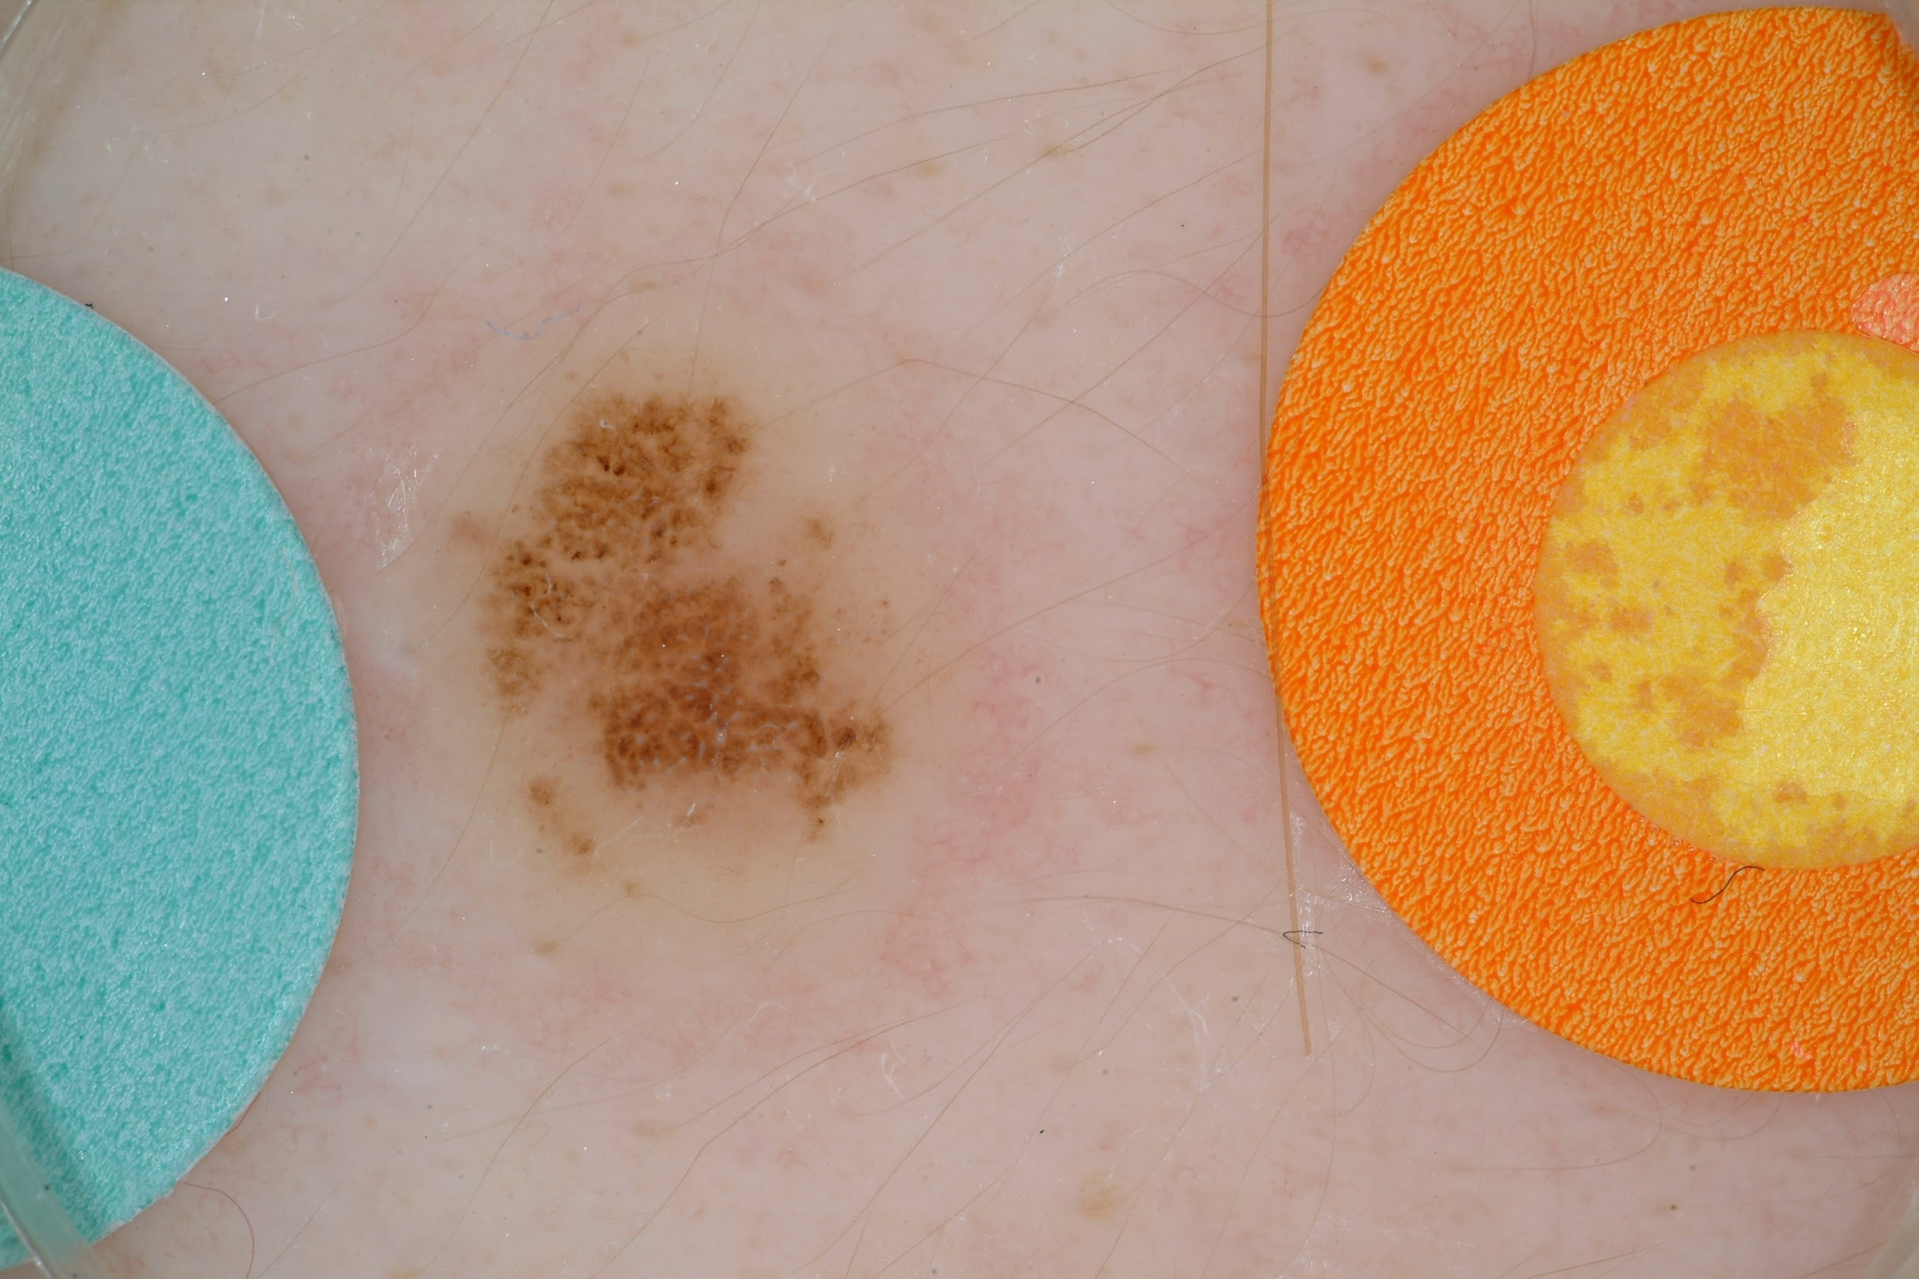

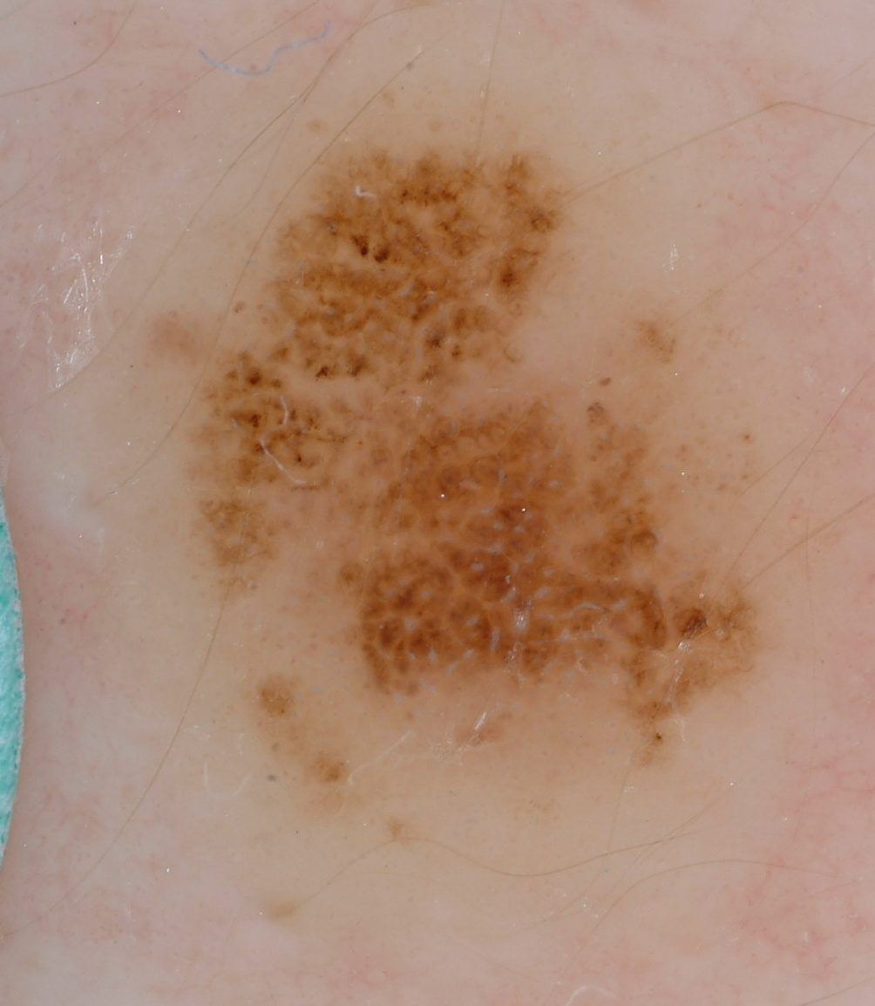
Dataset Preprocessing
Original Image
Segmentation Mask
Result

Slide 13
Dataset Preprocessing
Augmentation
Stochastic Horizontal Flip with p = 0.5
Stochastic Vertical Flip with p = 0.5
Resizing
Original image size ~(1000-4000x800-2000 pixels)
Resized to 128x128
Normalization
For each pixel, subtract channel-wise mean and divide by standard deviation

Slide 14
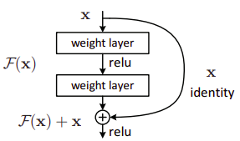
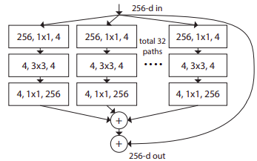
Models
ResNet-50^{[5]}
Uses residual connections
Proven to be effective for classification tasks
Resnext-50^{[6]}
Uses blocks of split-transform-merge operations
Outperforms some versions of the ResNet model with decreased complexity

Slide 15
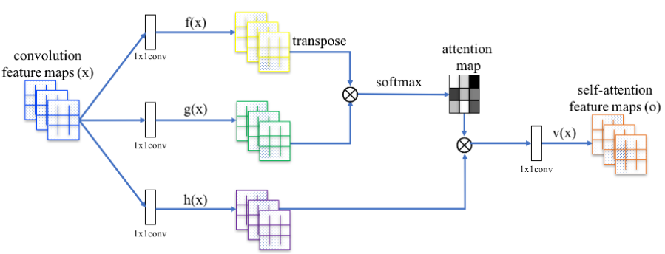
Self Attention^{[7]}
Uses attention maps to overcome limitations of convolution layers
Places more importance on relevant locations in an image
Self Attention

Slide 16
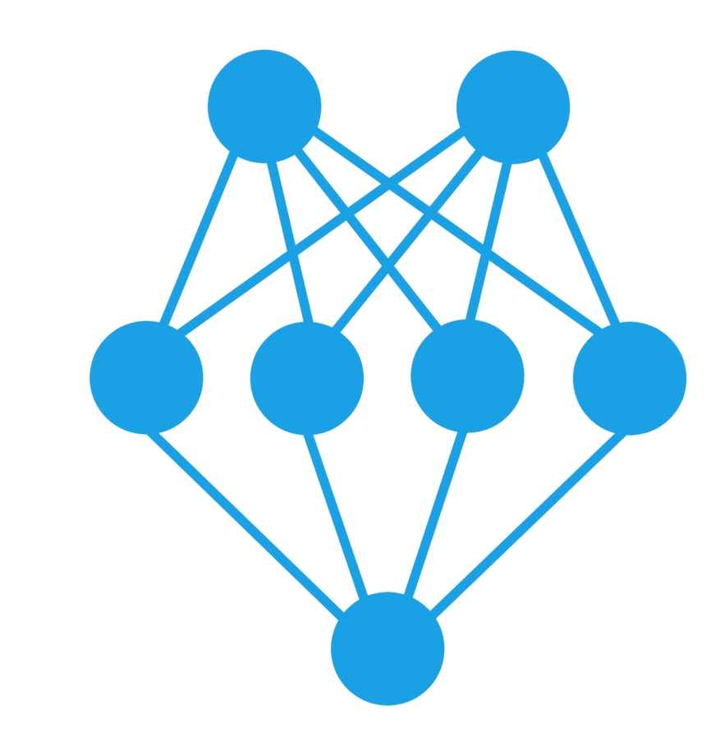
Architecture
ResNet-50
ResNext-50
Frozen
Self Attention
Trainable
Self Attention
Dense Layer
Dense Layer
Trainable

Slide 17
Training
100 epochs
Cross Entropy Loss^{[8]}
Adam Optimizer^{[9]}
4 training cycles
ResNet with attention
ResNet without attention
ResNext with attention
Resnext without attention

Slide 18
Results & Conclusion

Slide 19
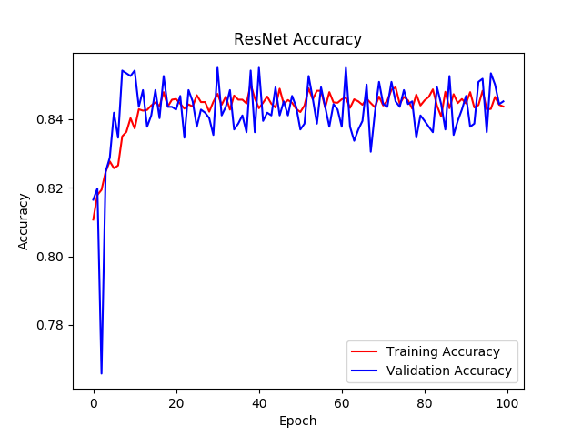
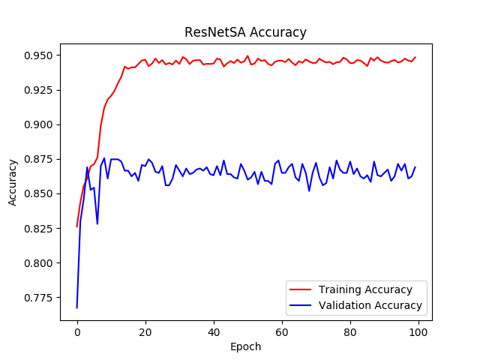
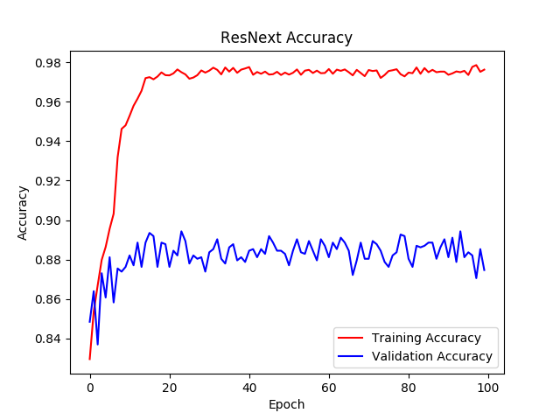
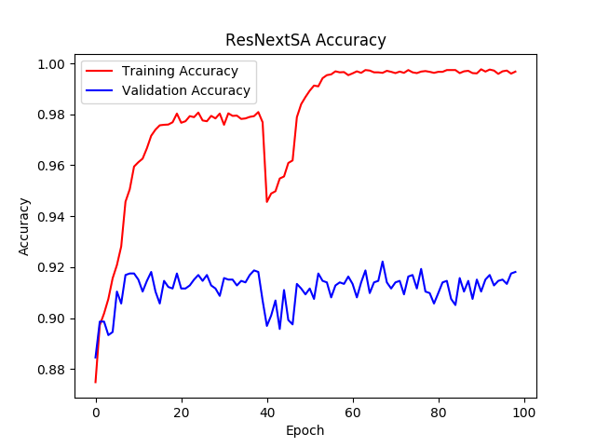
Results

Slide 20
Results
 | Test Accuracy (%) | Balanced Accuracy (%) | Precision | Recall | F1 Score | Training Time (100 epochs)
ResNet | 83.86 | 75.91 | 0.63 | 0.41 | 0.497 | 14.7 hrs
ResNetSA | 86.56 | 78.79 | 0.65 | 0.44 | 0.527 | 14.8 hrs
ResNext | 87.46 | 79.12 | 0.64 | 0.54 | 0.592 | 14.7 hrs
ResNextSA | 91.04 | 80.33 | 0.67 | 0.56 | 0.612 | 14.9 hrs

Slide 21
Further Improvements
Adding more attention layers
Ensembling
Using deeper models (e.g. ResNext-101)
Experimenting with different models
Increasing size of dataset
Incorporating sample metadata
Countering imbalance between class samples

Slide 22
References
[1] Project Code: https://github.com/AnasHamed73/676-deep-learning-project2
[2] ISIC Challenge:https://arxiv.org/pdf/1902.03368.pdf
[3] Melanoma: https://en.wikipedia.org/wiki/Melanoma
[4] ImageNet: http://www.image-net.org/
[5] ResNet: https://arxiv.org/pdf/1512.03385.pdf
[6] ResNext: https://arxiv.org/pdf/1611.05431.pdf
[7] Self Attention: https://arxiv.org/pdf/1706.03762.pdf
[8] Cross Entropy Loss: https://en.wikipedia.org/wiki/Cross_entropy
[9] Adam Optimizer: https://arxiv.org/pdf/1412.6980.pdf

