Slide 1
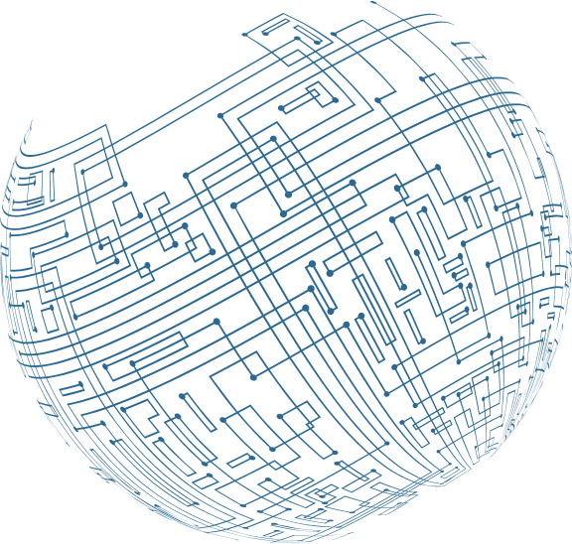
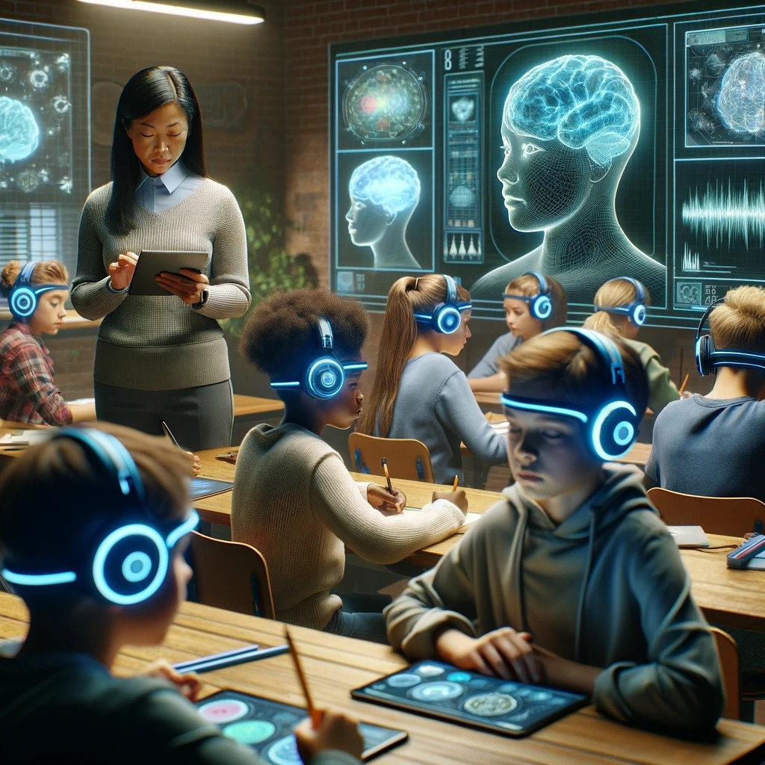


Final Year
Project Presentation
Enhancing Student Performance Through EEG-AI Based Classroom Device
Team Members
  Anas Hussain Khan
  Asadullah Khan
  Taimoor Ali
  Syed Shokat Ali
Group Number:43206

Slide 2
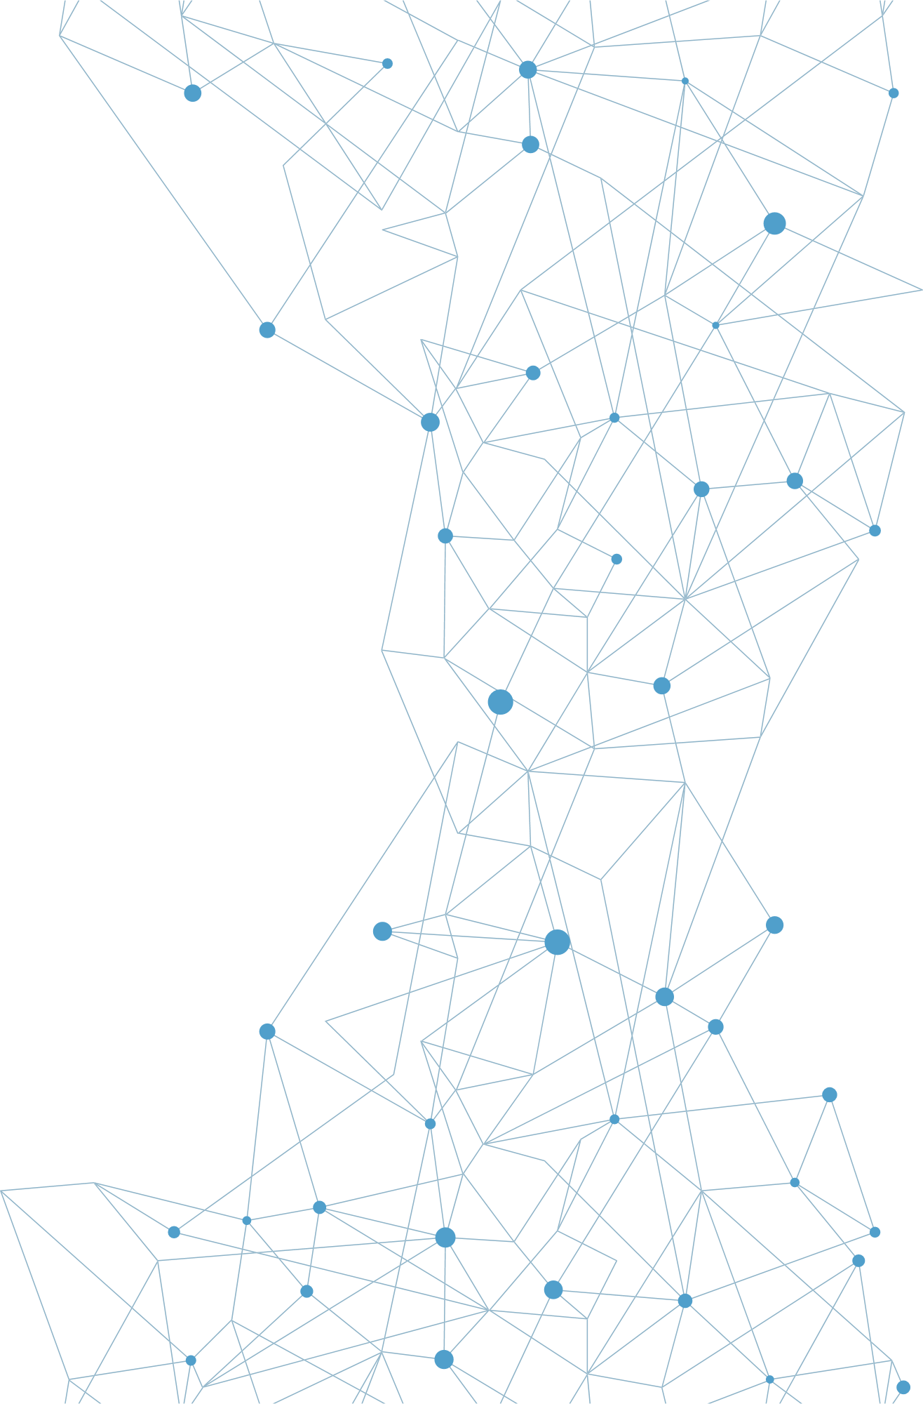

Enhancing Student Performance Through EEG-AI Based Classroom Device
Introduction
"UNLOCKING MINDS, EMPOWERING FUTURES.
In an era where technology and education increasingly intersect, our project, 'Enhancing Student Performance Through EEG-AI Based Classroom Device,' stands at the forefront of this evolution. This endeavor harnesses the power of Electroencephalography (EEG) and Artificial Intelligence (AI) to revolutionize the way student engagement and cognitive processes are understood and enhanced in educational environments. By merging neuroscience with cutting-edge technology, we aim to unlock new potentials in personalized learning and teaching methodologies."

Slide 3



PROBLEM
STATEMENT
The educational landscape is currently grappling with a decline in student engagement and concentration, with classrooms becoming battlegrounds against constant distractions ranging from technology to social dynamics.
This pervasive issue not only hampers academic achievement but also presents unique challenges for students with ADHD and learning disabilities, necessitating specialized educational interventions tailored to their
needs. Our project seeks to address these challenges by
enhancing the learning environment through innovative solutions.
Declining Student Engagement & Concentration
Classrooms Filled with Distractions
Impact of Poor Focus & Engagement
Students with ADHD & Learning Disabilities

Slide 4

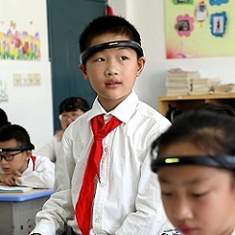
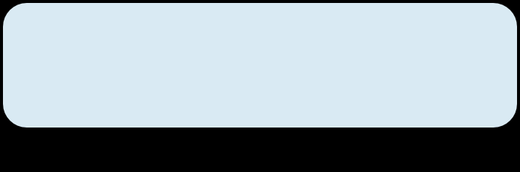
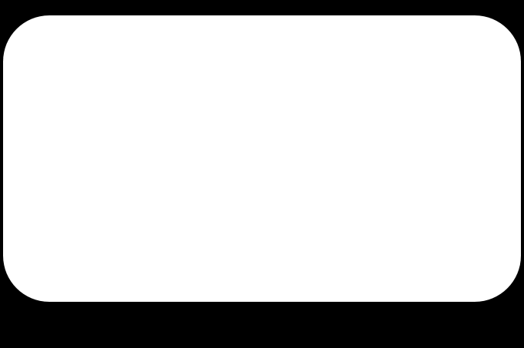




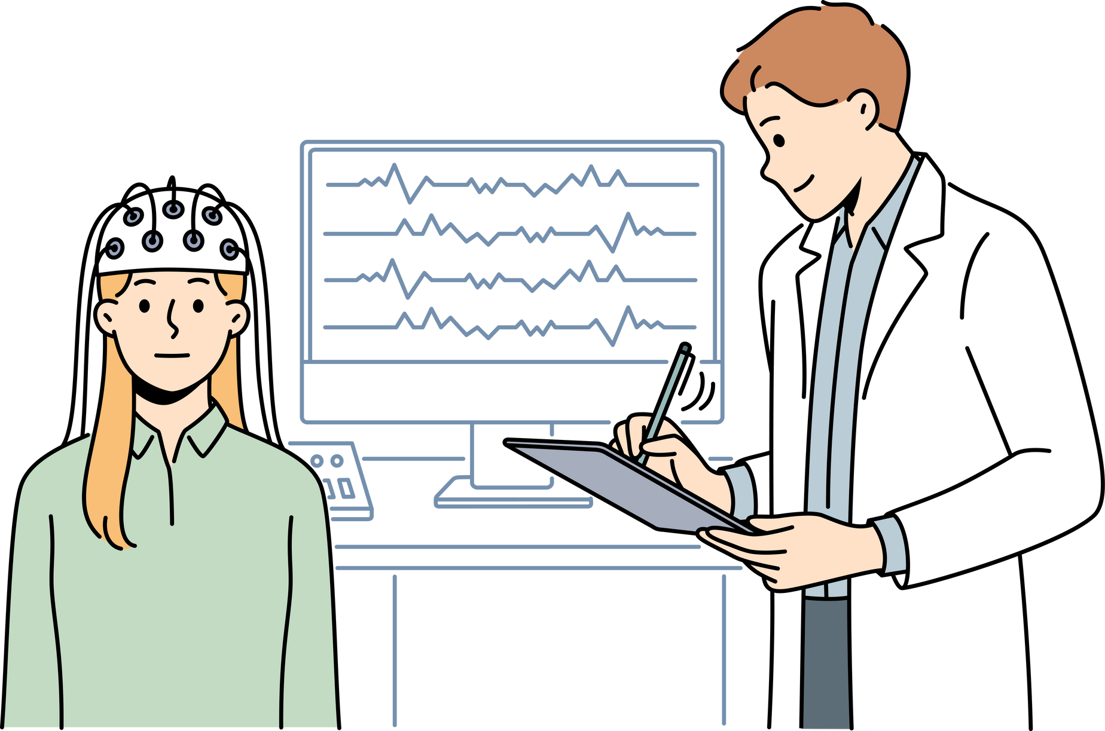
POSSIBLE
SOLUTION
SMART CLASSROOM CAMERAS
SMART EEG HEADBAND MODULE
Utilizing AI-powered cameras in classrooms to monitor student engagement. These cameras can analyze facial expressions and body language to identify when students are losing focus. This data helps teachers adjust their teaching style or content in real time to re-engage students.
Develop an electronic learning module that adjusts its content based on the student's attention level. This could utilize sensors to monitor student alertness like EEG and dynamically adapt the difficulty or type of educational content being presented, ensuring that the material remains engaging and appropriately challenging for each student.

Slide 5
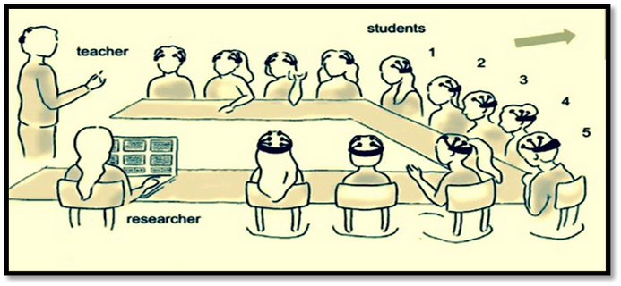
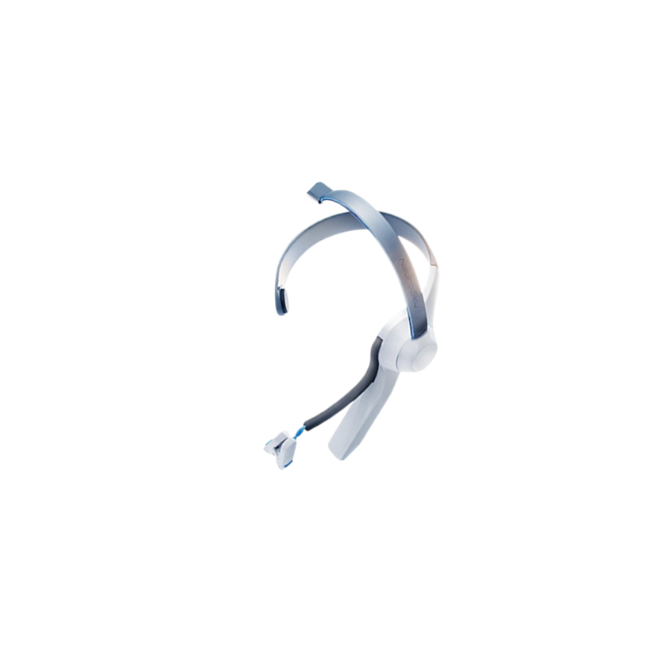
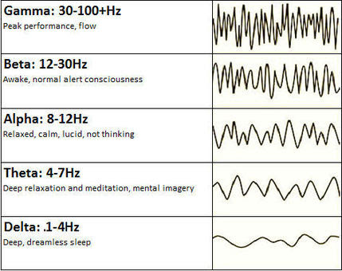
PROPOSED
SOLUTION
Our proposed solution is a simple, non-invasive EEG headband for monitoring students' cognitive states. This device captures brain activity to identify focus issues and evaluates the effectiveness of different educational strategies. With its connection to a user-friendly app, it provides real-time insights for parents and teachers, aiding in personalized student support and enhancing learning experiences. Brainwave frequencies, commonly categorized as
ALPHA WAVES (8-13 HZ)
BETA WAVES (13-30 HZ)
GAMMA WAVES (30-100 HZ)
01
02
03
Indicative of a relaxed, calm state and reducing stress.
Associated with active thinking, focus.
Reflect heightened perception, cognitive processing.

Slide 6

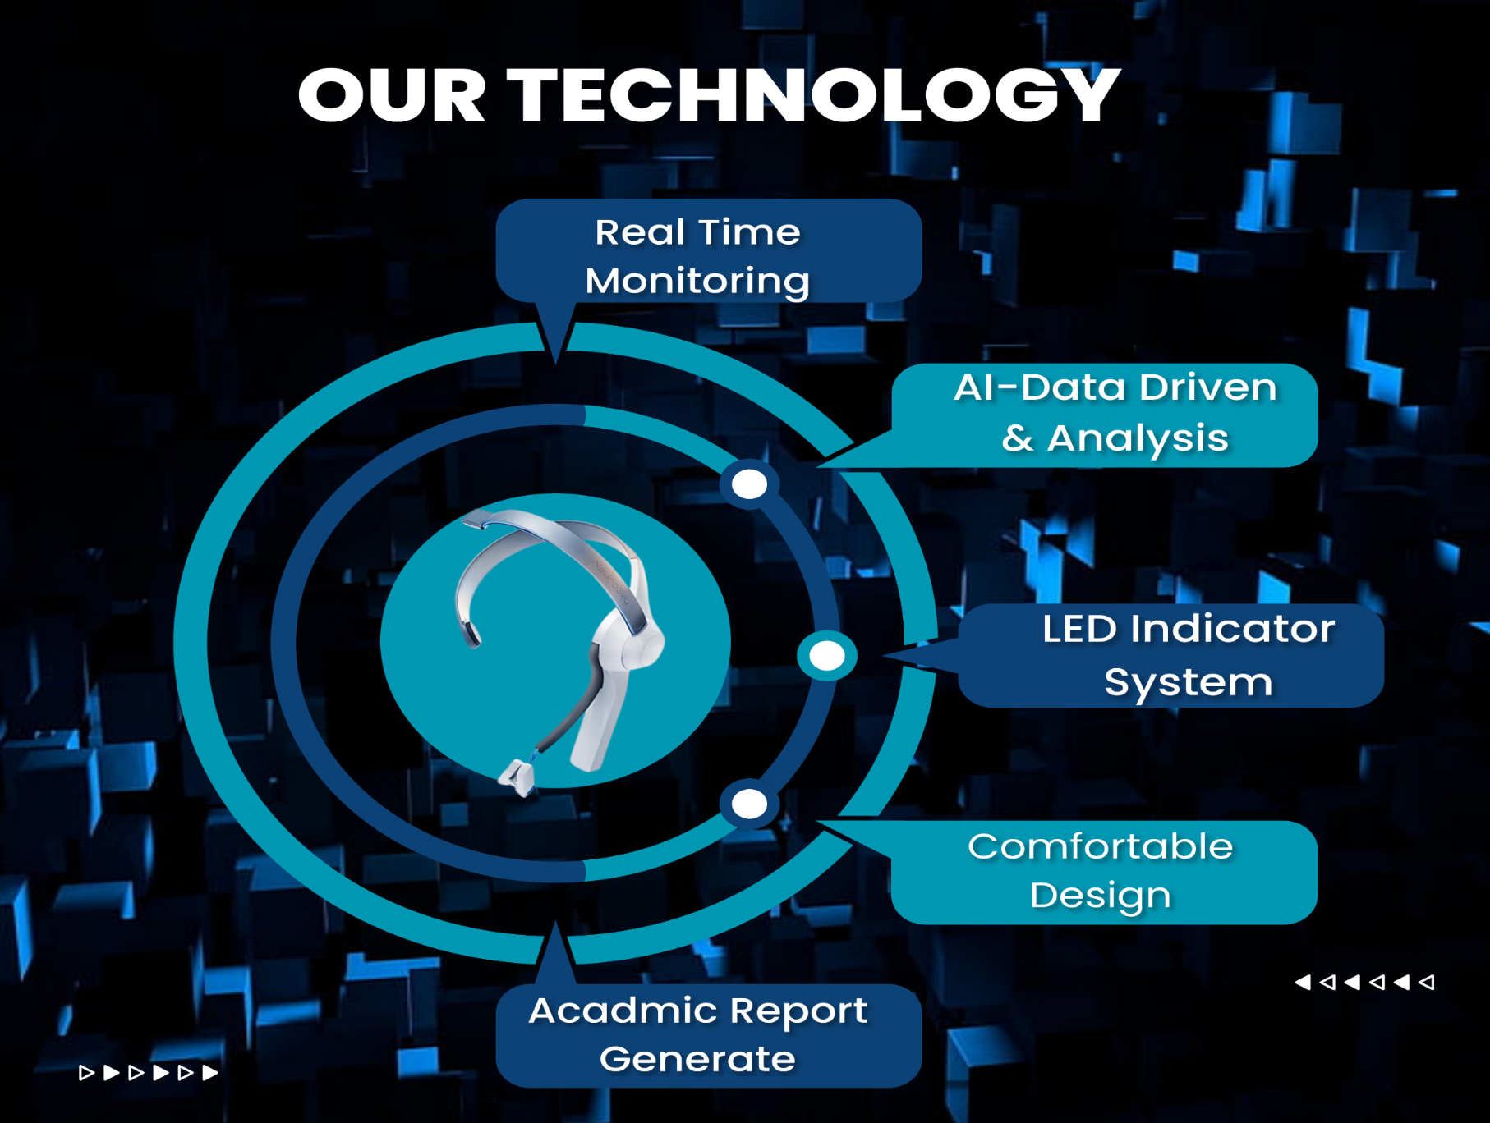
OUR
OBJECTIVE
Develop a wearable EEG device capable of accurately capturing brainwave signals in real-time.
Implement advanced signal processing algorithms to analyze EEG data and extract cognitive insights related to attention, focus, and engagement.
Create a cloud-based platform for storing and analyzing EEG data, enabling real-time feedback to educators and students.
Integrate machine learning algorithms to continuously enhance the accuracy and reliability of cognitive state detection based on EEG signals.

Slide 7
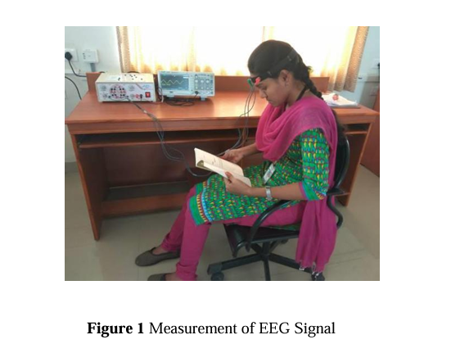
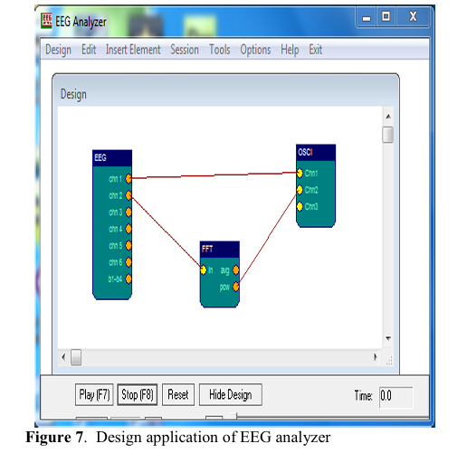
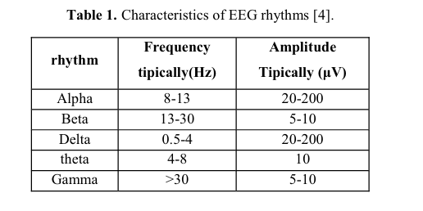
LITERATURE
REVIEW
EEG Technology in Education:[1]
Research in this area focuses on how EEG technology can be utilized to monitor and analyze students' cognitive states. This includes understanding how attention, engagement, and learning processes can be tracked and enhanced using EEG data.
AI and Machine Learning Integration:[4]
Studies highlight the use of AI and machine learning algorithms in interpreting EEG data. This involves analyzing brainwave patterns to deduce students' concentration levels, facilitating tailored educational approaches.
Impact on Learning Outcomes:[2]
Research explores the potential impact of such technologies on learning outcomes, especially for students with attention disorders or learning disabilities, underscoring the need for inclusive and adaptive learning tools.

Slide 8
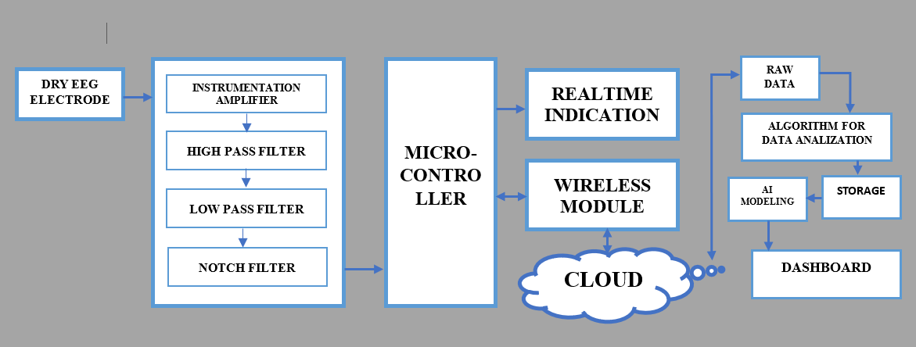
METHODOLOGY
SYSTEM MODEL

Slide 9
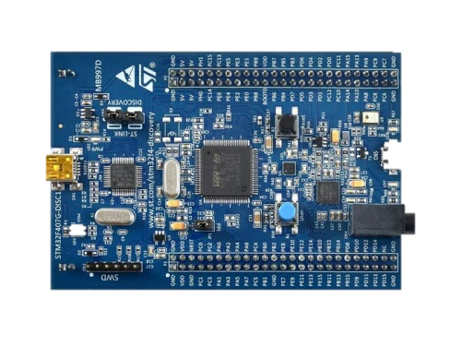
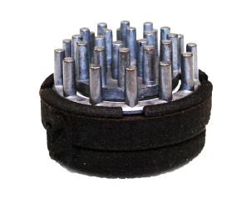
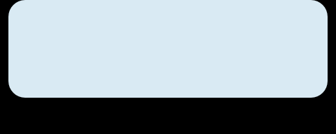
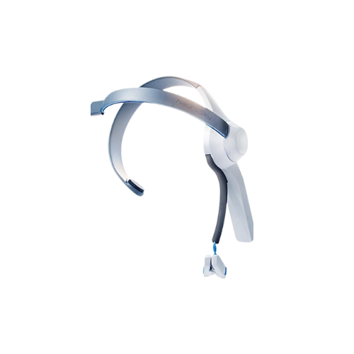
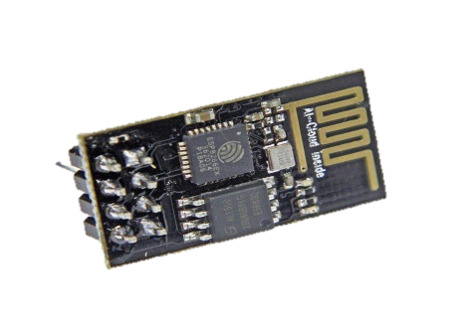
DETAIL OF THE
HARDWARE
Dry Electrodes
STM32F407
Catch EEG Signals
Fast, Having large memory
Our EEG-based classroom device combines stainless steel dry electrodes for comfortable brainwave monitoring, STM32F407/417 microcontrollers for high performance in a compact form, and the ESP8266 WiFi Module for reliable cloud connectivity. This blend of hardware ensures efficient, non-invasive cognitive state analysis in educational settings.
ESP8266
HEADBAND
WiFi Module
Integrated Hardware

Slide 10




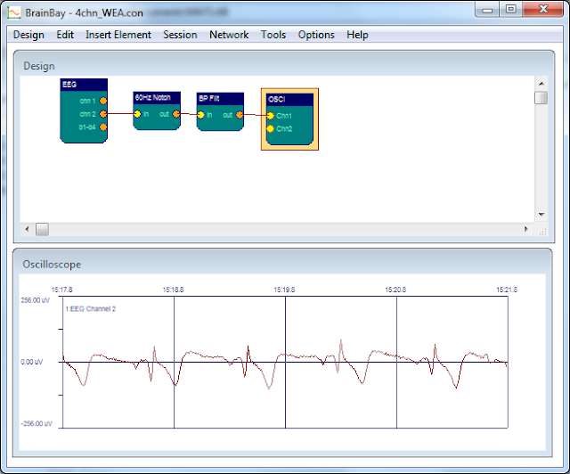
SOFTWARES
Our EEG-based classroom device integrates MATLAB for EEG signal processing, Python with TensorFlow for machine learning analysis, and Python's Pandas and Matplotlib for data visualization. This software combination ensures efficient processing and interpretation of cognitive data for educational applications.

Slide 11
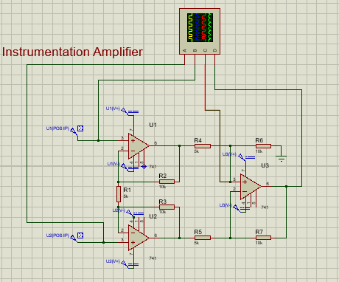
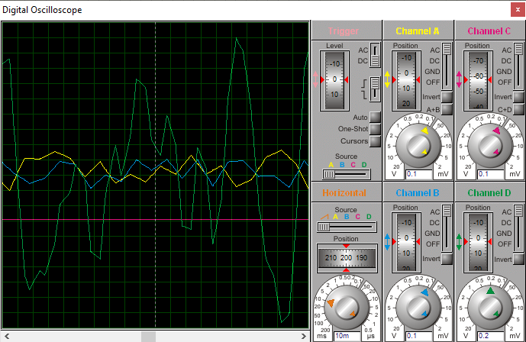
RESULTS & DISCUSIION
SIMULATION RESULTS
Instrumentation Amplifier
The instrumentation amplifier also has some useful features like low offset voltage, high CMRR (Common mode rejection ratio), high input resistance, high gain etc. The circuit diagram of a typical instrumentation amplifier :-

Slide 12
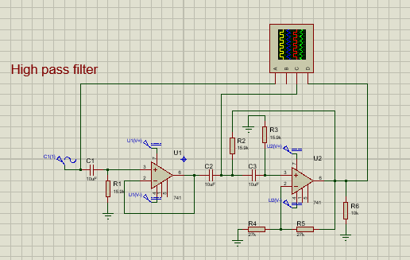
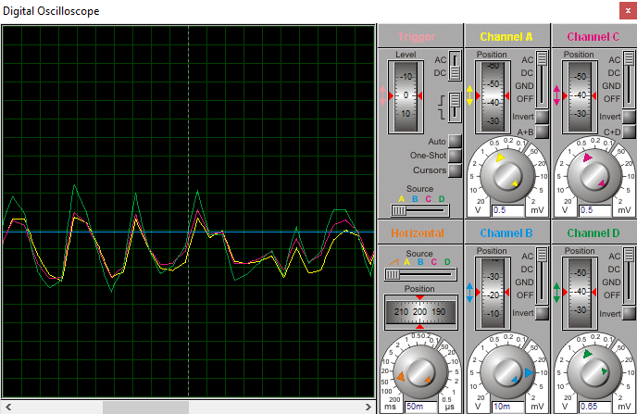
High pass filter (HPF) 1 Hz
The beginning of this circuit contains a quick HPF of cutoff frequency 1 Hz(Fc=1/(2*pi*R3*C2), just for some extra attenuation of unwanted noise. On the other end, the resistor and capacitor in parallel provide some extra filtering of high frequencies (Fc = 1/(2*pi*10nF*100kΩ) = 160Hz on a low-pass filter).

Slide 13
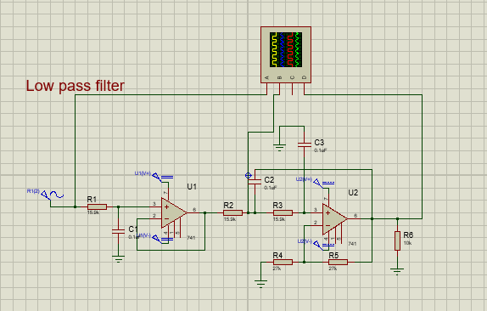
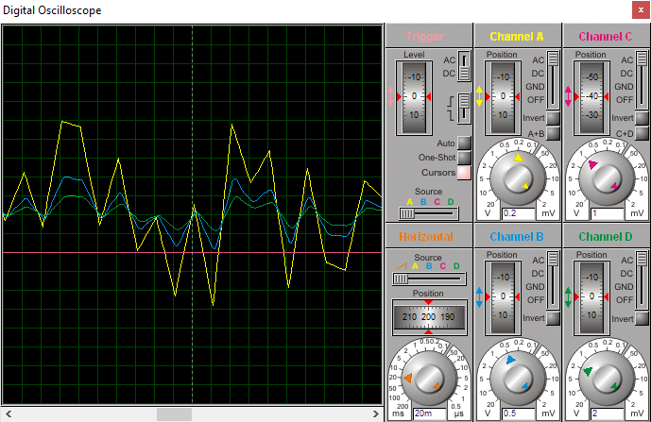
Low pass filter (HPF) 31 Hz
Next up, we want to filter out data above the frequencies we are interested in. More specifically, as beta wave information stops out at 30Hz, we want to get rid of anything above that, as combined it can contribute a good amount of noise to our data. The circuit design is very similar to the high pass filter from stage 3 - it has a gain of .71 at 31.23Hz, and decreases from there at a rate such that by 300Hz it has attenuated the data by about a factor of 100. Design of HPF-31 Hz circuit

Slide 14
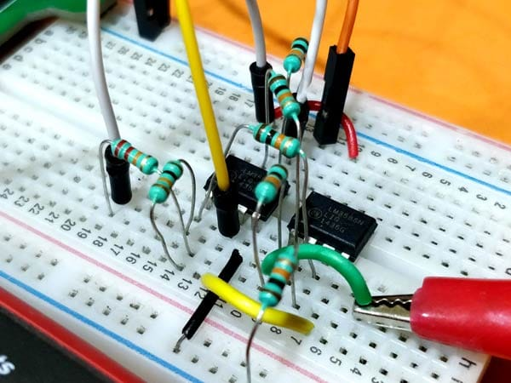
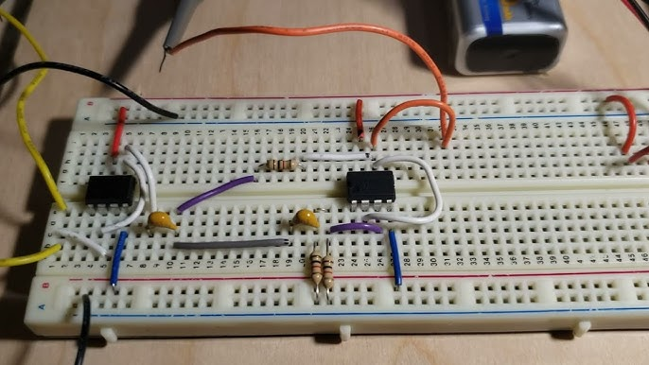
Setup Circuits on the Breadboard

Slide 15
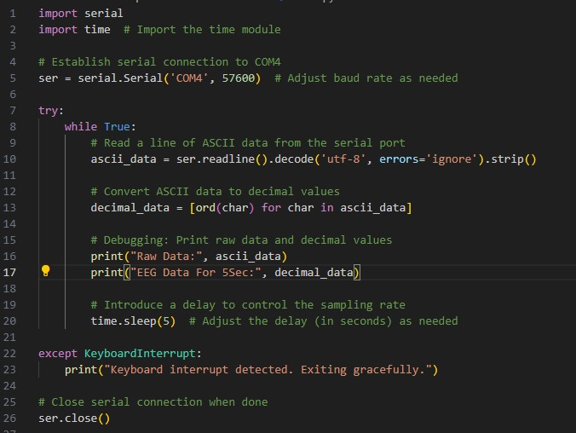
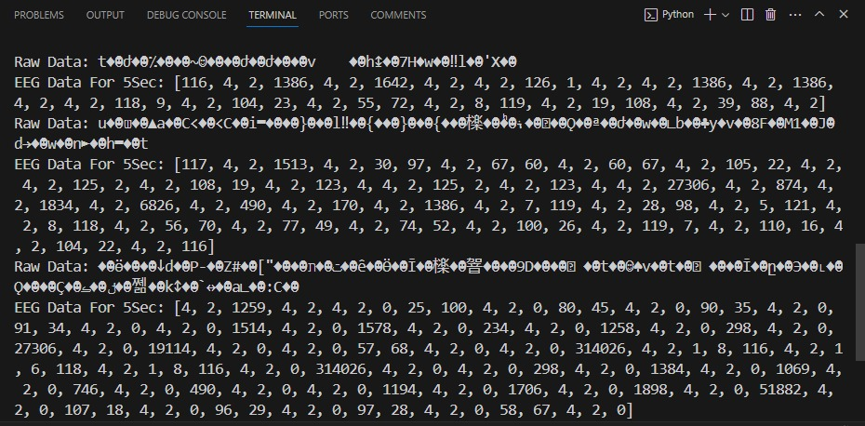
EEG Data From TGAM Module

Slide 16
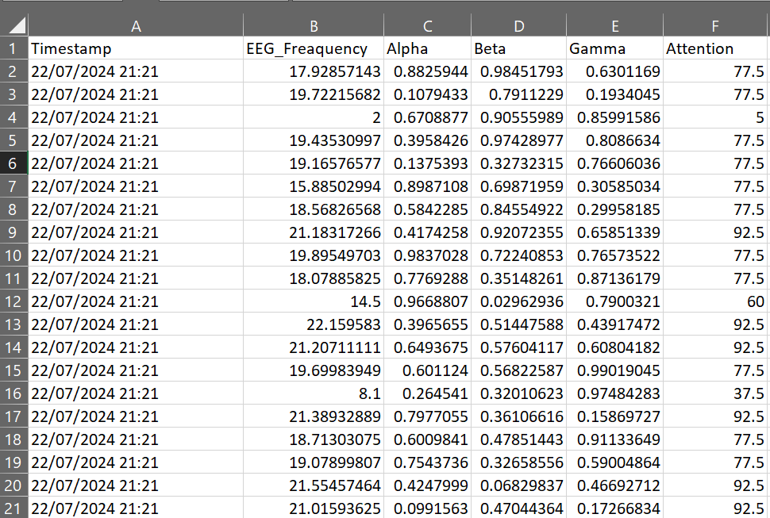
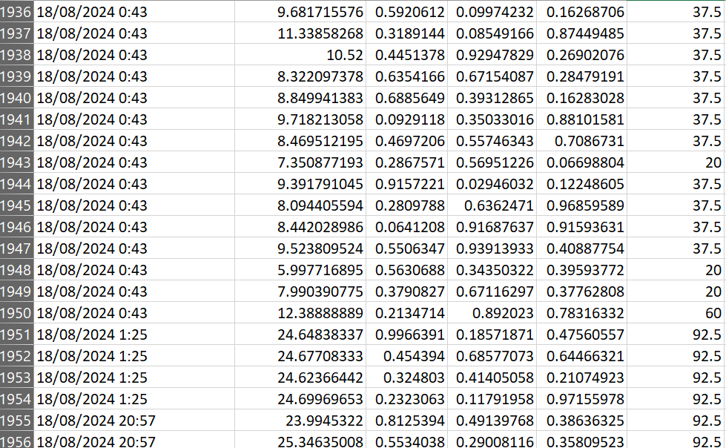
EEG Dataset From TGAM Module To Excel

Slide 17
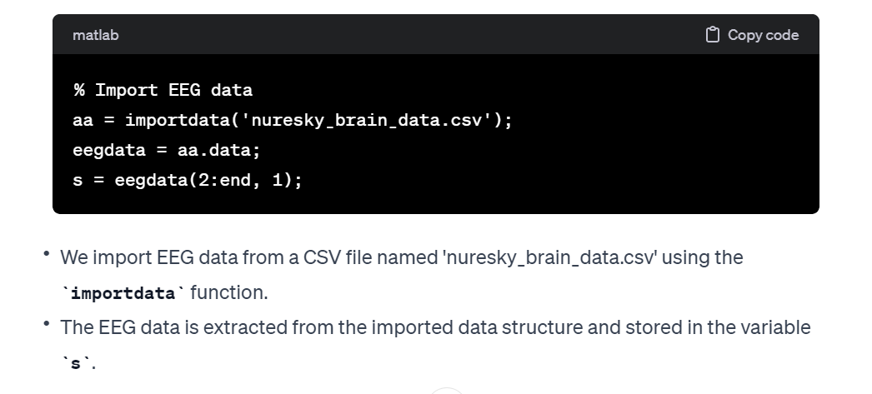
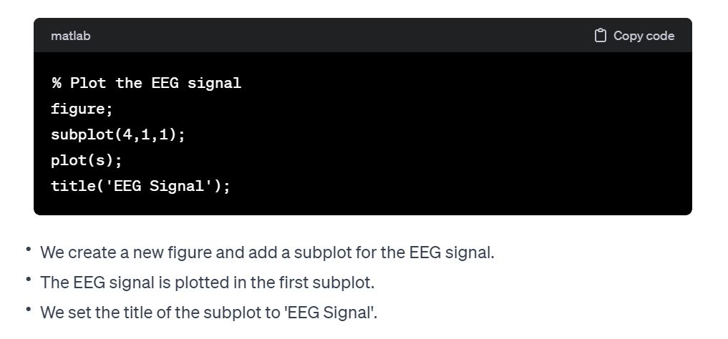
Experiment No # 1
Working on processing EEG (Electroencephalogram) signals and analyzing different frequency bands such as gamma, beta, alpha, theta, and delta. The code appears to be using a wavelet decomposition technique to extract these frequency components and perform spectral analysis.
MATLAB CODE:-

Slide 18
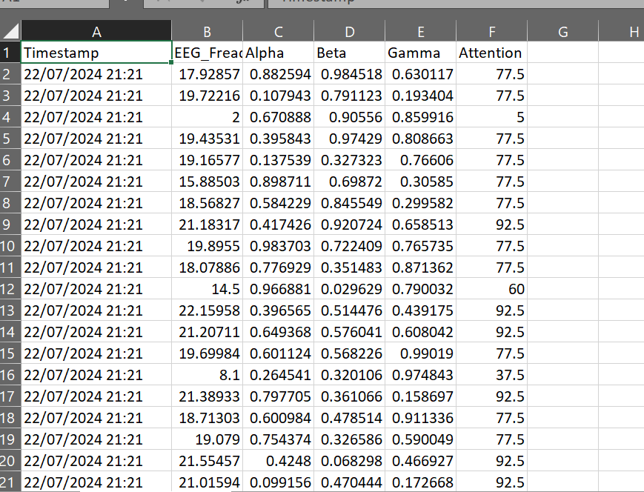
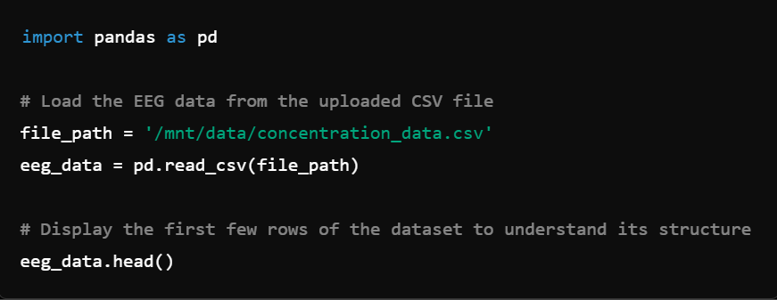
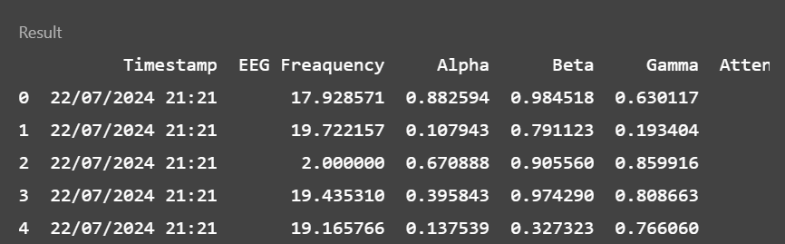
DATA SETS

Slide 19
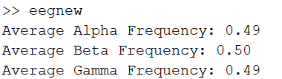
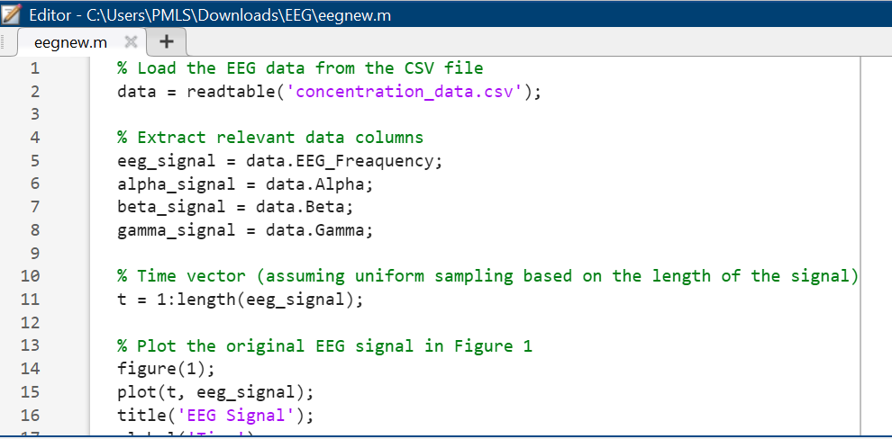
RESULTS-
Alpha Frequency (0.49): Indicates that the alpha band (8-13 Hz) has a moderate presence in the EEG signal.
Beta Frequency (0.50): Indicates that the beta band (13-30 Hz) has a slightly stronger presence compared to alpha and gamma.
Gamma Frequency (0.49): Indicates that the gamma band (>30 Hz) has a moderate presence, similar to alpha.

Slide 20
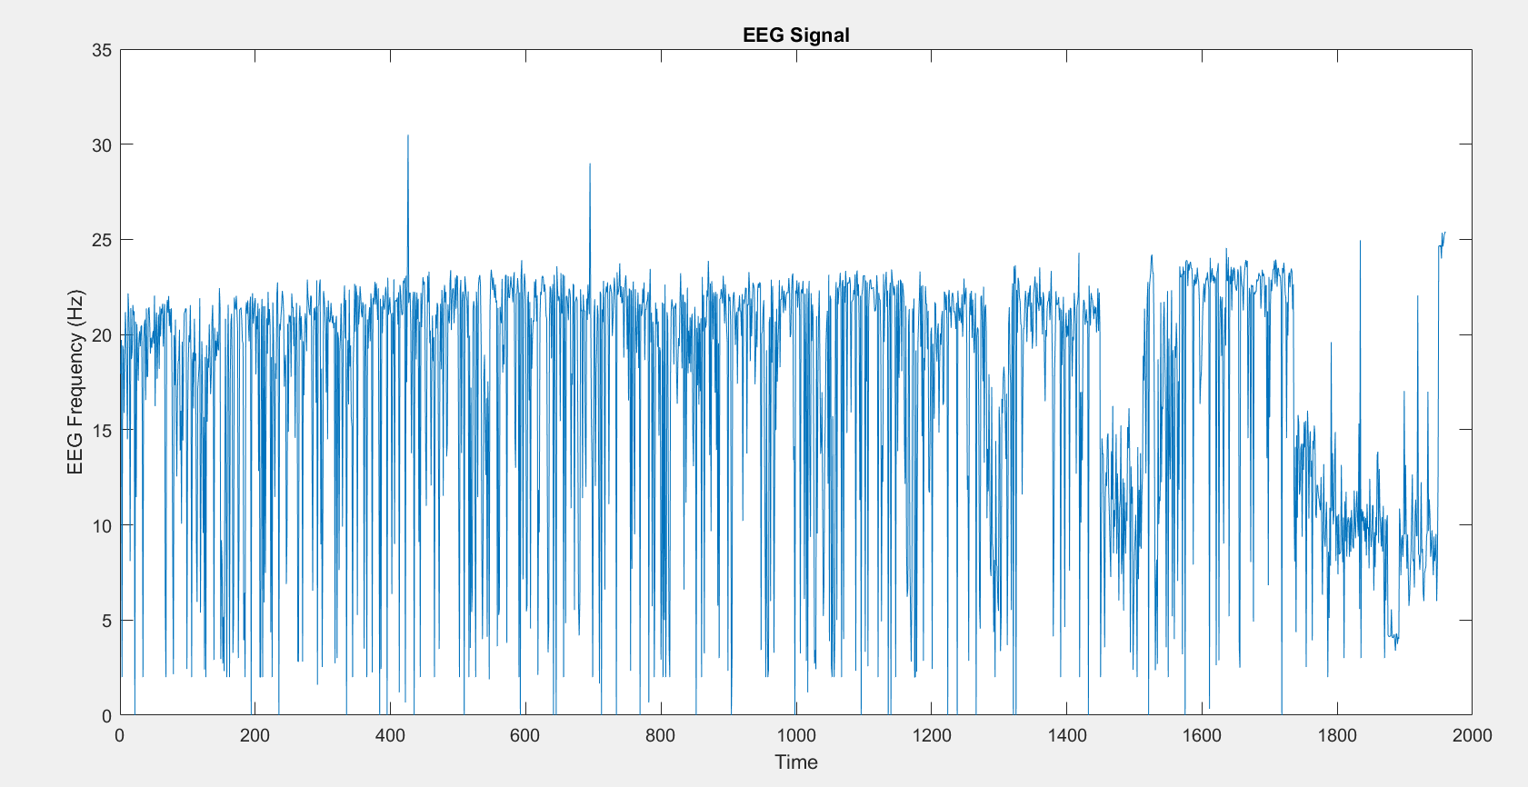
Graphical Representation
X-Axis (Time): Represents the time points or sample indices during the recording.
Y-Axis (EEG Frequency (Hz)): Represents the EEG signal's frequency component in Hertz (Hz).
Meaning: This plot shows how the EEG frequency changes over time, reflecting overall brainwave activity.
X-axis ranges from 0 to 2000, and the sampling rate is 256 Hz:
2000 data points / 256 samples per second =approximately 7.8 seconds of recording.

Slide 21
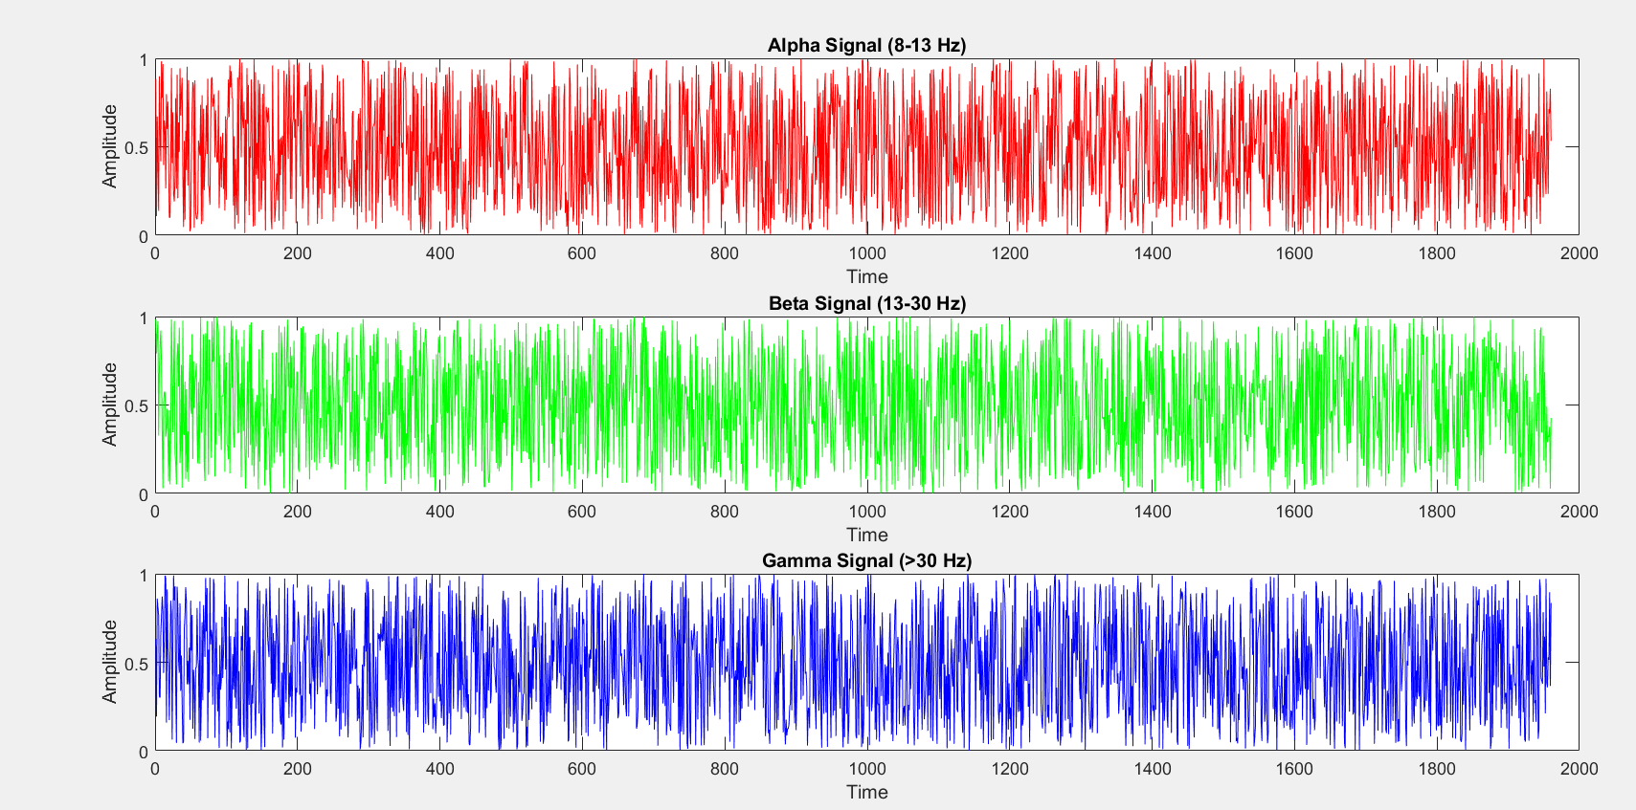
Graphical Representation

Slide 22
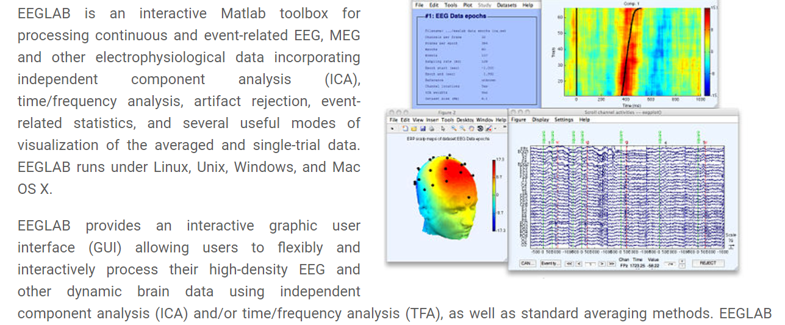
Experiment No # 2
EEGLAB:-

Slide 23
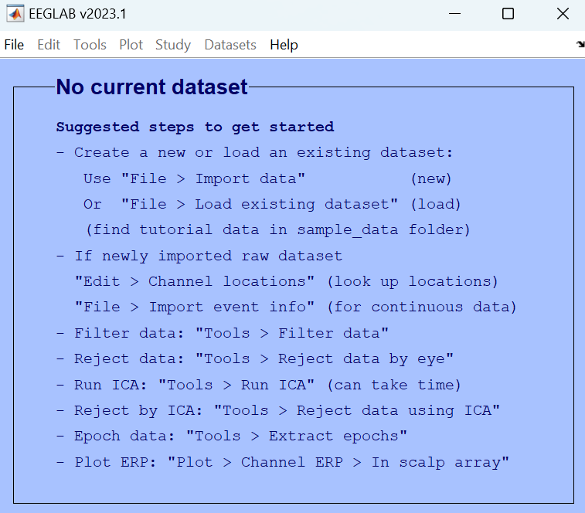
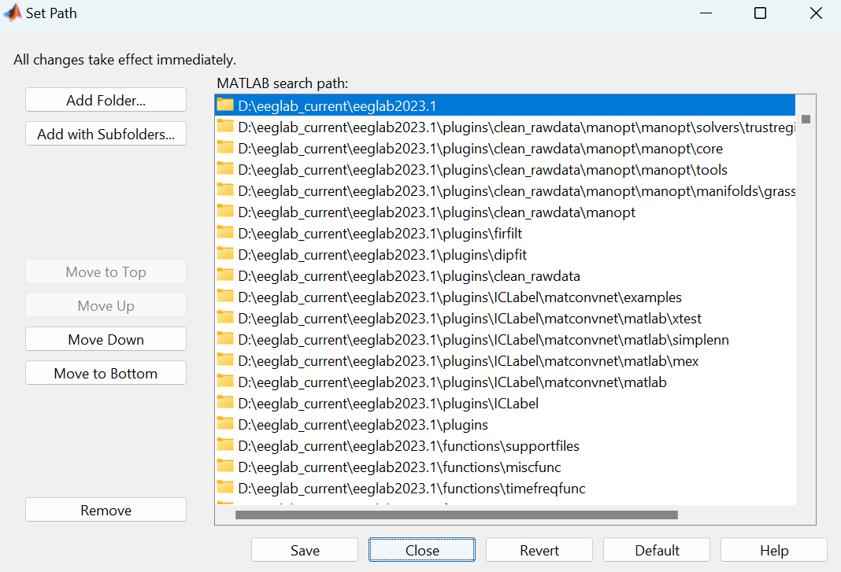
Start EEGLAB
Type eeglab at the MATLAB command line and hit enter. EEGLAB will automatically add itself to the MATLAB path.
Adding EEGLAB to the MATLAB path
You may want to add the EEGLAB folder to the MATLAB search path so the next time you start MATLAB, you will be able to directly open EEGLAB.

Slide 24
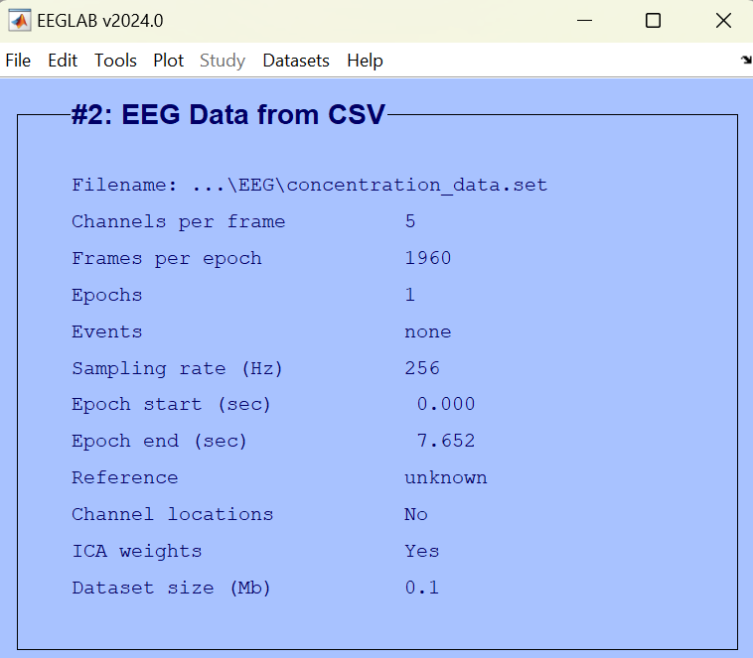
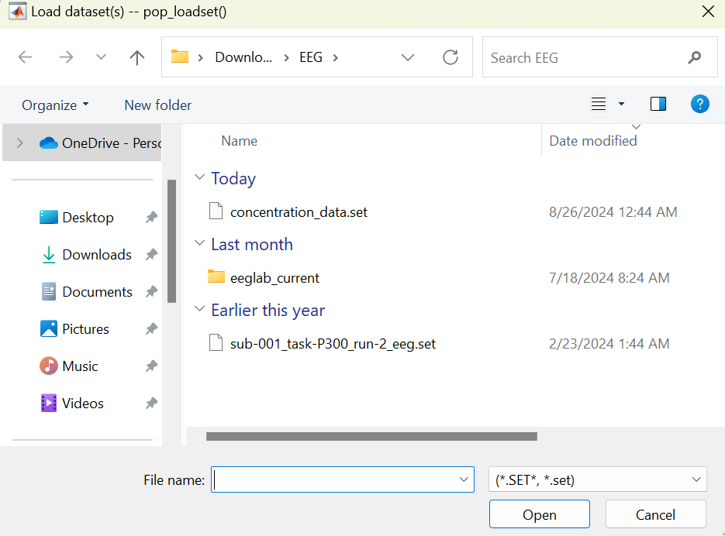
After EEGLAB loads the dataset, the main EEGLAB window shows relevant information about it – its number of channels, sampling rate, etc.
Load the sample EEGLAB dataset
1

Slide 25
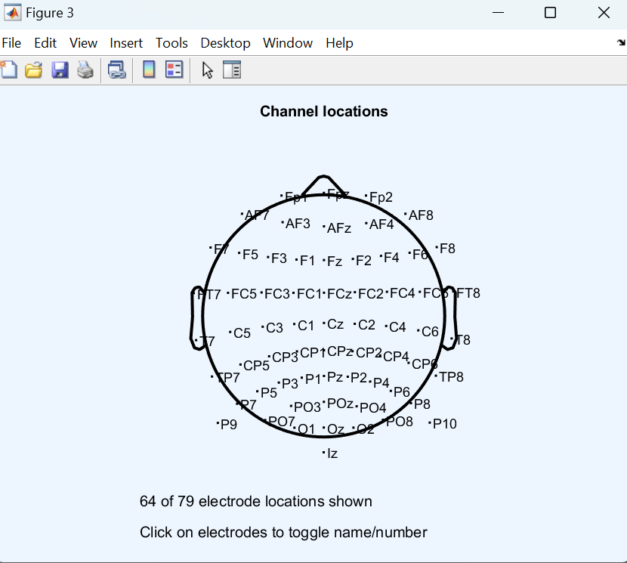
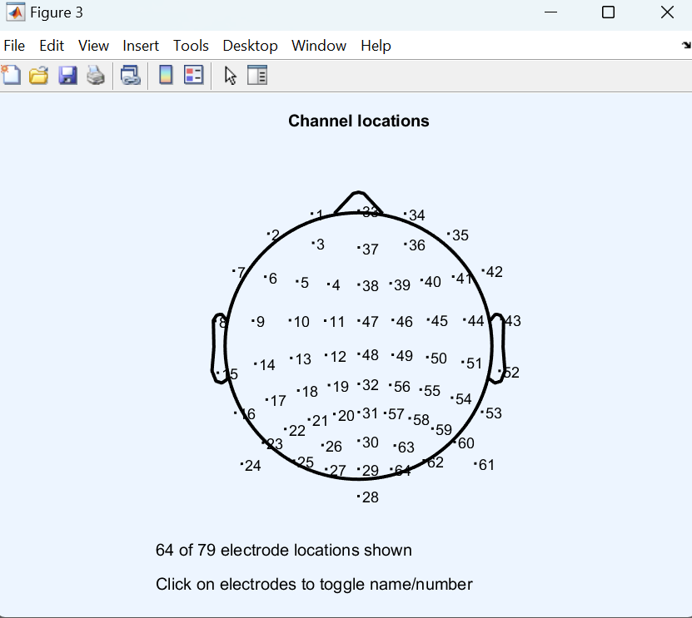
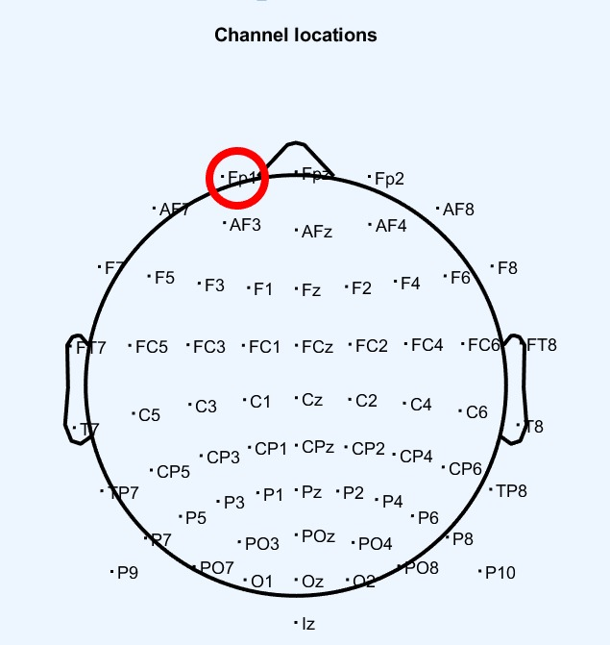

CHANNEL LOCATION
BY NAME:
CHANNEL LOCATION
BY NUMBER:

Slide 26


EEG Analysis
In the tutorial dataset, the EEG.event structure fields type, position, and latency are specified for each of the events marked in the dataset.
Used for detecting brainwave patterns, cognitive states,
Y-axis shows power (log scale) of brain activity;
X-axis shows frequency (2-25 Hz).

Slide 27


AI AND MACHINE LEARNING:-
Working with Python in Google Colab is a great choice for AI and machine learning projects, especially when processing EEG data
EEG data from 10 college students who watched two sets of MOOC video clips. The EEG data was recorded using a single-channel MindSet, measuring frontal lobe activity, with electrodes placed on the forehead and ears.

Slide 28


Start Machine Learning
An environment for a machine learning project, which involves classifying EEG data into different categories based on brainwave frequencies: alpha, beta, and gamma.
Different Libraries:-

Slide 29


Each Student Status:
summary table of unique value counts for different variables in your EEG dataset.
DATA READ:
12811 rows × 15 columns

Slide 30

Each Student Status:
summary table of unique value counts for different variables in your EEG dataset.
Histogram
The x-axis represents the count of unique values within each EEG feature, and the y-axis represents the frequency of EEG features within those unique value ranges.

Slide 31


count: The number of non-missing values in each column.
mean: The average of the values.
std: The standard deviation, a measure of the dispersion of the dataset.
min: The smallest value.
25%: The 25th percentile (first quartile), where 25% of the data points are below this value.
50%: The 50th percentile (median), where half of the data is below this value.
75%: The 75th percentile (third quartile), where 75% of the data points are below this value.
max: The largest value.
This is a good sign for data quality, as it means you can proceed with analysis without needing to handle missing data.

Slide 32



Clean Dataset
After cleaning, the data has 11388 rows and 12 columns

Slide 33


Normalization typically involves adjusting the values of numeric columns in the dataset to a common scale, often without distorting differences in the ranges of values.

Slide 34

Correlation matrix visualized as a heatmap. This matrix provides the correlation coefficients between different variables in your dataset, which indicate the strength and direction of the linear relationship between the pairs of variables

Slide 35


DATA Training:-
From training a machine learning model, specifically an LSTM (Long Short-Term Memory) neural network.

Slide 36



DATA TESTING:
The blue line represents the accuracy of the model on the training set.
The orange line represents the accuracy on the validation set. T

Slide 37


CONCLUSION
The "Enhancing Student Performance Through EEG-AI Based Classroom Device" project marks a significant step towards integrating advanced technology in education. By leveraging EEG sensors and machine learning, this device promises to revolutionize how educators understand and respond to students' cognitive states, particularly in enhancing engagement and personalizing learning experiences.
RECOMANDATIONS
Continued Research: Further studies on long-term impacts of EEG monitoring in educational settings.
User Experience Improvement: Focus on making the device more comfortable and user-friendly for prolonged use.
Expand Data Analysis: Explore more algorithms for comprehensive cognitive state analysis.
Collaboration: Engage with educators and psychologists to refine the device's applicability and effectiveness.

Slide 38
REFERENCES
Qin Y, Zhang Y, Zhang Y, Liu S, Guo X. Application and Development of EEG Acquisition and Feedback Technology: A Review. Biosensors (Basel). 2023
Ali A, Afridi R, Soomro TA, Khan SA, Khan MYA, Chowdhry BS. A Single-Channel Wireless EEG Headset Enabled Neural Activities Analysis for Mental Healthcare Applications. Wirel Pers Commun. 2022
Lim S, Yeo M, Yoon G. Comparison between Concentration and Immersion Based on EEG Analysis. Sensors (Basel). 2019
Liu NH, Chiang CY, Chu HC. Recognizing the degree of human attention using EEG signals from mobile sensors. Sensors (Basel). 2013
Thank You ☺

