Slide 1
TIMERS in STM32
Mohamed Saied

Slide 2
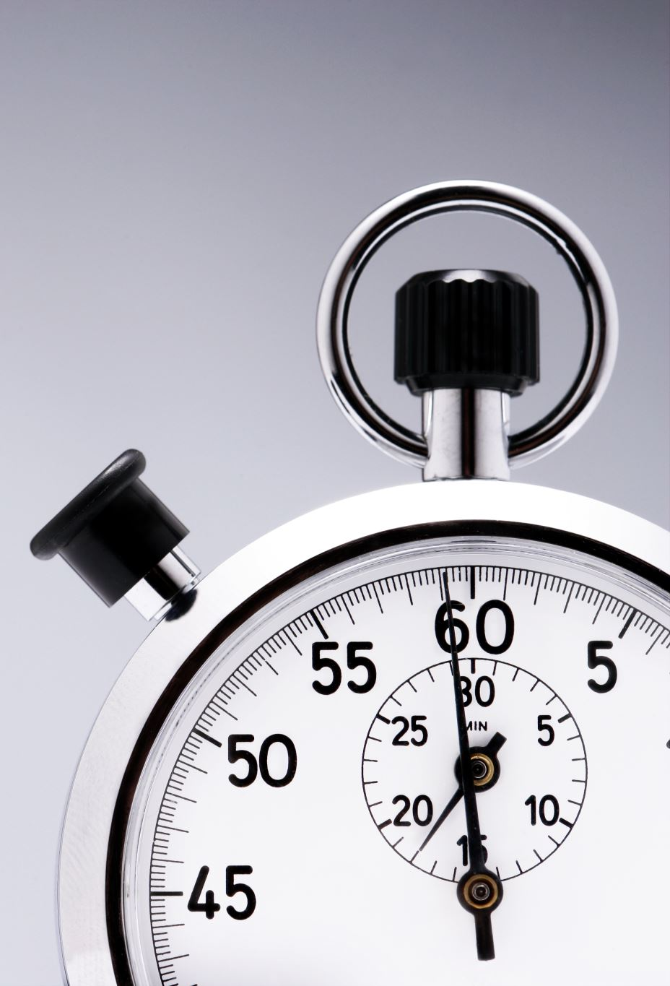
TIMERS
There are 3 types of Timers in stm32f10x Series
Advanced Timers TIM1 and TIM8
General Purpose Timers from TIM2 to TIM5 and TIM9 to TIM14
Basic Timers from TIM6 to TIM7

Slide 3
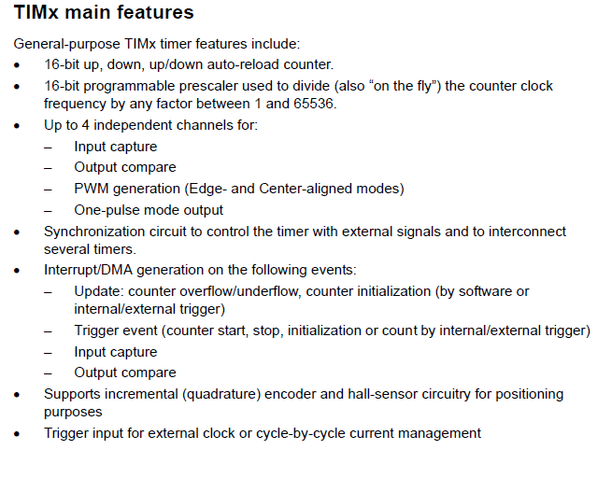

Slide 4
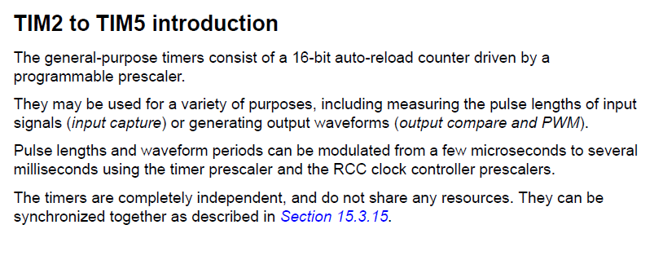

Slide 5
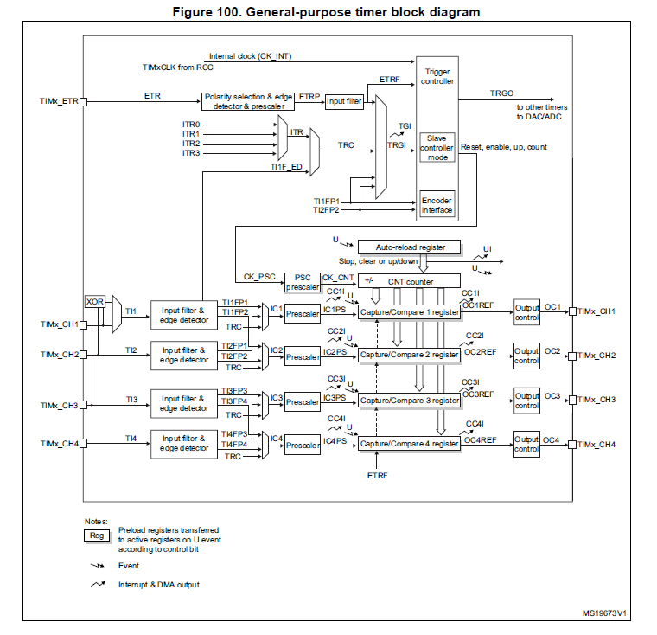

Slide 6
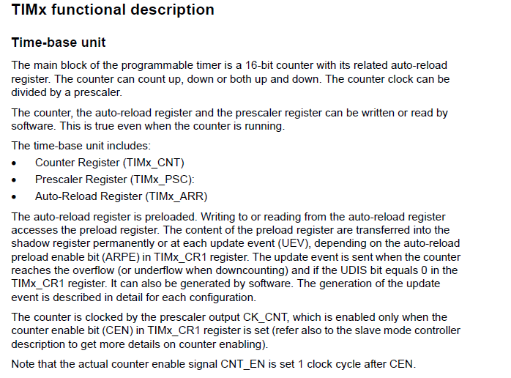

Slide 7
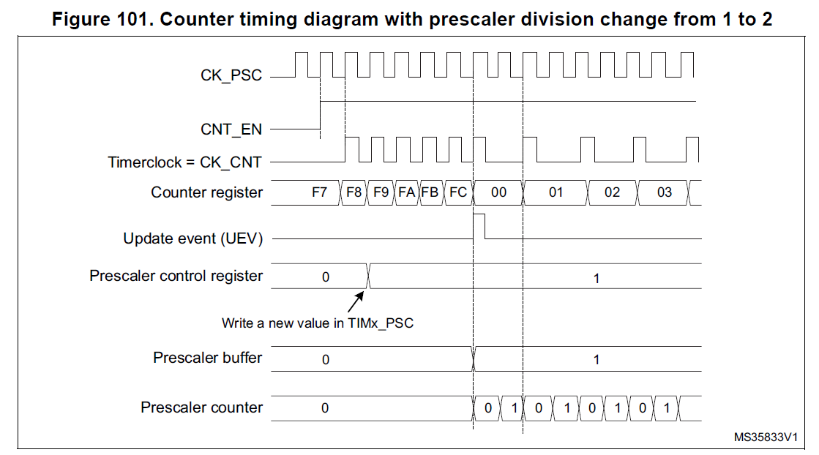

Slide 8
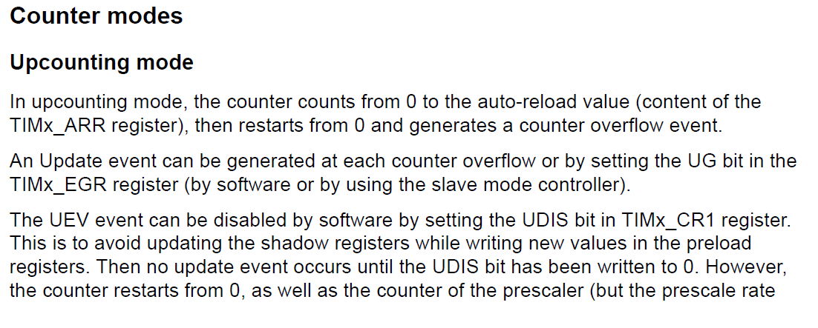
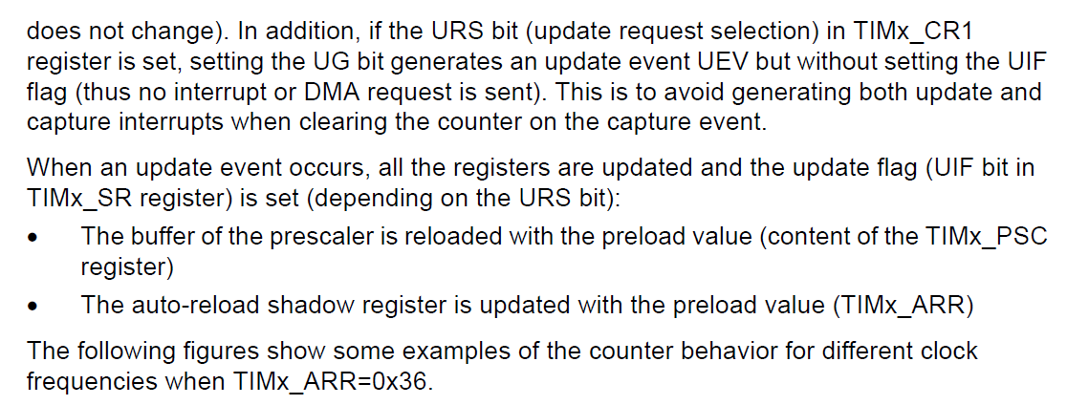

Slide 9
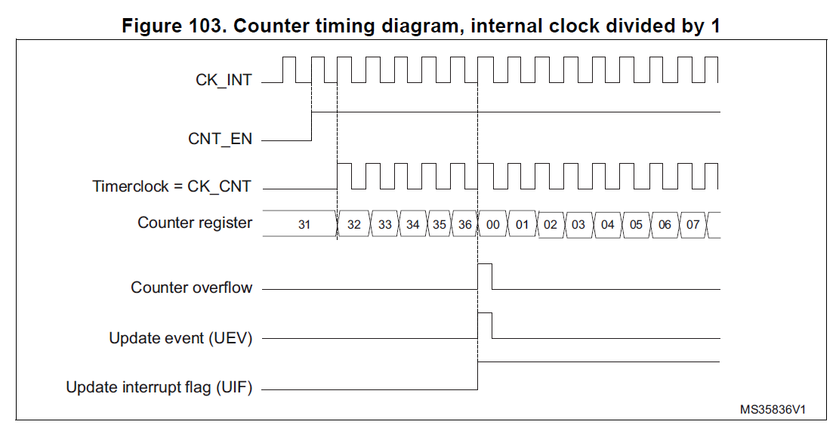

Slide 10
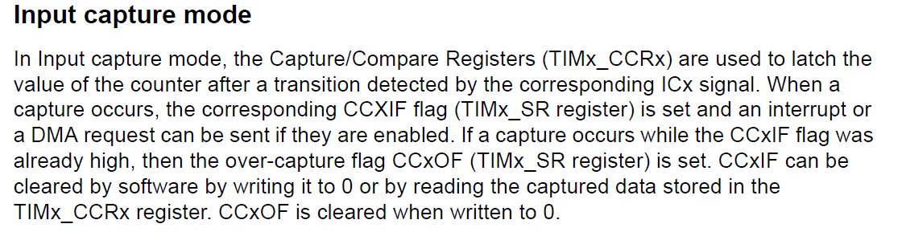
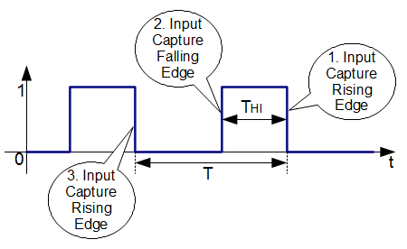

Slide 11
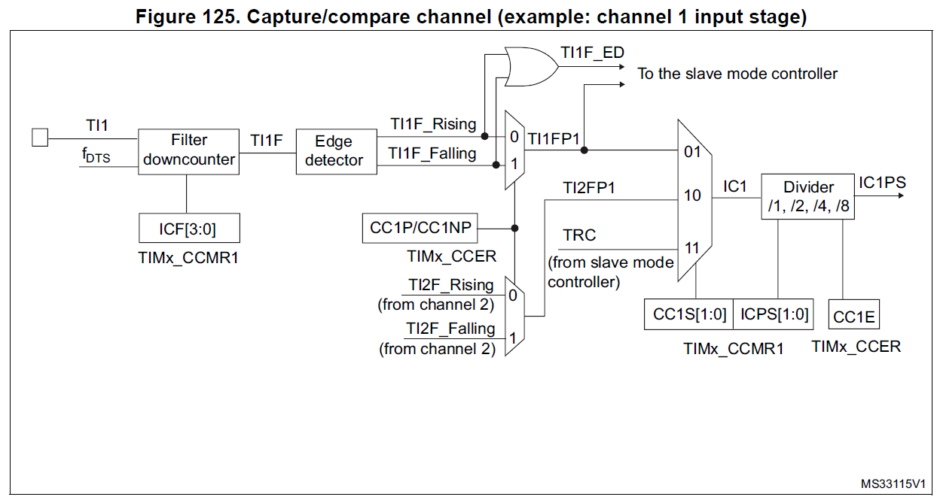

Slide 12
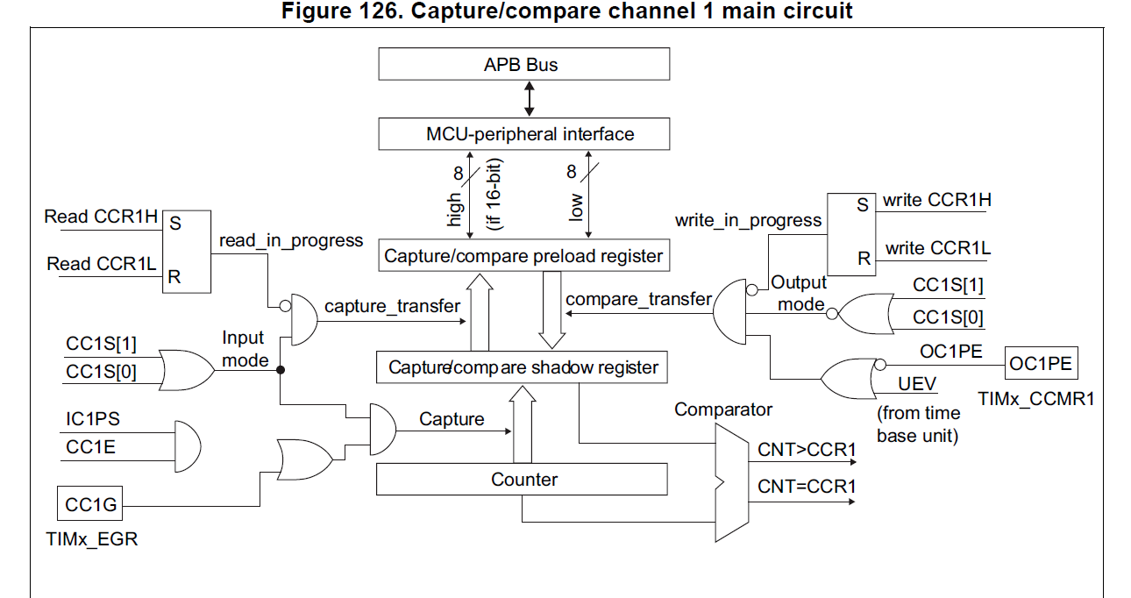

Slide 13
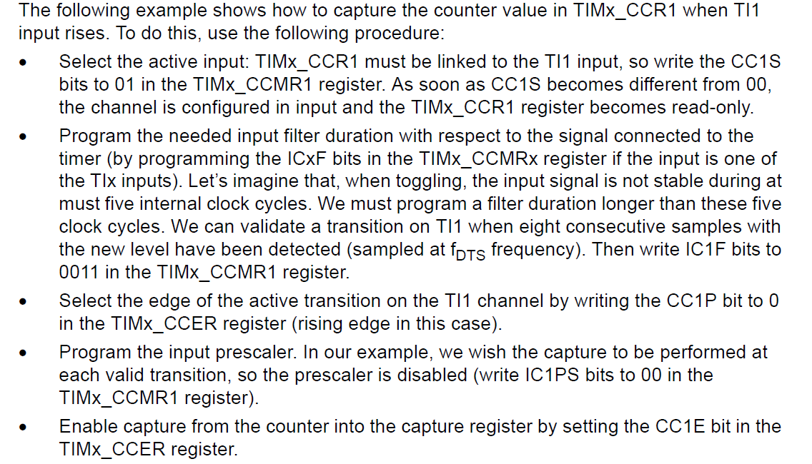

Slide 14
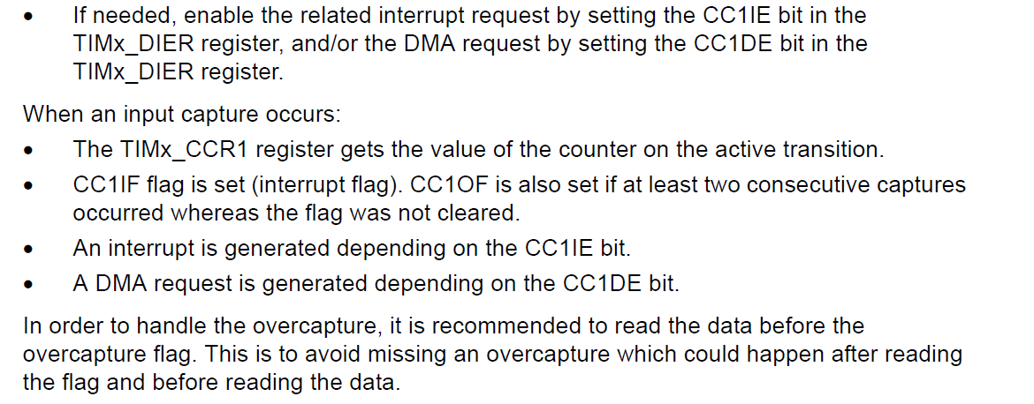

Slide 15
PWM
PWM (Pulse-Width Modulation) is mostly used for controlling the speed of DC motor or changing the brightness of LED or even mixing colors for RGB LED. In this part, I’m going to show you how to initialize the PWM function to control the brightness of the Green LED on the STM32 Blue pill kit.
Digital control is used to create a square wave, a signal switched between on and off. This on-off pattern can simulate voltages in between full on (3.3 Volts) and off (0 Volts) by changing the portion of the time the signal spends on versus the time that the signal spends off. The duration of “on time” is called the pulse width. So basically, when talking about PWM, we need to know immediately of 2 elements: Pulse width and Period. From these 2 elements, we can determine the Duty Cycle (%) of PWM signal. Low duty cycle will result in low brightness (LED) or low speed (DC motor) and vice versa.

Slide 16
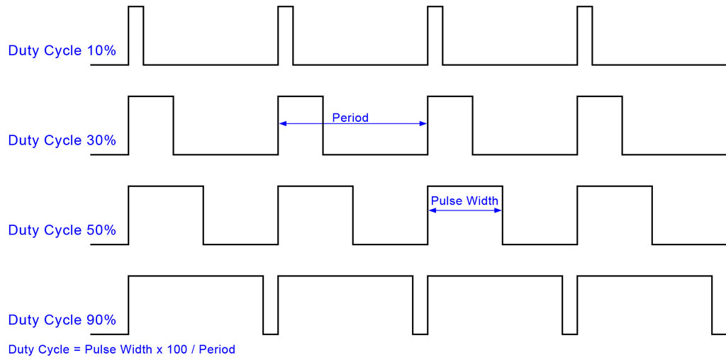

Slide 17
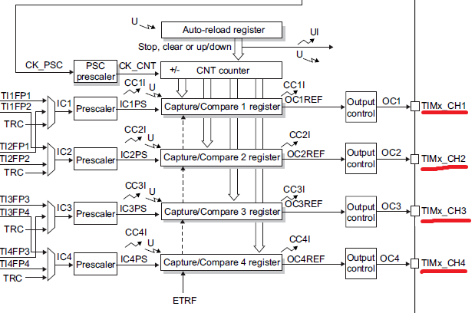
Configure PWM

Slide 18
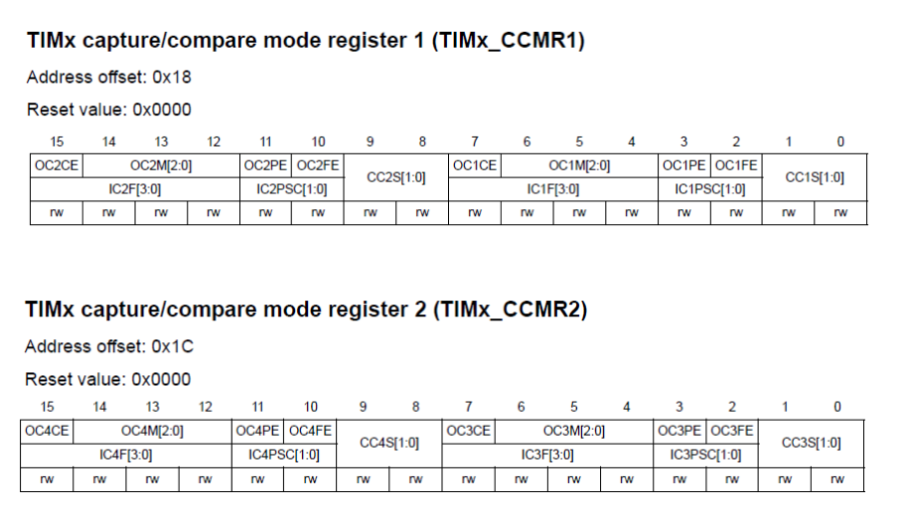

Slide 19
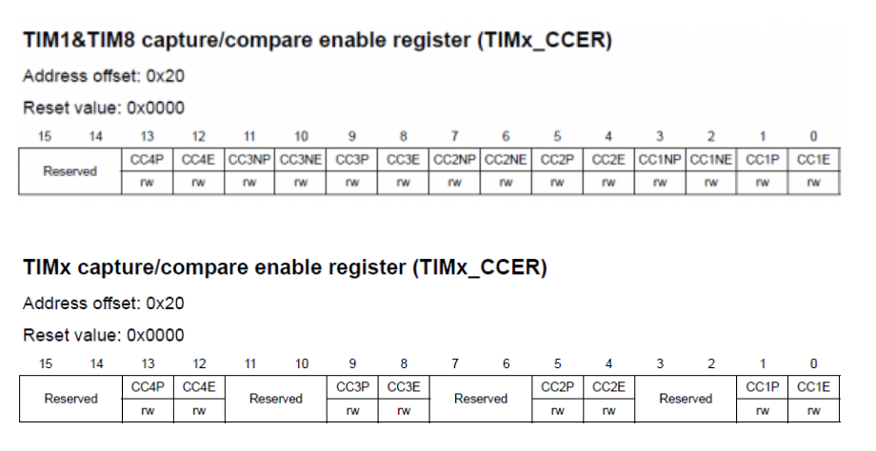

Slide 20
PWM Registers
For every timer except the basic ones, there are four capture/compare registers TIMx_CCRx which correspond to four capture/compare channels. Changing the values in them during compare mode allows us to change PWM width or duty cycle. The value that will be set in the TIMx_ARR register will correspond to maximum PWM count or 100% duty cycle. PWM generation is accomplished by comparing the values in TIMx_CCRxregisters and TIMx_CNT register. Note that complementary channels have no such registers and that’s because they output complementary signals of their respective ordinary channels.

Slide 21
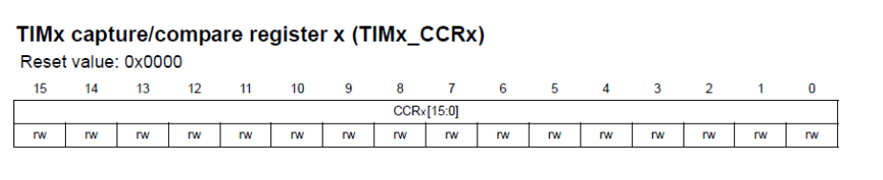
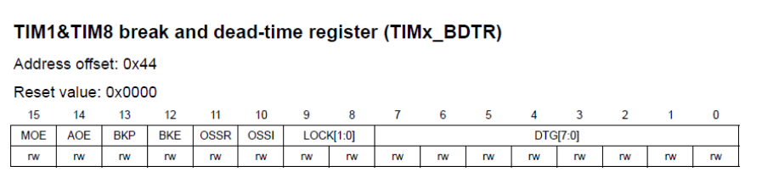
PWM in Advanced Timers
The registers I mentioned so far are common to all timers with capture/compare functionalities. Using them will allow us to accomplish common PWM-related tasks. However there is one more register that we will be needing to handle for more advanced tasks and so it is available only in advanced timers. This register is called Timer Brake and Dead Time Register, TIMx_BDTR. It is important to note that when using advanced timers for PWM generation the MOE bit should be set or else there will be no PWM output.

Slide 22
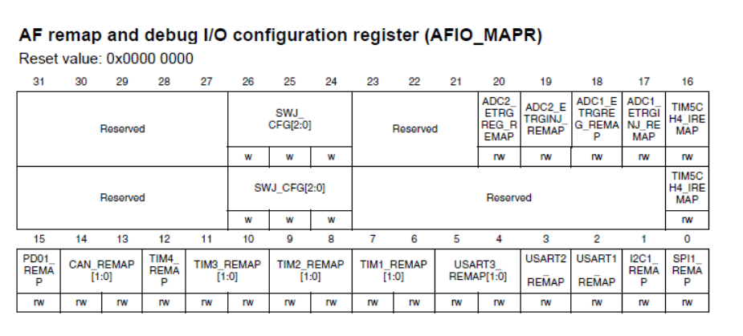
Alternate Function Enable
Since PWM generation and input capture are alternative functions of a GPIO pin, we need to enable and use AFIO registers as well for alternative functions of those pins. Provided it is supported, with AFIO registers we can remap/reposition default PWM/input capture pins to some other pins. AFIO_MAPR and AFIO_MAPR2 registers are used for such purposes.

Slide 23
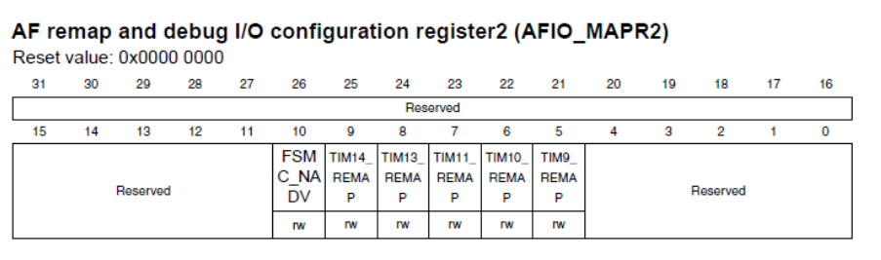
AFIO Cont’

Slide 24
Calculating the Timer
As stated before, a period of 20ms and a duty cycle between 1ms and 2ms is needed.
First thing to do is to determine what 20ms is in Hz. This is calculated by the formula:
To be able to adjust the duty cycle more fine grained we are going to use us instead of ms. So 20ms become 20000us, 1ms is 1000us and 2ms is then 2000ms.
First we prescale the 72Mhz frequency by 72:
This increases out count register CNT by 1 000 000 each second. To calculate what is the correct value for the ARR register (which defines the period), we divide the result of the prescaled frequency by the intended frequency for our period:
1000 ms / p1 ms = p2 Hz
For our 20ms period, it is:
1000 ms/ 20 ms = 50 Hz
72 000 000 Hz / 72 = 1 000 000 Hz (or 1 Mhz)
Now every time the CNT register is increased by one, this is the equivalent to 1us. The duty cycle now could by set easily. E.g. for a 1.5ms duty cycle we set the CCRx register to 1500.
1 000 000 Hz / 50 Hz = 20 000

Slide 25
Setting a ‘Counter’ Interrupt
With the peripherals enabled and the NVIC hardware interrupt enabled, it is fairly simple to set a timer interrupt to trigger every N milliseconds using the timer’s counter. You’ll only need to use 6 timer registers:
CR1: ‘Control Register 1’ – this register is used to enable and disable the peripheral.
CNT: ‘Control Register 2’ – this register hold’s the timer’s current counter value. It counts up from 0 once the timer is started.
PSC: ‘Prescaler Register’ – this register will hold the timer’s prescaler. A prescaler value of N will tick the timer’s counter register up by one every N+1 clock cycles.
ARR: ‘Autoreload Register’ – the autoreload value is the ‘period’ of the timer. An autoreload value of N will cause the timer to trigger an update event every time the CNT register counts up to N.
EGR: ‘Event Generation Register’ – Setting the UG bit in this registers resets all of the timer’s counters and tells it to use the currently-set prescaler/autoreload values.
DIER: ‘DMA/Interrupt Enable Register’ – Setting the UIE bit in this register sets the timer to trigger a hardware interrupt when an update event occurs. Usually, that happens when the ‘Counter’ register matches the ‘Autoreload’ value.
SR: ‘Status Register’ – The UIF flag is set in this register when a timer’s hardware interrupt triggers, and must be cleared before another one can occur.

Slide 26
Setup Timer Cont’
We’ll set the ‘Prescaler’ so that the timer counts up every millisecond, and then set the ‘Autoreload’ value to however many milliseconds the timer should measure. Then we’ll set the EGR_UG bit to apply those settings, the DIER_UIE bit to enable an interrupt, and start the timer:
TIMx->PSC = core_clock_hz / 1000;
TIMx->ARR = ms;
TIMx->EGR |= TIM_EGR_UG;
TIMx->CR1 |=TIM_CR1_CEN;
Send an update event to reset the timer and apply settings.
TIMx->DIER |= TIM_DIER_UIE;

Slide 27
Stop Timer
TIMx->CR1 &= ~(TIM_CR1_CEN);
Turn off the timer
TIMx->SR &= ~(TIM_SR_UIF);
Clear the 'pending update interrupt' flag, just in case.

Slide 28
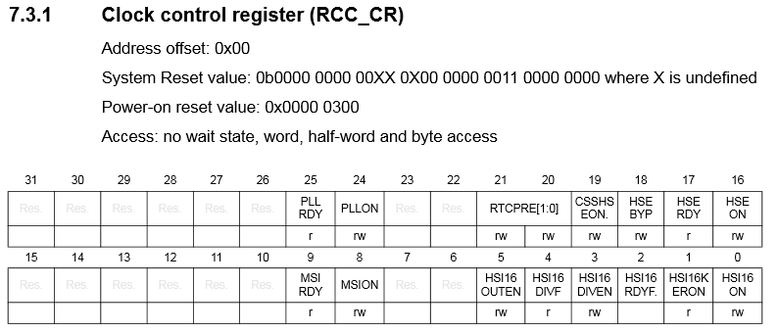
Clock Configuration

Slide 29
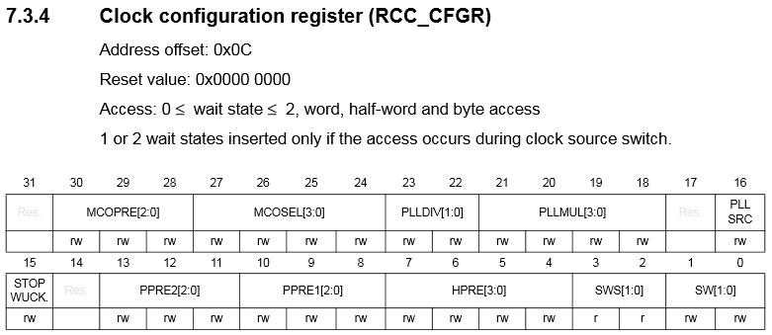
Clock Configuration Cont’

Slide 30
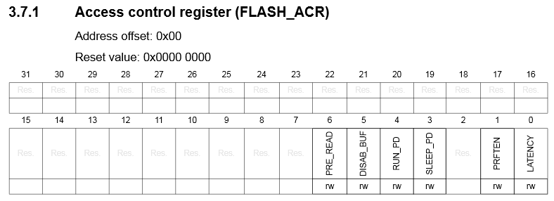
Access Flash
chip can reliably read data from it at a maximum speed of about 24MHz. What that means is that if our chip will be running faster than 24MHz, we need to tell it to slow down for one or more ‘wait states’ when it needs to retrieve data from memory.

Slide 31
Frequency Multiplication and Division
To get a specific frequency out of the Phase-Locked Loop peripheral, we need to tell it a few things about the signal that we want to generate:
1) What clock source should the PLL use for its base signal? 2) How much should the PLL multiply that signal’s frequency by? 3) (Sometimes optional) How much should the PLL divide that signal’s frequency by?

Slide 32
Which clock source?
HSI / 2: The PLL’s core clock source is set to the HSI oscillator divided by 2, which is 4MHz. With this option selected, you don’t need to select a specific division factor.
HSI / PREDIV: Similar to the HSI / 2 option, but the HSI signal is divided by the value in the PREDIV bits of RCC_CFGR
HSE / PREDIV: The “HSE” (High-Speed External) oscillator is used as the PLL’s base signal, after being divided by the PREDIV bits of RCC_CFGR
HSI/ PREDIV: Some of the more advanced STM32F103 chips have a 8MHz HSI oscillator built in, and that can be selected as a core source for the PLL..

