Slide 1
Analog to Digital Converter
Mohamed Saied

Slide 2
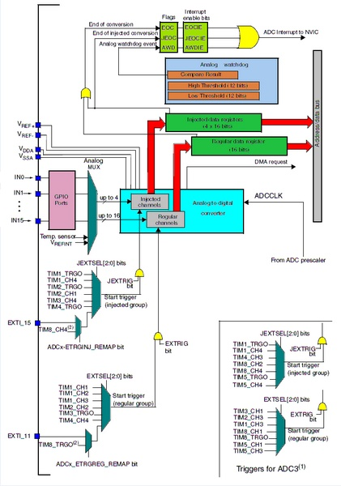

Slide 3
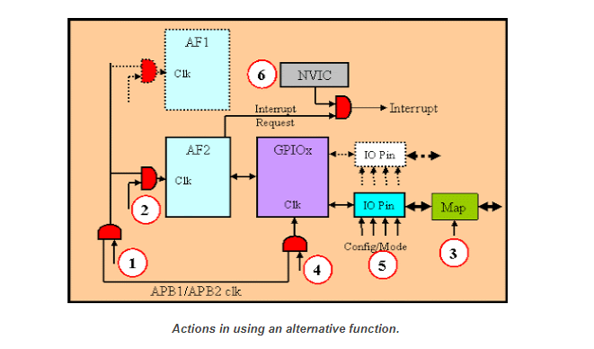
Alternate Function

Slide 4
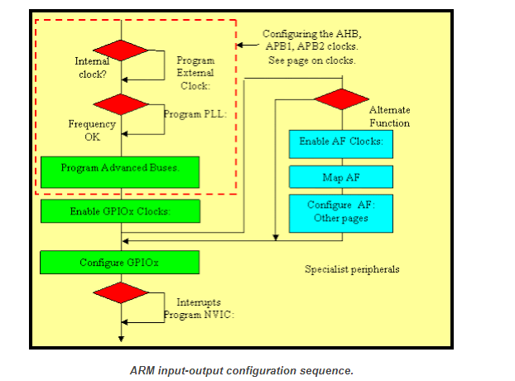
Configuration

Slide 5
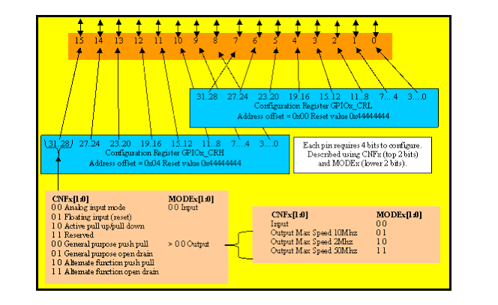
Pin Configuration

Slide 6
ADC Modes
Independent mode. It is just as the typical ADC use. Each ADC unit is operating on its own and without any mutual dependency.
Dual mode. In this mode two ADCs are converted simultaneously or with some (literally negligible) delay. Two ADC units mutually working together as if they are a single unit.

Slide 7
ADC Triggers
To start A/D conversion, an ADC unit needs to be stimulated with a trigger signal:
Software Trigger. A/D conversion as per demand from coded program.
Hardware Trigger. A/D conversion as per hardware events like external interrupts or timer events.

Slide 8

Regular Group
A/D conversions are done in groups. Group members are ADC channels and need not to be multiple channels. A group may consist of only one channel. Within these groups ADC channels are converted on a scheduled round-robin basis. The good stuff is the fact that unlike most micros we can program which channels belong in a group and with which sequence the A/D conversion is commenced. We can also set the sampling time for each channel separately. ADC groups can be categorized as follows:
Regular Group. A given fixed group of ADC channels are regularly converted. Up to 16 channels can be present in a regular group. A regular group is similar to a code

Slide 9
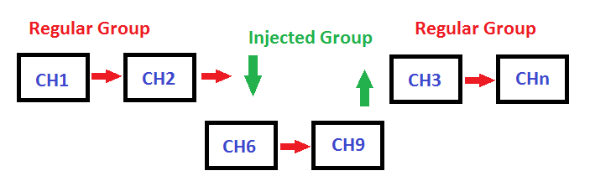
Injected Group
This group can interrupt a regular group conversion as it has a higher priority over the former. Up to 4 channels can be present in an injected group. When an injected group is present or injected over a regular group, all regular group conversions are halted temporarily. The injected group is processed first and then the regular groups are resumed. An injected group is analogous to having an interrupt over a running code. Alone without a regular group present, an injected group will behave like a regular group.

Slide 10
ADC Clock
Shown below is the STM32F10x clock tree. Notice some areas are highlighted. Check them out because these are related to the ADC block.
We can clearly see that the ADC peripheral is connected to the APB2 peripheral bus. APB2 can run at 72MHz speed which is by the way the maximum operating speed for STM32F10x series MCUs. ST recommends that the ADC be feed with no more than a 14MHz clock. Thus we should make sure that ADC clock is in the range of 600 kHz to 14MHz. Since it takes about 14 cycles to process ADC data the maximum possible number of conversions per second is one million. I Pay attention particularly to APB1, APB2 and PCLK2 clocks when setting clock for the ADC block.
Wrong settings will lead to unpredictable/erratic behaviours.

Slide 11
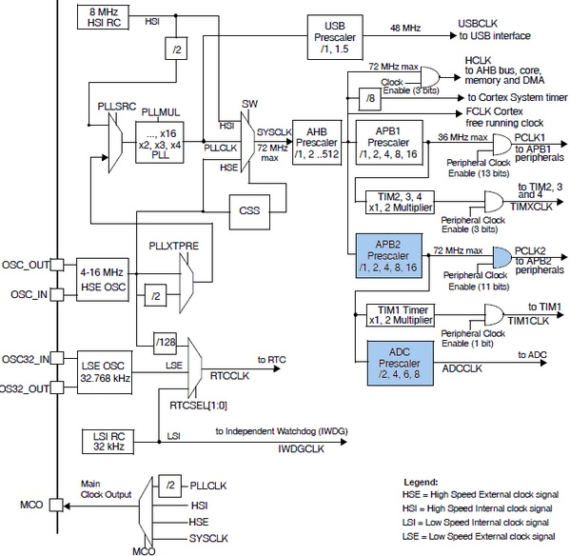

Slide 12
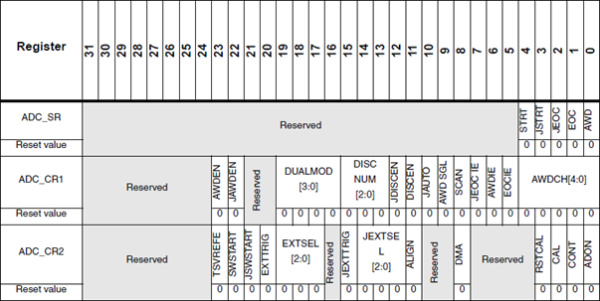
ADC Register Map

Slide 13
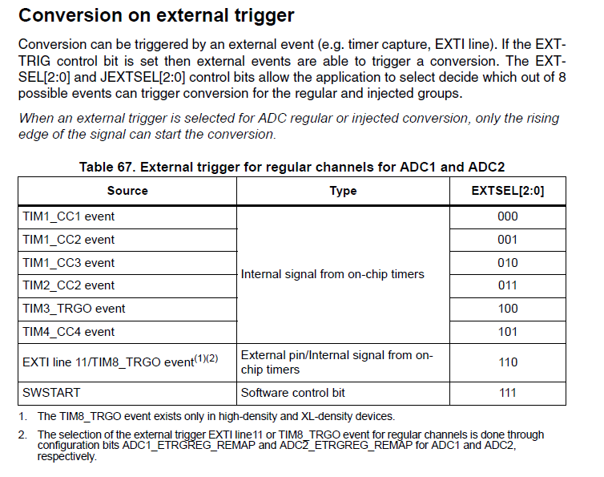

Slide 14
ADC Registers
There are several registers associated with each ADC unit. At first you may feel like getting lost in an ocean of 32-bit registers. However things aren’t so. Of these there are two ADC control registers called ADC_CR1 and ADC_CR2 that set ADC properties and mode of operation. There’s a status register, ADC_SR which flags important ADC events like end of a conversion, etc. These are the most important ones.

Slide 15
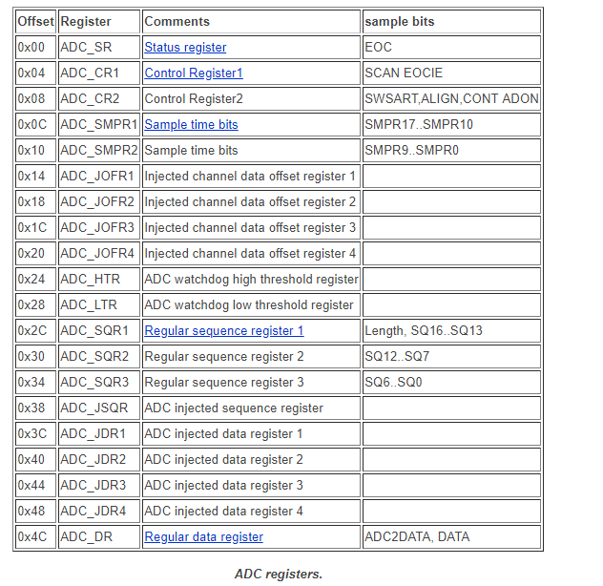
Registers

Slide 16
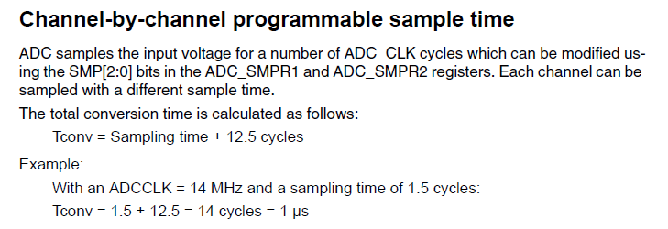

Slide 17
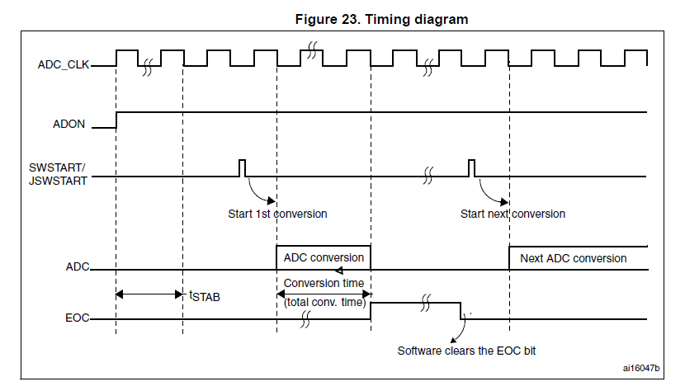
Timing Diagram

Slide 18
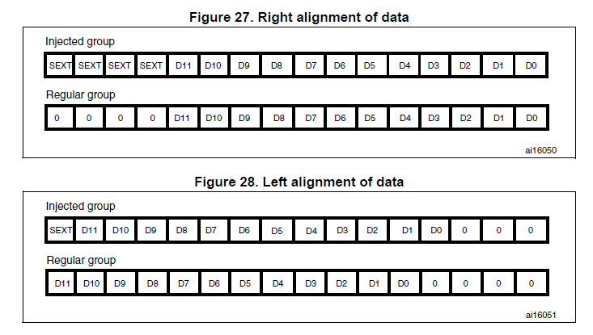
Data Alignment

Slide 19
Initialize Procedure
Enable Clock for ADC 1 & Alternate
MODE:CFG Input=00 : Analog=00
Select the required Channel ADC12_IN0
Sampling Time Selection ADC12_IN0 = PA0 @ 1.5 cycles
select SWSTART as trigger
enable external trigger
Right Alignment
ADC on[ Enable]
Reset calibration
wait until reset finished
start calibration
wait until calibration finished

Slide 20
Read ADC
start SW conversion
Wait until End Of Conversion [EOC] flag to be set
Read Data register
Reset EOC Flag

Slide 21
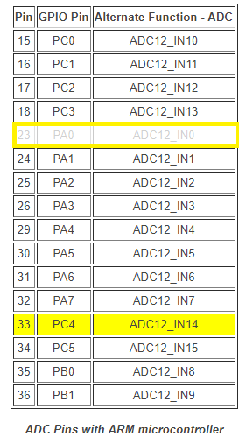
ADC Pins
Use PA0 in the example then try on PC4

