Slide 1

Getting Started with STM32
Mohamed Said

Slide 2
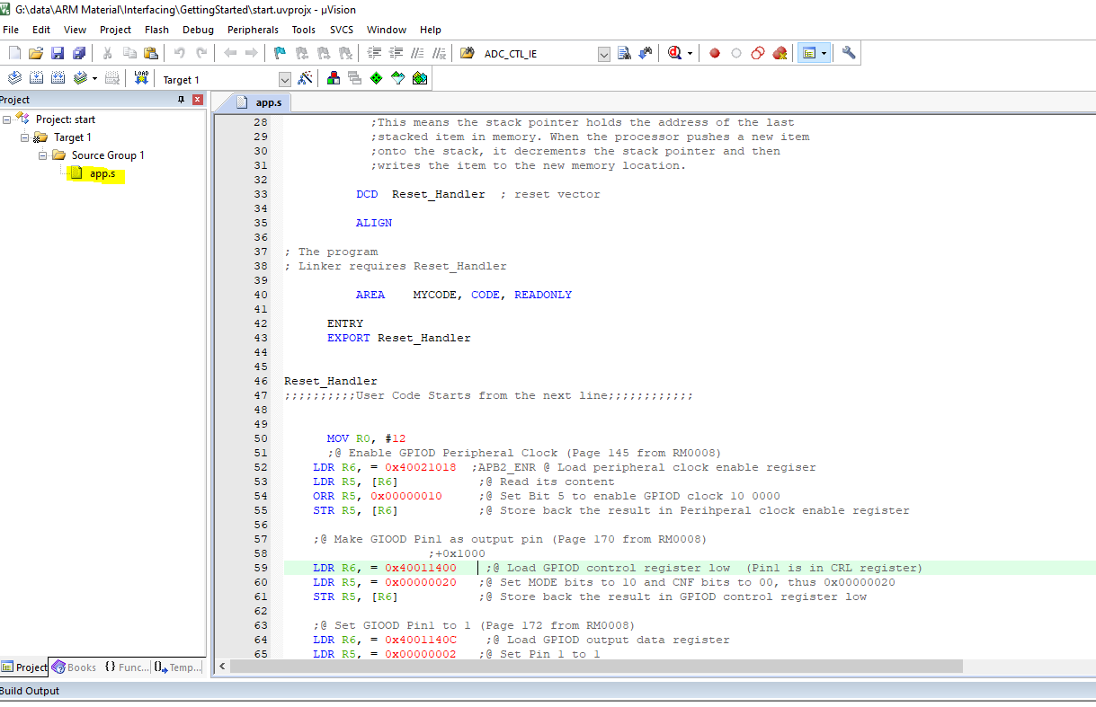
Getting Started with Keil

Slide 3
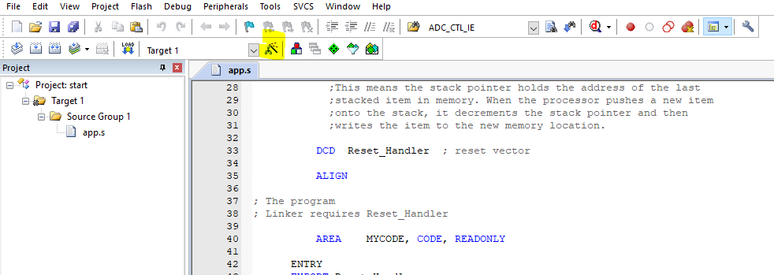
Options
Click on the Highlighted icon to go to options for this project

Slide 4
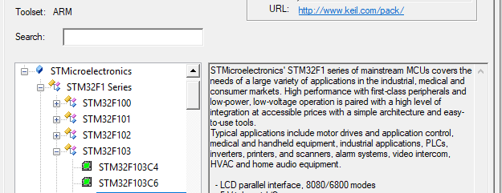
Select the desired Microcontroller
STM32F103C8 is used in the blue pill kit which is based on ARM Cortex-M3

Slide 5
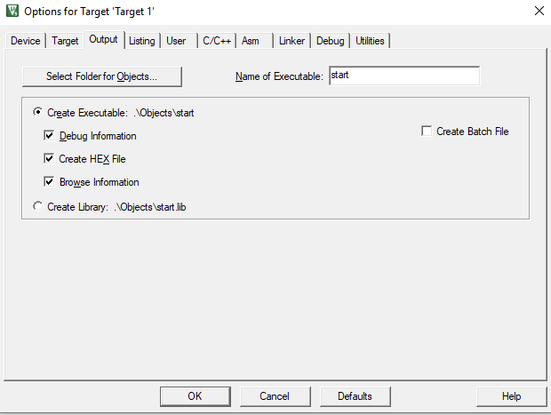
Options (Cont’)
Select Create HEX file from the output menu

Slide 6
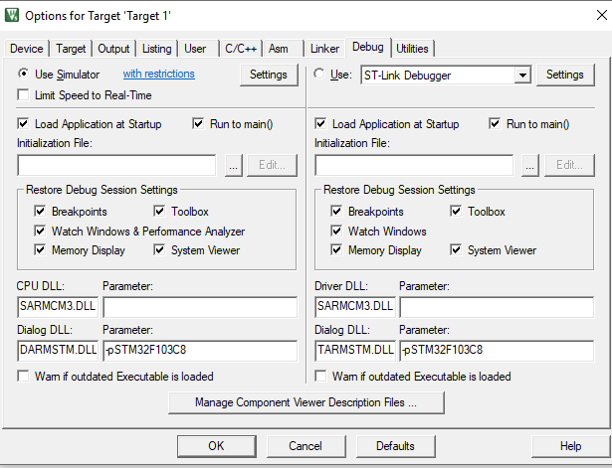
Select Debugging Type
You got two options for debugging
1) using Simulator
2) Using Hardware Debugger(Emulator)

Slide 7
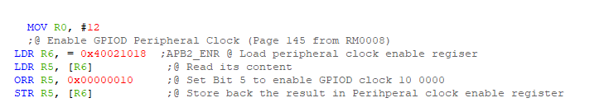
Getting Started with Assembly and GPIO
First we need to Enable Clock for the GPIO Peripheral
By loading the Address of APB2ENR and Set the Bit of Enabling GPIOD from APB2ENR (Advanced Peripheral Bus Enable Register)

Slide 8
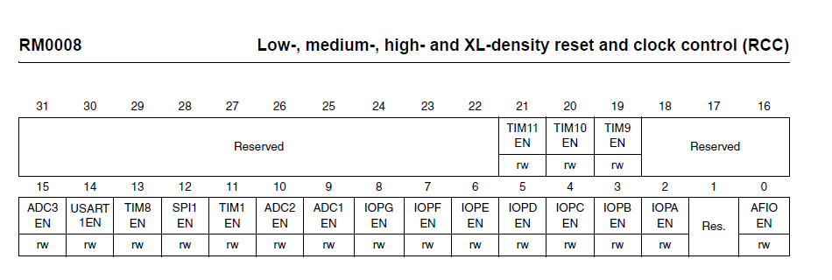
APB2ENR

Slide 9
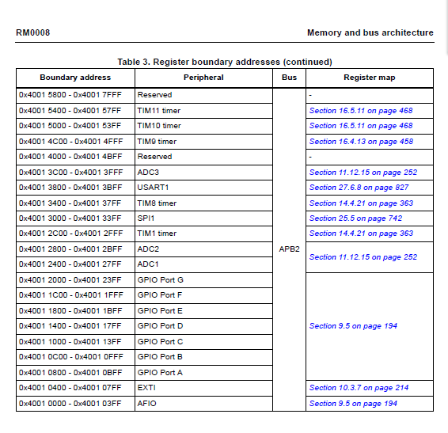
Address for GPIO’s
All the GPIO are placed in the Peripheral Area On APB2 Bus
Each GPIO has an Offeset which is added to the Address of APB
0x4001 is the address of APB2
GPIOD offset is 0x1400
So GPIOD_Base_address (0x4001+0x1400)

Slide 10

Configure GPIOD pins
Each GPIO has Two Configuration Registers Configuration Could be Input or Output
For each pin there are 4 bits for mode and Cfg , to decide input or output options

Slide 11
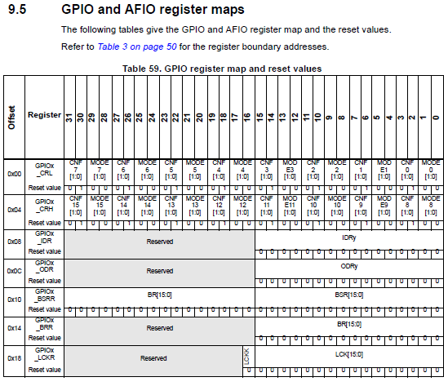
GPIO Registers
Each GPIO has 2 Registers for Configuration its Pins are Called GPIO Control Registers (Low and High) to config its 16 pins
For the first 8 pins (0 to 7) GPIO_CRL is selected and written
For the last 8 pins from 8 to 15
GPIO_CRH is written

Slide 12
GPIO Registers (Cont’)
For Output GPIO_ODR is Used
GPIO_IDR is used for Input
GPIO_BSRR for Bit Set Reset Register is used to output on a specific Pin

Slide 13
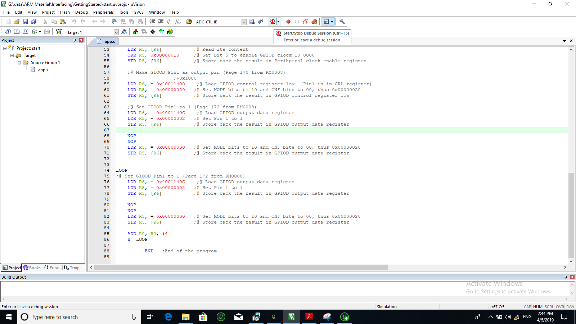
Using Keil Simulator
Start Debugging

Slide 14
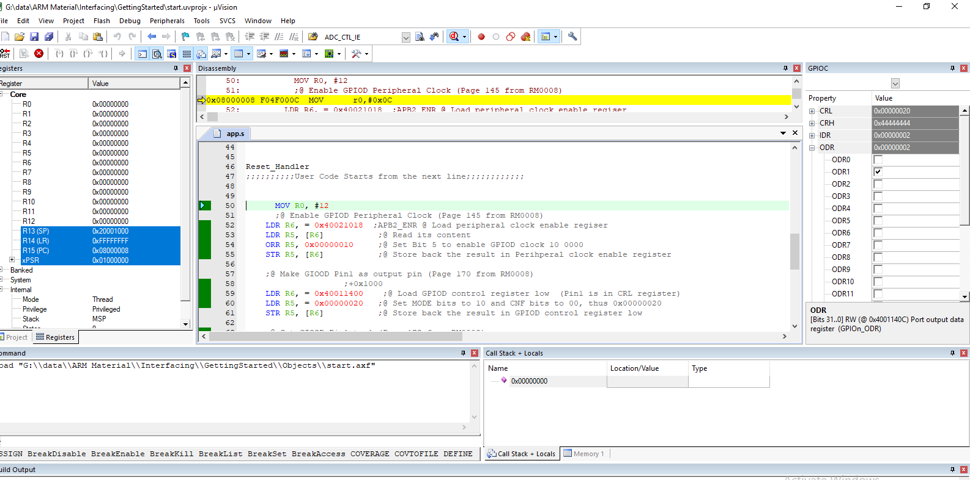
Simulator (Cont’)
From System Viewer Menu select the desired Peripheral to show the Output
Here is the simulation of GPIOC

Slide 15

Thank You

