Slide 1

GPIO
Mohamed Said

Slide 2
GPIO
GPIO stands for General Purpose Input Output
Input could be Analog Input or Digital input
Output could be Analog or Digital

Slide 3
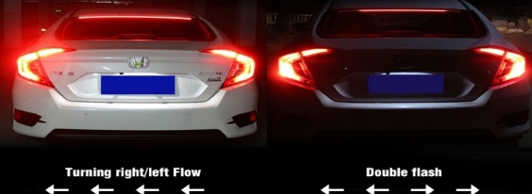
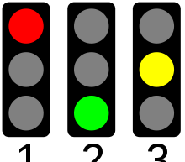
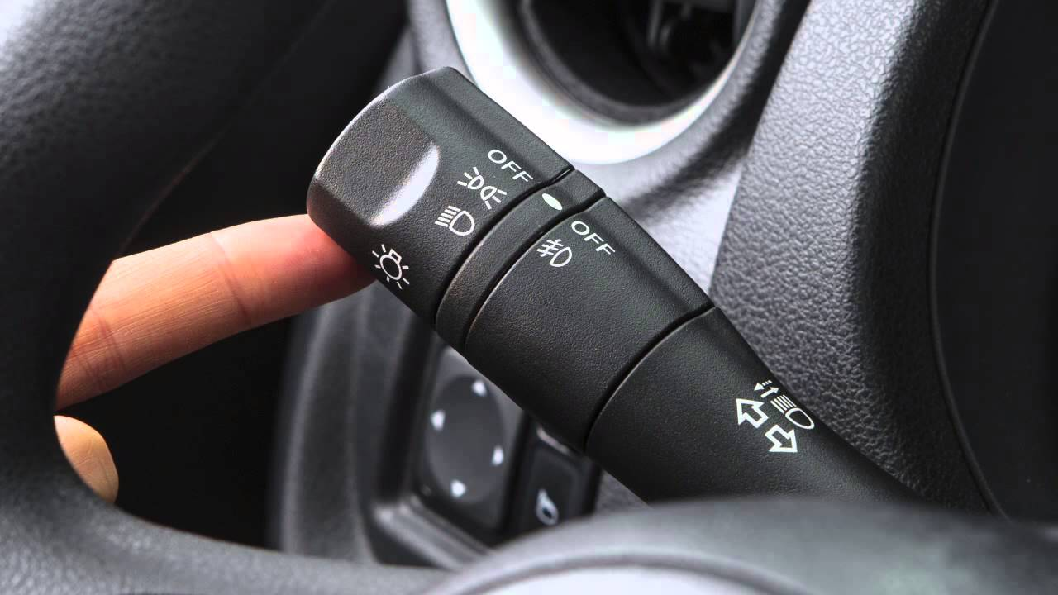
GPIO Examples
Traffic Lights

Slide 4
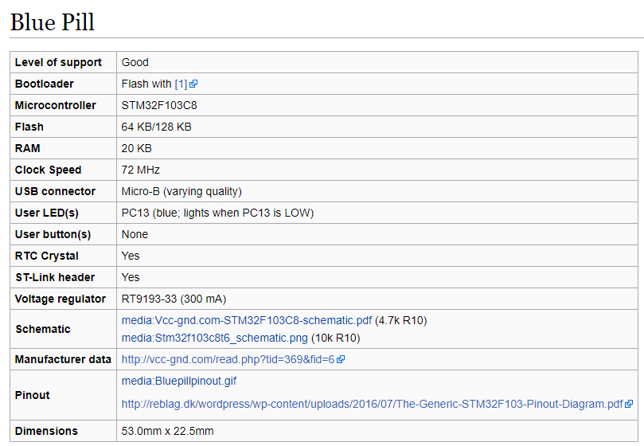
STM32 Blue Pill Features

Slide 5
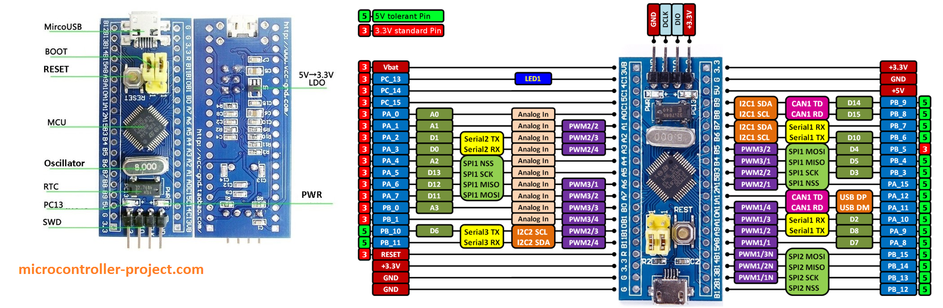
STM32 Blue Pill Pinout

Slide 6
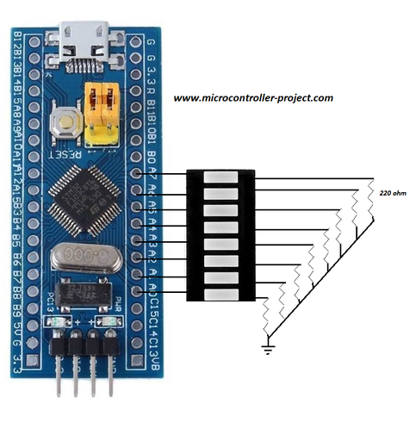
Stm32 LED Interfacing

Slide 7
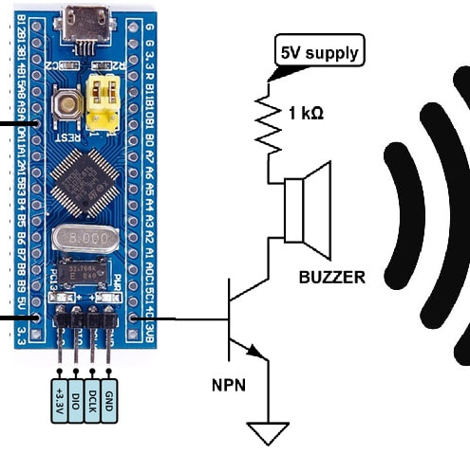
Stm32 Button and Buzzer Interfacing

Slide 8
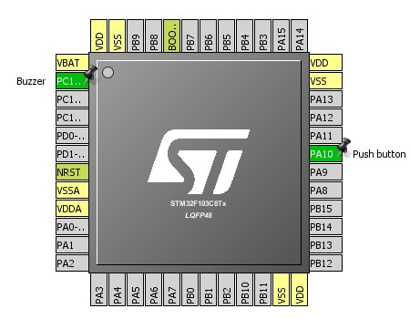
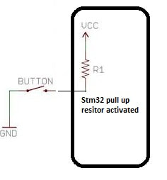
Stm32 Button Interface

Slide 9
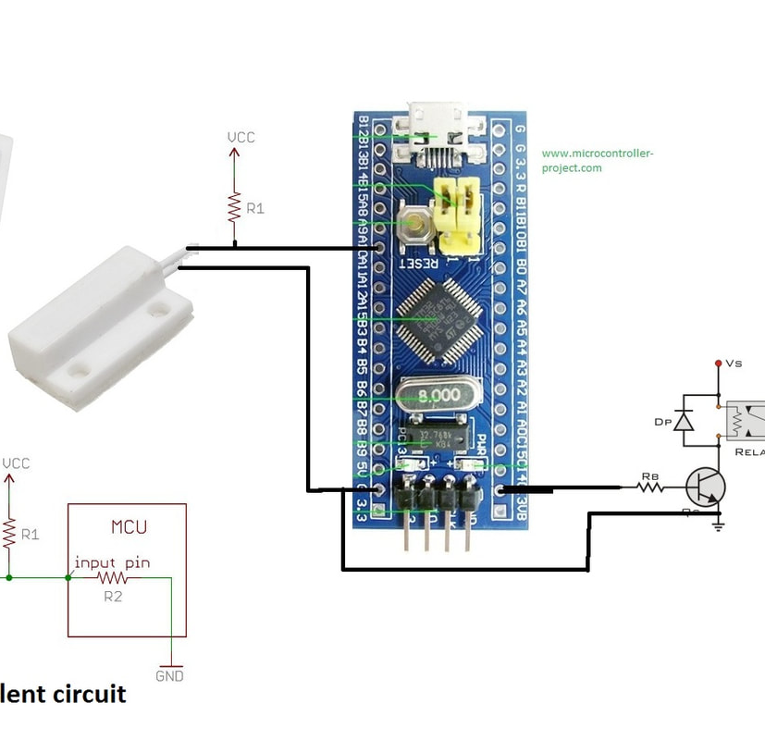
Door pin project
Mechanical Reed/Contact switch
Constructed from two pieces of magnet
If they are contacted it gives signal
Depends on the configuration of
Active high or active low
In this configuration its active Low

Slide 10
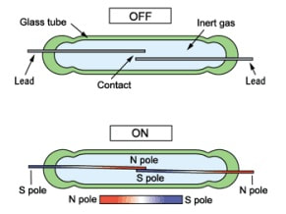
Reed Switch
Reed switch has two open leads. Leads are magnetizable and responds to external magnetic field when ever exposed to. Leads become charged and adopt the characteristics of magnet in present of magnetic field. One lead becomes north pole and the other becomes south pole. Leads attracts or repel each other when magnetic field is applied to them, depending on the configuration of the switch. Contact switch comes in two different polarities Normally open(NO) and Normally closed(NC). | Normally closed contact switch In normally closed configuration the leads are initially connected and circuit is closed. As soon we bring the magnet close to the switch the leads repel each other and circuit opens. Normally open contact switch A normally open contact switch is one in which the leads are open (Same like open circuit) in normal state. When a magnet is brought near the switch the leads make contact and circuit is closed.

Slide 11
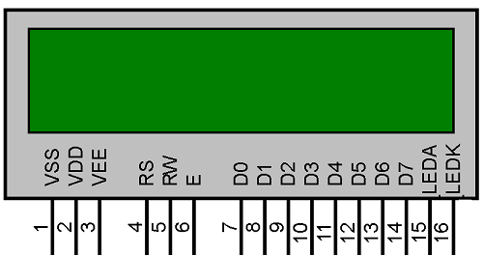
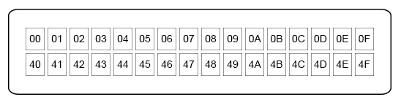
LCD
2 Lines 16 Characters LCD
8 bits mode or 4 bits mode

Slide 12
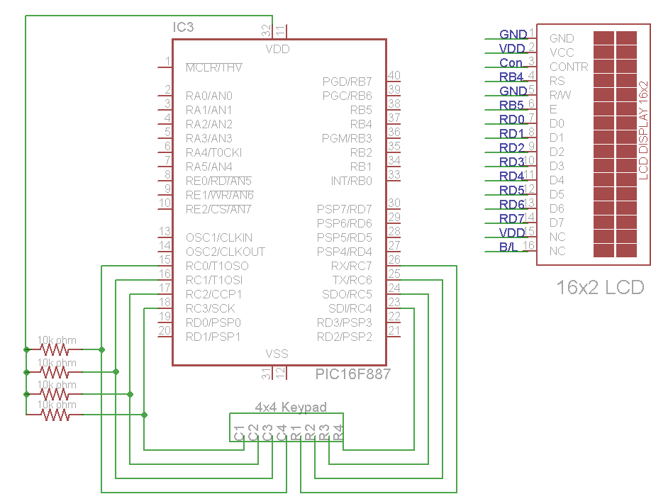
LCD Hardware

Slide 13
Pinout LCD
Pin No | Function | Name
1 | Ground (0V) | Ground
2 | Supply voltage; 5V (4.7V – 5.3V) | Vcc
3 | Contrast adjustment; through a variable resistor | V_{EE}
4 | Selects command register when low; and data register when high | Register Select
5 | Low to write to the register; High to read from the register | Read/write
6 | Sends data to data pins when a high to low pulse is given | Enable
7 | 8-bit data pins | DB0
8 |  | DB1
9 |  | DB2
10 |  | DB3
11 |  | DB4
12 |  | DB5
13 |  | DB6
14 |  | DB7
15 | Backlight V_{CC} (5V) | Led+
16 | Backlight Ground (0V) | Led-
Pin Description:

Slide 14
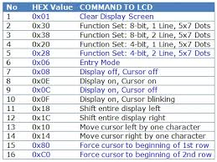

Slide 15
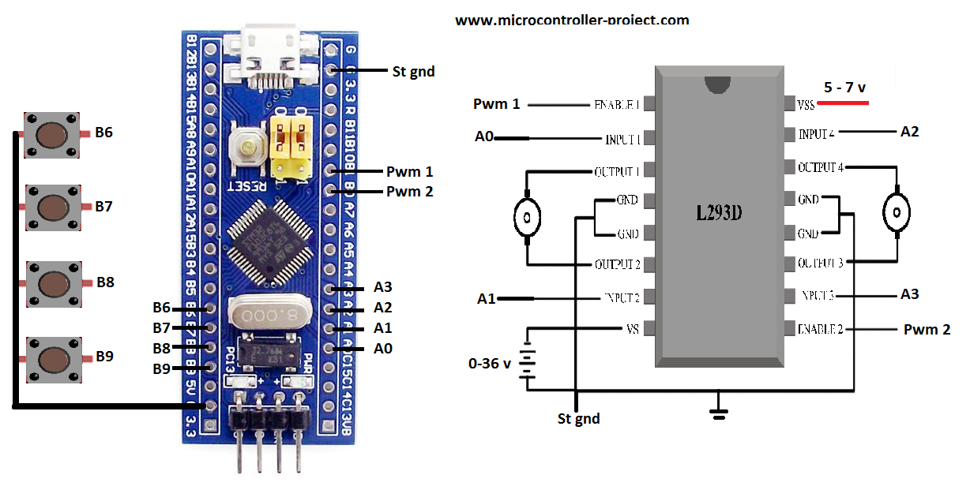
DC Motor

Slide 16
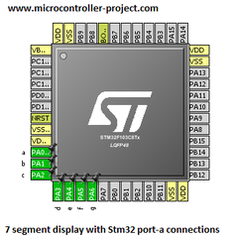
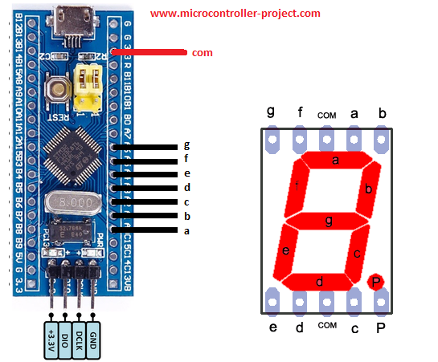
Seven Segment
Common Anode 7 segment

Slide 17
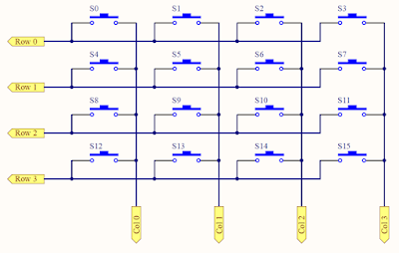
Keypad 4x4

Slide 18
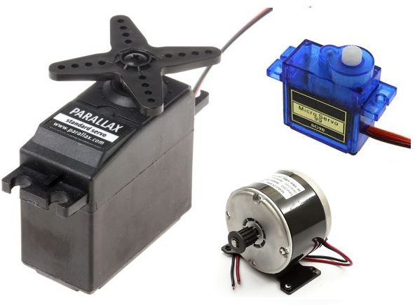
Servo Motors
Servo motors are small motors unlike size they possess greater torque and can move heavy loads. Their small size possessing high torque made them popular among toy makers. Many toys that are around us contains servo motors in them along with dc motors. Normally servo motors in ideal state consumes little power but during load moving power shoots off and servos start consuming greater amount of current. Servo motors works on pwm (pulse width modulated) signals. They have an arm/armature which rotates when sufficient voltage, current and pwm signal is applied to motor. When arm rotates it moves every thing that comes in its ways.
Servo motor working principle
Not every servo motor can move heavy loads. It depends on their specifications and details. Normally toy servo motors can move loads from 1 kg up to 12 kg. Their are two types of servo motors DC and AC. Ac servo motors can move even mush heavier loads they are used in industrial applications. DC servo motors are best for small projects. In this project i am also using a DC servo motor with stm32 microcontroller. As you learned servo motors work on pwm signal. Most of the dc servo motors require 50 Hz frequency for operation with variable duty cycle. Below is the standard requirement wave forms. Our motor also require the same pattern.
Different types of servo motors

Slide 19
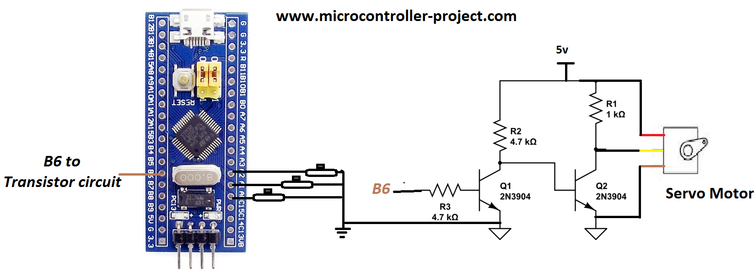
STM32 Servo Interfacing

Slide 20
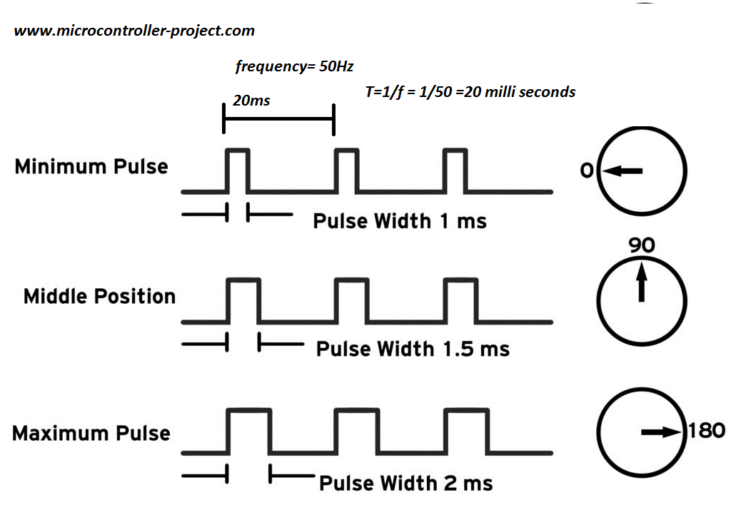
STM32 Servo Interfacing

Slide 21
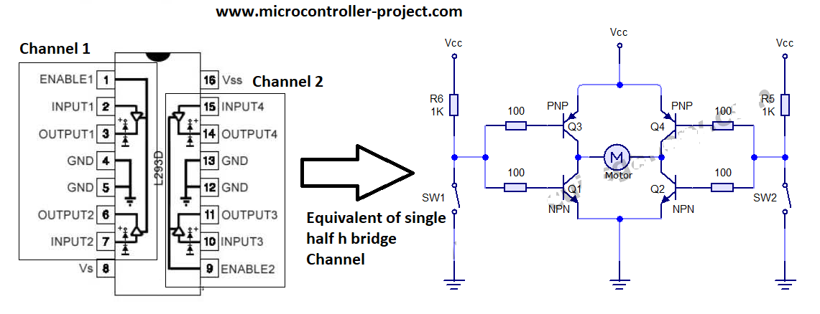
DC Motor Interfacing
H-bridge to drive the current for the Motor

Slide 22
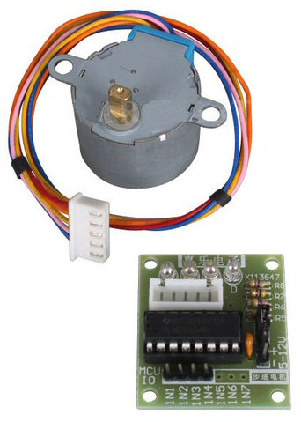
Stepper Motor
To interface a stepper motor from a microcontroller,
we can’t directly drive it with GPIO pins
because GPIO pins have maximum current
that can sink or source from it.
To overcome this problem, we can use driver circuit.
The driver circuit for unipolar stepper motor can be built by using 4 transistors to drive large current to the 4 wires of a stepper motor. It also can be built with ULN2003 IC. This is the circuit for driving a unipolar stepper motor from STM32F103 by using ULN2003 IC.

Slide 23
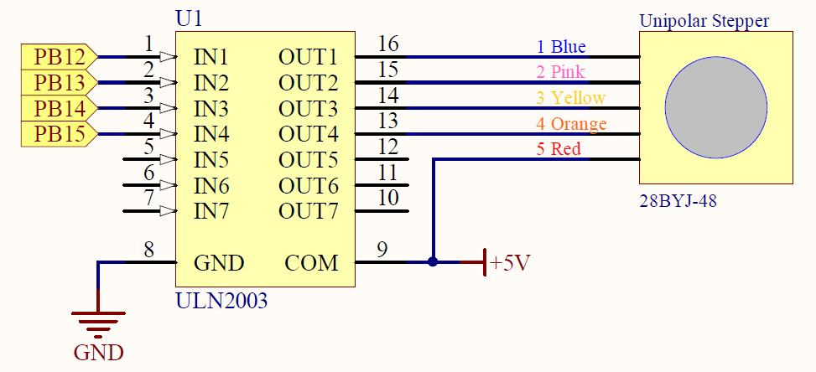
Stepper Motor

Slide 24
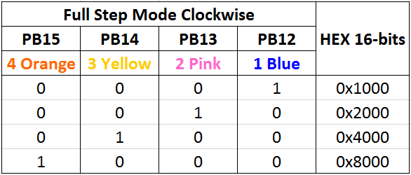
Stepper (Cont’)

Slide 25
Unipolar Stepper | Bipolar Stepper
Lower Torque | Higher Torque
Two Windings Per Phase | Single Winding Per Phase
Much Easier To Driver (requires 4 transistors array) | A little bit harder to drive (Needs polarity inversion with an H-Bridge)

Slide 26
Drive Modes
To drive a stepper motor (make it rotate), you need to activate the coils in a certain pattern to have the motor’s shaft rotating. This is called stepping, each step of the pattern sequence results in a step made by the motor’s rotor part. There are 4 different ways or patterns to drive stepper motors: [ Full-Step Drive, Half-Step Drive, Wave Drive, and Microstepping ].
In this tutorial, we’ll be focusing on the first 3 (Full-Step, Half-Step, and Wave Drive). And the option will be implemented into our library so the user can easily change the drive mode for a specific stepper motor in his/her application. Down below are the bit-patterns or sequences for the 3 stepper drive modes.

Slide 27
Full-Step Drive
index | IN1 | IN2 | IN3 | IN4
0 | 1 | 1 | 0 | 0
1 | 0 | 1 | 1 | 0
2 | 0 | 0 | 1 | 1
3 | 1 | 0 | 0 | 1

Slide 28
Half-Step Drive
index | IN1 | IN2 | IN3 | IN4
0 | 1 | 0 | 0 | 0
1 | 1 | 1 | 0 | 0
2 | 0 | 1 | 0 | 0
3 | 0 | 1 | 1 | 0
4 | 0 | 0 | 1 | 0
5 | 0 | 0 | 1 | 1
6 | 0 | 0 | 0 | 1
7 | 1 | 0 | 0 | 1

Slide 29
Thank You

