Slide 1
Interrupts
Mohamed Saied

Slide 2
Introduction to interrupts. (and Polling)
Interrupts are used to achieve rapid response with minimal overhead to infrequent, random or unexpected events.The alternative to interrupts is polling. With polling the firmware continually tests the status of input-output devices for a service request. The disadvantages of polling are:
The code overhead to continually test the status.
The response time that for worse-case can be as long as the time between the tests.
The overhead and response time are trade offs. The response time can be reduced at the expense of greater overhead and vice versa.Relative to polling the advantages of interrupts are the minimal overhead and very short response time. The disadvantages of interrupts are that it is difficult to anticipate and test for all contingencies.

Slide 3
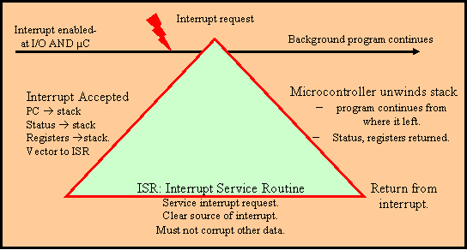
General Response to Interrupt Requests

Slide 4
General response to an interrupt request
The general response to an interrupt request is illustrated above. (Note it is not ARM specific). The cycle consists of the following phases:
Enabling the interrupt request. There are two steps here:
Enabling the input-output device to request an interrupt on some specified conditions/circumstance for example receiving new input data at a communications port. This will normally be included as part of the configuration code for the input-output device.
Configuring/enabling the central processing unit to accept the interrupt request. For some microcontrollers there is only one enable for all input-output interrupt requests. With the ARM microcontroller interrupt requested are handled by the Nested Vector Interrupt Controller (NVIC) and each request must be activated in the NVIC .
Once the interrupts are enabled should an interrupt occur it will be accepted so the programmer must be sure the microcontroller is ready for such an event.
Accepting the interrupt request. Once the microcontroller receives an interrupt request it will:
Place the current program counter and status register (flags) on the stack.
Some microcontrollers will also place other registers on the stack. For example the ARM pushes registers R0-R3, R12, Link register (LR), PSR, and PC onto the stack.

Slide 5
Registers saved on stack with ARM interrupt
R13(SP) at start of interrupt | R0
R13+4 | R1
R13+8 | R2
R13+0xC | R3
R13+0x10 | R12
R13+0x14 | R14(LR)
R13+0x18 | R15(PC)
R13+0x1C | PSW
R13+0x20 | SP prior to interrupt

Slide 6
Interrupt Response Cont’
The microcontroller will then branch to the interrupt service routine (ISR). This involves going to a vector table and reading the start address for the ISR and placing this into the microcontroller program counter. It is the responsibility of the programmer to initialize the vector table.
The interrupt service routine. This is the programmer's responsibility and involves:
Handling the source of the interrupt. For a serial input this might involve reading the data and placing it into a buffer.
Clearing the source of the interrupt. Often this handling the interrupt will also clear the interrupt source. For a serial device this might include reading the status register as well as the data register.
If the ISR is going to use any registers that were not automatically saved by the microcontroller these should be saved before they are used and then returned at the end of the ISR.

Slide 7
Return from interrupt
On the return from interrupt the microcontroller unwinds the interrupt response actions. The status register and program counter are returned along with any additional saved registers. To execute the return from interrupt:
For many microcontrollers return from interrupt (RTI) instruction is required. If programming in a high level language this implies a directive to force the function to end with a RTI instruction is required.
With the ARM microcontroller the NVIC handles the return so a specific RTI is not required and standard function calls may be used.

Slide 8
Return to background
Program continuation. The return from interrupt places the address of the next instruction into the program counter so the program continues from where it was prior to interrupt. The status register is also returned to its status prior to the interrupt. The program should run normally ARM Interrupts and Exceptions.

Slide 9
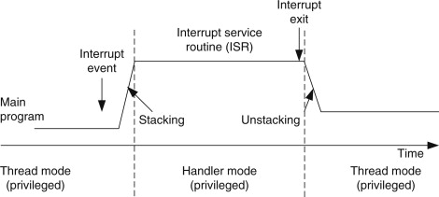
ARM Interrupts

Slide 10

Operation Modes
The Cortex-M3 processor has two modes and two privilege
The operation modes (thread mode and handler mode) determine whether the processor is running a normal program or running an exception handler like an interrupt handler or system exception handler (see Figure 2.4).
The privilege levels (privileged level and user level) provide a mechanism for safeguarding memory accessing to critical regions as well as providing a basic security model.

Slide 11
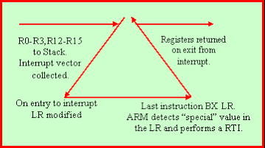
ARM response to an interrupt
The previous description is the general response to an interrupt. Two criteria for embedded systems are that operations are both deterministic and there is low interrupt latency. By using separate buses for program and data operations the ARM is able to collect the interrupt vector in parallel with saving the registers (R0-R3, R12-R15) that improves the response time (reduces the latency). Also with a separate vector for each interrupt source the ARM will vector directly to the interrupt in question rather than firmware needing to poll for the source.

Slide 12
Interrupt Groups
Note that the interrupts are grouped into two: The internal interruptsassociated with the ARM core. Note these interrupts/exceptions are all non maskable(NMI). That is once they are enabled if they occur the ARM will vector to the relevant/appropriate routine. One exampe of a NMI is the system tick. The external interrupts associated with the peripheral devices. These are maskable. That is they are interrupt requests and are only accepted if they they are also enabled at the NVIC (Nested Vector Interrupt Controller). An example of external interrupts are the USART interrupts. Note associated with each external interrupt is an interrupt number that is used in programming the NVIC. Notes: By default following reset all interrupts have the same priority. Once an interrupt is accepted it cannot be interrupted by interrupt requests from other sources. If two or more interrupts request service the first on the list will be serviced first. That is in this situation the interrupts have priority in the order listed.

Slide 13
Non-maskable Interrupt Example using the SystemTick Timer
The following uses the system tick as an illustration of a non-maskable interrupt. The example assumes that a 1ms system tick is required from a system where the AHB clock = 8Mhz .
For the STM32F103 will be the HSI clock.
For the system tick the designer has the choice of using either the AHB clock or AHB/8 clock. Assume that the AHB clock is used then the load valve will be 8000. The code will be;

Slide 14
SysTick Configuration for 1ms Interrupt
SysTick->LOAD = 8000; | //will give 1ms from 8Mhz AHB
SysTick->VAL = 0x3fff; | //any value resets
SysTick->CTRL = 4; | //Use AHB clock
SysTick->CTRL |=2; | // enable system tick interrupts
SysTick->CTRL |=1; | // enable tick

Slide 15
SysTick Interrupt Vector
The Keil start up code includes a default routine and vector.
 | DCD | SysTick_Handler | ; SysTick Handler
 | ;other vectors
SysTick_Handler | PROC
 | EXPORT | SysTick_Handler | [WEAK]
 | B | . | ; note B [full stop] - loop forever
 | ENDP

Slide 16
SysTick ISR
To complete the code there must be an interrupt service routine. (ISR) If there is no user routine provided the ARM will execute the default or continuous loop as shown.
Note: If the ISR uses the label "SysTick_Handler" this definition will take precedence as the definition above is defined as weak. no modifications to the vector table in the start up code will be required.
volatile | char flag;
void | SysTick_Handler( )
{
 | flag =1;
}

Slide 17
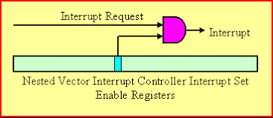
Maskable Interrupts and the Nested Vector Interrupt Controller
All interrupts including the core exceptions are managed by the NVIC (Nested Vector Interrupt Controller). Core exceptions are non maskable. That is they will always be honored or accepted.
External interrupts are maskable. That is when an event occurs the peripheral will issue an interrupt request. If the interrupt has been enabled in the NVIC it will be accepted and the microcontroller will proceed to the appropriate vector and interrupt service routine. If the interrupt has not been enabled at the NVIC no further action will occur. A simplified diagram of the logic is given below.

Slide 18
Maskable Interrupt simplified

Slide 19
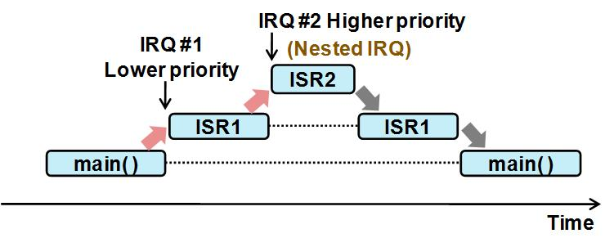
STM32 Supports Nested Interrupts

Slide 20
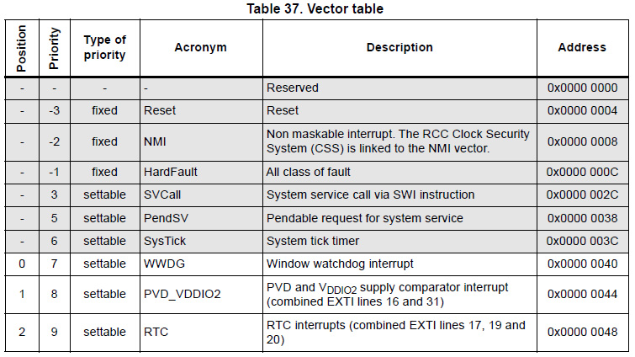
Stm32 Interrupt Vector Table

Slide 21
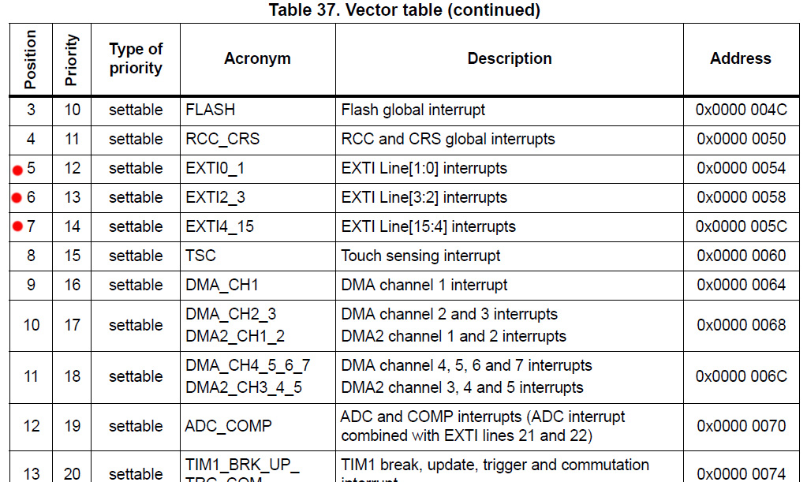
Vector table cont’

Slide 22
External Interrupt In STM32
In STM32 IO pins can be used as the external interrupt line (EXTI) while AVR only has 2 fixed pins for that. However, it does not mean that you can use all 55 pins of the STM32F051 as EXTI lines at the same time. In fact, we can use up to 16 EXTI lines simultaneously due to the following external interrupt GPIO mapping:

Slide 23
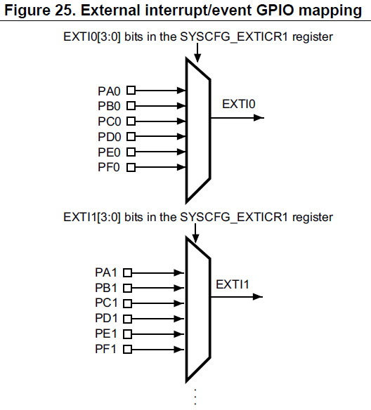
All GPIO’s can be EXT. Interrupt

Slide 24
Ext. Interrupt Cont’
So it means that you cannot use PA0 and PB0 as EXTI lines at the same time but PA0 and PB1 is ok.
EXTI0 is the one we need. Besides, EXTI0 and EXTI1 share the same interrupt handler (vector EXTI0_1 in the vector table) so just need to make sure that you check which one is triggered inside the handler (not mentioned in the video). Moreover, EXTI2 and EXTI3 share the EXTI2_3 handler and EXTI4 to EXTI15 will share the EXTI4_15 handler.

Slide 25
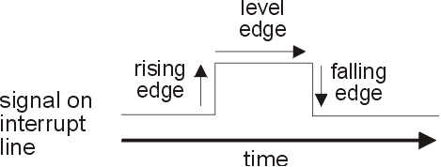
Signal Edge
The falling and rising edge of the signal is simply the transition from high to low and vice versa.

Slide 26
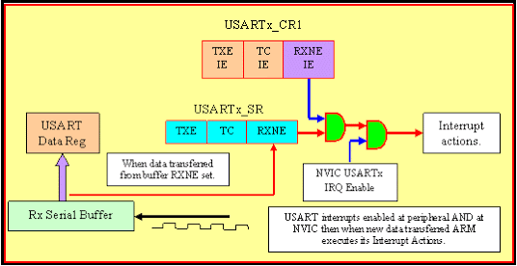
USART Maskable Interrupt

Slide 27
Enable USART1 Int. from NVIC
Configure NVIC to allow USART1 interrupts. USART1 is interrupt number 37 so is enabled via bit 5 in the Interrupt Set Enable Register 1.
Hand calculation. 37 is in the range 32 to 63 so the relevant register is ISER[1]. 37-32 = 5 so the relevant bit is 5.
The code:
NVIC->ISER[1] = 1<<5;
//enable USART1 interrupts
NVIC->ISER[0] handles interrupts 0 through 31. | That is when IRQn/32 = 0 | Bit in ISER[0] = IRQn % 32
NVIC->ISER[1] handles interrupts 32 through 63. | That is when IRQn/32 = 0 | Bit in ISER[1] = IRQn % 32
NVIC->ISER[2] handles interrupts 64 through 95. | That is when IRQn/32 = 0 | Bit in ISER[1] = IRQn % 32

Slide 28
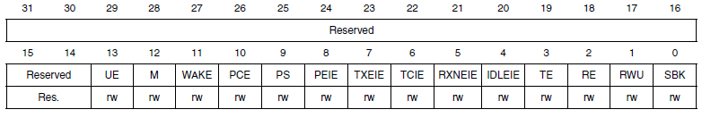
Enable Interrupt in USART
Assuming that USART1 has been configured for normal operations the additional code will be to enable interrupts at the USART. This requires setting bit 5 in control register 1.
USART Control Register showing bit 5 (RXNEIE) to enable interrupts when receiver buffer is not empty.

Slide 29
USART Interrupt vector
Upon interrupt the ARM will jump to a location in low memory where it expects to find the starting address for the interrupt service routine (ISR). It is generally the users responsibility to initialise these vectors.
The Interrupt Service Routine As noted the interrupt service routine (ISR) should be given the same label as defined by the start up code. That is (for USART 1)
void USART1_IRQHandler(void);

Slide 30
USART Interrupt vector summary
Number | Address | Interrupt/Exception | Comments
 | 0x000 | __initial_sp | Top of Stack
 | 0x004 | Reset_Handler
-14 | 0x008 | NMI_Handler
-13 | 0x00C | HardFault_Handler
 |  | External Interrupts | STM32 specific
0 | 0x040 | WWDG_IRQHandler | Window Watchdog
37 | 0x0D4 | USART1_IRQHandler
38 | 0x0D8 | USART2_IRQHandler
39 | 0x0DC | USART3_IRQHandler
52 | 0x110 | UART4_IRQHandler
53 | 0x114 | UART5_IRQHandler
71 | 0x15C | USART6_IRQHandler | STM32F407 only
A summary of the USART vectors for the ARM is listed below.

Slide 31
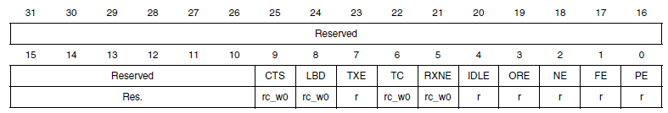
Define the source of interrupt in USART
Since the USART interrupts do not distinguish the individual interrupts part of the ISR will be to read the status register to identify the source of the interrupt.
RXNE: | Read data register not empty | Set by hardware when the content of the RDR shift register has been transferred to the USART_DR register. Cleared by a read of the USART_DR register.

Slide 32
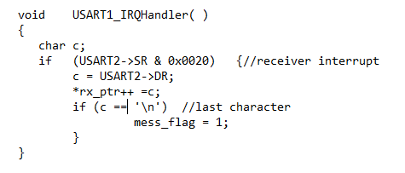
USART Interrupt Receive
Example Assume there is a packet of hexadecimal characters being received by interrupts using USART1. On each interrupt the received character will be placed into an array *rx_ptr. The character string will end with a character ‘\n'.
Possible solution

Slide 33
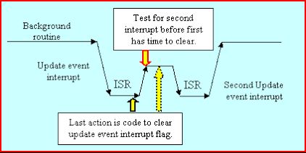
Multiple Interrupts

Slide 34
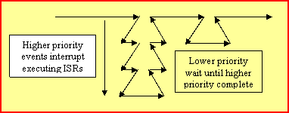
Nested Interrupts

Slide 35
Thank You

