Slide 1

Light Control
Photoresistor
Smart Home
Project
GitHub link.com

Slide 2
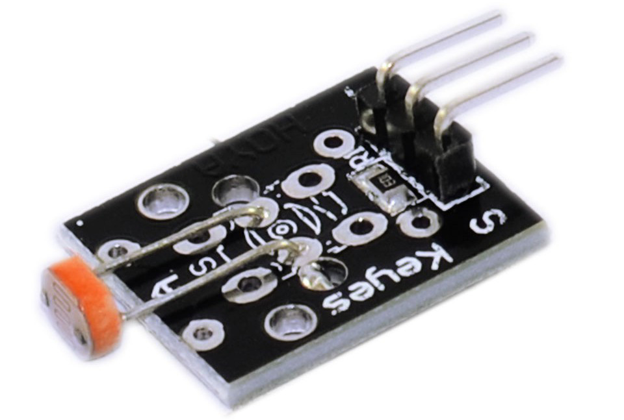
The Sensor: KY-018
Output range from 0-5V
0V indicates very intense light.
5V indicates complete darkness
Absolute 0V & 5V are highly unlikely to be outputted.
Photoresistor
Datasheet: https://tkkrlab.nl/wiki/Arduino_KY-018_Photo_resistor_module

Slide 3
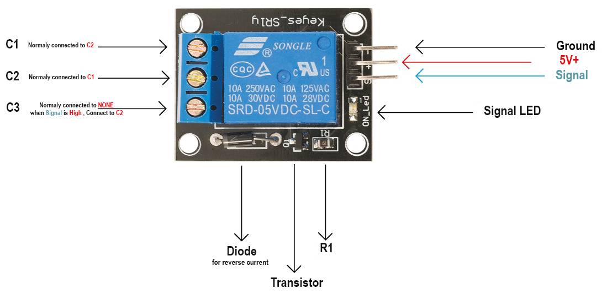
The Relay: KY-019
Photoresistor
Datasheet: https://tkkrlab.nl/wiki/Arduino_KY-019_5V_relay_module

Slide 4
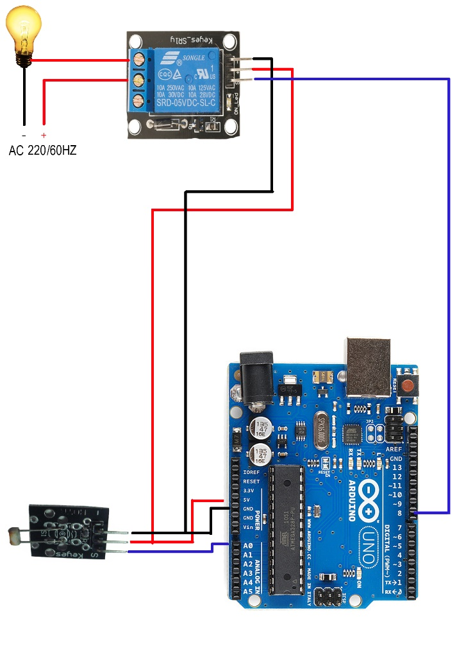
The Layout of The Design
In the actual implementation we added a Capacitor of 220uF (or lower) to remove oscillation.
We also used a transistor to power up the relay.
The relay consumes a lot of power (relative to what microcontrollers)
So the signal pin is connected to one an external power source via transistor.
The transistor is enabled through the microcontroller control pin which we define in the code
Photoresistor

Slide 5
The Code:
float photo_resistor_voltage; //to store the voltage from the photoresistor
byte photo_resistor_pin = A0; //the pin the photoresistor reads from
byte relay_pin = 8; //the control pin for the relay
void setup() {
}
void loop() {
photo_resistor_voltage= analogRead(photo_resistor_pin);
photo_resistor_voltage=photo_resistor_voltage*(5.0/1023.0);//convert to range 0-5V
if(photo_resistor_voltage >= 2.6){ // it's almost dark
digitalWrite(relay_pin,LOW);
}
else if(photo_resistor_voltage <= 2.4){ // some light detected
digitalWrite(relay_pin,HIGH);
}// the threshold at which the light is turned on or off is chosen to satisfy the user's preferences
}
Photoresistor

Slide 6
How It Works
The Photoresistor output is connected to an analog in the microcontroller.
The Photoresistor is placed outside the house and facing the sky.
If the microcontroller reads High voltage (low light ) then environment is dark (night has fallen), then the light is automatically turned on.
The opposite is true, if the microcontroller reads Low voltage (light presence) then environment is lit (the sun is rising), then the light is automatically turned off.
The threshold at which the light is turned on or off is chosen to satisfy the user's preferences.
The sensor indicates whether it’s day or night, this can be used to drive other smart features.
Photoresistor

