Slide 1
University Admission Chatbot
23BCE119 – Jenil Soni
23BCE156 – Rishi Kukadiya
23BCE157 – Karmit Langhnoda
23BCE161 – Mahin Mehta
23BCE188 – Anas Multani

Slide 2
Introduction to University Chatbot System
Developed an intelligent chatbot that understands and responds to university-related queries using Natural Language Processing (NLP).
Aims to automate information delivery about admissions, fees, scholarships, and courses through natural conversations.
A Natural Language Computing–based Chatbot that:
Understands user intent and context.
Extracts key information (slots) from queries.
Retrieves accurate answers from university documents using RAG (Retrieval-Augmented Generation).
Provides an engaging, human-like chat experience.

Slide 3
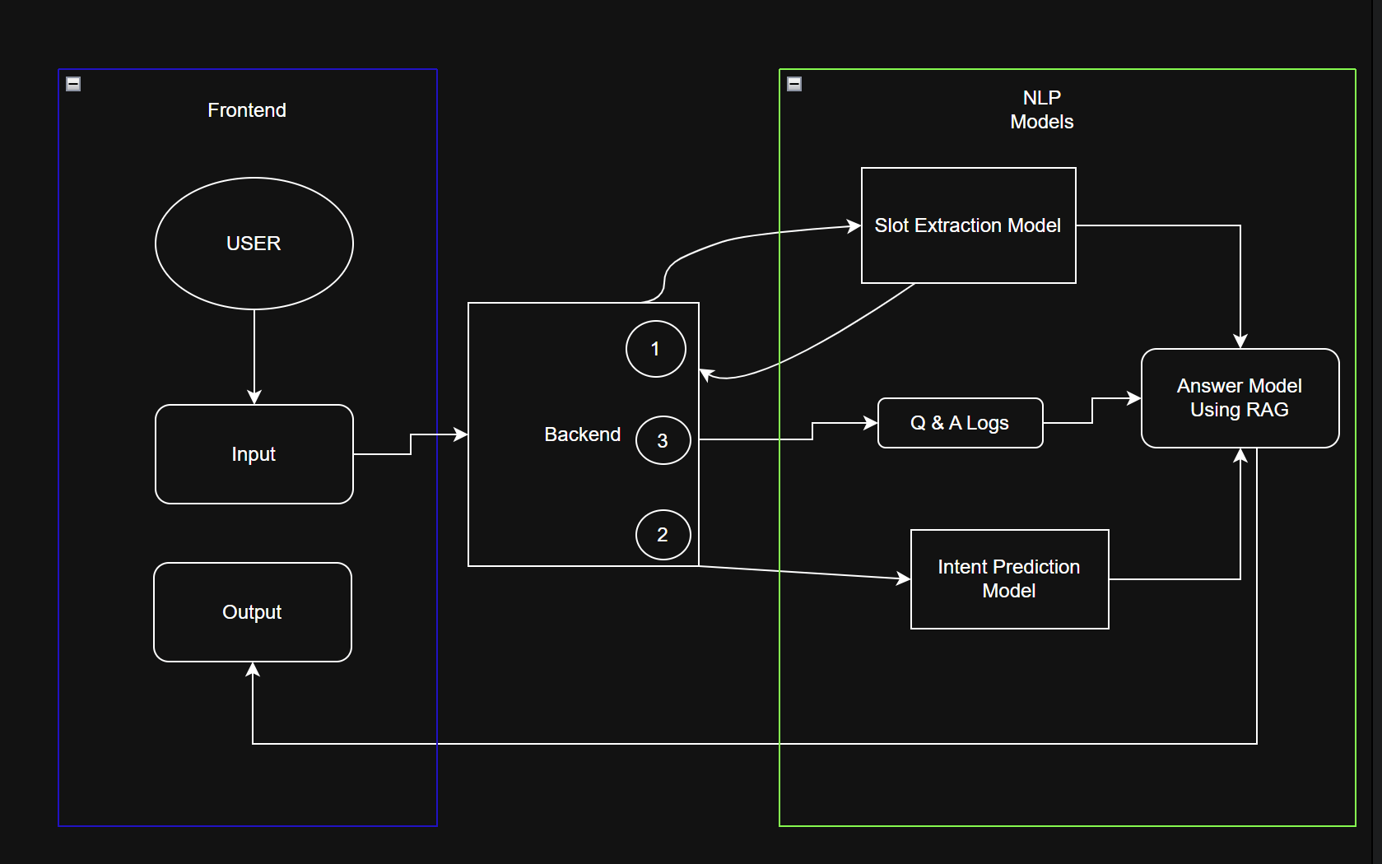
Step-by-Step Process

Slide 4
AI Components & System Analysis
Slot Extraction Model
Model: Google Gemini 2.5 Flash (via LangChain)
Role: Converts user text → structured slots (course, location, scholarship, etc.)
Method: Few-shot prompt engineering for JSON output
Intent Classification Model
Model: intent_classifier (HuggingFace Transformers)
Purpose: Identify user’s intent category (e.g., fees_info, admission_process)
Output: Intent + confidence score → Example: { intent: "fees_info", confidence: 0.94 }
RAG Pipeline (Retrieval-Augmented Generation)
Retrieval: TF-IDF + cosine similarity (Top 3 document chunks)
Augmentation: Adds slot and log context to LLM prompt
Generation: Gemini 2.5 Flash generates factual response
Documents: PDF + scanned images processed via PyPDF2 + Tesseract OCR

Slide 5
System Insights & Conclusion
Complete Data Flow (Recap)
- User Input: Typed in chat window (React frontend)
- Backend Handling: Creates/updates session and asks next question
- AI Agent Call: Extracts slot → updates MongoDB
- Completion: When all slots filled → intent + RAG response
- Final Output: Accurate, document-based answer sent back to user
System Strengths
- Natural Language Understanding — powered by Gemini & Transformers - Persistent Context — MongoDB session tracks user flow - Factual Answers — RAG ensures domain-specific accuracy - Scalable Design — Modular architecture for easy expansion - Multilingual & Adaptive — Can be extended for multiple languages
Conclusion
The Gujarat University Admission Chatbot demonstrates how Natural Language Computing enables real-world, human-like information systems. By combining NLP models, document retrieval, and conversational memory, the system provides accurate, context-aware responses — redefining digital university interaction.

Slide 6

THANKS

