Slide 1
Keypad

Slide 2
Overview
What is Keypad
Simplified schematic
Types of Keypad
How it works
Wiring diagram and code
Use cases
How to decrease number of pins

Slide 3
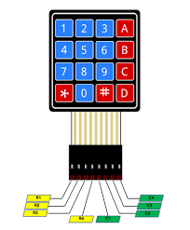
What is Keypad
The keypad is a set of buttons arranged in rows and columns (called matrix). Each button is called key.

Slide 4
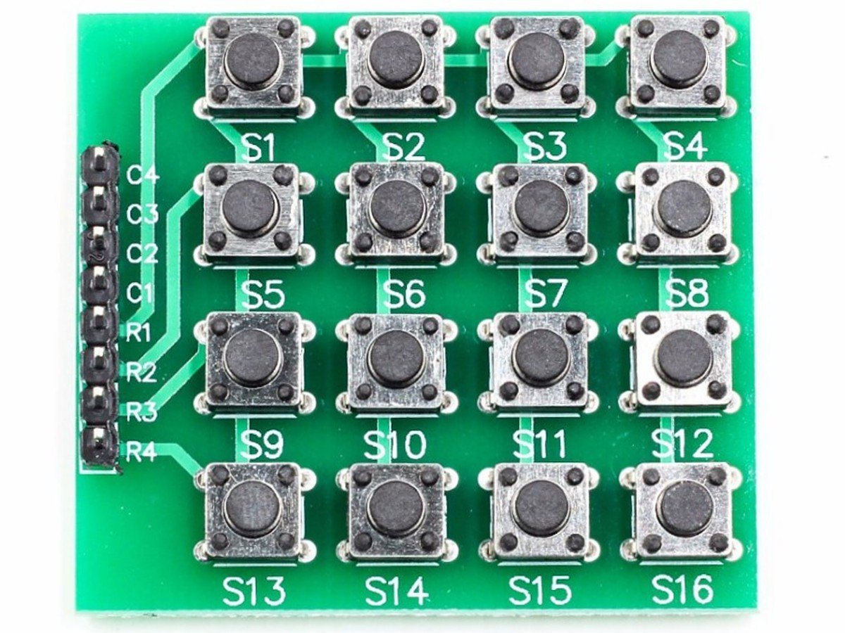
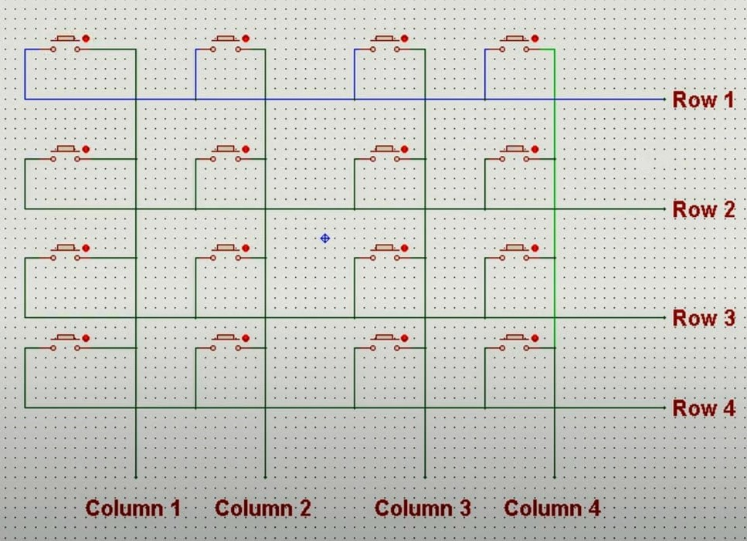
Simplified schematic
It consists of 16 push button arranged in form of a matrix.

Slide 5
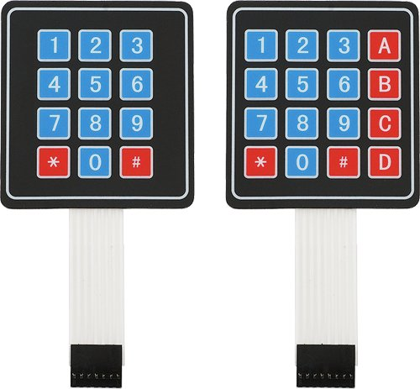
Types of Keypad
There are many types of keypads, but the two most popular types are “12-button keypad’’ Or the “4*3 keypad” and the “16-button keypad” Or the “4*4 keypad”.
The 4*3 keypad has 7 pins.
The 4*4 keypad has 8 pins

Slide 6
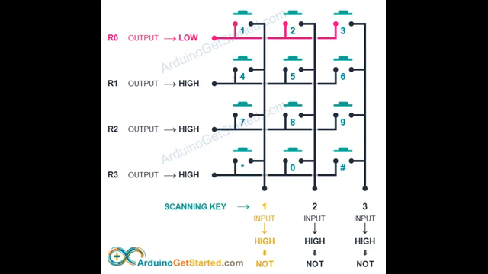
How it works
Pins layout : -
Rows are connected to Arduino’s output pins.
Columns are connected to Arduino’s input pins.

Slide 7
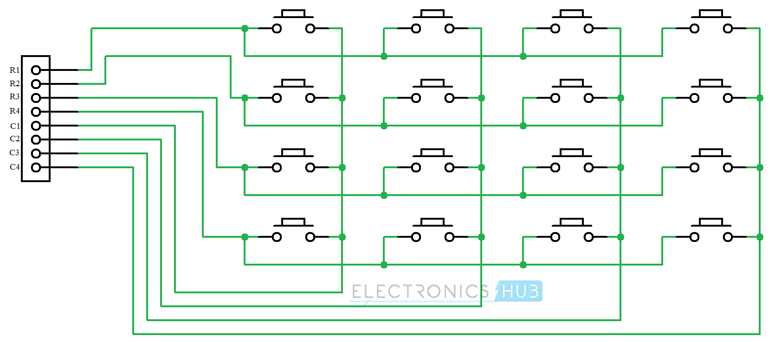
How it works
When the button is pushed the circuit is closed and “R1 and C1” will have a value in Arduino.

Slide 8
Question for you
A frequently asked question which is “why is the keypad arranged as a matrix? And why not use each key as an independent button?”

Slide 9
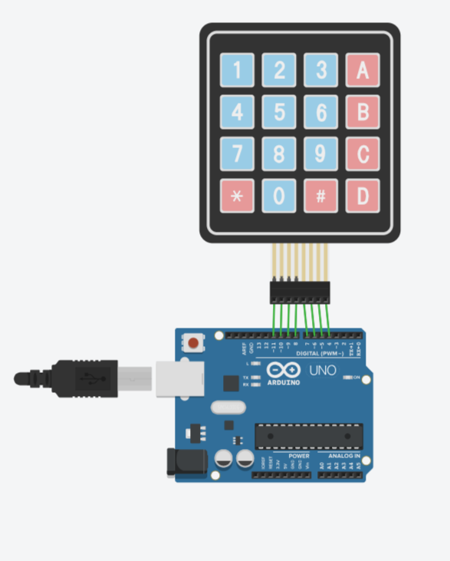
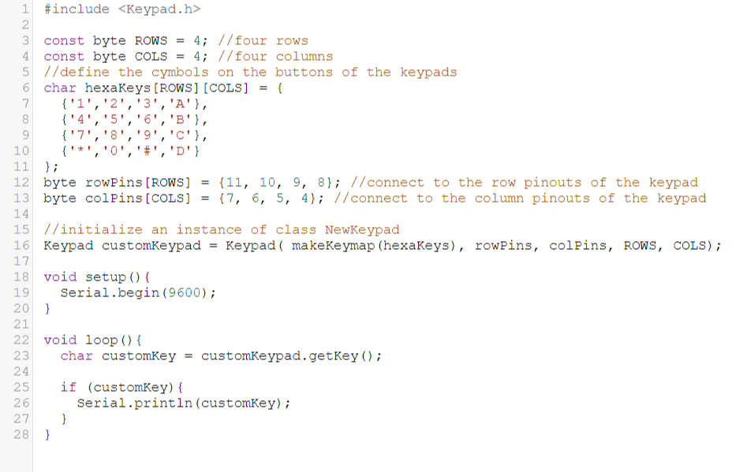
Wiring diagram and code

Slide 10
Wiring diagram and code
https://www.tinkercad.com/things/cwAtpWOjw7F-keypad

Slide 11
Use cases
Security Systems
Data Entry
Home Automation
Alarm Systems
Game Controllers
Automation and Robotics

Slide 12
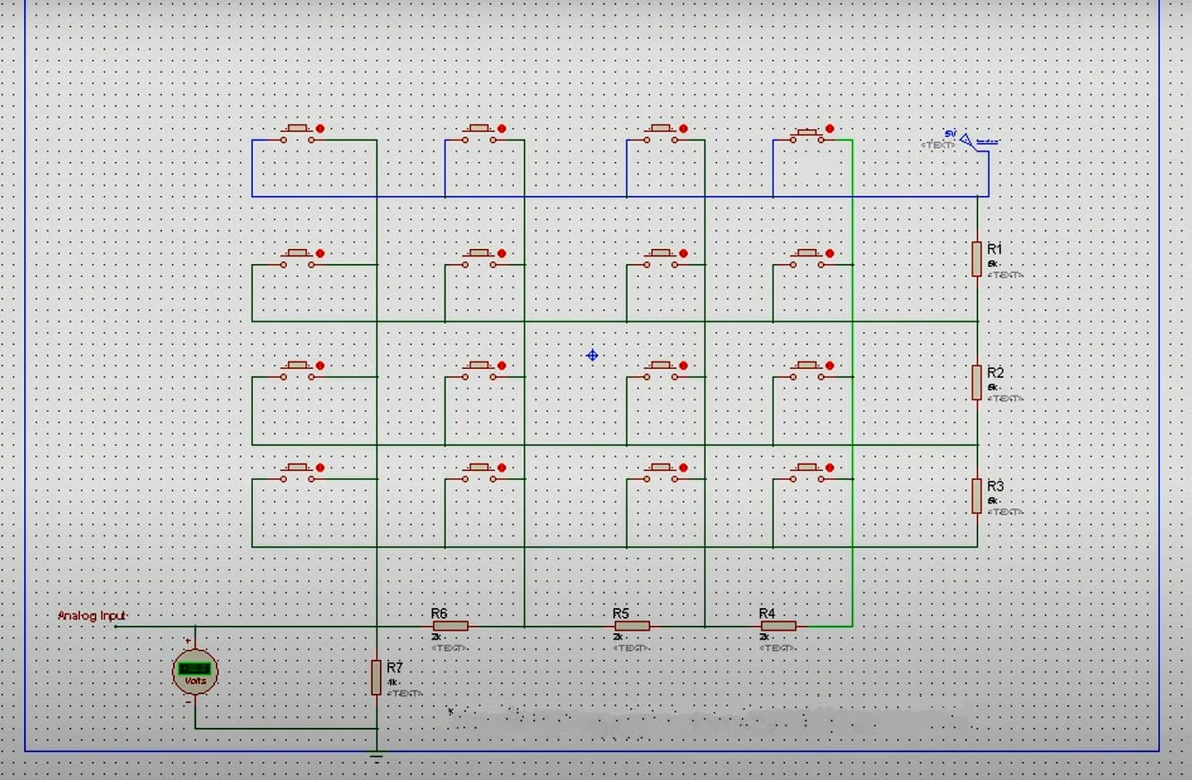
How to decrease number of pins
How to use 1 pin for keypad
We use analog pin to read the buttons.
Why?
Because analog pin read the value between 0 to 1023.
How ?
Let’s put 3 resistors for each row it’s value 5K ohm
And put 3 resistors for each column it’s value 2K ohm.

Slide 13
How to decrease number of pins
And put a 1k ohm resistor connected to ground.
Then let’s measure the voltage after each press.
Every button has a unique voltage difference, so we used the analog pin to specify the value of each button.

Slide 14
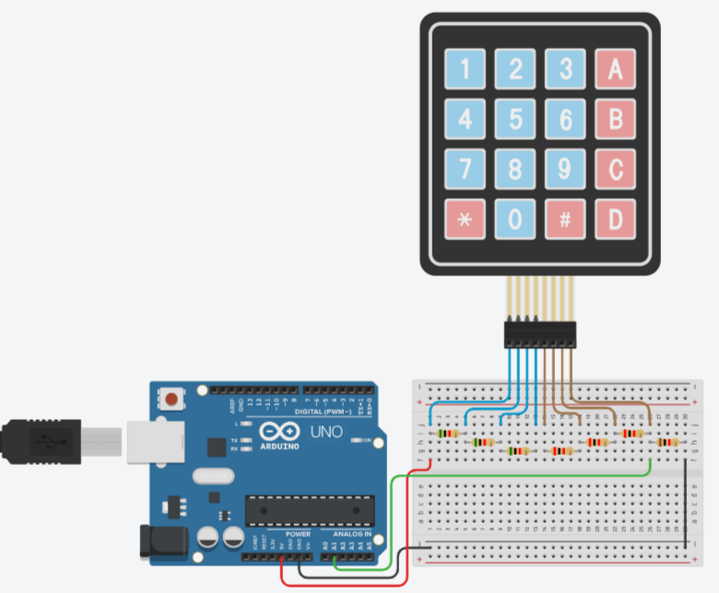
How to decrease number of pins

Slide 15
How to decrease number of pins
https://www.tinkercad.com/things/2AfH9kzAjyo-keypad-1pin?sharecode=mfa2USUoFwhvmvPuc2zBAxehGJ3qW9ZYCGEBRd-i-M8

