Slide 1
System overview of Threading
Presenter :- Anurag Tyagi

Slide 2

Content
Defining Threads
System view of Threads
Threading Above the Operating System
Threads Inside The Operating System
Threads Inside The Hardware

Slide 3

Defining Threads
A thread is a discrete sequence of related instructions that is executed independently of other instruction sequences.
Every program has at least one thread—the main thread—that initializes the program and begins executing the initial instructions.
That thread can then create other threads that perform various tasks, or it can create no new threads and simply do all the work itself.
In either case, every program has at least one thread. Each thread maintains its current machine state.

Slide 4
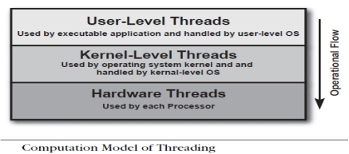
System View of Threads
The thread computational model is having three layers for threading:
User-level threads: Threads created and manipulated in the application software.
Kernel-level threads: The way the operating system implements most threads.
Hardware threads: How threads appear to the execution resources in the hardware.

Slide 5
Flow of Threads
In the Defining and Preparing stage, threads are specified by the programming environment and encoded by the compiler.
During the Operating stage, threads are created and managed by the operating system.
Finally, in the Executing stage, the processor executes the sequence of thread instructions.
Defining and Preparing Threads
Operating Threads
Executing Threads
Performed by Programming Environment and Compiler
Performed by OS using Processes
Performed by Processors
Showing return trip to represent that after execution operations get pass to user space

Slide 6
Threading above the Operating System
In general, application threads can be implemented at the application level using established APIs.
The most common APIs are OpenMP and explicit low-level threading libraries such as Pthreads and Windows threads.
The choice of API depends on the requirements and the system platform.
OpenMP, in contrast, offers ease of use and a more developer-friendly threading implementation.
OpenMP requires a compiler that supports the OpenMP API. Today, these are limited to C/C++ and Fortran compilers.

Slide 7
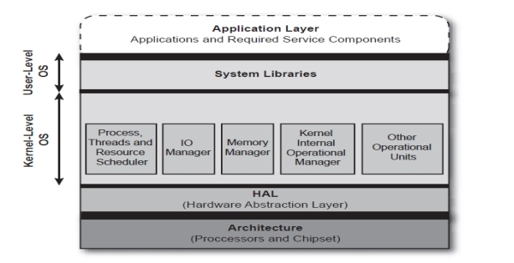
Threads inside the OS
The key to viewing threads from the perspective of a modern operating system is to recognize that operating systems are partitioned into two distinct layers: the user-level partition (where applications are run) and the kernel-level partition (where system oriented activities occur).

Slide 8
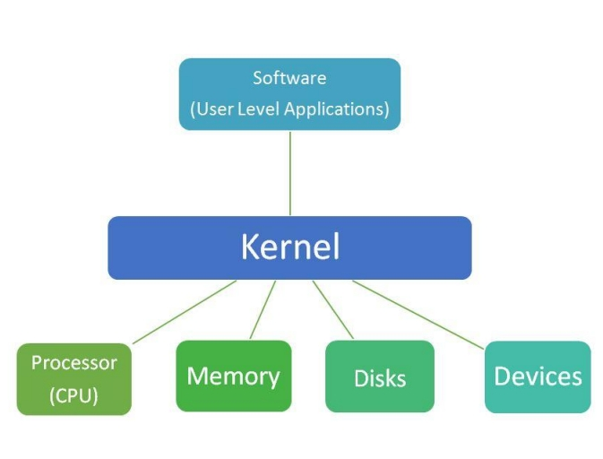

Slide 9
Conditions of Threads at different levels
The kernel is the nucleus of the operating system and maintains tables to keep track of processes and threads.
Threading libraries such as OpenMP and Pthreads (POSIX standard threads) use kernel-level threads.
User-level threads, which are called fibers on the Windows platform, require the programmer to create the entire management infrastructure for the threads and to manually schedule their execution.
Kernel-level threads provide better performance, and multiple kernel threads from the same process can execute on different processors or cores

Slide 10
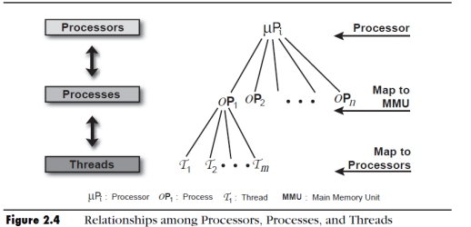
Relationship Among Processors, Processes, And Threads
Below figure shows the relationship between processors, processes, and threads in modern operating systems.
A processor runs threads from one or more processes, each of which contains one or more threads.
A program has one or more processes, each of which contains one or more threads, each of which is mapped to a processor by the scheduler in the operating system.

Slide 11
Multi-Threading Models
Many – to – One (M:1)
Many – to – Many (M:N)
One – to – One (1:1)

Slide 12
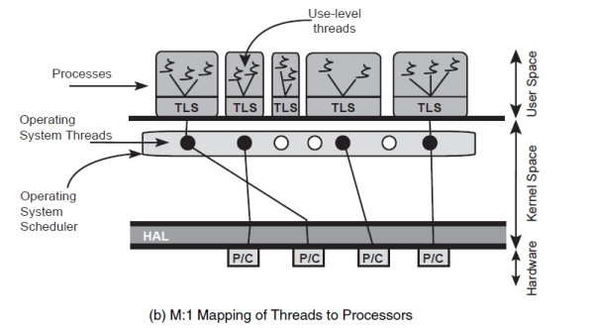
Many – to – One (M:1)
In the M:1 model , the library scheduler decides which thread gets the priority.This is called cooperative multi-threading.

Slide 13
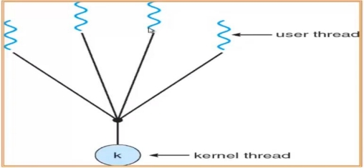
Many – to – One (M:1)
Many user-level threads are mapped to one kernel.

Slide 14
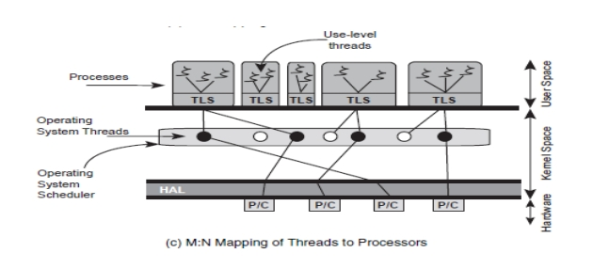
Many – to – Many (M:N)
In the case of M:N, the mapping is flexible.

Slide 15
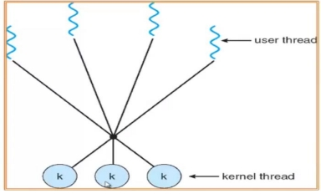
Many – to – Many (M:N)
Multiplexes many user-level threads to a smaller or equal number of kernel threads.
When a thread performs a blocking system call, the kernel schedules another thread for execution.

Slide 16
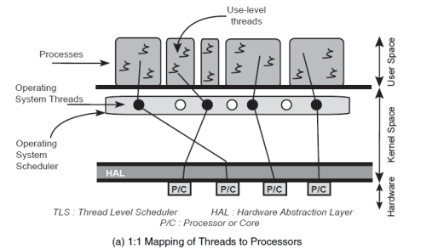
One – to – One (1:1)
The 1:1 model requires no thread-library scheduler overhead and the operating system handles the thread scheduling responsibility. This is also referred to as preemptive multi-threading.

Slide 17
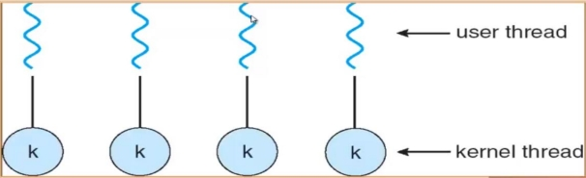
One – to – One (1:1)
Each user thread maps to one kernel thread.
Provide more concurrency , if one threads make a blocking call another thread is allowed to run.
Creating user thread requires creating corresponding kernel thread .

Slide 18
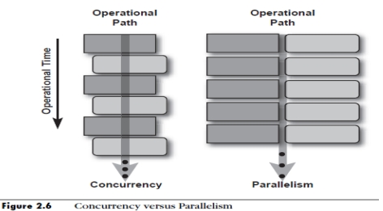
Thread Inside The Hardware
The hardware executes the instructions from the software levels.
Instructions of your application threads are mapped to resources and flow down through the intermediate components-the operating system, runtime environment, and to the hardware.
Threading on hardware once required multiple CPUs to implement parallelism: Multi-core CPUs.
The CPU might have only one execution engine or core but share the pipeline and other hardware resources among the executing threads: SMT- concurrent.

Slide 19
THANK YOU

