Slide 1
Fundamental concepts of parallel programming..
Designing for Threads
Task Decomposition
Data Decomposition
Data Flow Decomposition
Implications of Different Decompositions

Slide 2
Fundamental Concepts of Parallel Programming..
Parallel programming, in simple terms, is the process of decomposing a problem into smaller tasks that can be executed at the same time using multiple compute resources.
The entire concepts of parallel programming is based on threads.
It deals with design, develop, and deployment of threads within an application.
It also deals with communication between threads and application.

Slide 3
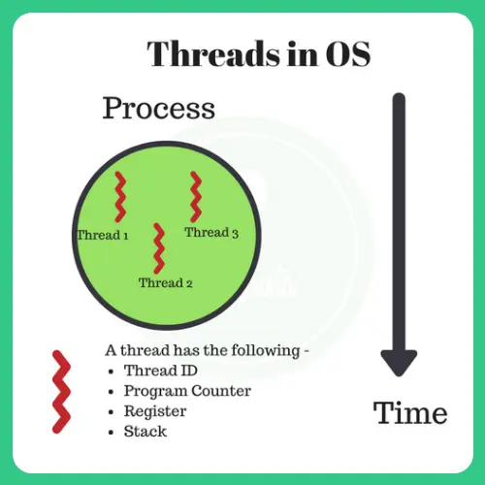
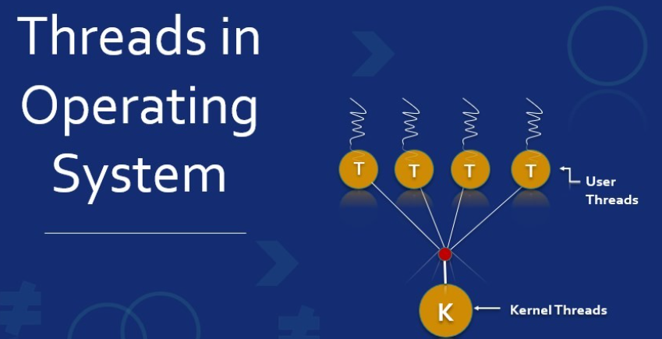
Designing for Threads..
Threads are the smallest unit of a program.
Threads are lightweight processes within a program that enable concurrent execution.

Slide 4
Traditional Programming model..
Developers who are unacquainted with parallel programming generally feel
comfortable with traditional programming models contains following things:-
OOP(object oriented programming)
Main() (there must be main method available in the program)
Serial Programming
Waits for User interaction in a loop
Simple to program and execute
One Step is generally flows into the next.
Based on predetermined parameters, a predictable conclusions can be reached.

Slide 5
Parallel programming model..
Rethinks the idea of process flow.
Identify activities that can be run in parallel.
A program are a set of tasks with dependencies between them.

Slide 6
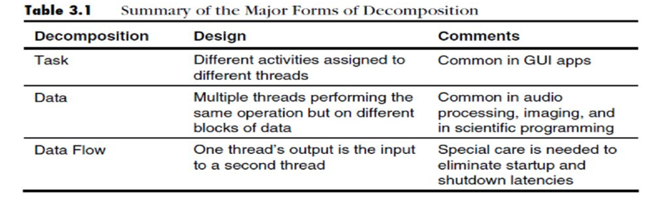
Decomposition..
The process of breaking a program to tasks and identifying dependencies between them are called decompositions.
Programs can be decomposed based on task, data and data flow.

Slide 7
Task decomposition..
Decomposition a program by the functions that performs is called task decomposition.
One of the simplest ways to achieve parallel execution.
Tasks are catalogued and if two can run concurrently developer assigns them concurrent.
Running tasks in parallel requires slight modification to avoid conflicts.

Slide 8
Examples..
Mowing and weeding a lawn : one worker mowes the lawn, another worker weeds.
Text entry and pagination in MS Word.

Slide 9
Data decomposition..
Data decomposition breaks down tasks by the data they work on rather than by the nature of the task.
Data decomposition also known as data-level parallelism.
Programs that are broken down via data decomposition generally have many threads performing the same work, just on different data items.
As the number of processor cores increases, data decomposition allows the problem size to be increased. This allows for more work to be done in the same amount of time.

Slide 10
Examples..
Digital Image Processing
Mowing and weeding in a garden: both mow half the property first, and then weed the property.

Slide 11
Data Flow Decomposition..
Data flow decomposition refers how data flows between tasks.
Example: Producer Consumer Problem
Output of producer, input to consumer.
Different threads for producer and consumer.
Consumer cannot start until producer finishes some portion of execution.

Slide 12
Example: Gardening
One gardener can prepare the tools, put gas in the mower, clean shear etc
To be used by both gardeners.
No gardening is occurs till this step is finished.
Example: Parsing
An input file must be parsed and analyzed semantically before code generation.

Slide 13
Implications of Different Decompositions
Different decompositions have different benefits.
Applications are threaded for higher performance. So choice of decomposition is important.
Certain tasks are suited to certain decompositions
Example:
Digital image processing - task decomposition: one thread does color balancing, one thread does decoding etc.. - data decomposition: each thread does all the work on one frame and moves to next frame.

Slide 14
Decision made on resource constraints.
Example - gardening : suppose only one mower.

Slide 15

THANK YOU..

