Slide 1
What is Web development ?
01 Web development is the act of building, creating and maintaining websites.
02 Web development consists of three main components:
Front-end development (UI).
Back-end development (Logic, Database , APIs).
Full-Stack (Front-end , Back-end).

Slide 2
what is the difference between the Internet and the web ?
Definition
Components
Protocols used
Internet : A global system of
interconnected
computer networks that use TCP/IP
protocol to link devices worldwide.
web : A system of interlinked hypertext
documents and multimedia
content accessible via the Internet..
Internet: Hardware(servers, routers,
devices), protocols(TCP/IP).
web: Websites, web pages
Internet: TCP/IP, FTS, SMTP,
IMAP and many more. Web: Mainly HTTP/HTTPS
Invention
Examples
Usage
Internet : Originated in the late 1960s and early 1970s as ARPANET.
web: 1989 by Tim
Berners-Lee
Internet: Email services, VoIP, Online gaming, Cloud storage and more.
Web: Websites like
Google, Wikipidea, Youtube, Amazon, Facebook
Internet: Used for all forms of digital communication and data exchange.
Web: Used mainly for accessing
information and multimedia
using web browsers.

Slide 3
Front-End Development: Focuses on user experience and building elements for end-users.
Jobs in web developments:
Full-Stack Developer:
Develops both client and server sides of a software application.
Back-End Development:
Handles server-side code, databases, and functionality.
UX vs UI Design:
UX solves user problems, while UI focuses on aesthetics and interface interaction.
Front-End Development:
Focuses on user experience and building elements for end-users.

Slide 4

project manager
A project manager, or PM, coordinates the elements of a project, aiming for timely completion within budget and with high standards.
Their key responsibilities include:
Project Planning
Team Management
Budgeting and Resource Allocation Risk
Management.
CommunicationQuality Control

Slide 5
QA&QC
Quality Control: A reactive process focused on identifying and resolving issues in the final product after it reaches consumers.
Quality Assurance: A proactive process aimed at ensuring quality requirements are met before the product or service is released to the public.

Slide 6
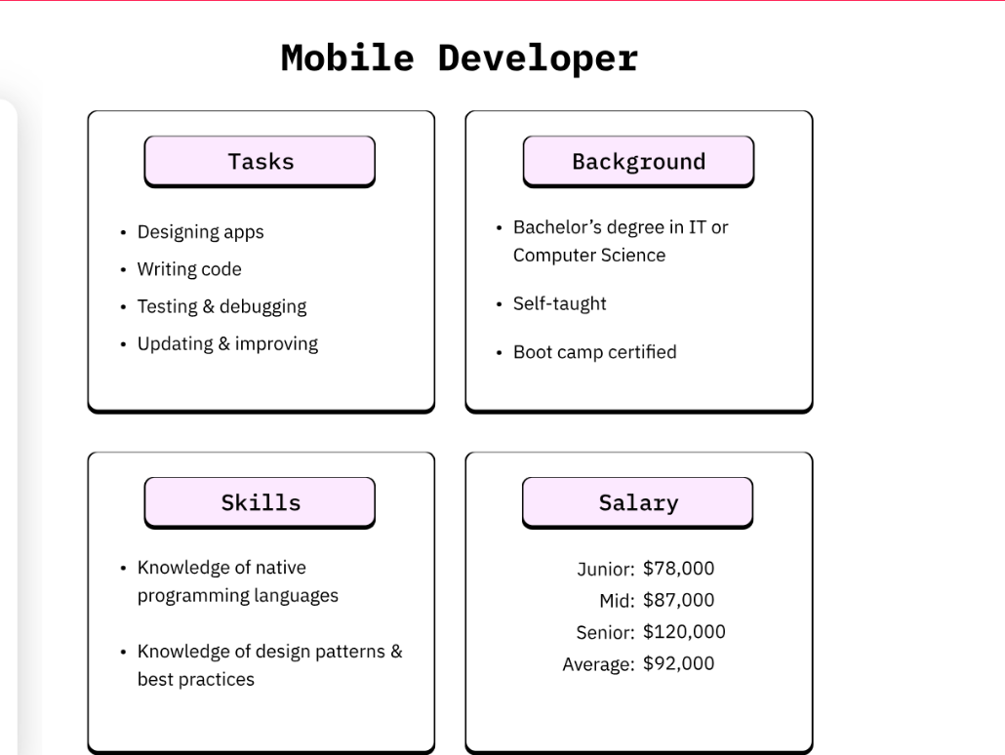
Mobile Developer
A mobile developer is a professional software engineer who specialises in designing, building, and maintaining applications for mobile devices.

Slide 7
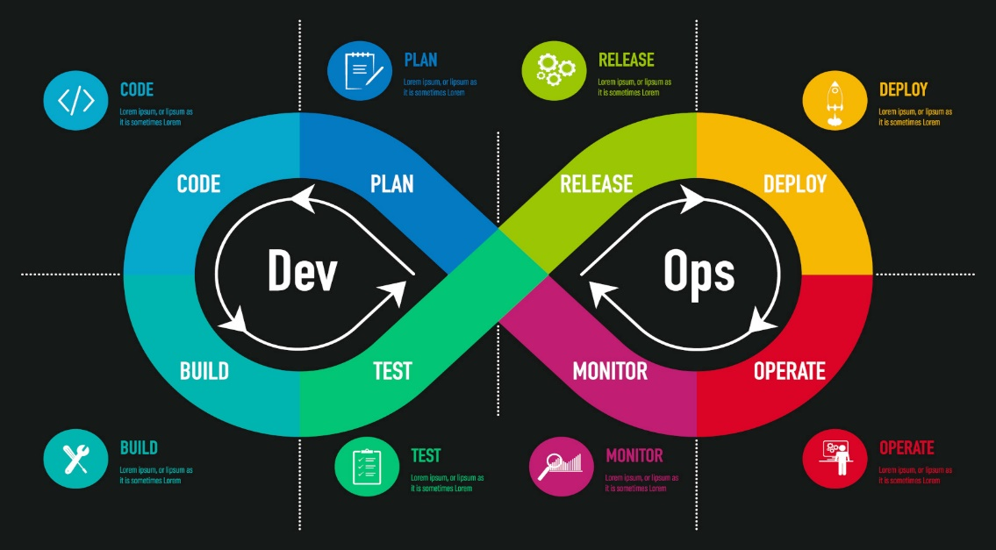

Slide 8
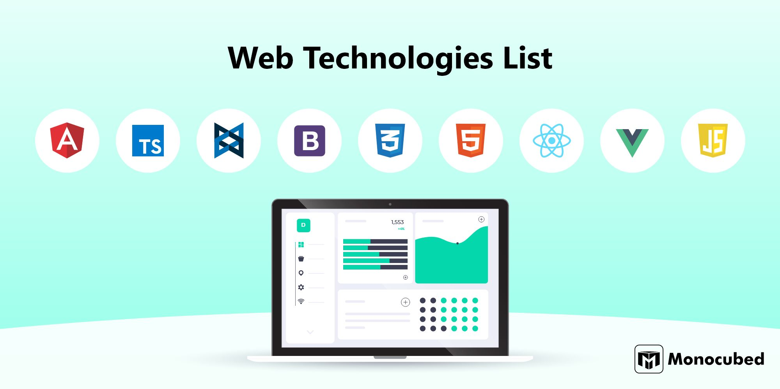

Slide 9
The estimated total pay for a Web Developer is :
JORDAN
Berlin
US
7140 JD per year
$69,328 per year
$ 125,198 per year

Slide 10
Most demand field in web development ?
Front-End Development: Focuses on user experience and UI design, making websites attractive and easy to use. Some argue this is crucial for a website's success.
Back-End Development: Manages servers, databases, and logic to ensure smooth and efficient site performance. Demand may depend on market factors.
Full-Stack Development: Combines front-end and back-end skills, offering flexibility and cost-efficiency. Preferred by companies seeking comprehensive solutions.
Conclusion: The demand varies based on market needs, with some companies favoring specialized developers and others opting for flexible full-stack developers.

Slide 11

شكرااااااااااااااااااااااااااااااااااا من القلب

