Slide 1
Movie Data Analysis in Power BI
Aksana Bourosh

Slide 2
Project Scenario:
A movie company wants to get some insights about the difference between total amount ($) generated across different zones (worldwide, domestic and foreign) during the period of 2016-2020.
In addition, the company is interested in quick insights about top 5 movies for every year from the period of 2016-2020.
Movie data (Boxoffice Data) that was used for this project can be viewed here.

Slide 3
Project Steps:
Cleaning five datasets (each dataset contains the information about movies that were released in every year and profit received in different zones (worldwide, domestic and foreign);
Replacing errors, detecting and changing datatypes;
Appending five datasets;
Performing aggregation on the data using group by on the transform tab;
Creating the table with top 5 movies for every year;
Unpivoting columns for detailed analysis;
Visualisation of the results;
Formulating the insights.

Slide 4
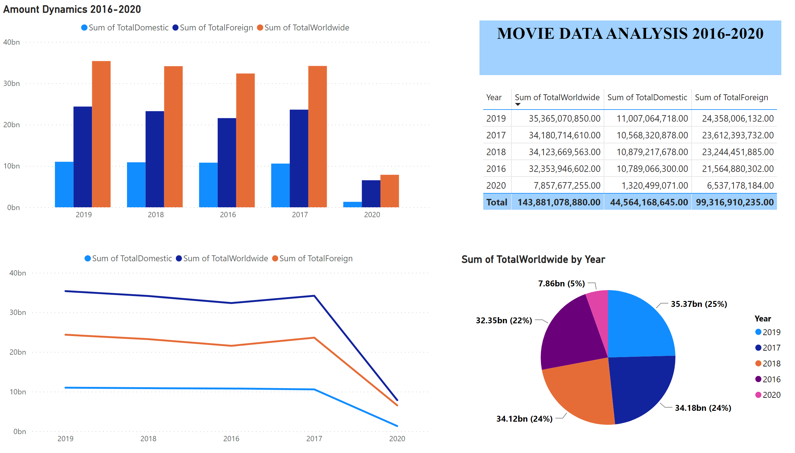
Page 1
Notes:
Amount Dynamics 2016-2020
No alt text provided
lineChart
No alt text provided
tableEx
No alt text provided
pieChart
No alt text provided
textbox
No alt text provided

Slide 5
Insights From ANALYSIS:
Total film release revenues were almost the same level of about 32-35 bn $ in 2016-2019, but this indicator fell sharply in 2020 (by 4,5 times to 7,86 bn $). The main reason for the decline in revenues is coronavirus pandemic that has led to many restrictions on visiting public places, including cinemas.
Basically worldwide amounts are formed due to foreign revenues. Its share in the total worldwide amount was approximately 66-68% every year in the period of 2016-2019. Only in 2020 total worldwide amount consisted of 83% foreign amount and 17% domestic amount.
Much of the decline in worldwide movie release revenues in 2020 was driven by a drop of almost 8 times in domestic amount, while foreign amount declined in 3,5 times in 2020.

Slide 6
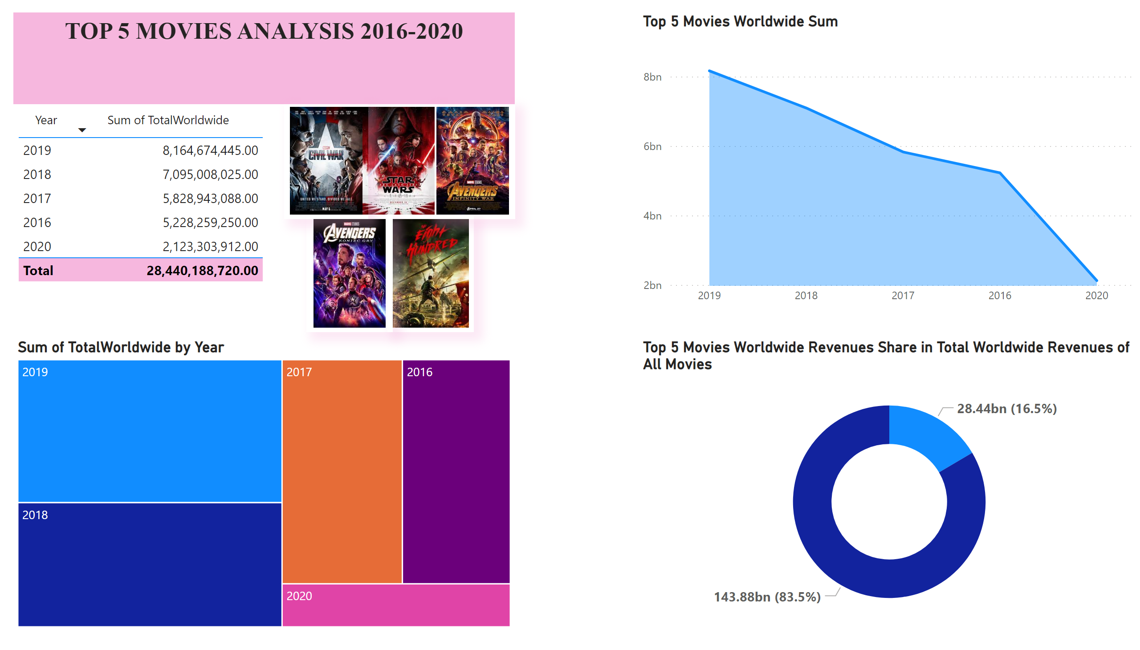
Page 2
Notes:
Top 5 Movies Worldwide Sum
No alt text provided
tableEx
No alt text provided
treemap
No alt text provided
textbox
No alt text provided
Top 5 Movies Worldwide Revenues Share in Total Worldwide Revenues of All Movies
No alt text provided
image
No alt text provided
image
No alt text provided
image
No alt text provided
image
No alt text provided
Top 2016
Top 2016

Slide 7
Quick insights about TOP 5 MOVIES:
Worldwide amount from top 5 movies increased gradually over the period of 2016-2019 from 5,23 bn $ in 2016 to 8,16 bn $ in 2019, but then dropped significantly to 2,12 bn $ (drop by almost 3 times). The main reason is the same – coronavirus pandemic.
Top 5 film worldwide amount of 28,44 bn $ for 2016-2020 represents 16,5% of total worldwide amount for all the movies from the database which is 143,88 bn $.

Slide 8
THANK YOU FOR YOUR ATTENTION!
AKSANA BOUROSH
+48792652440
E-mail: oksana.bourosh@gmail.com
Follow me
in

