Slide 1
RESEARCH PREVIEW
MalariAI
A Label-Resilient Decoupled Framework for Universal Cell Segmentation
and Explainable Stage Classification in Dense Malaria Blood Smears
Kaysarul Anas Apurba · Mohammed Ali
Laurentian University, Canada | Melbourne Institute of Technology, Australia
Target venue: arXiv / MICCAI · Live demo: Hugging Face Spaces

Slide 2
The Global Burden of Malaria
249M
608K
537:1
cases globally
(WHO, 2022)
deaths per year
95% Sub-Saharan Africa
RBC to Gametocyte
in NIH BBBC041
Why deep learning hasn't solved this yet
Manual microscopy remains the clinical gold standard. Expert microscopists are scarce in endemic regions. Deep learning approaches exist — but three compounding failure modes prevent clinical deployment in every published system.
This project addresses all three failure modes simultaneously — in a single, deployable, explainable pipeline.

Slide 3
Three Unsolved Problems in Malaria AI
P1
Incomplete Annotation
✗ Prior work: unannotated = background
End-to-end detectors treat every unannotated cell as background. In NIH BBBC041, most healthy RBCs are not individually labelled — the model learns the wrong signal.
✓ MalariAI: watershed finds ALL cells — label-agnostic
P2
Dense Overlap & NMS Failure
✗ Prior work: filter dense images out entirely
Non-Maximum Suppression deletes overlapping proposals assuming they are duplicates. 58% of BBBC041 images have genuinely overlapping cells — NMS discards real detections.
✓ MalariAI: distance transform splits touching cells
P3
Black-Box Clinical Output
✗ Prior work: opaque class label only
No published whole-slide malaria system produces per-cell spatial attention heatmaps. Physicians cannot see what the model is looking at — blocking clinical adoption.
✓ MalariAI: Grad-CAM++ heatmap per cell

Slide 4
Dataset: NIH BBBC041
1,208
79,672
6
58%
Training images
Valid bounding boxes
Cell classes
Images with overlapping cells
537:1
RBC-to-Gametocyte ratio
Motivates Focal Loss (γ=2.0)
Giemsa-stained P. falciparum
thin blood smears
1600×1200 px · 100× oil objective
Broad Bioimage Benchmark Collection

Slide 5
MalariAI: Two-Stage Decoupled Framework
STAGE 1 — CELL SEGMENTATION
STAGE 2 — CLASSIFICATION + XAI
→
Full blood smear (1600×1200 px)
EfficientNet-B0 (5.3M parameters)
Otsu thresholding — global binarisation
Focal Loss γ=2.0, per-class α from EDA
Morphological opening — noise removal
7-class head: background + 6 categories
Distance transform — topology map
Grad-CAM++ spatial heatmap per cell
Marker-based watershed — cell separation
→ Class label + confidence + heatmap
→ N individual 64×64 crops (label-agnostic)
Stage 1 is annotation-agnostic — it finds every cell the dataset never labelled. Stage 2 never encounters NMS.

Slide 6
Baseline A: Faster R-CNN — 80 Epochs
58.99%
ResNet-50 FPN (COCO pretrained)
80 epochs · Kaggle T4 GPU
Best checkpoint: epoch 23
Val loss: 0.2294
mAP@0.5
6 classes
90.94%
RBC (77K samples)
24.57%
Schizont (179 samples)
25.95%
Gametocyte (144 samples)
Rare class AP is a direct function of training instance count — proving the class imbalance failure mode.

Slide 7
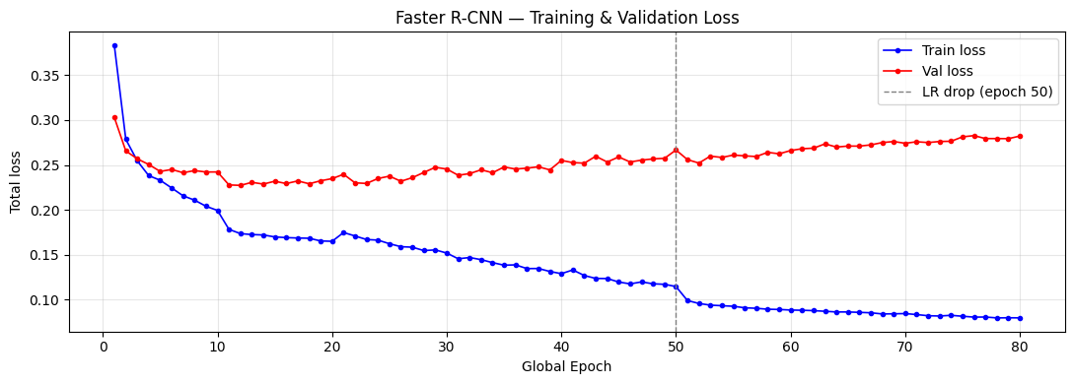
The Evidence: P1 Proven Empirically
Epoch 8–50: Hard Plateau
Val loss stuck at ~0.23 while train keeps falling. Model detects unannotated cells — penalised as false positives.
Post-Epoch 50: Gets Worse
LR drop → train 0.08 but val rises to 0.28. Smaller updates cause over-commitment to unannotated cells.
Best at Epoch 23
"This is not overfitting. This is annotation incompleteness.
No learning rate schedule can fix it within an end-to-end detector."
57 more training epochs produce no improvement and actively degrade performance. Structural ceiling — not optimisation.

Slide 8
Research Contributions
Label-Resilient Segmentation
C1
Annotation-agnostic Stage 1 detects every cell without ground-truth bounding boxes. Directly addresses P1 — the incomplete-annotation failure mode documented in NIH BBBC041.
P1 confirmed: val loss plateau at epoch 8 while train loss falls 5 more epochs.
Density-Invariant Overlap Handling
C2
Distance-transform watershed separates touching cells at instance level, recovering detections that NMS-based detectors systematically suppress in dense smear regions.
58% of BBBC041 images contain cell pairs IoU > 0.3 — empirical P2 motivation.
Integrated End-to-End Explainability
C3
Grad-CAM++ heatmaps generated within the full detection-to-classification pipeline — crop detail AND full-image overlay. First whole-slide malaria system with integrated per-cell XAI.
No prior whole-slide system produces spatial heatmaps at inference — P3 gap confirmed.

Slide 9
Project Status & Roadmap
Phase 1
EDA & Dataset Analysis
Class distribution · Overlap quantification · EDA plots
Done
Phase 2
Faster R-CNN Baseline
80 epochs · mAP@0.5=58.99% · P1 & P2 failure modes confirmed
Done
Phase 3
Watershed + EfficientNet-B0
Stage 1 watershed · Focal Loss classifier · Grad-CAM++ XAI
Next
Phase 4
Flask Web App + HuggingFace
Live demo · 3-card UI · Smear view / Cell gallery / Report
Soon
Phase 5
Evaluation, Ablation & Paper
mAP tables · Dense-region analysis · arXiv / MICCAI submission
Soon

Slide 10
Paper: Current Status
Target: arXiv / MICCAI 2026
Abstract
§3.5 Baseline A
Written
Written
§1 Introduction
§3.6 Evaluation Metrics
Placeholder
Written
§2 Related Work (5 subsections)
§4.1–4.2 Experiments & Results
Written
Partial (Baseline A)
§3.1 Dataset & Setup
§5 Results & Discussion
Written
After Phase 3
§3.2–3.4 Pipeline B
§6 Conclusion & Bibliography
After Phase 3
Placeholder

Slide 11
Thank You
MalariAI — addressing three unsolved problems in malaria AI, simultaneously.
Open to collaboration on:
Kaysarul Anas Apurba
Laurentian University, Canada
kaysarulanas2@gmail.com
Mohammed Ali
Melbourne Institute of Technology
Australia
→ Supervisory support for arXiv / MICCAI submission
→ Co-authorship on Results & Discussion (§5)
→ Clinical validation of Grad-CAM++ outputs
→ Feedback on experimental design & methodology
github.com/Anaskaysar/MalariAI-Automated-Malaria-Cell-Segmentation-from-Blood-Smear-Images

