Slide 1



Credit Risk Prediction
SIC 6 Team 4
Notes:
Note:
1

Slide 2





About Us
Shahd Ammar
Mahmoud Ali
Anas Mahmoud
Samsung Innovation Campus
Notes:
Note:
2

Slide 3
Agenda
Problem Statement
Dataset
Data Visualization
Data Preprocessing
ML Model
Model Deployment
Samsung Innovation Campus
Notes:
Note:
3

Slide 4
Problem Statement
Loan Requests
Medium-Sized Banks: 100-500 loan application per day
Large Banks: 1000-5000 loan application per day
How does the credit department decide?!!!
Samsung Innovation Campus

Slide 5

Dataset
Credit Risk Analysis Dataset
This dataset includes customer credit histories to predict credit risk, with key features like demographics, loan details, and payment history.
https://www.kaggle.com/datasets/ranadeep/credit-risk-dataset
Samsung Innovation Campus

Slide 6
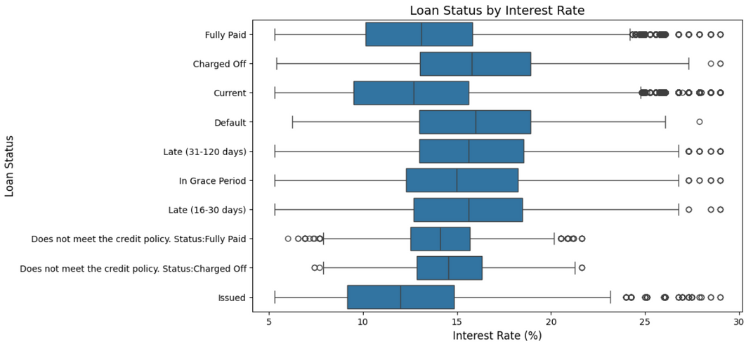
Data Visualization
Higher interest rates are generally associated with loan statuses indicating higher risk, such as Charged Off, Default, and Late payments.
Samsung Innovation Campus

Slide 7
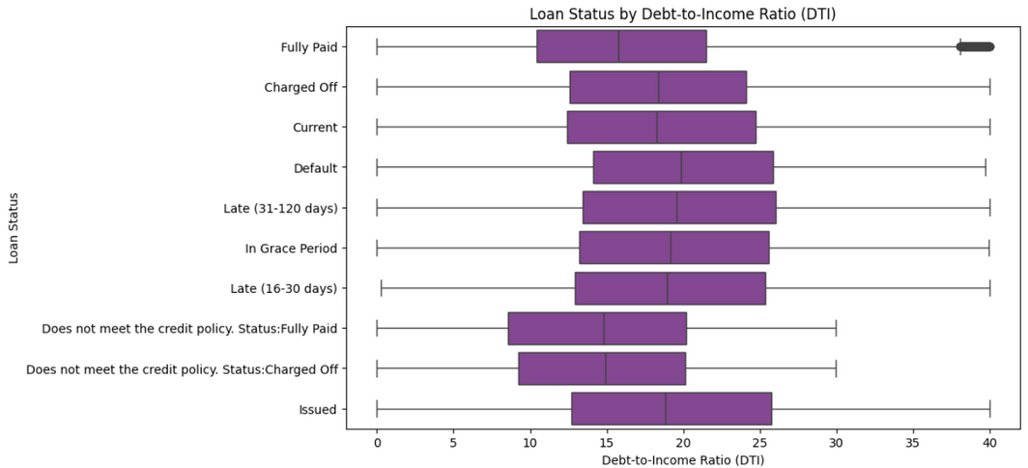
Data Visualization
Higher Debt-to-Income Ratios (DTI) are more likely to be in default or charged off.
Samsung Innovation Campus

Slide 8
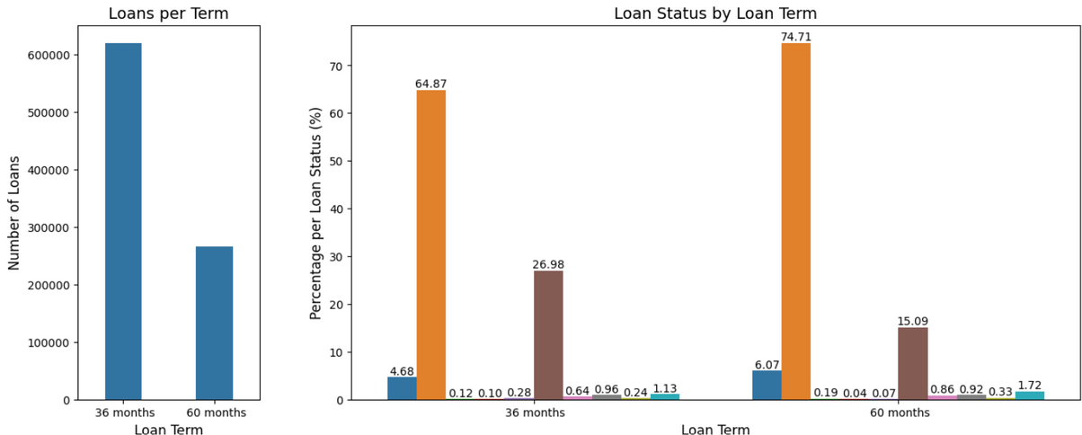
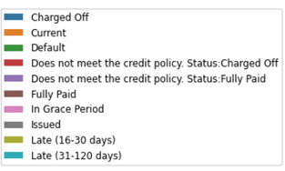
Data Visualization
Shorter-term loans are more common and generally have better repayment statuses compared to longer-term loans.
Samsung Innovation Campus

Slide 9
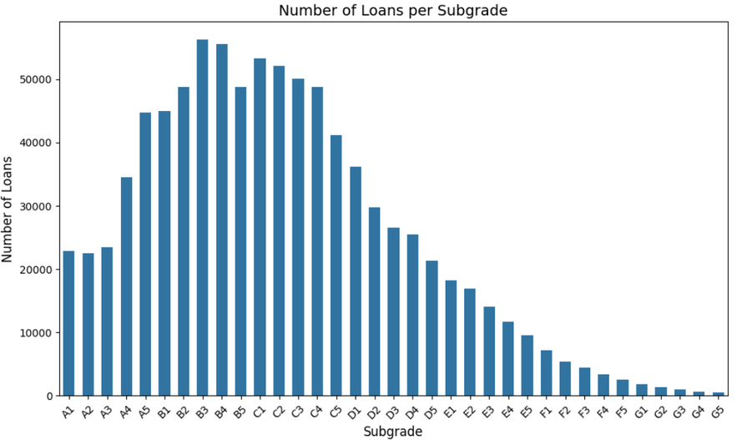
Data Visualization
Loans with better credit ratings are issued more frequently than those with poorer credit ratings.
Samsung Innovation Campus

Slide 10
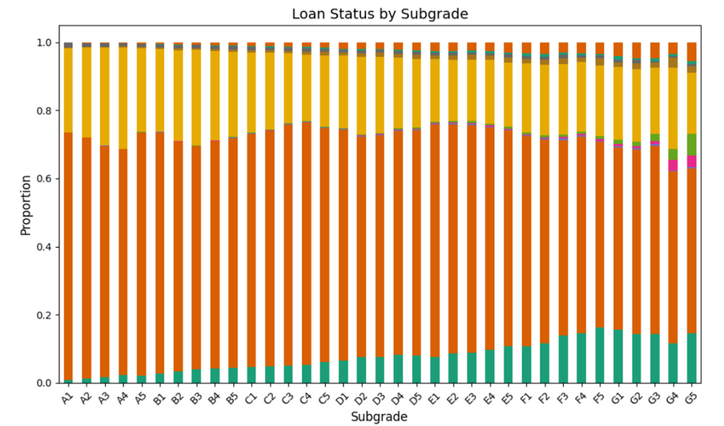
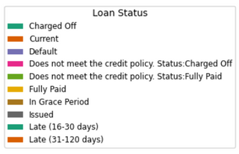
Data Visualization
Majority of loans across all subgrades are current, but higher subgrades have a larger proportion of fully paid loans, while lower subgrades have more charged-off and defaulted loans.
Samsung Innovation Campus

Slide 11
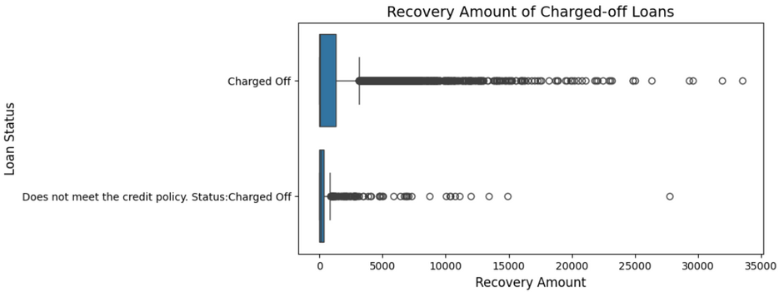
Data Visualization
Recovery amounts are generally higher for loans that are “Charged Off” compared to those that “Do Not Meet the Credit Policy: Charged Off.”
Samsung Innovation Campus

Slide 12
Data Preprocessing
Handling Missing Values
Dropping columns with > 20% missing values.
Dropping rows with > 3 missing features.
Iterative Imputer, why?
It uses a series of regression models to predict missing values.
Samsung Innovation Campus

Slide 13
Data Preprocessing
Categorical Encoding:
Label Encoding
One-Hot Encoding
Custom Encoding
Samsung Innovation Campus

Slide 14
Data Preprocessing
Dimensionality Reduction
Dropping insignificant features
PCA to calculate Cumulative Variance Ratio
25 features achieve CVR =99.4%
Samsung Innovation Campus

Slide 15
ML Modeling
Logistic Regression
SVC
Decision Tree Classifier
Random Forest Classifier
XGBoost Classifier
Samsung Innovation Campus

Slide 16
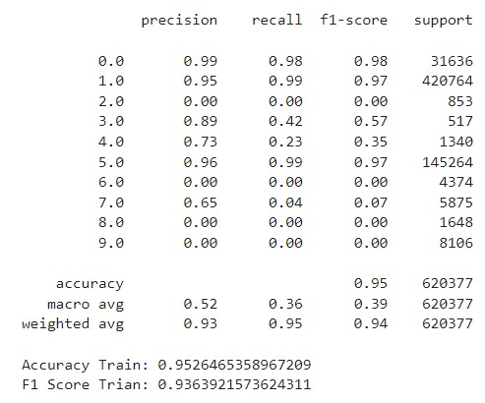
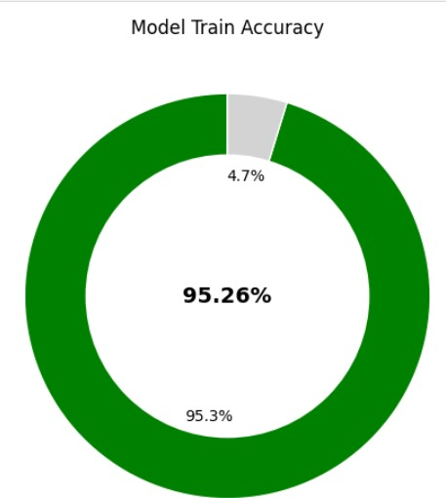
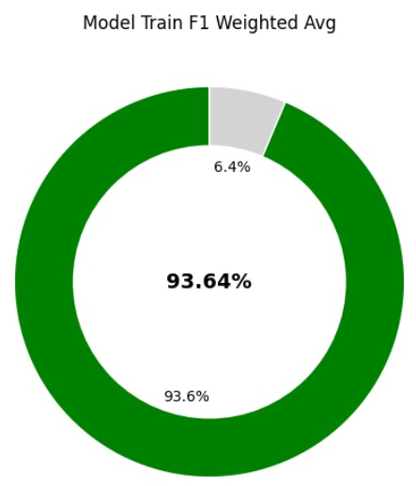
XGBoost Classifier
Samsung Innovation Campus

Slide 17
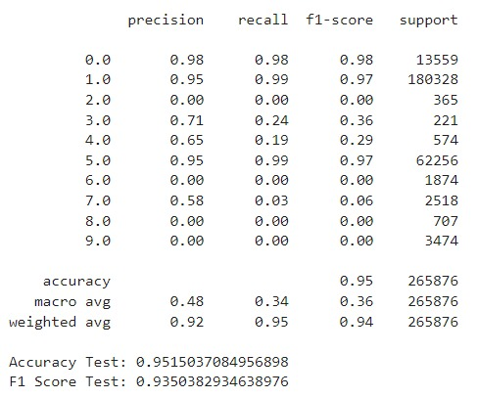
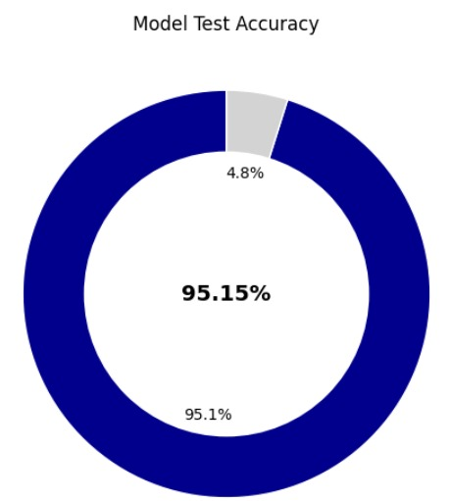
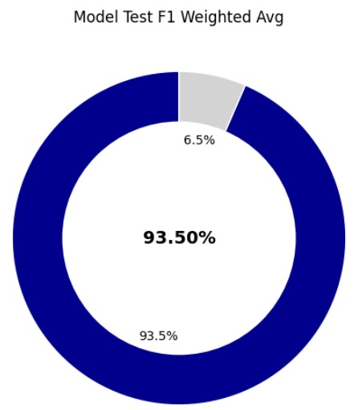
XGBoost Classifier
Samsung Innovation Campus

Slide 18
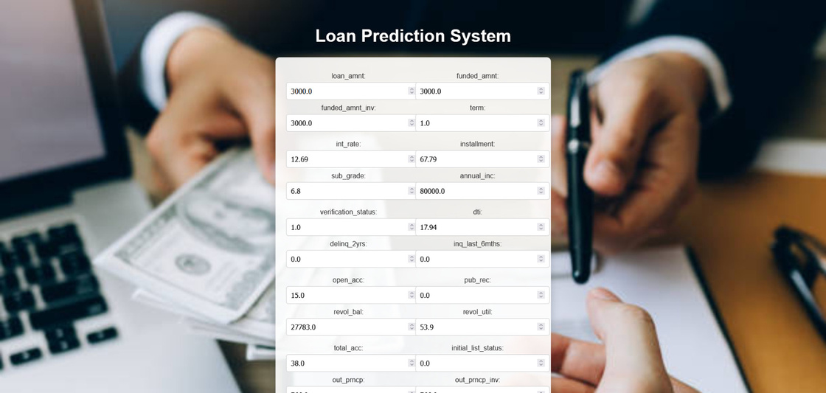
Model Deployment
Samsung Innovation Campus
Notes:
18

Slide 19
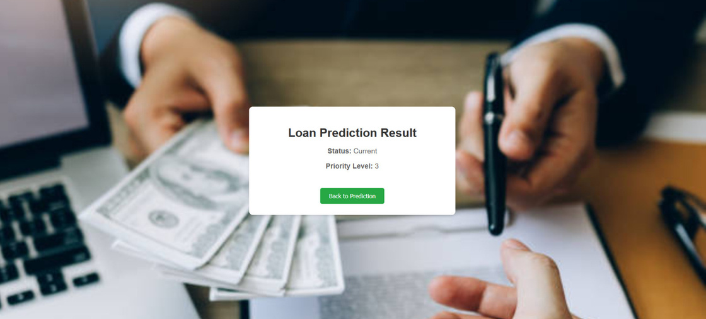
Model Deployment
Priority 1 is the lowest, and 10 is the lowest.
Samsung Innovation Campus
Notes:
19

Slide 20
Thank You
Samsung Innovation Campus
Notes:
Note:
20

Slide 21

ⓒ2020 SAMSUNG. All rights reserved.
Samsung Electronics Corporate Citizenship Office holds the copyright of book.
This book is a literary property protected by copyright law so reprint and reproduction without permission are prohibited.
To use this book other than the curriculum of Samsung innovation Campus or to use the entire or part of this book, you must receive written consent from copyright holder.
Notes:
21

