Slide 1
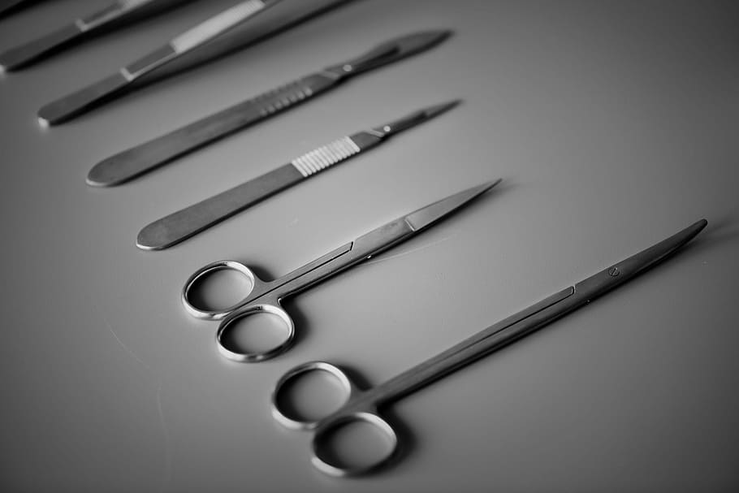

KLSMARTIN
PRODUCT DEMO

Slide 2



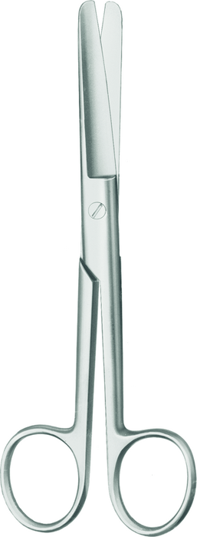
ArticleNo: 11-100-11-07
Description:
Operating scissors, blunt/blunt, straight, length 12 cm
Catalogues & Brochures:
• General Surgery • Neurosurgery

Slide 3
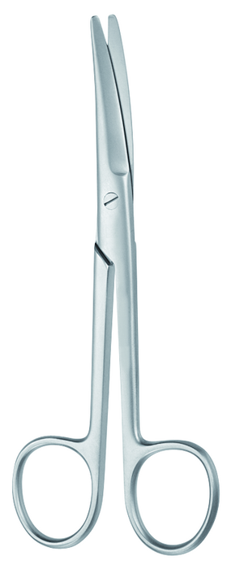
ArticleNo: 11-171-23-07
Description:
Scissors, acc. to Mayo, curved, length 23.5 cm
Catalogues & Brochures:
• General Surgery • Neurosurgery • Plastic Surgery

Slide 4
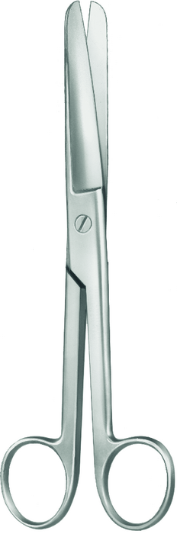
ArticleNo: 11-230-17-07
Description:
Gynecological scissors, standard, acc. to Doyen, blunt/blunt, straight, length 18.5 cm
Catalogues & Brochures:
General Surgery

Slide 5
ArticleNo: 10-130-03-07
Description:
Scalpel handle, no. 3, length 12 cm
Catalogues & Brochures:
• Cardio • Thoracic and Vascular Surgery • General Surgery • Neurosurgery • Oral and Maxillofacial Surgery • Plastic Surgery

Slide 6
ArticleNo: 10-137-07-07
Description:
Scalpel handle, no. 7, solid, length 16 cm
Catalogues & Brochures:
• Cardio • Thoracic and Vascular Surgery • General Surgery • Neurosurgery • Oral and Maxillofacial Surgery • Plastic Surgery

Slide 7
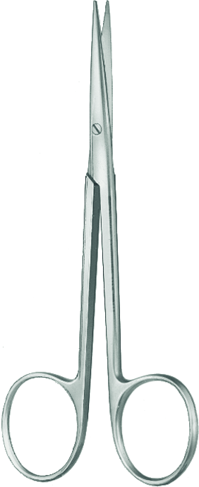
ArticleNo: 11-594-11-07
Description:
Surgical scissors, standard, fine, blunt, blunt, straight, length 11.5 cm
Catalogues & Brochures:
• General Surgery • Oral and Maxillofacial Surgery

Slide 8
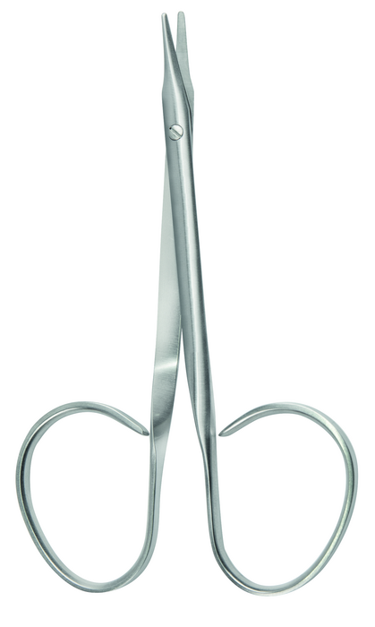
ArticleNo: 11-682-11-07
Description:
Tendon scissors, acc. to Stevens, blunt, blunt, straight, length 11 cm
Catalogues & Brochures:
• General Surgery • Neurosurgery • Oral and Maxillofacial Surgery • Plastic Surgery

Slide 9
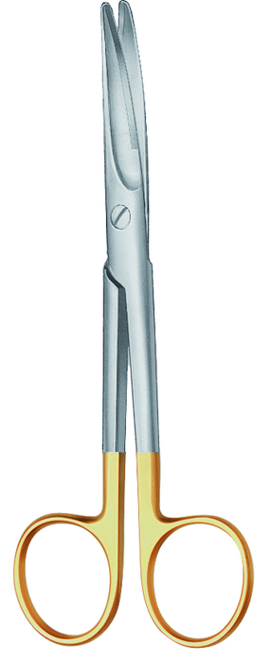
ArticleNo: 11-911-17-07
Description:
Face-lift scissors, acc. to Mayo, curved, length 17 cm
Catalogues & Brochures:
• General Surgery • Neurosurgery • Plastic Surgery

Slide 10
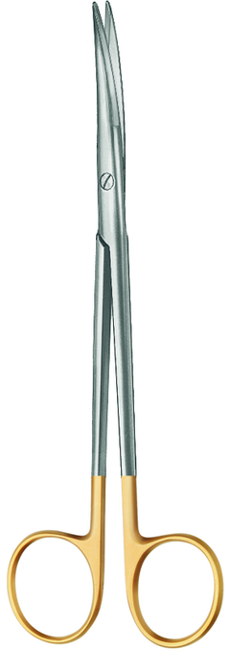
ArticleNo: 11-965-14-07
Description:
TC gold dissecting scissors, acc. toacc. to Lahey, curved, length 14.5 cm
Catalogues & Brochures:
• Cardio • Thoracic and Vascular Surgery • General Surgery • Neurosurgery • Oral and Maxillofacial Surgery

Slide 11
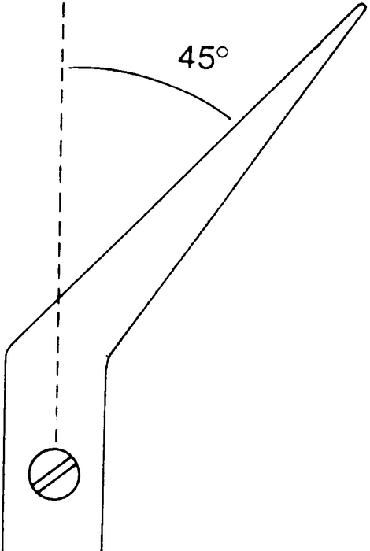
ArticleNo: 11-985-45-07
Description:
TC gold scissors, acc. to De Bakey,, 45°, length 18.5 cm
Catalogues & Brochures:
• Cardio • Thoracic and Vascular Surgery • General Surgery

Slide 12
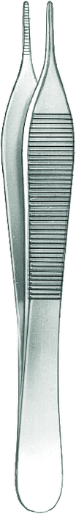
ArticleNo: 12-168-12-07
Description:
Dressing forceps, acc. to Adson, length 12 cm
Catalogues & Brochures:
• Cardio • Thoracic and Vascular Surgery • General Surgery • Neurosurgery • Oral and Maxillofacial Surgery • Plastic Surgery

Slide 13
ArticleNo: 12-258-18-07
Description:
TC gold dressing forceps, acc. to Potts-Smith, length 18.5 cm
Catalogues & Brochures:
• Cardio • Thoracic and Vascular Surgery • General Surgery • Neurosurgery

Slide 14
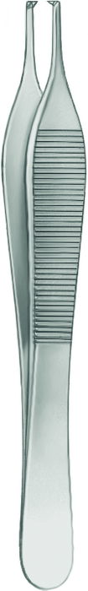
ArticleNo: 12-368-12-07
Description:
Tissue forceps, acc. to Adson, 1 x 2 teeth, length 12 cm
Catalogues & Brochures:
• Cardio • Thoracic and Vascular Surgery • General Surgery • Neurosurgery • Plastic Surgery

Slide 15
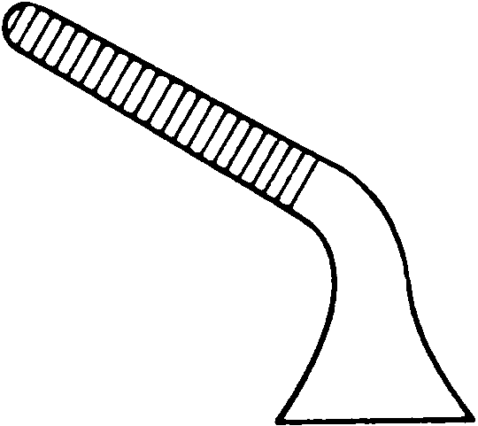
ArticleNo: 13-121-08-07
Description:
Bulldog clamp, acc. to Diethrich, curved, length 8 mm
Catalogues & Brochures:
• Cardio • Thoracic and Vascular Surgery • General Surgery • Plastic Surgery

Slide 16
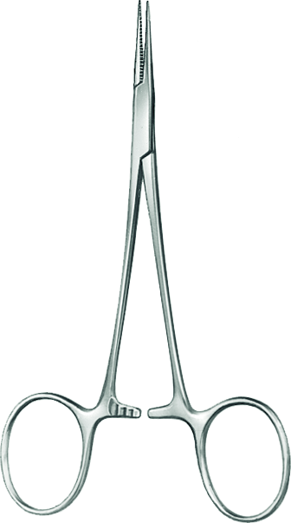
ArticleNo: 13-310-12-07
Description:
Hemostatic forceps, acc. to Mosquito, straight, length 12.5 cm
Catalogues & Brochures:
• Cardio • Thoracic and Vascular Surgery • General Surgery • Neurosurgery • Oral and Maxillofacial Surgery • Plastic Surgery

Slide 17
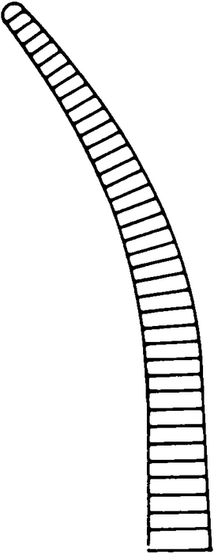
ArticleNo: 13-311-12-07
Description:
Hemostatic forceps, acc. to Mosquito, curved, length 12 cm
Catalogues & Brochures:
• Cardio • Thoracic and Vascular Surgery • General Surgery • Neurosurgery • Oral and Maxillofacial Surgery • Plastic Surgery

Slide 18
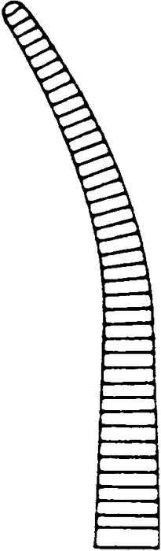
ArticleNo: 13-321-10-07
Description:
Micro hemostatic forceps, acc. to Mosquito, curved, length 10 cm
Catalogues & Brochures:
• Cardio • Thoracic and Vascular Surgery • General Surgery • Oral and Maxillofacial Surgery • Plastic Surgery

Slide 19
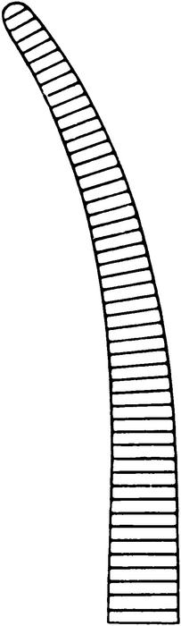
ArticleNo: 13-341-14-07
Description:
Hemostatic forceps, acc. to Crile, curved, length 14.5 cm
Catalogues & Brochures:
• Cardio • Thoracic and Vascular Surgery • General Surgery • Neurosurgery

Slide 20
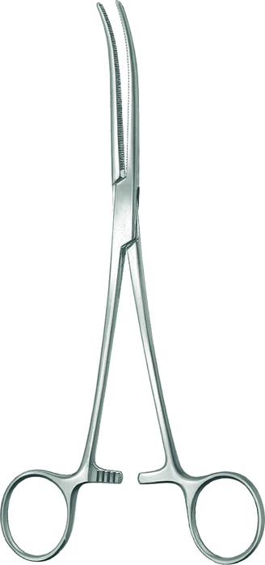
ArticleNo: 13-411-16-07
Description:
Hemostatic forceps, acc. to Pean, curved, length 16 cm
Catalogues & Brochures:
• Cardio • Thoracic and Vascular Surgery • General Surgery • Neurosurgery

Slide 21
ArticleNo: 13-411-22-07
Description:
Hemostatic forceps, acc. to Pean, curved, length 22 cm
Catalogues & Brochures:
• Cardio • Thoracic and Vascular Surgery • General Surgery • Neurosurgery

Slide 22
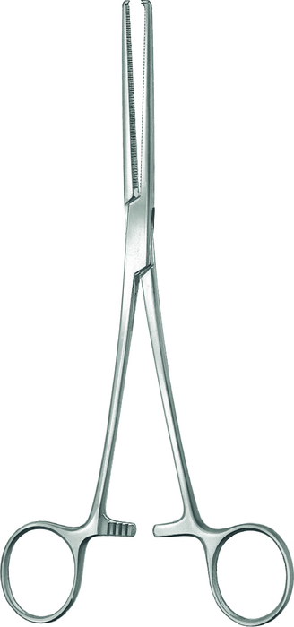
ArticleNo: 13-414-16-07
Description:
Hemostatic forceps, acc. to Kocher, 1 x 2 teeth, straight, length 16.5 cm
Catalogues & Brochures:
• Cardio • Thoracic and Vascular Surgery • General Surgery • Neurosurgery

Slide 23
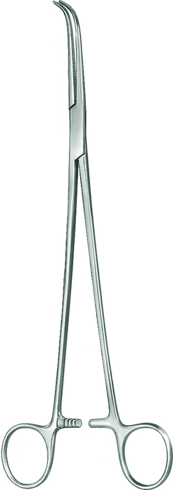
ArticleNo: 13-451-13-07
Description:
Dissecting forceps, acc. to Gemini, curved, length 13 cm
Catalogues & Brochures:
• Cardio • Thoracic and Vascular Surgery • General Surgery • Neurosurgery

Slide 24
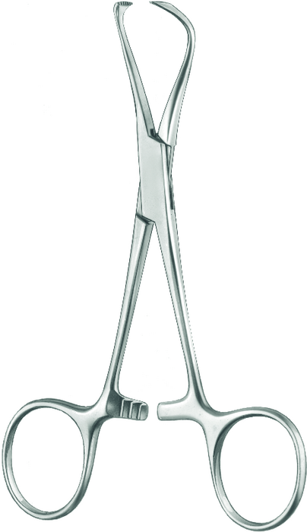
ArticleNo: 13-919-13-07
Description:
Towel forceps, acc. to Lorna, fine serration, wide jaw, length 13 cm
Catalogues & Brochures:
• Cardio • Thoracic and Vascular Surgery • General Surgery

Slide 25
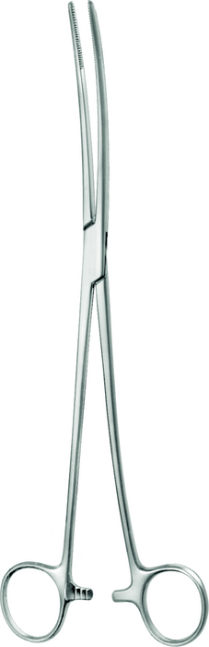
ArticleNo: 14-313-26-07
Description:
Sponge forceps, acc. to Bozemann, s-shape, length 26 cm
Catalogues & Brochures:
General Surgery

Slide 26

ArticleNo: 15-091-14-07
Description:
Hooklet, acc. to Desmarres, width 14 mm, length 16 cm
Catalogues & Brochures:
• Cardio • Thoracic and Vascular Surgery • General Surgery • Neurosurgery • Oral and Maxillofacial Surgery • Plastic Surgery

Slide 27

ArticleNo: 15-167-16-07
Description:
Hooklet, acc. to Senn-Miller, blunt, length 16 cm
Catalogues & Brochures:
• Cardio • Thoracic and Vascular Surgery • General Surgery • Plastic Surgery

Slide 28
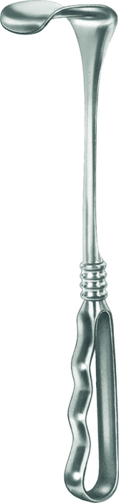
ArticleNo: 15-391-01-01
Description:
Retractor, acc. to Richardson, 25 mm x 21 mm, length 23.5 cm
Catalogues & Brochures:
• Cardio • Thoracic and Vascular Surgery • General Surgery

Slide 29
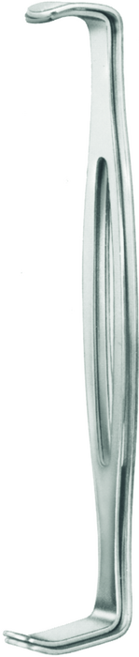
ArticleNo: 15-687-00-07
Description:
Retractor, double, acc. to Parker-Langenbeck, set, length 21.5 cm
Catalogues & Brochures:
• Cardio • Thoracic and Vascular Surgery • General Surgery

Slide 30
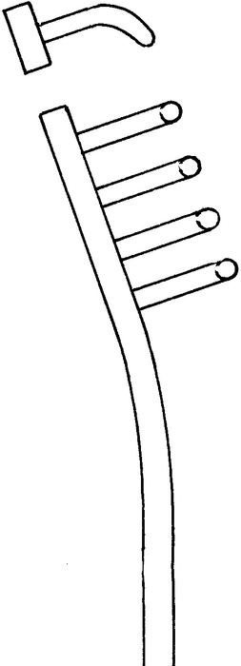
ArticleNo: 15-715-07-07
Description:
Woundspreader, acc. to Alm, blunt, 4 x 4 teeth, 55 mm, length 7 cm
Catalogues & Brochures:
• Cardio • Thoracic and Vascular Surgery • General Surgery • Neurosurgery • Plastic Surgery

Slide 31
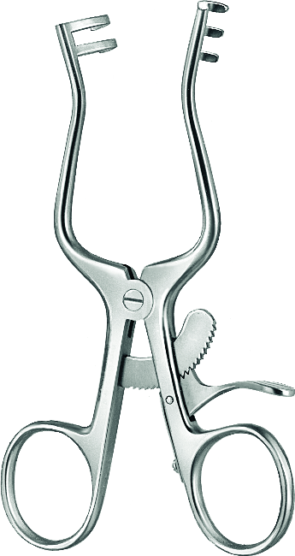
ArticleNo: 15-749-10-07
Description:
Woundspreader, acc. to Weitlaner, blunt, 2 x 3 teeth, 40 mm, length 11 cm
Catalogues & Brochures:
• Cardio • Thoracic and Vascular Surgery • General Surgery • Neurosurgery • Plastic Surgery

Slide 32
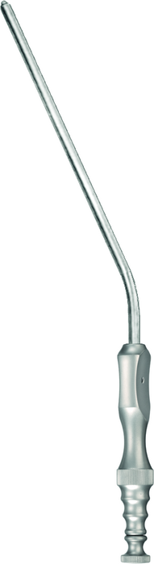
ArticleNo: 18-523-08-01
Description:
Suction tube, acc. to Frazier, Ø 2.7 mm, 130 mm, length 19.5 cm
Catalogues & Brochures:
• General Surgery • Neurosurgery • Oral and Maxillofacial Surgery

Slide 33
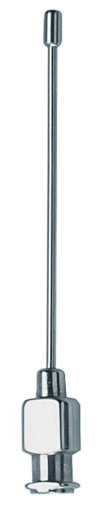
ArticleNo: 18-696-06-01
Description:
Heparin flushing needle, Luer Lock connection, Ø 2,9 mm, length 65 mm
Catalogues & Brochures:
• Cardio • Thoracic and Vascular Surgery • General Surgery

Slide 34
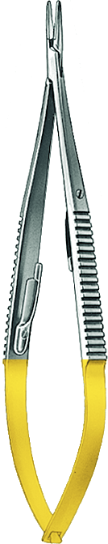
ArticleNo: 20-620-00-07
Description:
TC-Gold micro needle holder, acc. to Castroviejo, straight, micro-profile, with ratchet lock, thread size 5-0 - 8-0, length 14.5 cm
Catalogues & Brochures:
• Cardio • Thoracic and Vascular Surgery • General Surgery • Neurosurgery • Oral and Maxillofacial Surgery • Plastic Surgery

Slide 35
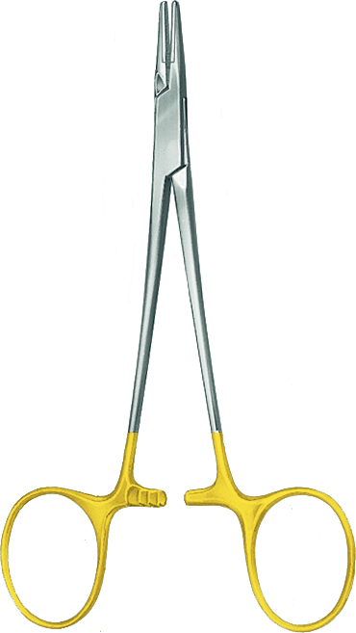
ArticleNo: 20-637-13-07
Description:
TC-Gold needle holder, acc. to Halsey, straight, mini profile, thread size 4-0 - 6-0, length 13 cm
Catalogues & Brochures:
• Cardio • Thoracic and Vascular Surgery • General Surgery • Neurosurgery • Oral and Maxillofacial Surgery • Plastic Surgery

Slide 36
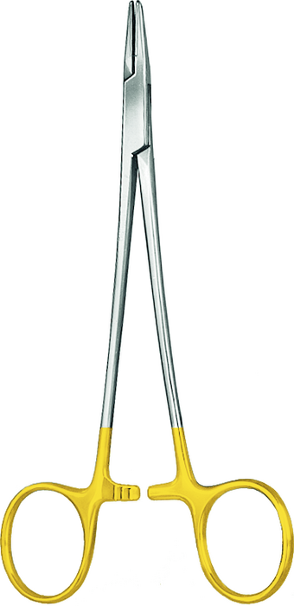
ArticleNo: 20-638-15-07
Description:
TC-Gold needle holder, acc. to Crile-Wood, straight, mini profile, thread size 4-0 - 6-0, length 15 cm
Catalogues & Brochures:
• Cardio • Thoracic and Vascular Surgery • General Surgery • Neurosurgery • Oral and Maxillofacial Surgery

Slide 37
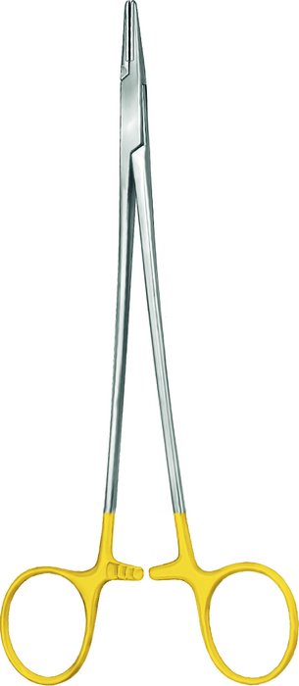
ArticleNo: 20-646-18-07
Description:
TC-Gold needle holder, acc. to DeBakey, straight, mini-profile, thread size 4-0 - 6-0, length 18 cm
Catalogues & Brochures:
• Cardio • Thoracic and Vascular Surgery • General Surgery • Neurosurgery • Oral and Maxillofacial Surgery • Plastic Surgery

Slide 38

ArticleNo: 24-388-16-07
Description:
Atraumatic forceps, acc. to De Bakey, width 2 mm, length 16 cm
Catalogues & Brochures:
• Cardio • Thoracic and Vascular Surgery • Neurosurgery • Oral and Maxillofacial Surgery

Slide 39
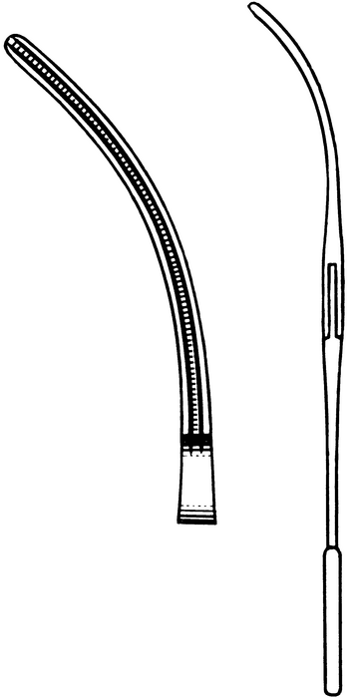
ArticleNo: 24-458-11-07
Description:
Pediatric vascular clamp, Atrauma, acc. to De Bakey, curved, length 13 cm
Catalogues & Brochures:
• Cardio • Thoracic and Vascular Surgery

Slide 40
ArticleNo: 24-458-12-07
Description:
Pediatric vascular clamp, Atrauma, acc. to De Bakey, straight, length 13 cm
Catalogues & Brochures:
• Cardio • Thoracic and Vascular Surgery

Slide 41
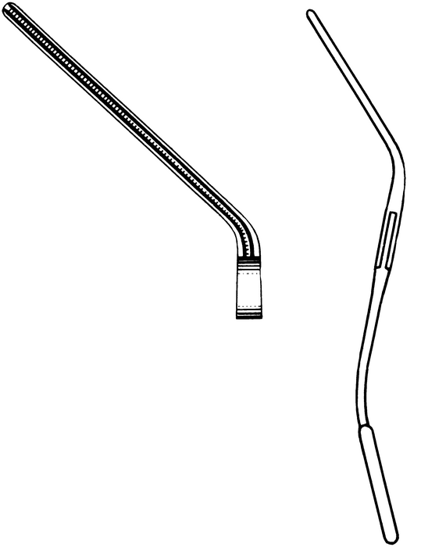
ArticleNo: 24-459-13-07
Description:
Pediatric vascular clamp, Atrauma, acc. to De Bakey, angled, length 12.5 cm
Catalogues & Brochures:
• Cardio • Thoracic and Vascular Surgery

Slide 42
ArticleNo: 24-492-10-01
Description:
Dilator, acc. to De Bakey, Ø 1.0 mm, length 19 cm
Catalogues & Brochures:
• Cardio • Thoracic and Vascular Surgery

Slide 43
ArticleNo: 24-492-15-01
Description:
Dilator, acc. to De Bakey, Ø 1.5 mm, length 19 cm
Catalogues & Brochures:
• Cardio • Thoracic and Vascular Surgery

Slide 44

ArticleNo: 24-492-20-01
Description:
Dilator, acc. to De Bakey, Ø 2.0 mm, length 19 cm
Catalogues & Brochures:
• Cardio • Thoracic and Vascular Surgery

Slide 45

ArticleNo: 24-492-25-01
Description:
Dilator, acc. to De Bakey, Ø 2.5 mm, length 19 cm
Catalogues & Brochures:
• Cardio • Thoracic and Vascular Surgery

Slide 46
ArticleNo: 24-492-30-01
Description:
Dilator, acc. to De Bakey, Ø 3.0 mm, length 19 cm
Catalogues & Brochures:
• Cardio • Thoracic and Vascular Surgery

Slide 47
ArticleNo: 24-492-35-01
Description:
Dilator, acc. to De Bakey, Ø 3.5 mm, length 19 cm
Catalogues & Brochures:
• Cardio • Thoracic and Vascular Surgery

Slide 48
ArticleNo: 24-492-40-01
Description:
Dilator, acc. to De Bakey, Ø 4.0 mm, length 19 cm
Catalogues & Brochures:
• Cardio • Thoracic and Vascular Surgery

Slide 49
ArticleNo: 24-492-45-01
Description:
Dilator, acc. to De Bakey, Ø 4.5 mm, length 19 cm
Catalogues & Brochures:
• Cardio • Thoracic and Vascular Surgery

Slide 50
ArticleNo: 28-209-18-07
Description:
Skin hook, acc. to Gillies, figure 2, length 18 cm
Catalogues & Brochures:
• Oral and Maxillofacial Surgery • Plastic Surgery

Slide 51
ArticleNo: 28-215-03-07
Description:
Face-lift hooklet, acc. to Kaye, 4 prongs, length 13 cm
Catalogues & Brochures:
• Plastic Surgery • Portfolio Overview • Suggested Surgical Instrument Sets

Slide 52
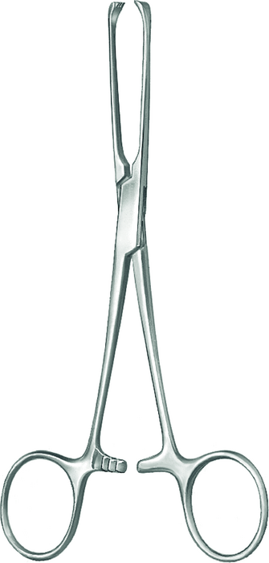
ArticleNo: 30-132-15-07
Description:
Intestinal and tissue grasping forceps, acc. to Allis, 4 x 5 teeth, length 15.5 cm
Catalogues & Brochures:
• Cardio • Thoracic and Vascular Surgery • General Surgery • Oral and Maxillofacial Surgery

Slide 53
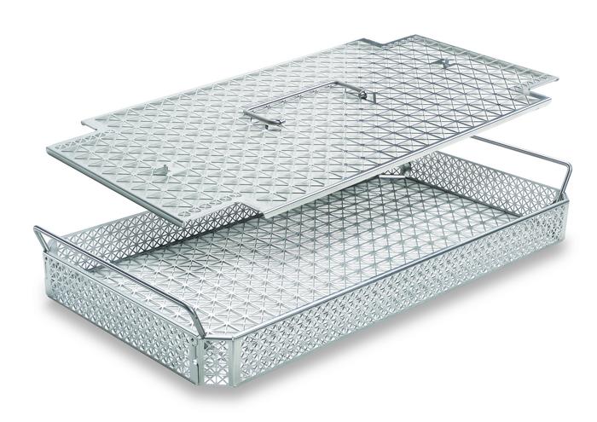
ArticleNo: 55-804-49-01
Description:
Mesh trays and perforated wire-mesh trays size DIN, 477x251x44 mm
Catalogues & Brochures:
Tray Systems

Slide 54
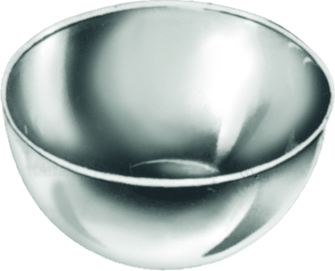
ArticleNo: 56-231-08-01
Description:
Stainless steel bowl, Ø 80 mm, height 40 mm, capacity 140 ml
Catalogues & Brochures:
• General Surgery • Oral and Maxillofacial Surgery • Suggested Surgical Instrument Sets

