Slide 1
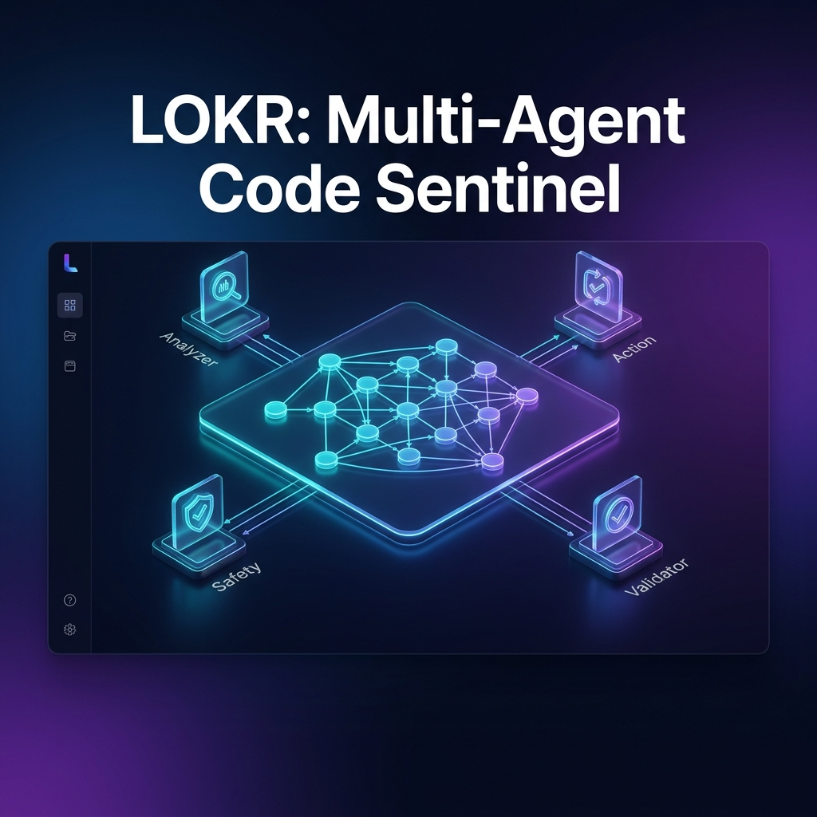
[INSERT COVER IMAGE HERE]
🛡️ LOKR
Multi-Agent Code Sentinel
AI Engineering Copilot

Slide 2
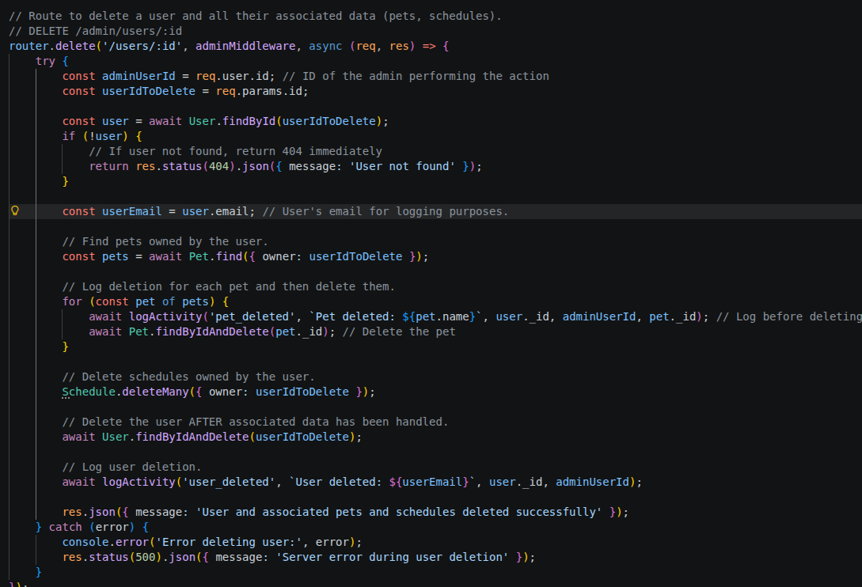
The Problem
[INSERT IMAGE HERE]
Modern codebases are too complex for manual review.
Silent bugs like IDOR, logic inversions, and missing validations slip past traditional CI/CD.
AI assistants hallucinate fixes for code they've never seen.
Traditional tools can't understand actual code structure or dependencies.

Slide 3
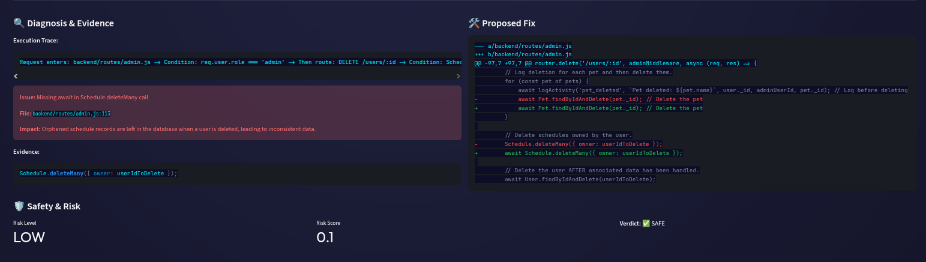
The Solution
LOKR isn't just a chatbot.
It's a multi-agent framework that:
• Detects bugs using Graph-RAG over your actual codebase
• Repairs issues with validated patches
• Prevents dangerous deployments before they happen, Grounded in evidence. Zero hallucinations.

Slide 4
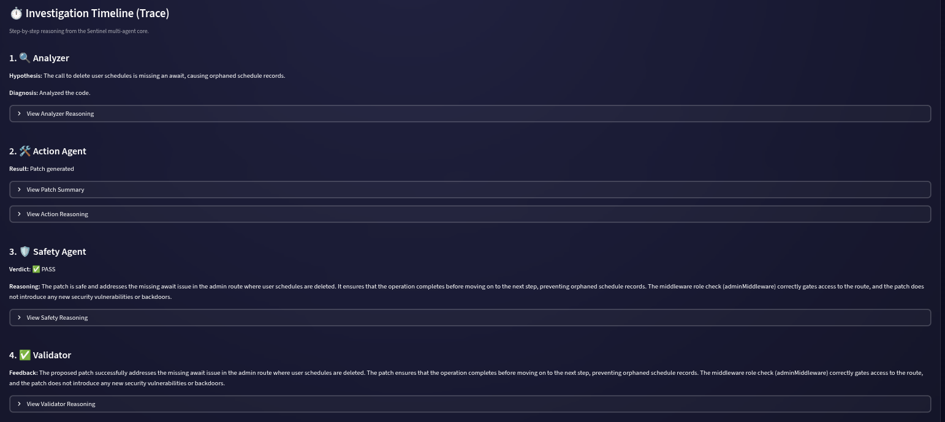
How It Works
4 specialized agents collaborate in a deterministic loop:
1. Analyzer: Diagnoses the issue
2. Action: Proposes a fix
3. Safety: Evaluates risk
4. Validator: Verifies correctness
Every decision is cross-referenced against your actual codebase.

Slide 5
Why AMD
MI300X gives us 192GB VRAM for full codebase analysis.
Deployed on ROCm for cost-effective inference.
Qwen 2.5-Coder 32B and 72B running natively on AMD hardware.
Privacy-first: Code stays on-premise. Enterprise-ready.

Slide 6
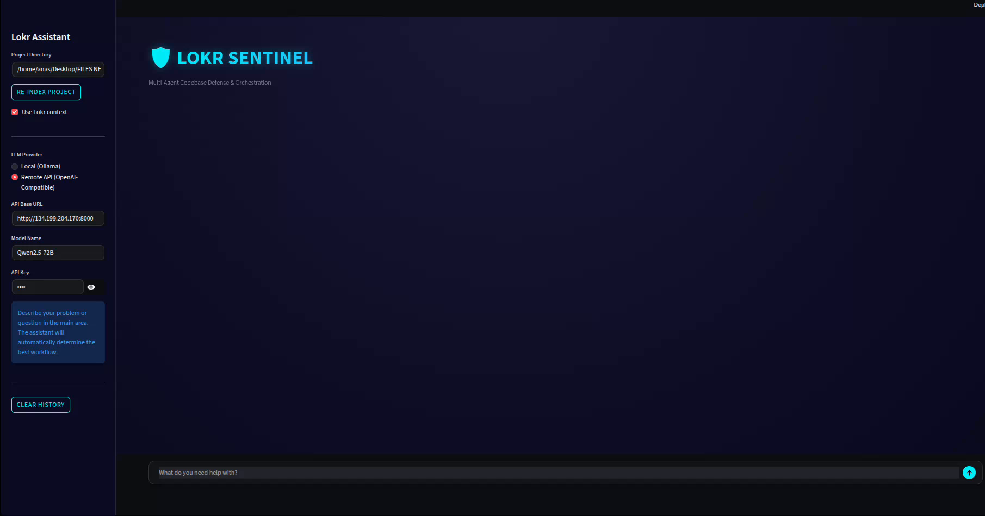
The Demo
Watch LOKR in action:
REPAIR Mode: Detect a missing‑await race condition
- Trace the broken async call to its root cause
- Propose a validated fix in seconds
REVIEW Mode: Catch a dangerous logic regression
- Reject a || → && condition change that weakens validation
- Risk scoring with evidence
PREVENT Mode: Block a dangerous deployment
- Failing CI + disabled auth + missing migration
- Returns NO_GO_FIX_BLOCKERS with reasoning

Slide 7
The Impact
10x Faster Debugging
Engineers spend less time manually tracing code.
Zero-Regression Deployments
Every fix is validated before merge.
Total Codebase Visibility
LOKR makes development faster, safer, and entirely transparent.
Built on AMD Infrastructure. Open Source. Production-Ready.

