Slide 1

Wireless Charging
Florian Garibal
Guillaume Hottin
Noah Michel Jay
Friday 9th December, 2016

Slide 2
Introduction
We rely more on more on electronic devices
Portable devices need to be charged
Cables are needed to do so
Wireless charging technologies are becoming increasingly popular
2/17

Slide 3
Introduction
How does wireless charging work?
What are they good for, and what are their limits?
3/17

Slide 4
Introduction
Plan
Introduction
I – Why would we need this?
II – How can it be achieved?
III - What are the limits of this technology?
Conclusion
4/17

Slide 5
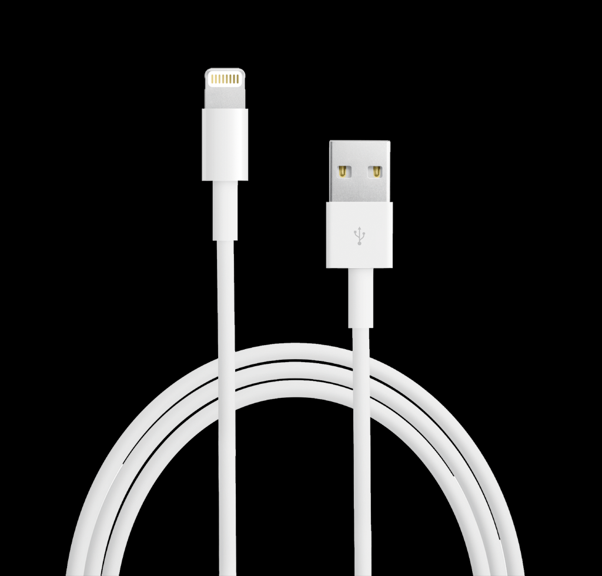
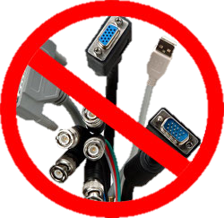
Why do we need this?
Plugging and unplugging can lead to port damaging
Cable ports use precious space
Ports are not aesthetically pleasing
Some devices need to be usable in wet environments
Some devices are implanted under the skin
With cables comes trouble
5/17

Slide 6
How can wireless charging be achieved?
Near Field Techniques
Very short range
Non radiative (no loss of energy)
Two main techniques
Inductive coupling
Capacitive coupling
6/17

Slide 7
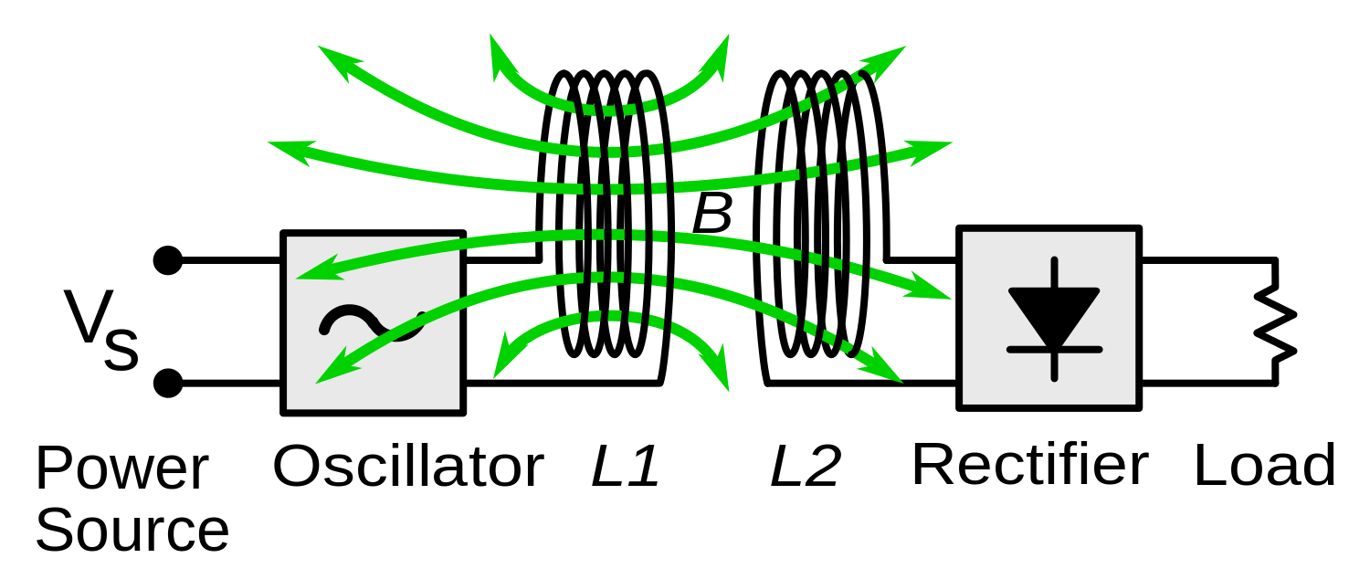
How can wireless charging be achieved?
Inductive Coupling
Ampere’s Law and Faraday’s Law of induction
Made of an emitter and a receiver
The emitter’s coil creates a magnetic field :
Ampere’s Law
The receiver’s coil create’s an electric current :
Faraday’s law of induction
7/17

Slide 8
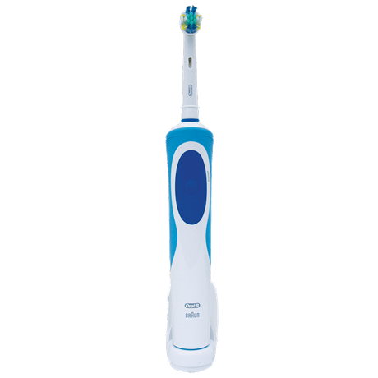
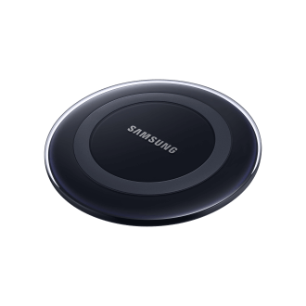
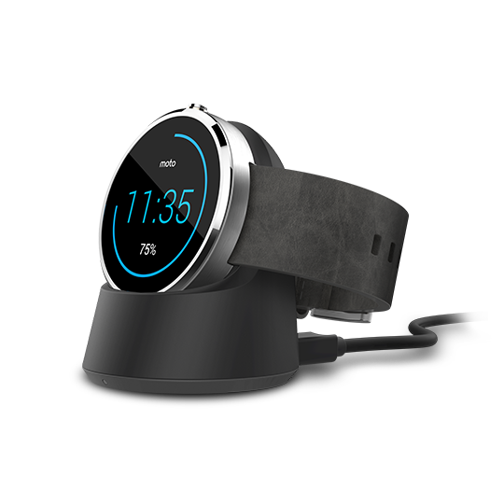
How can wireless charging be achieved?
Inductive Coupling
Very efficient at close range
Most used technology for wireless power transfer :
Mobile phones
Smartwatches
Toothbrushes
… and larger devices
8/17

Slide 9
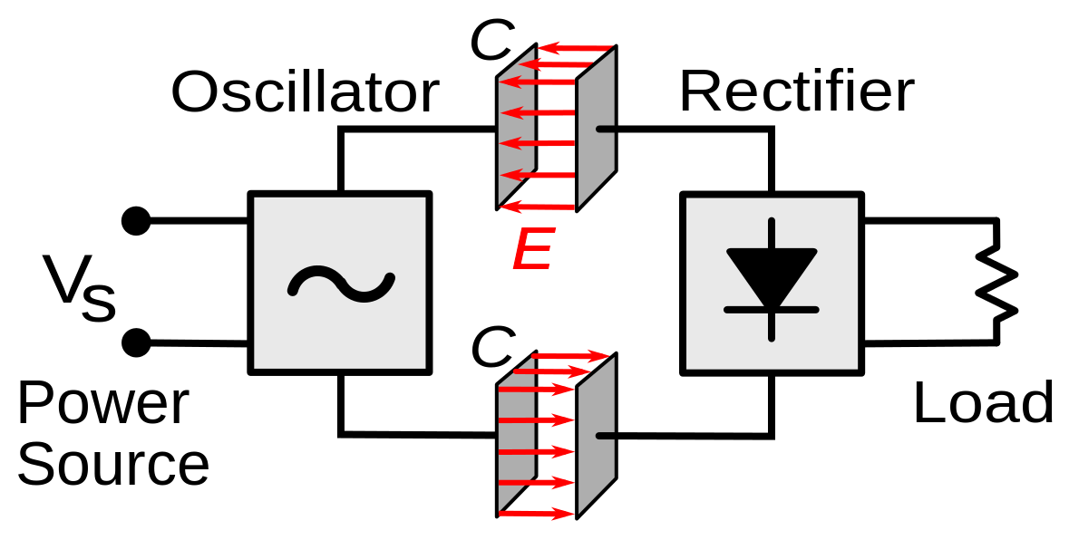
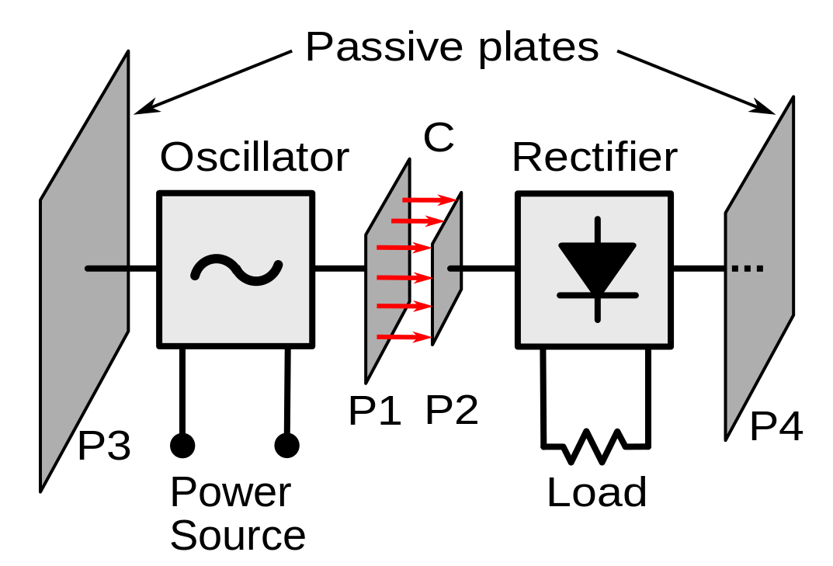
How can wireless charging be achieved?
Capacitive Coupling
Electrodes and capacitors
Made of an emitter and a receiver
By aligning the electrodes, you create an electric field
You have to form two capacitors to close the circuit
9/17

Slide 10
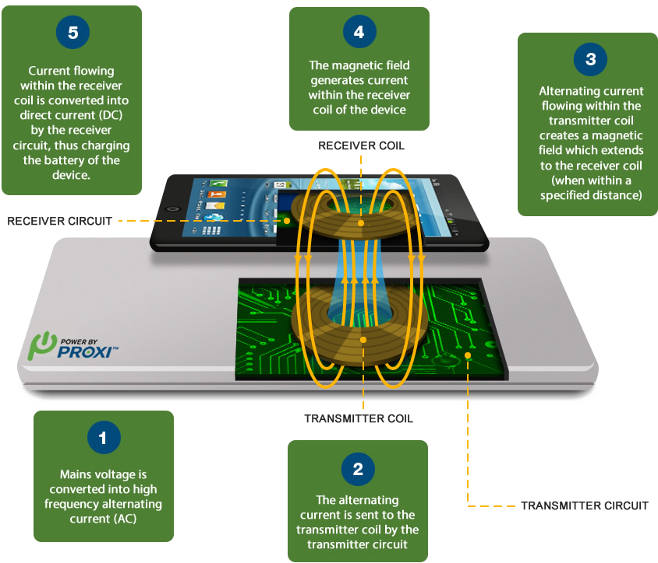
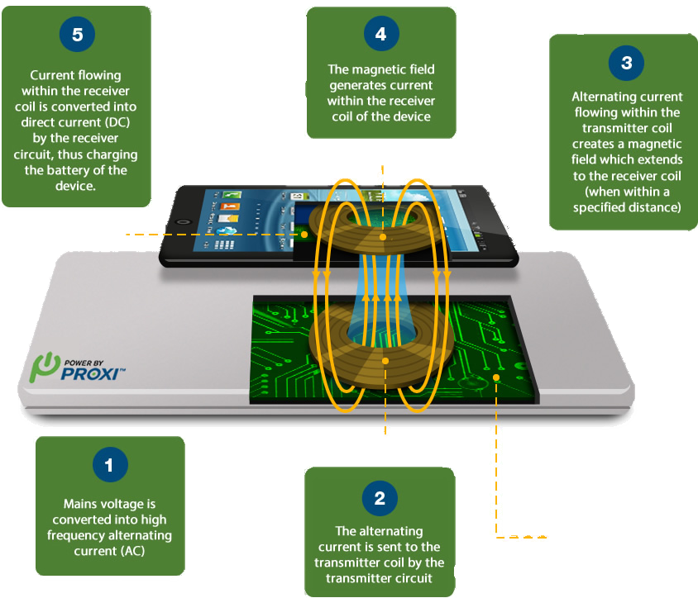
How can wireless charging be achieved?
Receiver Coil
Receiver Circuit
Diagram of wireless charging functionning
Transmitter Coil
Transmitter Circuit
10/17

Slide 11
How can wireless charging be achieved?
Capacitive Coupling
Very efficient at close range
Less used than inductive coupling
Requires high voltage
Reacts badly with the human body
Still has advantages
Less interferences
Alignement is less of a problem
11/17

Slide 12
How can wireless charging be achieved?
Something Else
Clean energy is needed
Solar power
Limited Earth surface
Useless at night
Earth’s atmosphere absorbs a lot of energy
Solar power is too important to give up on it
12/17

Slide 13
How can wireless charging be achieved?
Something Else
Put the solar panels in space
More space available
Can be used 24/7
Nothing to absorb energy
Transfer the power to Earth
Can’t put a cable from the ground up to space
Electromagnetic waves
Research is being pushed this way
13/17

Slide 14
Limits and future
Only short range technology available to this day
Long range power transfer is difficult
Impossible with non radiative techniques
Still a challenge with radiative techniques
Long range power transfer is not that far away
14/17

Slide 15
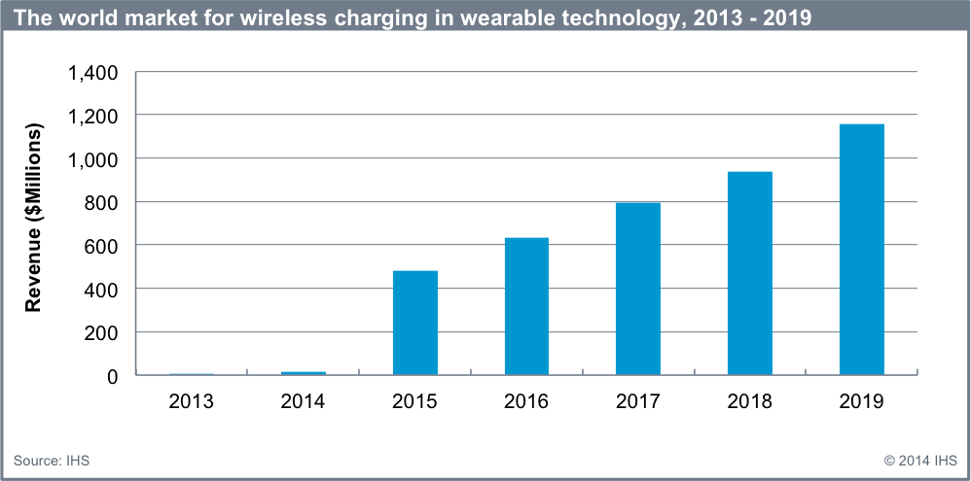
Conclusion
Concept in full development accoring to IHS Markit©
15/17

Slide 16
Conclusion
Mature
Affordable
Efficient
But only at home or for very specific case
Only 20% of consumers are actually using wireless charging
16/17

Slide 17
Questions ?
Thank you for you attention.
Feel free to ask any question.

