Slide 1
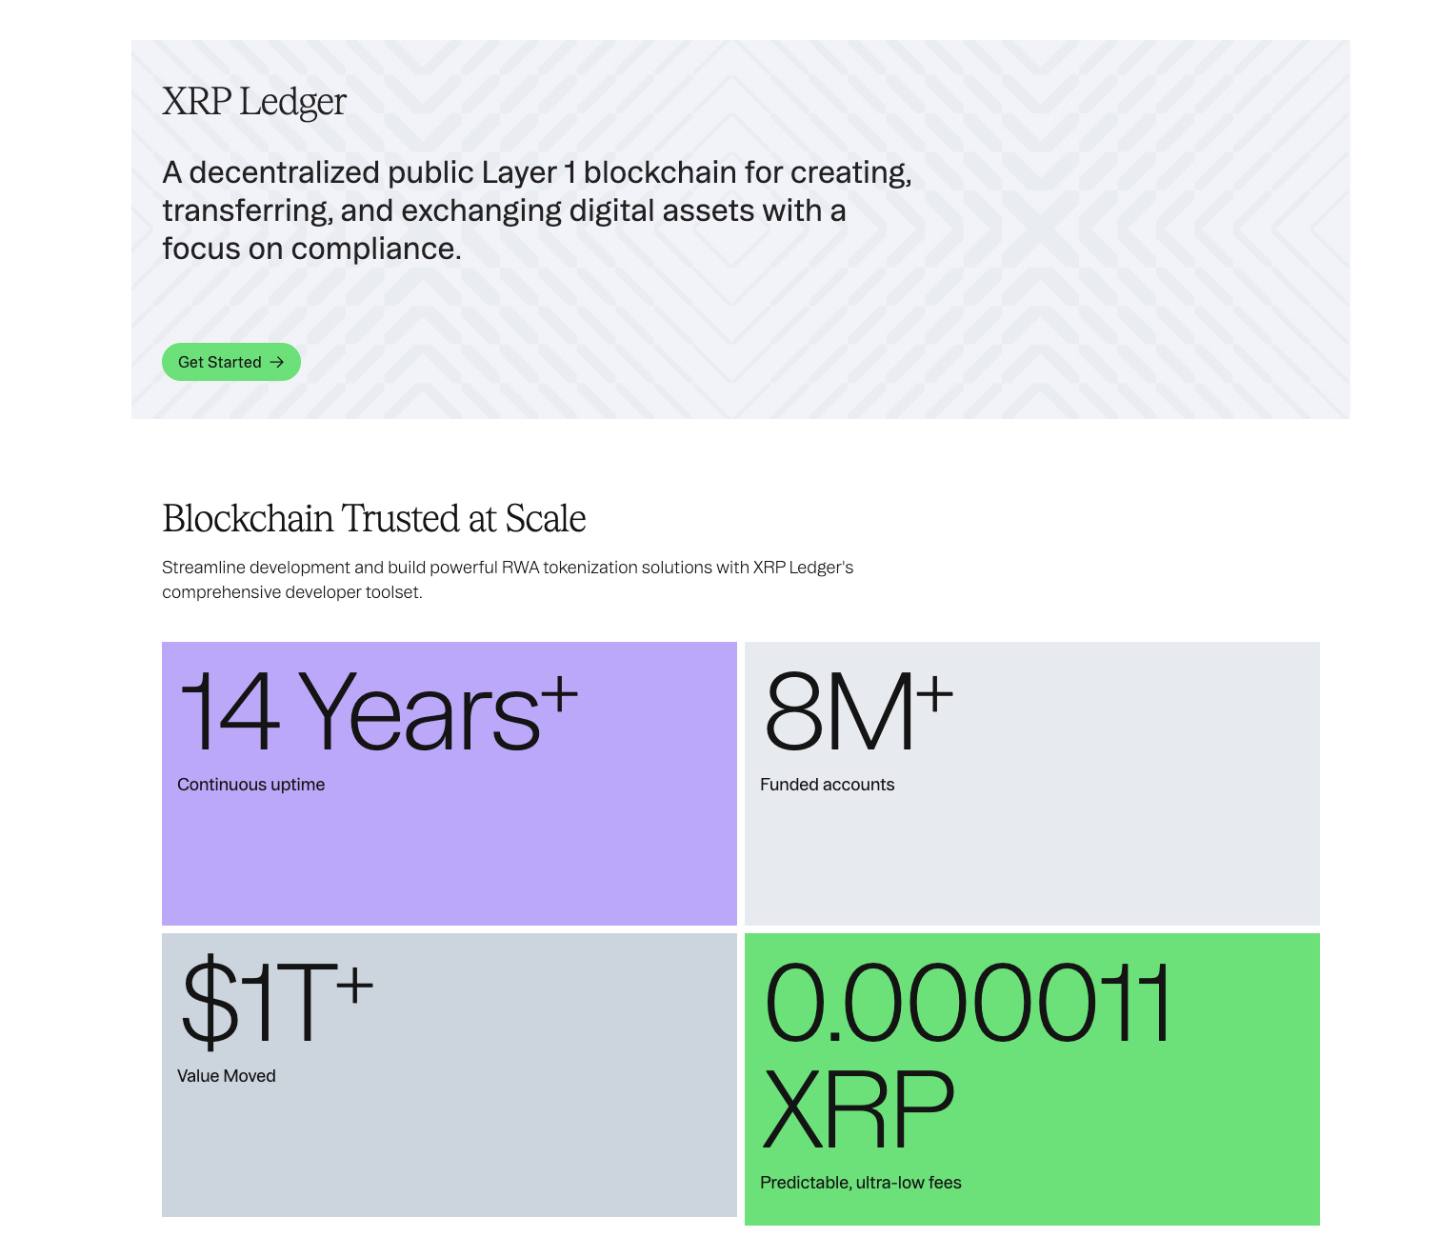
XRP
XRP Ledger
Research of a Layer 1 blockchain:
foundation-level parameters
https://xrpl.org/ ->>>>>>>>>>>>>>
Anastasia Korshunova
Module 2 – Blockchain Basics

Slide 2
PARAMETER 1 · NETWORK AND YEAR
XRP Ledger, mainnet live since 2012
Open-source, public Layer 1 blockchain designed for fast and cheap payments and value transfer. Native asset: XRP.
Created by David Schwartz, Jed McCaleb and Arthur Britto; developed with the support of Ripple (originally OpenCoin).
Mainnet go-live: June 2012
Reference server implementation: rippled (C++).
2012
3–5 s
mainnet go-live
ledger close & finality
~1,500
100 B
transactions per second
XRP created at genesis, no mining
XRP Ledger · Module 2 – Blockchain Basics
2 / 10
Notes:
The earliest ledger still available is #32570: the first ledger versions of June 2012 were lost due to a bug, so ledger #32570 is treated as the effective genesis.

Slide 3
PARAMETER 2 · CONSENSUS
XRP Ledger Consensus Protocol
A Byzantine fault tolerant, federated agreement protocol: no mining (PoW) and no staking (PoS).
1
2
3
4
Collect
Propose
Agree
Validate
Each validator gathers candidate transactions into a proposed set.
Proposals are exchanged with the validators on its Unique Node List (UNL).
Repeated rounds until ≥ 80% of the UNL agrees on one transaction set.
Validators sign the ledger hash; validated once a supermajority agrees.
Fault tolerance: safe while fewer than 20% of trusted validators are faulty · Energy: negligible, no mining
XRP Ledger · Module 2 – Blockchain Basics
3 / 10

Slide 4
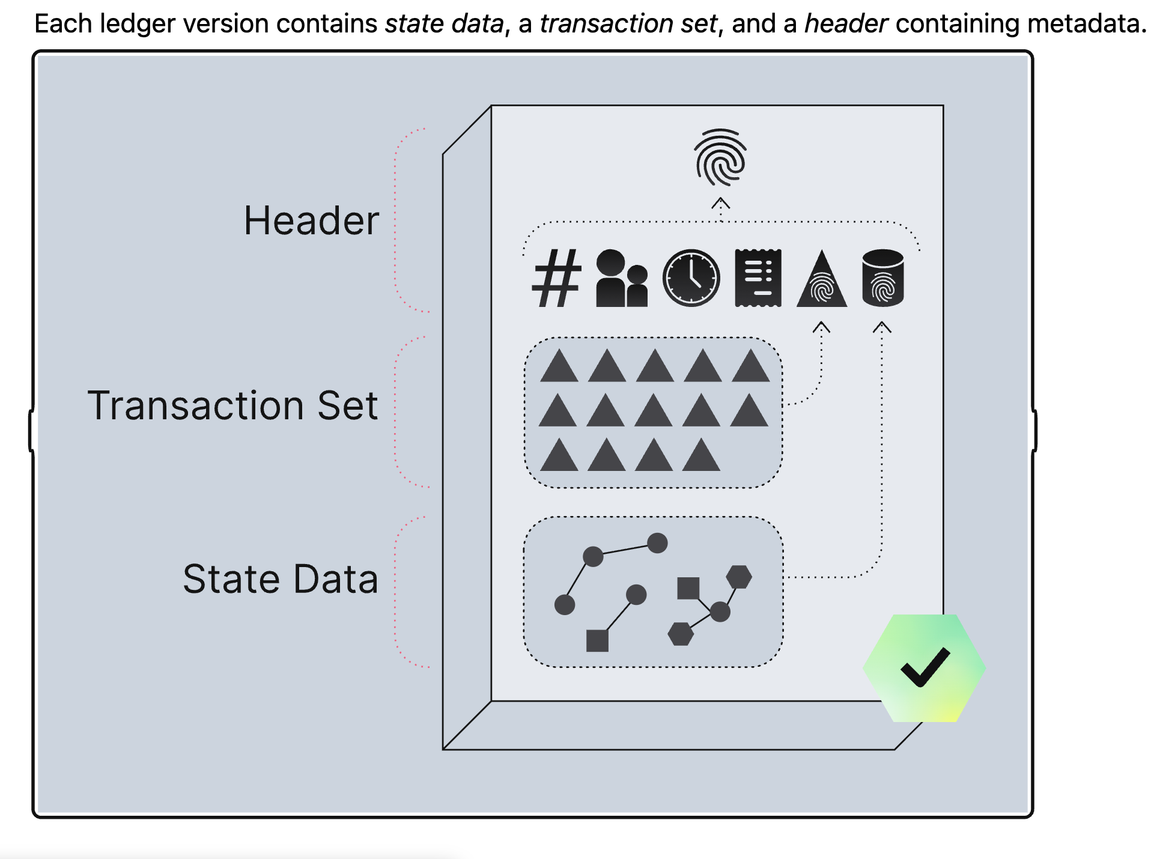
PARAMETER 3 · LEDGER STORAGE TOPOLOGY
A chain of ledger versions
Each ledger version references its parent by hash, so the history forms a linear chain, similar to a chain of blocks.
Unlike a Bitcoin block, every version also commits to a full snapshot of the state (SHAMap: a radix-16 Merkle tree), not only to transactions.
Ledger N − 1
Ledger N
Ledger N + 1
Header: index, close time, parent hash
State tree: all accounts & objects
Tx tree: transactions applied
Header: index, close time, parent hash
State tree: all accounts & objects
Tx tree: transactions applied
Header: index, close time, parent hash
State tree: all accounts & objects
Tx tree: transactions applied
4 / 10

Slide 5
PARAMETER 4 · HASH ALGORITHM AND IMMUTABILITY
SHA-512Half secures the history
✓
Hash-linked headers
Hash function
Changing an old ledger changes its hash and breaks every later link.
SHA-512Half
✓
Merkle trees
State and transaction trees roll up into root hashes stored in the header.
First 256 bits of SHA-512. Used for ledger, transaction and tree-node hashes. Signatures: ECDSA secp256k1 or Ed25519.
✓
Signed validations
Validators sign each validated ledger hash.
✓
Strong finality
Validated ledgers are final; temporary competing unvalidated versions may exist.
XRP Ledger · Module 2 – Blockchain Basics
5 / 10

Slide 6
PARAMETERS 5 AND 6 · JOIN MODEL AND PERMISSION
Public and permissionless
5
6
Nuance: federated trust
Which validators count is chosen per server via its UNL. Most servers use default UNLs published by the XRPL Foundation and Ripple, so critics call XRPL semi-permissioned.
Public
Permissionless
Anyone can run a rippled server, read the full ledger, create an account and submit transactions.
No approval is needed to transact or to run a validator. Accounts are activated by funding the minimum XRP reserve.
Result: an open network for users and node operators, with a curated set of trusted validators for consensus.
XRP Ledger · Module 2 – Blockchain Basics
6 / 10

Slide 7

PARAMETER 7 · DESIGN PRINCIPLE
Consistency first: pause rather than fork
Decentralisation
traded off
CAP theorem
During a serious network partition XRPL prefers to pause validating new ledgers rather than keep going at the cost of consistency.
As a simplification this is CP-leaning; CAP is not a strict classification of every blockchain property.
Blockchain trilemma
Strong security and scalability (3–5 s finality, ~1,500 TPS, tiny fees) in exchange for weaker decentralisation of the validator set.
Security
strong
Scalability
strong
XRP Ledger · Module 2 – Blockchain Basics
7 / 10

Slide 8
SUMMARY
XRP Ledger at a glance
1 | Network / mainnet year | XRP Ledger, June 2012
2 | Consensus | XRP Ledger Consensus Protocol (federated BFT, UNL, 80% quorum)
3 | Ledger topology | Hash-linked chain of ledger versions with Merkle state & tx trees
4 | Hash / immutability | SHA-512Half; signed validations; strong finality of validated ledgers
5 | Join model | Public
6 | Permission | Permissionless (trust in validators is federated via UNL)
7 | CAP / trilemma | Pauses rather than forks; favours security & scalability over decentralisation
XRP Ledger · Module 2 – Blockchain Basics
8 / 10

Slide 9
REFERENCES
Sources
1
XRPL.org — Consensus Protocol
xrpl.org/docs/concepts/consensus-protocol
2
XRPL.org — Ledger Structure
xrpl.org/docs/concepts/ledgers/ledger-structure
3
XRPL.org — Cryptographic keys
xrpl.org/docs/concepts/accounts/cryptographic-keys
4
Chase & MacBrough (2018), Analysis of the XRP Ledger Consensus Protocol
arxiv.org/abs/1802.07242
5
J. Bachini, CAP Theorem & Blockchain Trilemma
jamesbachini.com/cap-theorem-blockchain-trilemma
XRP Ledger · Module 2 – Blockchain Basics
9 / 10

Slide 10
APPENDIX · PARAMETER 0
Topic selection
Name: Anastasia Korshunova
Birthday: 5 December 1984
D = 5, M = 12, Y = 84
S = 5 + 12 + 84 = 101
R = (101 mod 16) + 1 = 6
XRP Ledger · Module 2 – Blockchain Basics
10 / 10

