Slide 1
Metric Learning for discriminative features

Slide 2
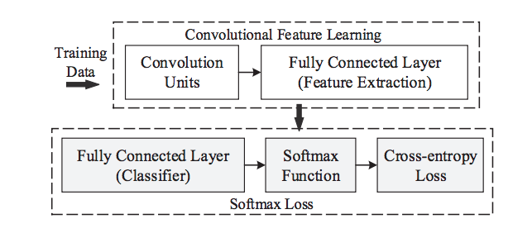
Typical classification architecture

Slide 3
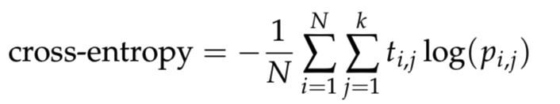
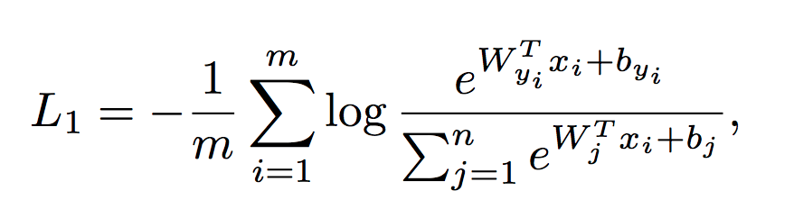
since matrix-vector product is just a vector of scalar products of this vector and corresponding matrix rows.

Slide 4
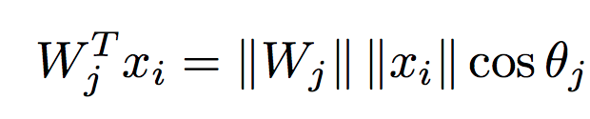

Norm of weight matrix W is constrained to 1.

Slide 5
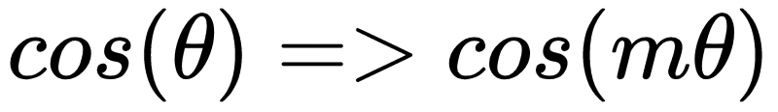
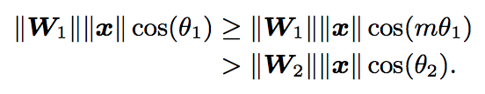


Main idea
What if we replace cos(theta) with cos(m*theta)?
Since
A stricter condition for correct classification. Formula for any theta in [0, …, pi]:
For k in [1, …, m]:

Slide 6
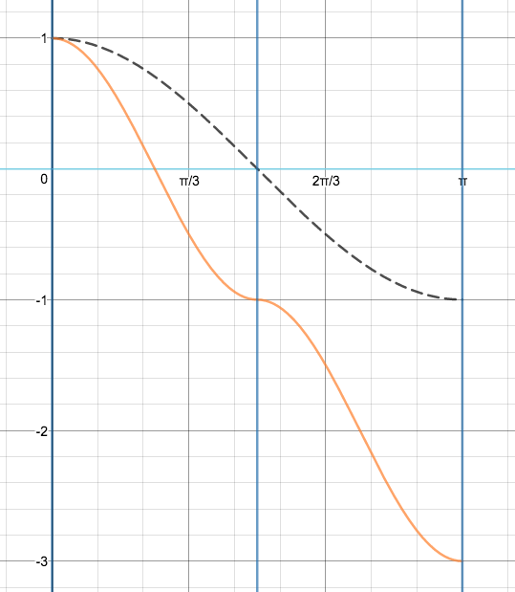
This is called Large Margin Softmax.
Black - Traditional Softmax.
Orange - Large Margin Softmax with m=2.

Slide 7
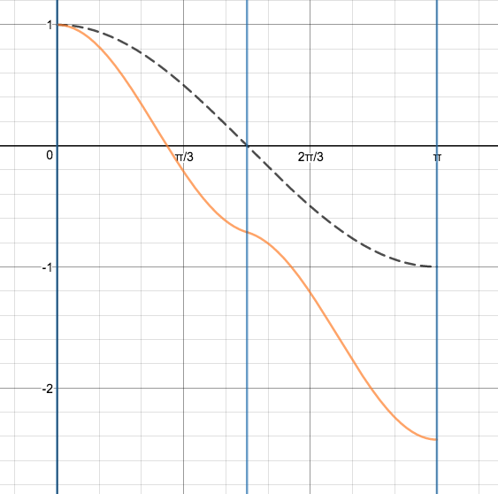

Problem
We have inflection points which may lead to local optima convergence.
Let’s modify formula:

Slide 8
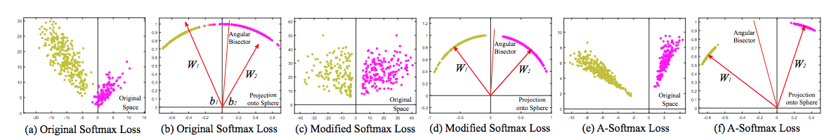
Larger margin for classification

Slide 9

CosineFace
Another approach: let’s normalize x, and then rescale it with some big constant s.
For example s = 64

Slide 10

Additive Angular Margin
And then, let’s shift down the whole cosinusoid.
This will push decision boundary even further.

Slide 11

ArcFace
Finally, we can directly increase theta. This is one of the best approaches.

Slide 12
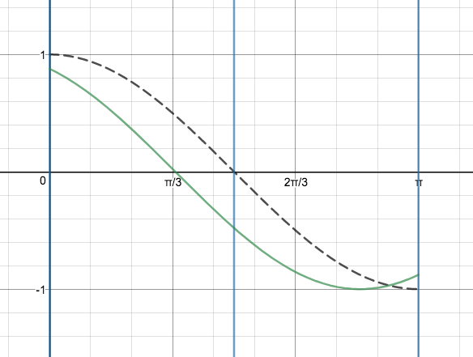
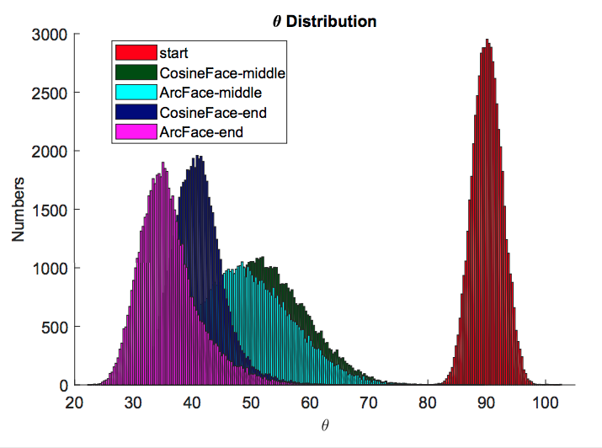
Local optima!?

Slide 13
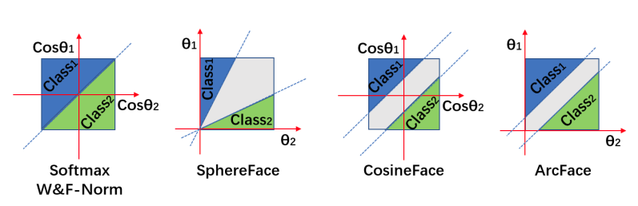
Some decision boundaries

Slide 14
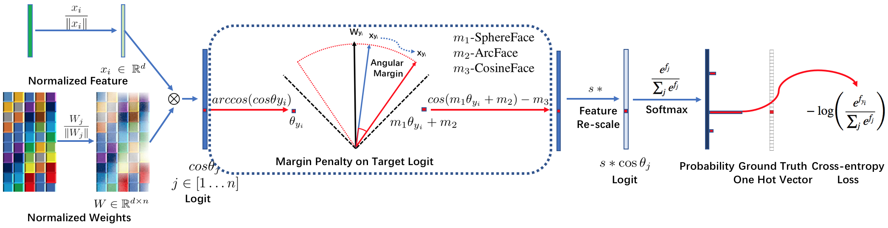
Final thought
You can combine all of these crazy loss functions into a single loss function!

Slide 15
Visualisation
https://www.desmos.com/calculator/hyt1xlpqkl

