Slide 1
FlashyMind: Flashcard Learning App
DEV272 Team Project Presentation
Created by : Shu Yu Wang, Ahmet Deger and Anastasia Taucci
Bellevue College, Spring 2025

Slide 2
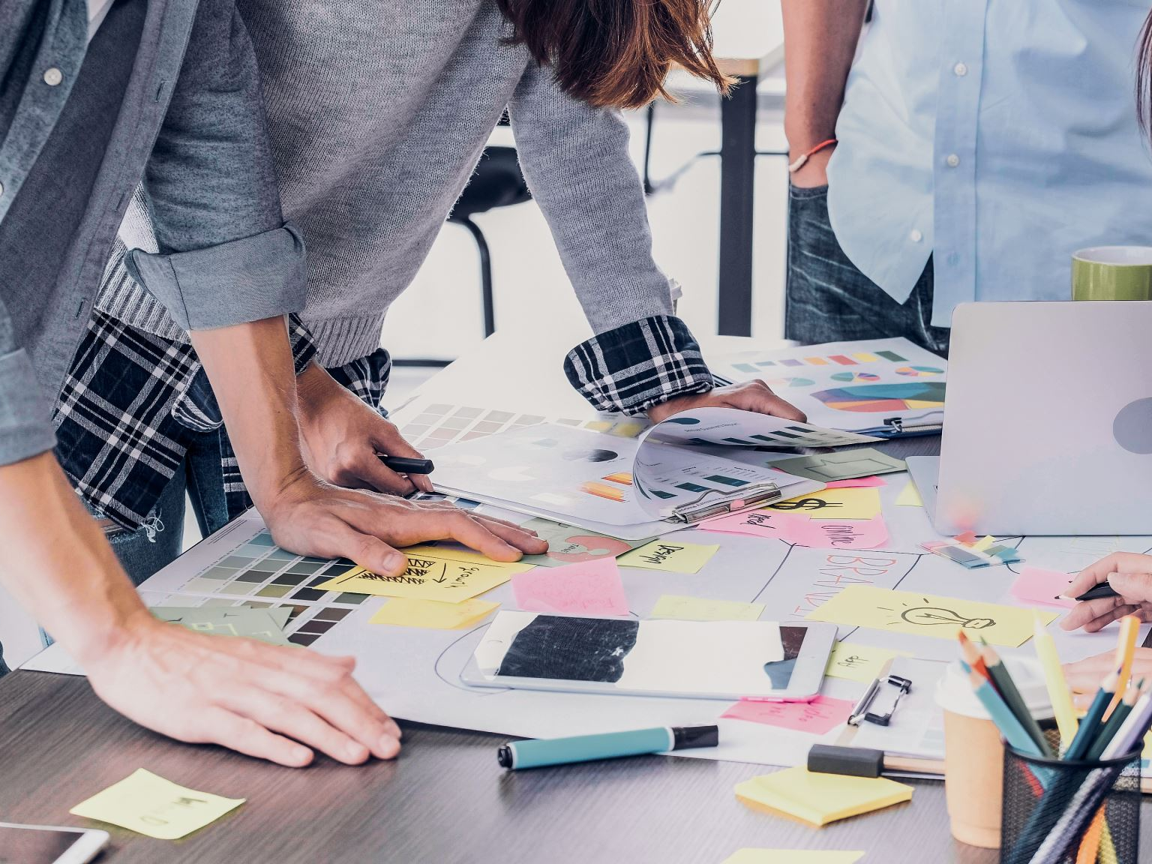
Project Goals & Intended Audience
Goal: Build a sleek, flashcard-powered app to help users study smarter, not harder. Audience: Busy students and lifelong learners who want quick, on-the-go review tools. Focus: Seamless experience with offline access, easy navigation, and custom decks tailored to each learner.

Slide 3
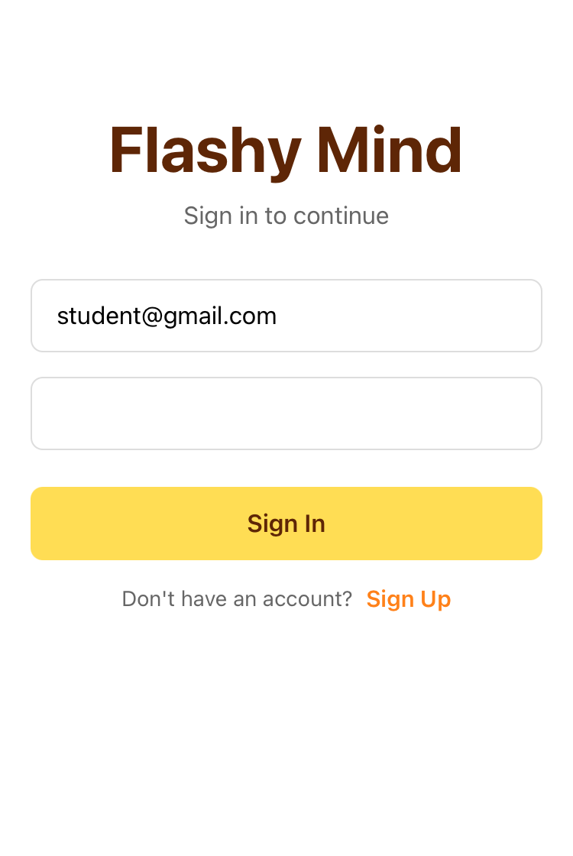
App demo

Slide 4
Team Contributions
Ahmet: Supabase integration, backend logic, and Quiz Mode functionality.
Joshua: Authentication (Login/Signup), Add/Edit Deck and Card screens, UI/UX design, unit testing, and debugging full-deck issues.
Anastasia: Project management, wireframes, initial navigation, UI/UX design, Home screen, Explore Deck feature, Study Mode, unit testing and front-end debugging.

Slide 5
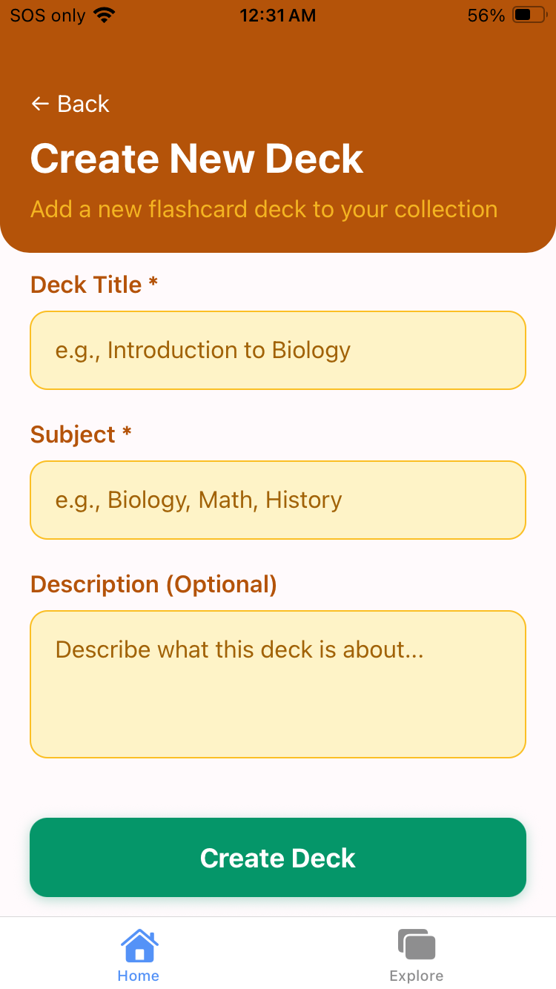
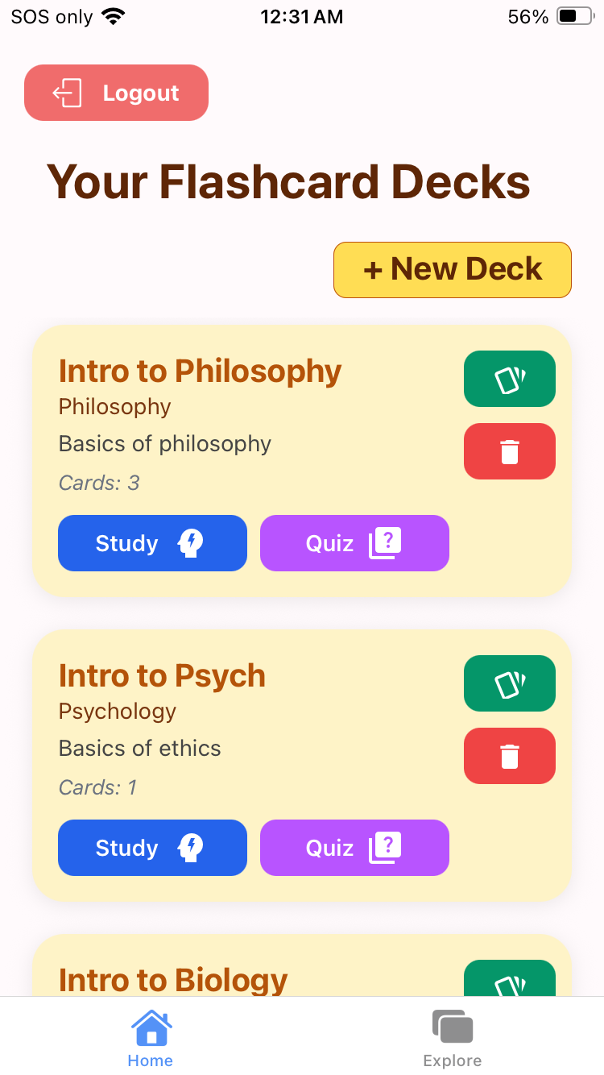
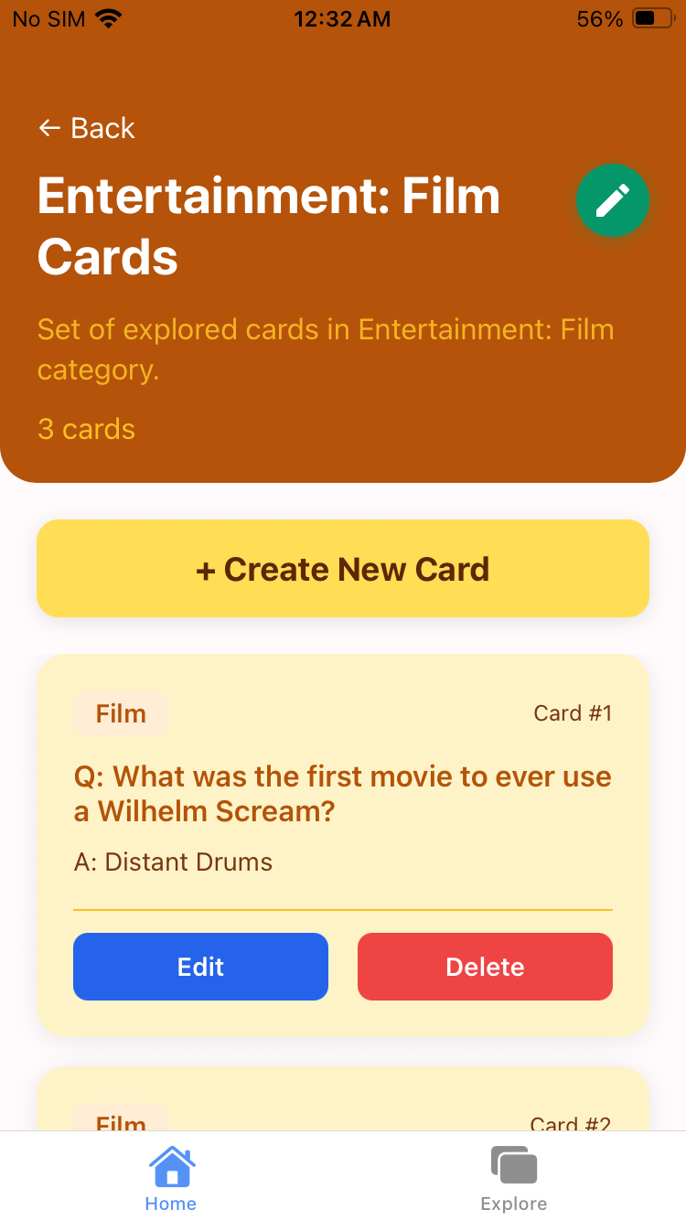
Design & UX Decisions
It all started with the home screen — picking a color palette and designing simple, clean card layouts.
We kept a consistent layout and style across all screens to make the app feel smooth and unified.
Fonts, buttons, and spacing were chosen to be mobile-friendly and easy to interact with.
We also added simple animations to create a more polished and enjoyable experience.

Slide 6
Technical Highlights
Supabase: cloud-based database used for storing decks, cards, and handling user authentication.
Zustand: lightweight global state management.
Formik + Yup: form input and validation.
Expo Router: navigation between screens.
ExpressJS: custom backend API.
AsyncStorage: saving user progress and decks locally for offline access and a smoother study experience.

Slide 7
Challenges & Solutions
Team Communication: Improved through GitHub Projects, retrospectives, and in-person meetings.
Simulators & Devices: Required constant cross checking.
Custom Backend: Ongoing development and debugging of Express API endpoints.
Version Control: Established a clear pull request process and merge practices for smooth collaboration.

Slide 8
What We’d Do Differently
Standardize development setup for all members.
Begin unit testing earlier.
Share components across screens from the start.
Stick to tighter sprint timelines.

Slide 9

Thank You!
We appreciate your time and attention. Feel free to ask questions or try the app yourself!
— FlashyMind Team

