Slide 1


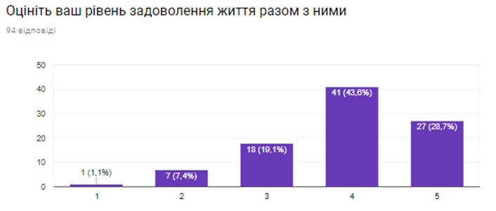
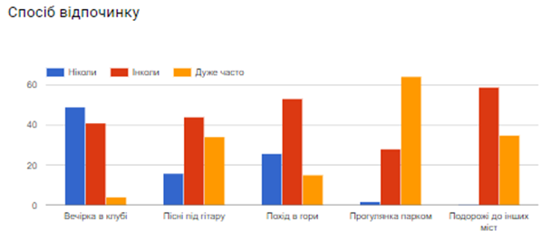
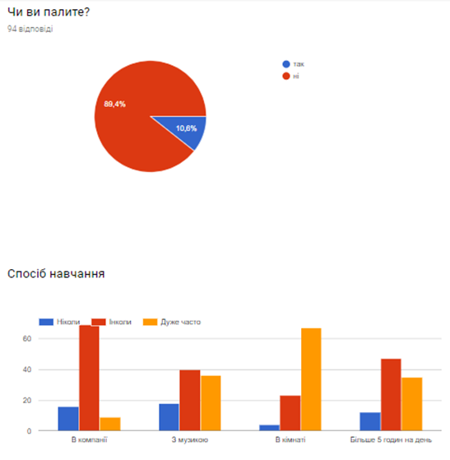
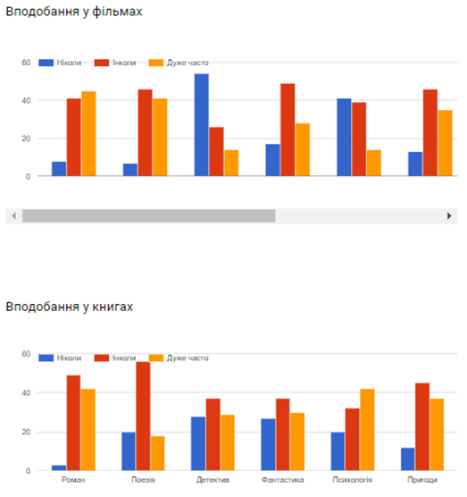
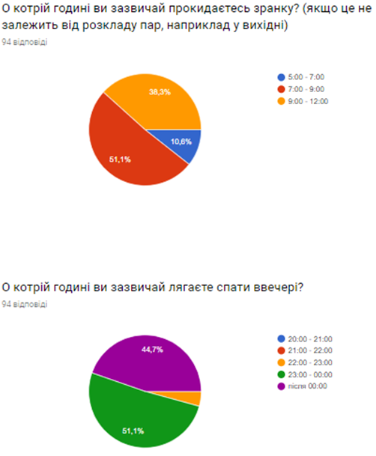
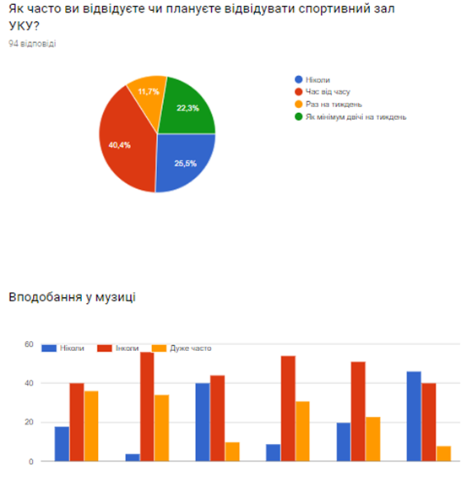
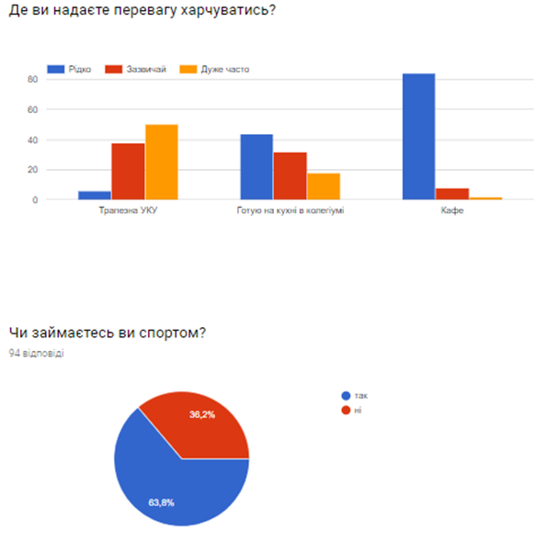
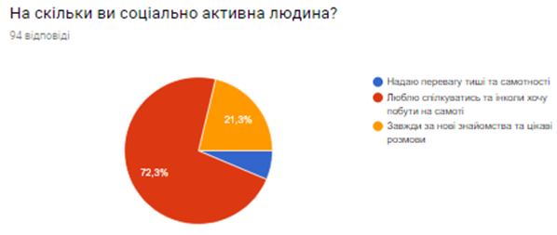
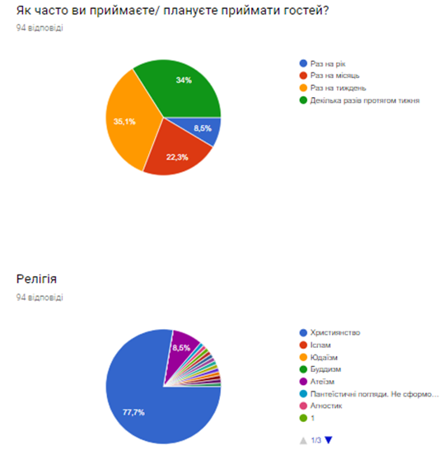
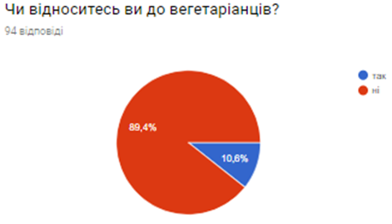
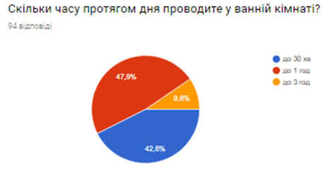

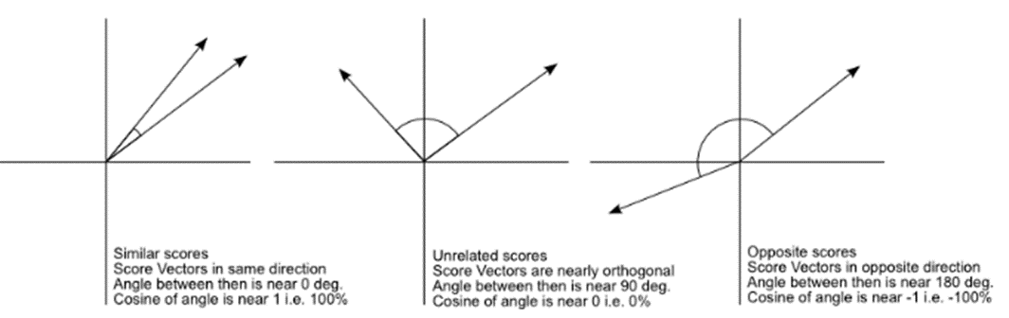
PURPUSE OF THE PROJECT
To develop an effective settlement system in the dormitory (collegium UCU) to increase the likelihood of a friendly relationships between students, which will affect their success in studying and satisfying student life.
Created recommendation system will give student a chance to answer questions (fill created questionnaire) and get 3 students’ Facebook links with the highest similarity in habits and interests, so they can agree on living together.
GATHERING DATA
I have investigated several articles about choosing the best neighbor individually. Based on this knowledge, I have created questionnaire (Google Form), agreed it with the master of collegium and spread it among students who live currently in the dormitory.
STATISTICS OF ANSWERS
Questionnaire
PROCESSING DATA
Cleaning and creating pairs of neighbors in pandas dataframe (in two forms):
Answers of first neighbor, answers of second one, average level of satisfying living together (sum of scores/2)
Answers of first neighbor, answers of second one, scores of first neighbor
Variables are converted to dummy values – 0/1.
MODELING
Linear Regression,
Logistic Regression,
KNN classifier,
K-Means clustering,
PCA,
XGBoost,
Random Forest
SCORES FOR SCHEMA WITH AVERAGE LEVEL
SCORES FOR SCHEMA WITH FIRST LEVEL AFTER PCA
COSINE SIMILARITY
Measure of orientation (not magnitude) that gives cosine of angle between 2 vectors.
Results in degrees:
Pairs with 2 score - 69.7, 74.7, 56.1, 65.4, 65.7
– mean: 66.32
3 score - 74.7, 53.7, 61.4, 24.2, 60.4, 65.4, 65.5, 53.4, 53.7, 65.5, 67.3, 58.6, 60.7
– mean: 58.8
4 score - 58.0, 63.3, 67.3, 56.0, 58.0, 54.0, 60.4, 64.6, 24.2, 59.8, 61.4, 66.9, 62.6, 56.1, 71.6, 62.8, 66.7, 64.8, 67.3, 69.7, 63.3, 62.8, 61.1, 70.2, 65.4, 63.7, 58.9, 58.9, 70.6, 70.6
– mean: 62.0
5 score - 54.0, 66.9, 73.0, 73.0, 71.6, 64.8, 65.7, 55.9, 55.9, 51.2, 56.8, 53.4, 63.7, 55.2, 55.2, 51.2, 58.6, 56.0
– mean: 60.1
SCORES FOR SCHEMA WITH
FIRST LEVEL
SCORES FOR FIRST SCHEMA USING FEATURES GENERATED BY K-MEANS CLUSTERING
SCORES FOR FIRST SCHEMA BEFORE DELETING OUTLIER
CONCLUSION
Models: KNN classifier, Linear and Logistic regressions, XGBoost, Random Forest classifier. Approaches: different schemas, k-means clustering for new features, cosine similarity, PCA, analysis of outliers, tuning parameters for XGBoost.
I have tried different combination of steps: 1.Adding k-means features + Model (For each model), 2.Adding cosine similarity as feature + Model (Foe each model), 3.Adding k-means features + Adding cosine similarity as feature + Model (For each model), 4.Adding k-means features + PCA + Model (For each model), 5.Adding cosine similarity as feature + PCA + Model (Foe each model), 6.Adding k-means features + Adding cosine similarity as feature + PCA + Model (For each model)
As a result the best combination for my dataset was: K-Means features + Random Forest classifier with score of 0.857 on 10% of test data and 0.(6) on 30% of test data. The main challenge in this project was - very small dataset of only 94 students’ answers. But I was trying to get maximum of it. I have created one more questionnaire for new students (not gathering history information as above), program for processing answers and recommendation system (using combination above) that gives 3 best neighbors’ Facebook links to agree on living together in collegium UCU.
FEATURES ENGENEERING USING K-MEANS CLUSTERING
I have clustered all single students using k-means clustering into 3, 7 and 15 clusters. Then I have added numbers of clusters as new features, converted them to dummy variables. As a result I have got 25 new features.
New dataset I was using for modeling Linear regression, Logistic regression, KNN classifier, Random Forest classifier. Results are presented in the table above. Random Forest classifier gave me the best score of 0.857 on 10% of test data.

