Slide 1
Prediction of Chemical Reaction Yields with Enhanced Reaction Representations

Slide 2
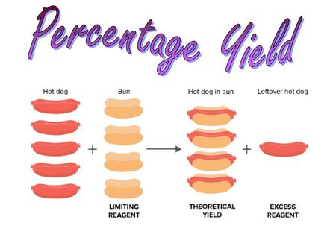

Currently, the process of predicting reaction yields mainly relies on a human. However, human approach has its limitations:
the recommendation might be biased by chemists’ preference and familiarity with certain types of reactions;
the heuristic rules might not be all-encompassing or too abstract to narrow down to specific molecules.
Relevance
too narrow heuristics
too abstract heuristics
limited knowledge
preferences

Slide 3
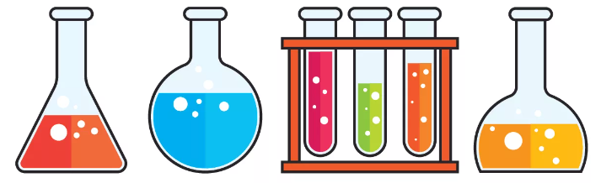

Purpose
This project aims to improve the quality of reaction yield prediction based on fingerprints as state-of-the-art reaction representations.
Objectives
To study the existing models, their main features, advantages and disadvantages
To develop a model for yield prediction
Analyze and preprocess reactions USPTO dataset
To compare metrics with other researchers
To create reaction and molecular fingerprints

Slide 4
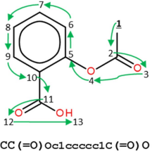
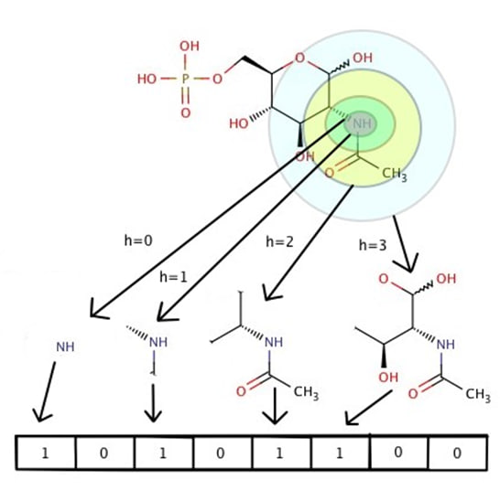
Basic theoretical provisions
Molecular representations allow us to represent chemical compounds in a syntax that would be readable by computer. In this project three types of molecular representations are used:
SMILES (Simplified Molecular Input Line Entry System)
SMILES is obtained by assigning a number to each atom in the molecule and then traversing the molecular graph using that order. Reaction SMILES (SMARTS) can be obtained from reactants’ and products’ SMILES.
Morgan circular fingerprints (ECFP)
In this type of representation heavy atoms (non-hydrogen) are encoded into multiple circular layers up to a given radius. Each substructure creates a bit in a bit-string. Reaction fingerprints represent a symmetrical difference between fingerprints of products and reactants.

Slide 5
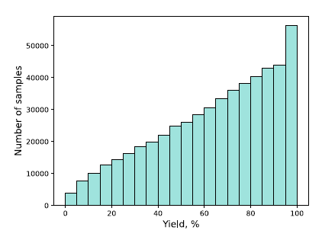
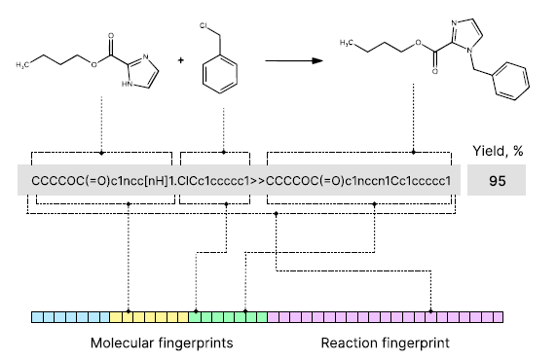
Dataset
organic reactions
yields (%)

