Slide 1


Sales Data Analysis for e-commerce
Anastasios Vitsios
30.3.2021

Slide 2
Table of Contents
Executive Summary ………………………………………………………………………………………………………………………………….……... 3
Introduction ……………………………………………………………………………………………………………………………………………………. 4
Methodology ………………………………………………………………………………………………………………………………………………..… 5
Initial View – Sales for the 2 first years ………………………………………………………………………………………………………...…. 6
Sales in Top 6 States and Top 15 Products Categories ……………………………………………………………………………………. 7
Sales between Year_1 and Year_2 - Spike in November 2017 …………………………………………………………………………. 8
Spike in November 2017 – Sales vs MRKT qualified leads ……………………………………………………………………….…..…. 9
Decline in Sales after May 2018 …………………………………………………..……………………………………………………………..…. 10
Sellers for period May - July 2018 …………………………………………………………………………………………………………………. 11
Top 5 Product_categories - Growth in 2018 ……………………………………………………………………………………………..……. 12
Decline in Product Categories (top 15 product categories) ……………………………………………………………………..……… 13
Watches_gifts - Increase and drop in 2018 ……………………………………………………………………………………………………. 14
MARKETING - Origins for MRKT Qualified Leads per Month (data for period June 2017 - May 2018) …………. 15
Population in States vs Sales …………………………………………………………………………………………………………………………. 16
Conclusion ………………………………………………………………………………………………………………………………………………….…. 17
Suggestions …………………………………………………………………………………………………………………………………………………… 18
Appendix …………………………………………………………………………………………………………………………………….…………………. 19

Slide 3
Executive Summary
In this analysis we will examine the sales and marketing performance of the company Olist.
Olist has a web platform from where any Brazilian company can sell their products in Brazil. They started their activity in September 2017 and the data that we possess are for 24 months (until August 2018).
In this analysis we will see that there was an overall increase in sales in these 2 year with some spikes and some drops.
The big spike was in November 2017 and it was not related to the marketing of Olist. After this month there was an increase in marketing qualified leads which affected the sales positively.
After May 2018 there was a decline in sales in almost all States in Brazil and in the majority of product categories. Even though the sellers (companies which sell products through Olist) were increased after May 2018, the increase in sales was not possible. We don’t have marketing data for the months after May 2018 to compare but it is true that in 2018 there was a 9% decline in GDP per capita which may affect the sales performance of Olist.
We will also realize that there are many States in Brazil where the sales are too low compared to the population, so we can expect increase in sales in those States with the proper strategic plan.

Slide 4
Introduction
Olist is the largest department store in Brazilian marketplaces. Olist has a web platform where small businesses from all over Brazil are able to sell their products through the Olist Store and ship them directly to the customers using Olist logistics partners.
The data that we have is from kaggle.com. They are for 24 months, from September 2016 to August 2018. The first 12 months consider as the Year 1 (Sep 2016 - Aug 2017) and the rest of months as the Year 2 (Sep 2017 to Aug 2018)
In total, in those 24 months Olist had:
99,441 orders
112,649 items sold, from
71 product categories, in
29 States, from
2383 sellers and
13,591,498 BR total sales
The analysis was made in files olist_all.xlsx, olist_groups1.xlsx, mrkt_leads.xlsx, .IPYNB

Slide 5
Methodology
I used 7 files from Kaggle.com which are: olist_custome_dataset.csv, olist_order_items_dataset.csv, olist_orders_dataset.csv, olist_products_dataset.csv, olist_sellers_dataset.csv, product_category_name_translation.csv
For the purposes of this analysis I downloaded 3 more tables from the web with the state population, state names/abbreviations and GDP per capita.
The analysis was made:
in the excel files olist_all.xlsx, olist_groups1.xlsx, mrkt_leads.xlsx,
in python file Olist_groupby.IPYNB and
in Power BI file olist.pbix
I created tables in excel by joining the tables from Kaggle.com, with the appropriate format in order to be analysed in Power BI.
I grouped by year, month, product category, seller some tables with python in order to aggregate the sales for further analysis.
The first month for each period is September. So, the first year (from now on Year_1) starts in September 2016 and ends in August 2017. The second year (from now on Year_2) starts in September 2017 and ends in August 2018.

Slide 6
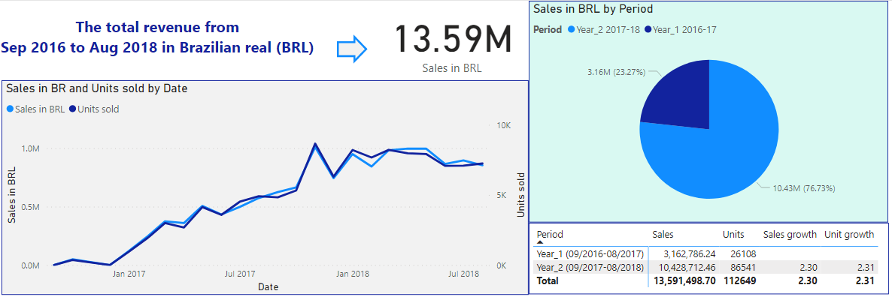
Initial View – Sales for the 2 first years
Olist started to sell on September 1st 2016. The data that we have is until August 31st 2018. I split the 24 months sales period in 2 annual periods. The 1st is from 9/1/2016 to 8/31/2017 (named "Year_1") and the 2nd is from The 1st is from 9/1/2017 to 8/31/2018 (named "Year_2") .
In Year_2 there is an increase or 230% in revenue and 231% in units and as we see in the graph "Sales in BR and Units sold" the growth between revenue and units is identically.
The 76.73% of total sales became in Year_2.
There is a spike in November 2017 and a decline in sales after May 2018 which we will examine in the following slides

Slide 7
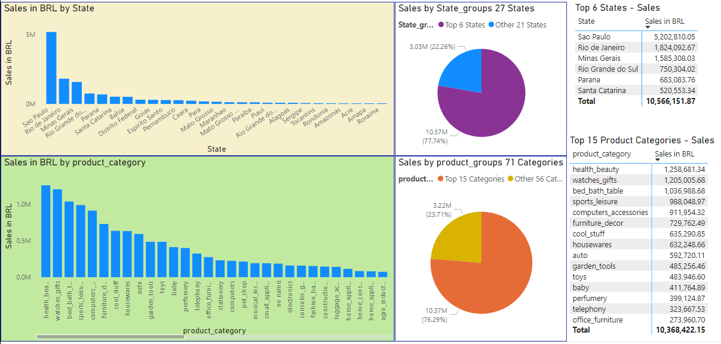
Sales in Top 6 States and Top 15 Products Categories
The sales became in 27 States in Brazil and in 71 different product categories. Here we will analyse the sales performance in the top 6 States and in the top 15 product categories where Olist has 77.74% and 76.29% of total sales respectively.

Slide 8
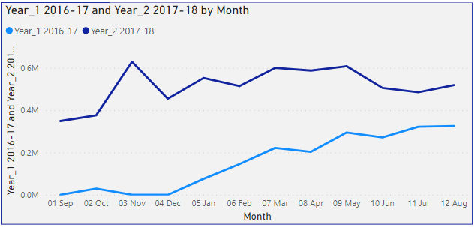
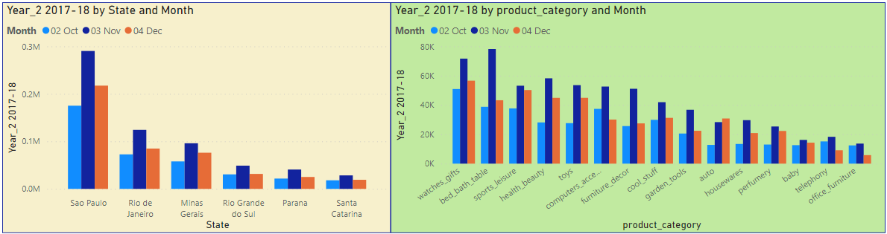
Sales between Year_1 and Year_2 - Spike in November 2017
In graph "Year_1 2016-17 and Year_2 2017-18 by Month" we see the sales in the annual periods.
We notice a spike in November 2017 when there is not something similar in November 2016. In graphs "Year_2 2017-18 by State and Month" and "Year_2 2017-18 by product_category and Month" we see that there is an increase in sales from October to November 2017 in all States and in all Product categories. So the spike is not related to some specific States or products.
Also, we notice a decline after May 2018, which we will examine later

Slide 9
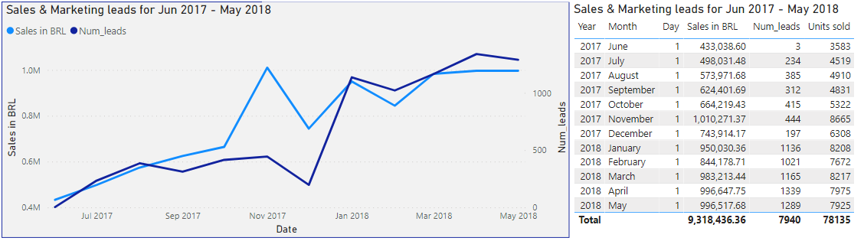
Spike in November 2017 – Sales vs MRKT qualified leads
The data for marketing qualified leads are for only 12 months, from June to 2017 to May 2018
The increase from October 2017 to November 2017 is:
52% in revenue
62% in units sold
7% in marketing qualified leads
From this we can assume that either the same number of people bought more items on average or more qualified leads were converted to customers (or of course both). This could happened because of a discount campaign (more units were sold than the revenue which was created) or another marketing campaign.
Another assumption is that the big event of Gran Prix which took place in Brazil in November 2017, could affect positively the growth in sales if it was combined with a marketing campaign.

Slide 10
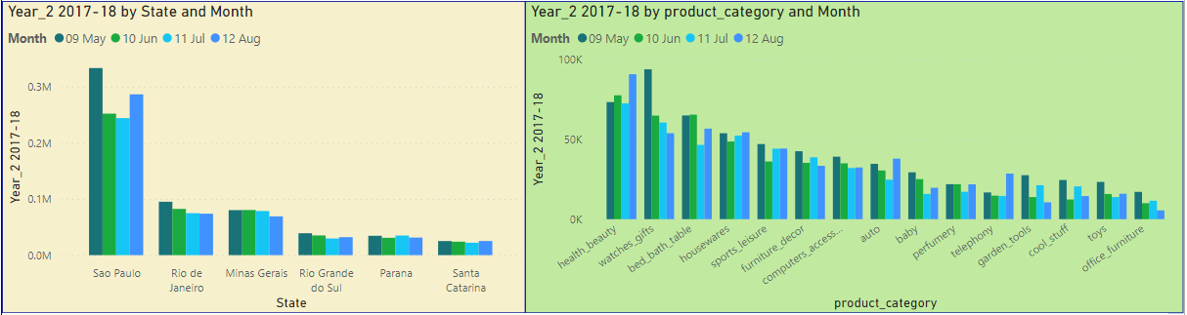

Decline in Sales after May 2018
The decline in sales after May 2018 happened in almost all States in almost for all product categories as we see in the 2 graphs above.
Here we can consider as the main reason the 9% drop in GDP per capita in 2018, which could be a reason for this drop (see table below “GDP per capita 2017 & 2018”)
The GDP per capita in 2018 was 9% less than 2017 but in 2018 Olist had increase in sales of 230%.
The high increase in sales is normal since is the 2nd year that the company is active but by the fact the GDP per capita is less, we understand that Olist increased their proportion in the Brazilian market versus their competitors.

Slide 11
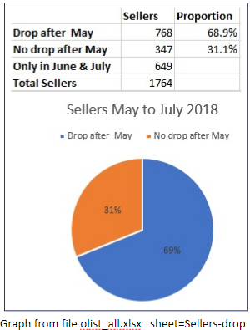
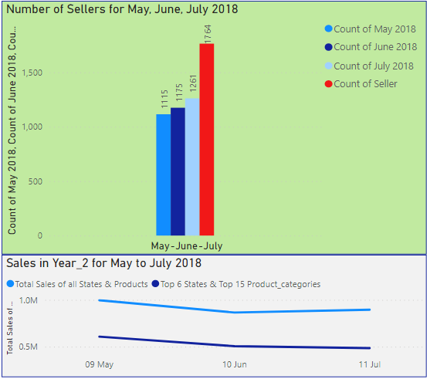
Sellers for period May - July 2018
We see that the 69% (768) of all 1097 Sellers (who sold in May 2018) had drop in sales from May 2018 to July 2018.
Although in June and in July 2018 the sellers increased 58% (649 more) from May 2018, there was a 10% decline in sales from May to July for all States and Product_categories.
So, the drop is not related to some specific sellers.
However, in July 2018 there was a 3.5% raise in total, but there was a 4% decline in the top 6 States and in top 15 Product categories as we see in graph "Sales in Year_2 for May to July 2018".

Slide 12
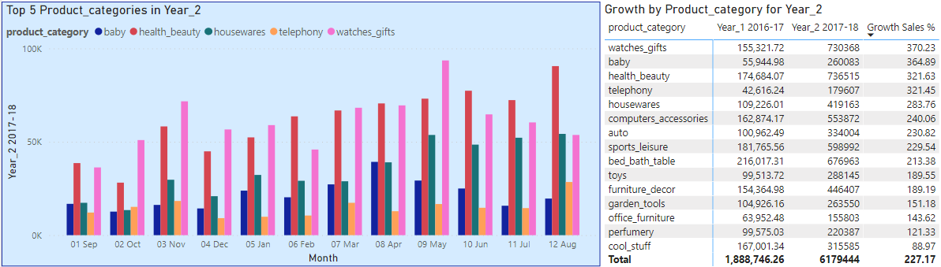
Top 5 Product_categories - Growth in 2018
In the graph "Top 5 Product_categories in Year_2" we see the performance by month of each 5 product categories which had the highest growth in Year_2.
The products "watches_gifts" had the highest growth in whole 2nd Year (370%).
Only the watches_gifts and baby had a decline after May with the first to have the highest drop.
In the next page we see the sales growth of watches_gifts by State, in order to examine deeper if the drop was related to some specific States

Slide 13
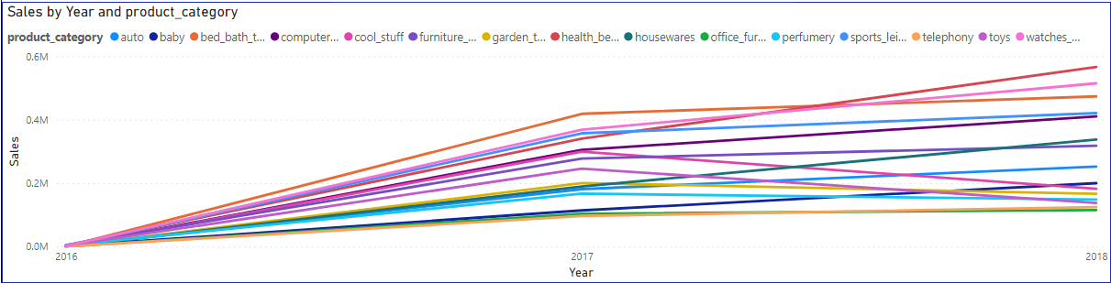
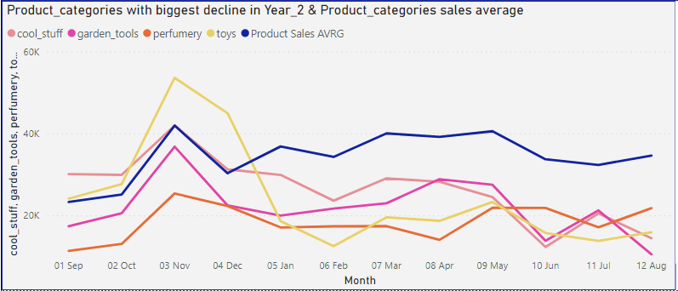
Decline in Product Categories (top 15 product categories)
In graph "Sales by Year and product_category" we see the performance of all top 15 product categories. The worst performance in 2018 belongs to product categories cool_stuff, graden_tools, perfumery and toys. But because this graph is to noisy, we see separately these 4 categories in the next graph.
In graph "Product_categories with biggest decline in Year_2 & Product_categories sales average" we see only these 4 product categories by month compared with the average sales of top 15 categories*.
The sales of "toys" and " cool_stuff" were above average until December 2017 but later they declined a lot
*total sales / 15

Slide 14
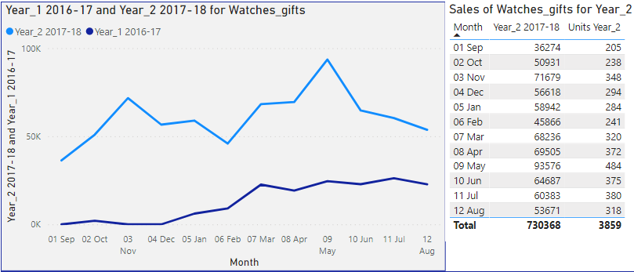
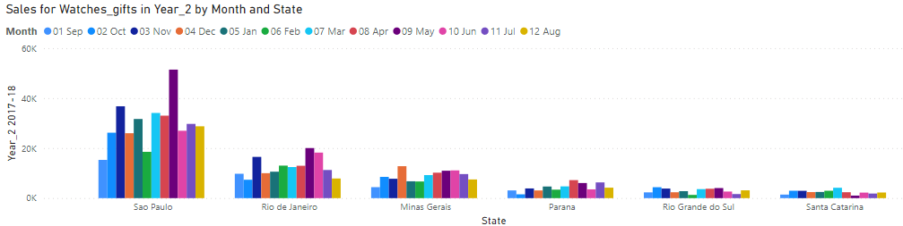
Watches_gifts - Increase and drop in 2018
For the products "watches_gifts" we see 2 spikes, in November 2017 and in May 2018 but not for all States.
In November and in May, the spikes happened only in Sao Paulo and Rio de Janeiro. Parana had a spike only for November.
On the other hand the decline of February happened in Sao Paulo, Parana and Rio Grande do Sul.
So far, we see that whatever happened to Sao Paulo affects the total growth, since in Sao Paulo there is the biggest portion of total sales, as we saw in graph "Sales in BR by State" in the page 7 "Sales in Top 6 States and Top 15 Products Categories".
We need to identify the reasons of increase and decline and react accordingly with a strategic plan.

Slide 15
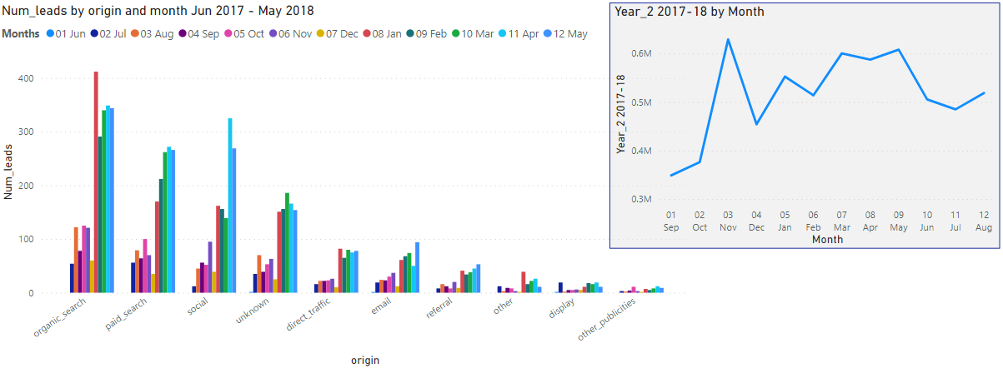
MARKETING - Origins for MRKT Qualified Leads per Month (data for period June 2017 - May 2018)
We see in the graph "Num_leads by origin and month Jun 2017 - May 2018" that there is a drop in all marketing channels in December 2017 which is reflected also in sales.
On the other hand there is significant increase in the marketing leads in January 2018 and in sales as well, but the increase in paid_search, email and display of February didn't lead to increase in sales, but the opposite.
From March and on there was an increase in qualified leads from all marketing channels and an increase in sales as well.
Unfortunately, we don't have data regarding the marketing qualified leads after May 2018 to see if the decline in sales was related to marketing activities.

Slide 16
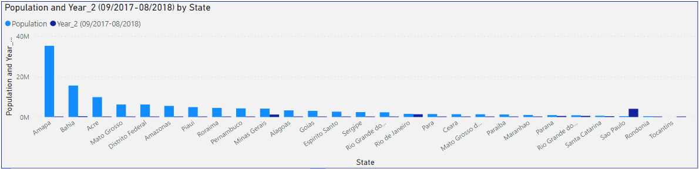
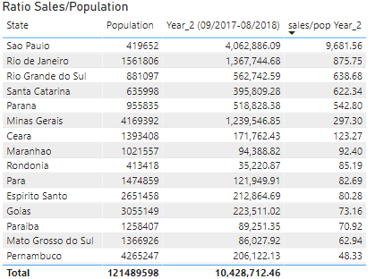
POPULATION IN STATES vs SALES
In Sao Paulo, Olist's ratio sales vs population = 9681*, which means that the revenue is 9,6 times more than the population of the State. Sao Paulo has the greatest sales/population ratio, which means the best performance compared to population
In the other top 5 States (Rio de Janeiro, Minas Gerais, Rio Grande do Sul, Parana and Santa Catarina) the ratio is from 297 to 875, which is not so bad.
But, there are many States, where the population is much higher than the top 6 States and the sales are very low. For example, at Amapa, Bahia, Acre, Mato Grosso the ratio sales/pop is 0,33 to 24. This means that either the habitats there are very poor or (if not) Olist should advertise more in these States because there is a big potential there.
*The ratio sales/pop is : sales/population * 1000

Slide 17
Conclusion
Olist has 230% growth in the 2nd year of activity, in which the 76.73% of total sales were occurred
In November 2017 there was a pick.
Increase 52% in sales from October 2017, in all top 6 States and all top 15 product categories, without the qualified marketing leads to be increased accordingly (only 7% increase). The increase of sales units was about the same (62%). This means that the same number of people bought more items or more qualified leads were converted to clients in November 2017. Maybe it was a discount campaign, more products available in the platform or a deficit from competitors
After May 2018 and till July 2018 there was a drop of 20% in top 6 States and in top 15 Product_categories.
The drop was in almost all States. The highest drop was for States Sao Paulo, Rio Grande do Sul and Rio de Janeiro with 13.8%, 12.7% and 11.3% respectively. The drop was in all products except from health_beauty. The biggest drop was in baby, toys and watches_gifts, 25.7%, 22.3% and 18.8%
respectively. The main reason for this drop could be the 9% decline of GDP per capita in 2018.
Less sales with more Sellers after May 2018
There was a 58% increase in Sellers from May to July 2018 with a 10% decrease in sales for the same period. Also, the 69% of existing sellers from May had a decline in sales after May. We have to find out which was the reason of the drop (apart from GDP per capita) and create a strategic plan.
Big decline in watches_gifts
The product category "watches_gifts" had the highest growth in whole 2nd Year (370%) but the 2nd biggest drop in June 2018 (32.5%) and the drop from May (93576 BR) to August (53671 BR) was 42.6%. The biggest drop from May to August was in Rio de Janeiro (60%) and in Sao Paulo (34%).
We have to investigate the reasons and create a strategy.
The marketing affects the sales
In December 2017, there was a drop in marketing qualified leads and this affected the sales for the same month. After February 2018 there was an increase in marketing qualified leads with an increase in sales. On the contrary, the increase in qualified leads from paid search and email campaigns in February 2018 didn’t help the sales which were declined in the same month.
In many States the sales/population ratio is very small. The fact that in July 2018 there was an overall 3.5% increase in sales but a 4% decrease in top 6 States (graph "Sales in Year_2 for May to July 2018", page Sellers) confirms that there is potential in the rest 23 States.

Slide 18
Suggestions
We need to collect more data in order to get better insights. These data should be:
GDP per State in Brazil for the years 2016, 2017, 2018 to examine the growth of sales per State vs the market growth. That way we will identify in which states there is potential so as to advertise more.
Source: https://tradingeconomics.com/ cost: $199 monthly
Retail market share for each product category, in order to compare Olist’s sales vs competitors
Source: https://www.reportlinker.com/ cost: € 1500 yearly
Marketing cost for each marketing channel, number of clients who came from each marketing channel in order to calculate the CPC and the cost per customer. Then we can allocate the marketing budget properly.
Source: Olist

Slide 19
Appendix
Datasets for Olist
https://www.kaggle.com/olistbr/brazilian-ecommerce
Population for Brazil (2020)
https://en.wikipedia.org/wiki/List_of_Brazilian_states_by_population
Brazil GDP Per Capita
https://www.macrotrends.net/countries/BRA/brazil/gdp-per-capita
Brazilian States - Abbreviations
https://brazil-help.com/brazilian_states.htm

Slide 20


