Slide 1
Some useless facts about Australia

Slide 2
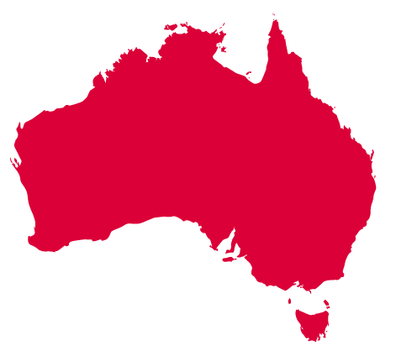
Australia is the world's sixth-largest country by total area

Slide 3
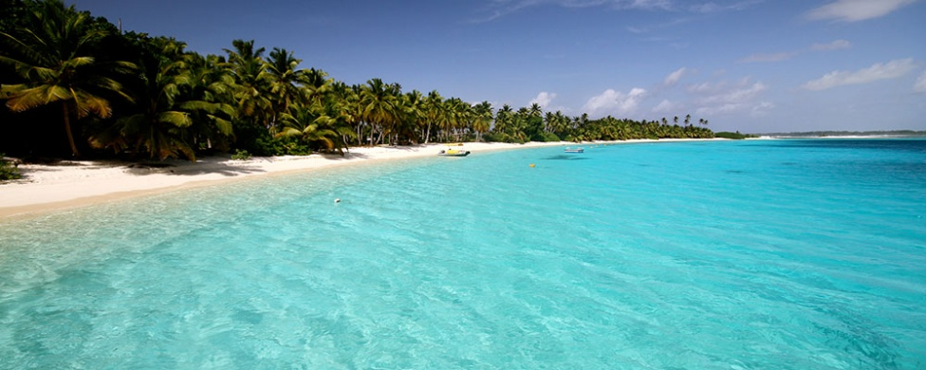
Australia is an island surrounded by more than 8,000 smaller islands

Slide 4
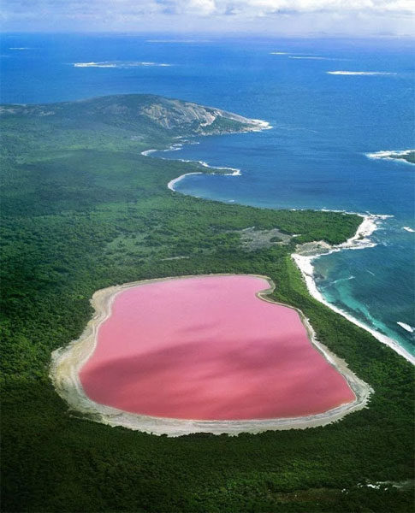
Lake Hillier in Australia is a bright pink color and scientists aren't sure why

Slide 5
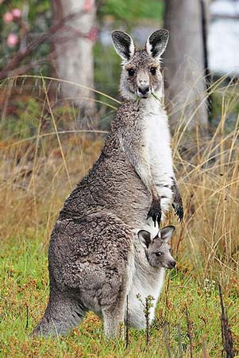
In Australia, there are more kangaroos than people

Slide 6
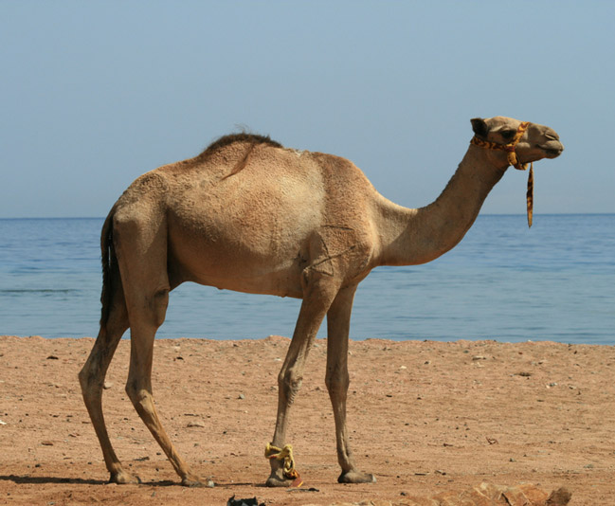
Australia exports camels to Saudi Arabia

Slide 7
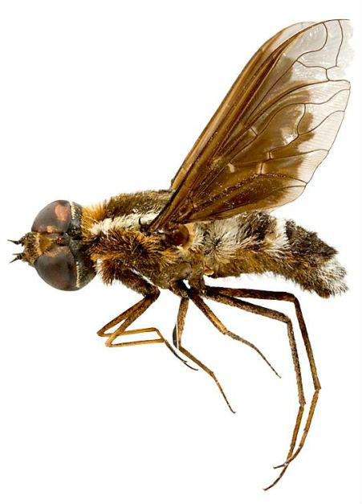
75% of Australia's living species are unknown to man

Slide 8
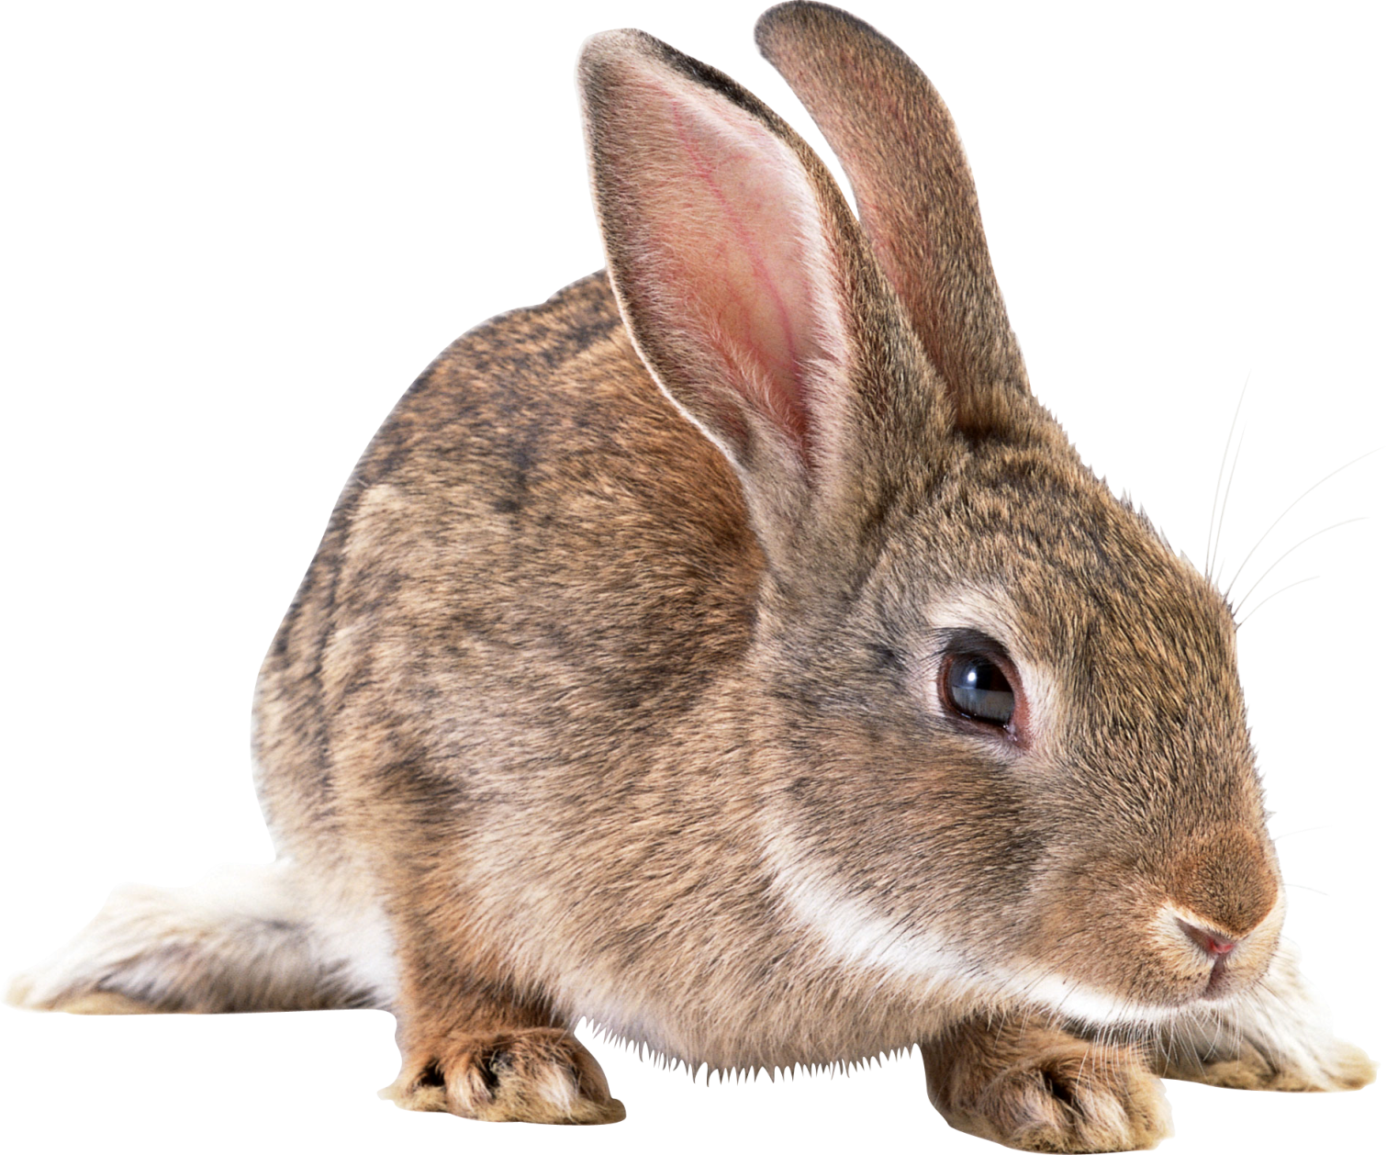
24 rabbits that were introduced to Australia in 1859 had multiplied in number to over 2 million in ten years

Slide 9
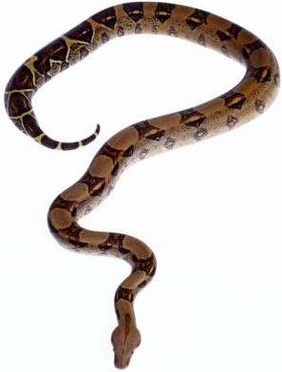
The top ten deadliest snakes can be found in Australia

Slide 10

Australia's National Science Agency claims to have invented the technology behind Wi-Fi and has sued companies using the technology without a license

Slide 11
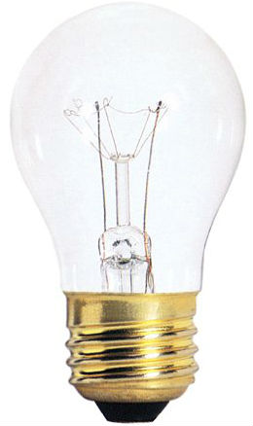
In Victoria, Australia, only a licensed electrician is allowed to change a light bulb

