Slide 1
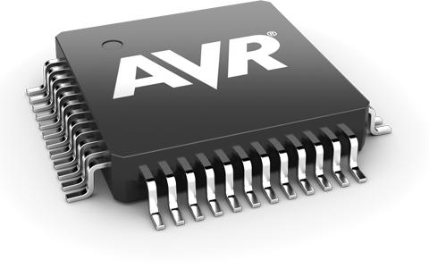
What is microcontroller? and how they infiltrated into our lives

Slide 2
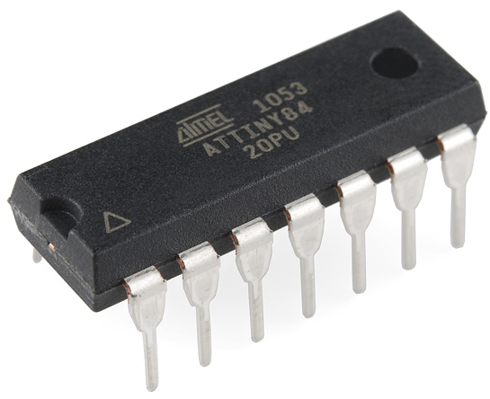
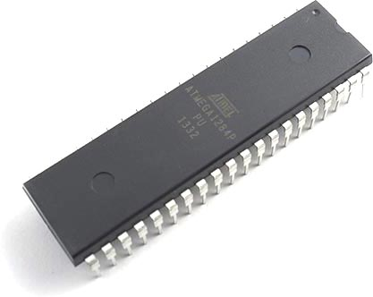
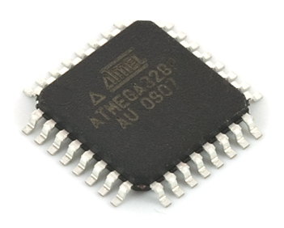
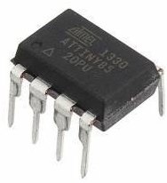
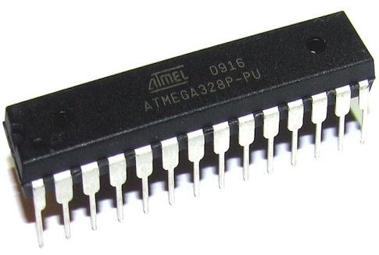
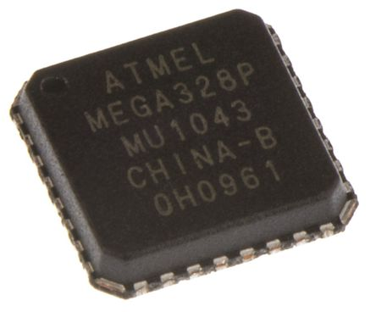

Slide 3


A little history
Alf-Egil Bogen
Vegard Wollen

Slide 4
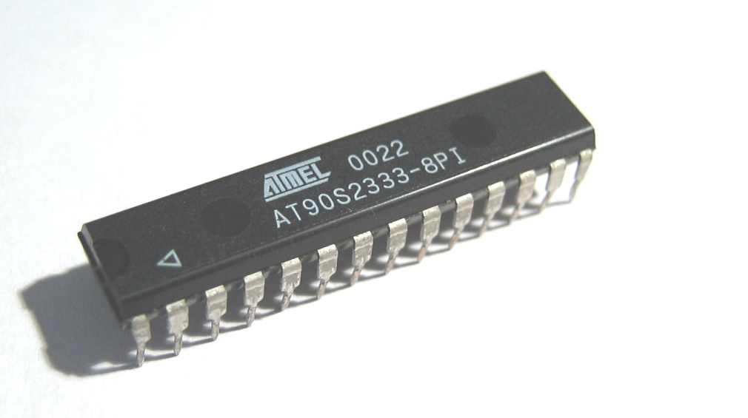
What is special in AVR?
The PIC (Programmable Interrupt Controller) appeared around 1980.
→ 8 bit bus
→ executes 1 instruction in 4 clk cycles
→ Harvard architecture
AVR (1994)
→ 8 bit bus
→ one instruction per cycle
→ Harvard architecture

Slide 5
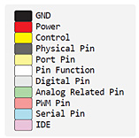
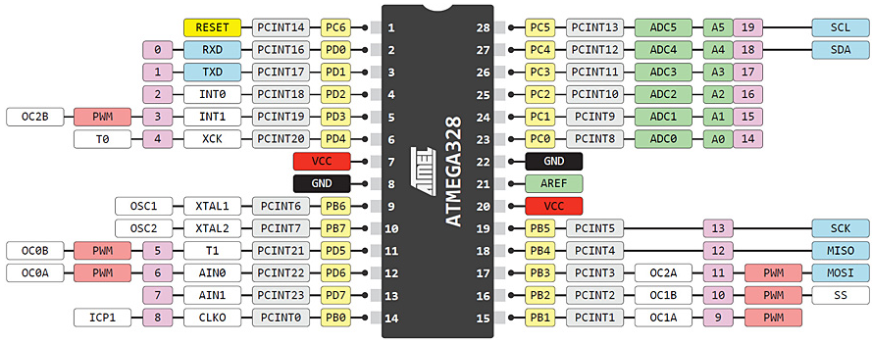
How do I connect it?

Slide 6
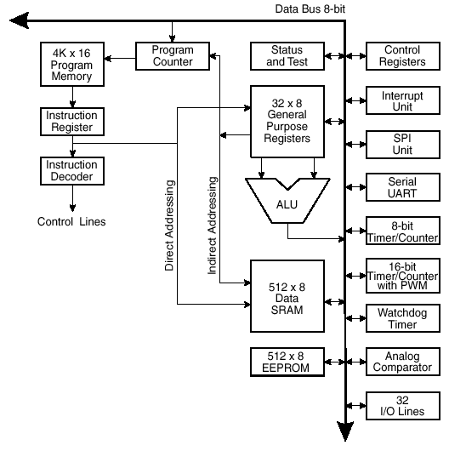
Internal structure AVR

Slide 7
Hardware
32 Registers (R0-R31)
4K Prog ROM
512 bytes RAM
512 bytes EEPROM
32 I/O lines
13 Interrupts
Lots of fun built-in peripherals

Slide 8
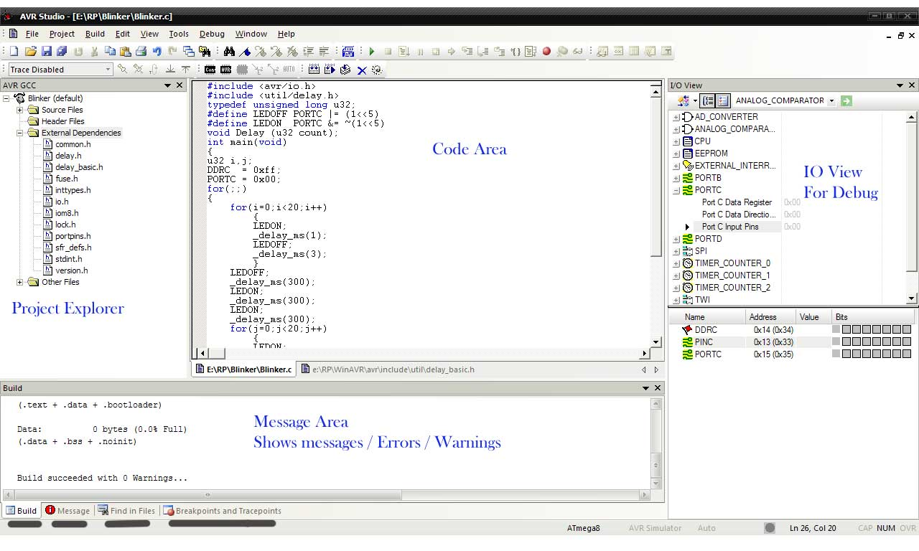
Programming AVR

Slide 9
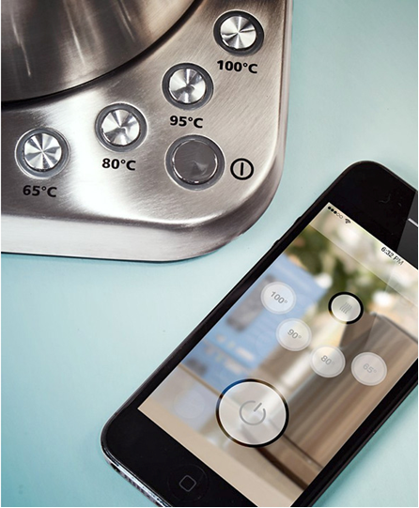
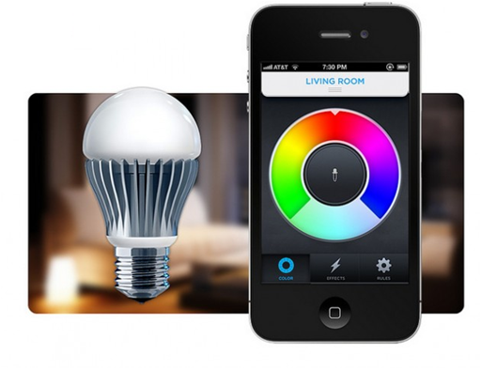
Smart devices

Slide 10
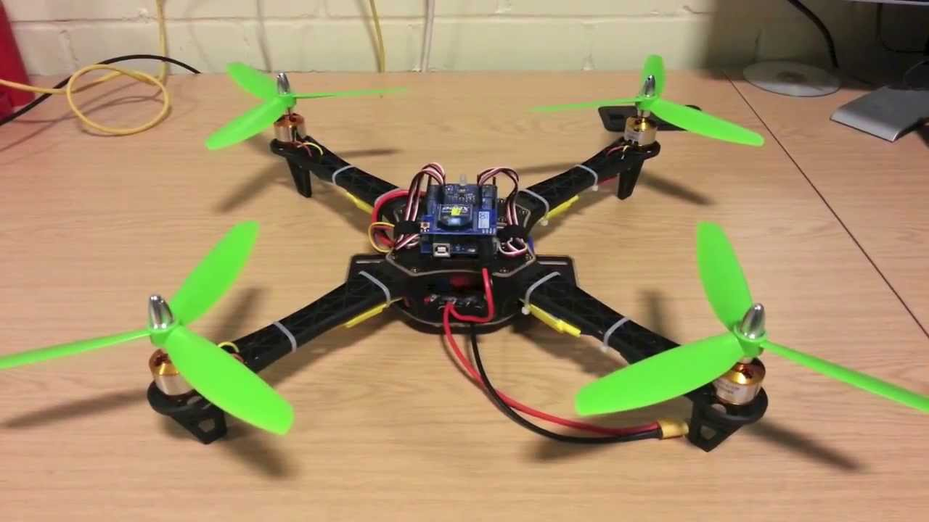
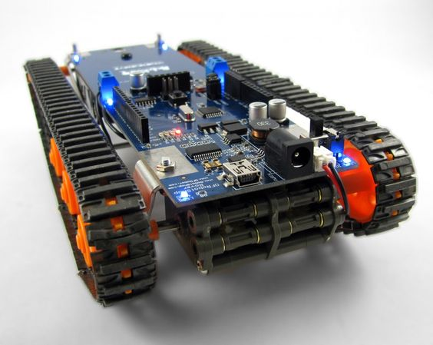
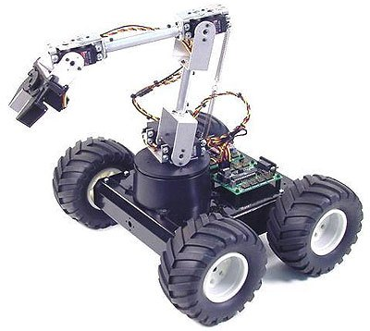
Robots

Slide 11
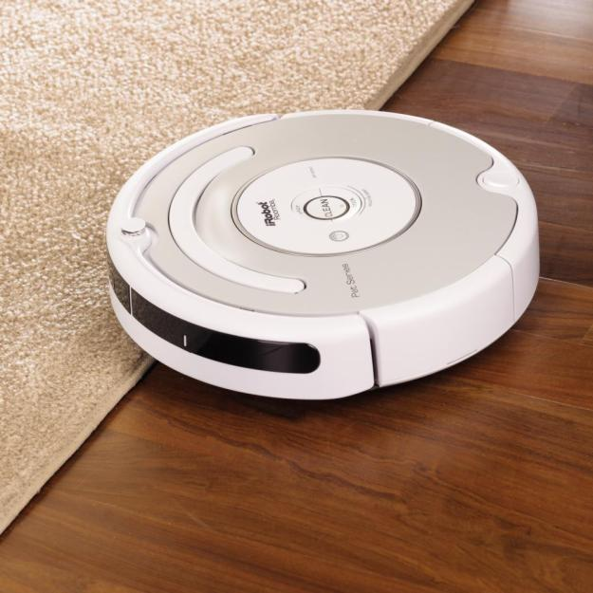


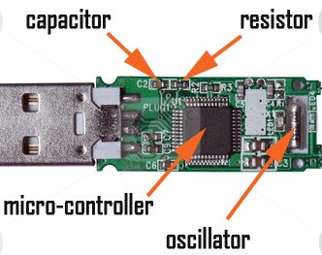
Where else can you meet a microcontroller?

