Slide 1
BANK LOAN PORTFOLIO ANALYSIS
Data cleaning • SQL analysis • Power BI reporting
38,576 loan records
Understanding lending performance, borrower patterns and repayment risk
01

Slide 2
Project overview
What this analysis aims to answer
How large is the loan portfolio and how much has been funded?
What proportion of loans are fully paid, charged off, or current?
How do borrower characteristics and loan grades vary?
Where are the potential credit-risk concentrations?
How did loan applications change across 2021?
02

Slide 3
Data and tools
End-to-end workflow
01 Python + Pandas
Data checks, preprocessing and derived categories
02 PostgreSQL + SQL
Store and analyze 38,576 cleaned loan records
03 Power BI + DAX
Calculate KPIs and visualize lending patterns
03

Slide 4
Data preparation
From raw CSV to analysis-ready data
Reviewed missing values, duplicate records and data types
Validated loan amount, interest rate, DTI and date fields
Prepared income, loan amount, DTI and risk categories
Saved the cleaned dataset as cleaned_financial_loan.csv
Loaded cleaned records into PostgreSQL and connected Power BI
04

Slide 5
Portfolio at a glance
Key performance indicators
38,576
$436M
$473M
12.05%
13.33%
Loan applications
Total funded
Amount received
Average interest rate
Average DTI
Figures reflect the full dataset and are rounded where indicated.
05

Slide 6
Loan repayment status
Most loans are fully paid
Fully paid
32,145
83.33%
Charged off
5,333
13.82%
Current
1,098
2.85%
Charged-off loans are an important segment for continued risk monitoring.
06

Slide 7
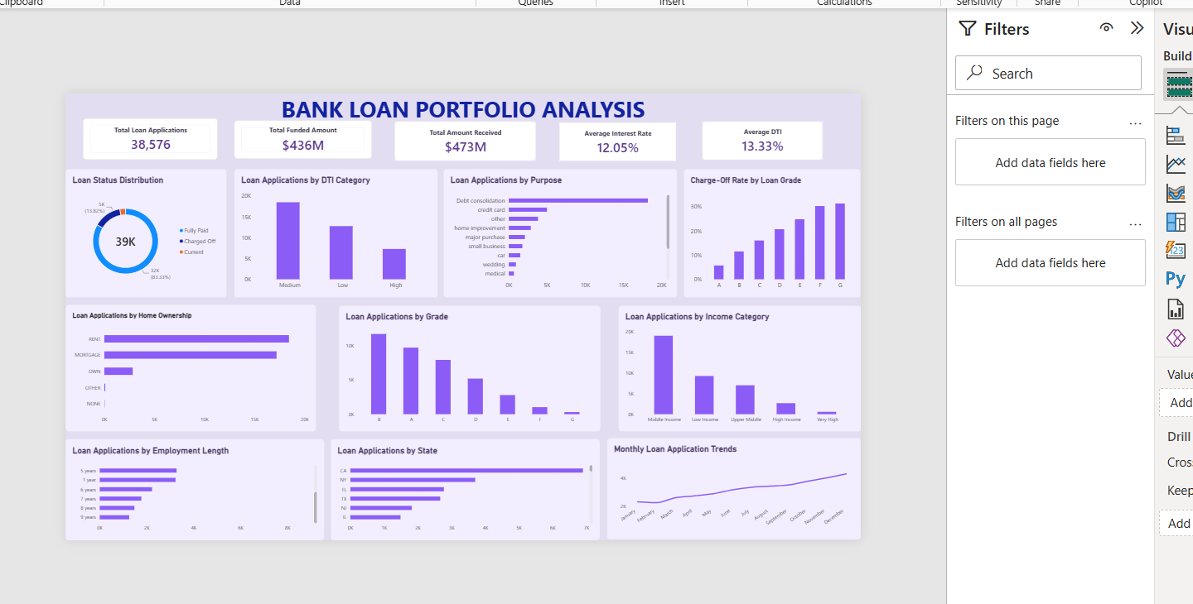
Power BI dashboard
Your lavender-themed portfolio overview
07

Slide 8
Key findings
Insights from SQL and Power BI
Grade B has the highest application count, followed by A and C.
Debt consolidation is the leading loan purpose; credit cards follow.
Renters account for 18,439 loans; mortgage holders for 17,198.
Lower credit grades, particularly F and G, show higher charge-off rates.
Monthly loan applications generally increased during 2021.
08

Slide 9
Recommendations and conclusion
How the analysis can support decisions
Monitor lower-grade loans for elevated repayment risk.
Review higher-DTI segments and repayment patterns.
Analyze debt-consolidation borrowing behavior.
Track monthly demand for forecasting and planning.
Use dashboard KPIs to support ongoing portfolio monitoring.
Project skills: Python • Pandas • PostgreSQL • SQL • Power BI • DAX
09

