Slide 1
Final Assessment excel Anasuya Lingampalli

Slide 2
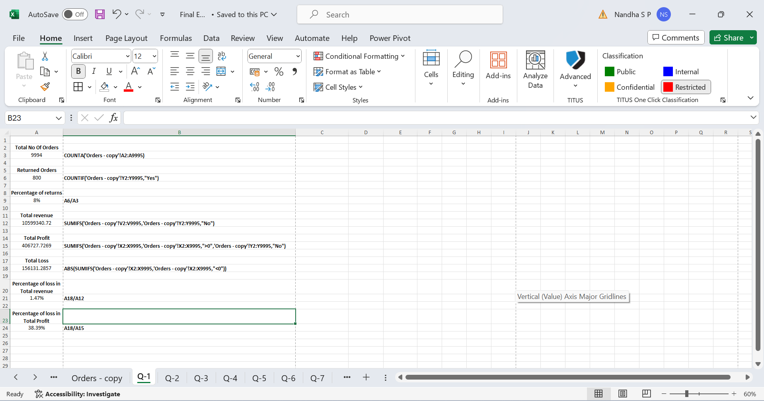
Q1
Insights –
The number of orders returned indicates the extent of dissatisfaction or issues faced by customers with the products or services offered. It reflects on product quality, accuracy in fulfilling orders, and customer service effectiveness.

Slide 3
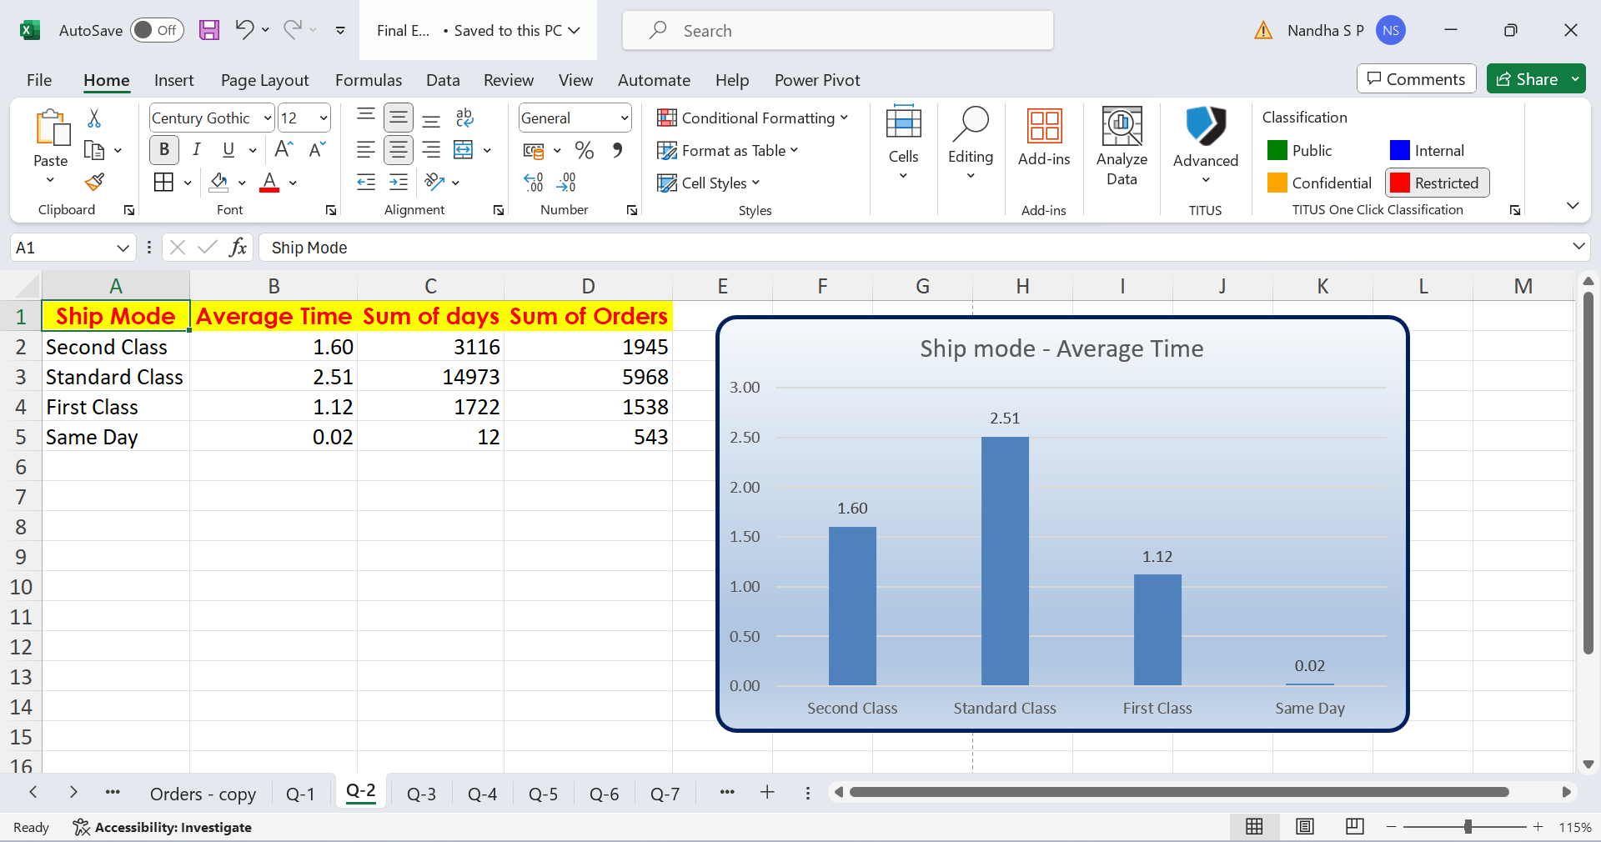
Q2
Insights-
Calculating the average shipping time for each shipping mode allows businesses to understand the typical turnaround time from order placement to shipment.

Slide 4
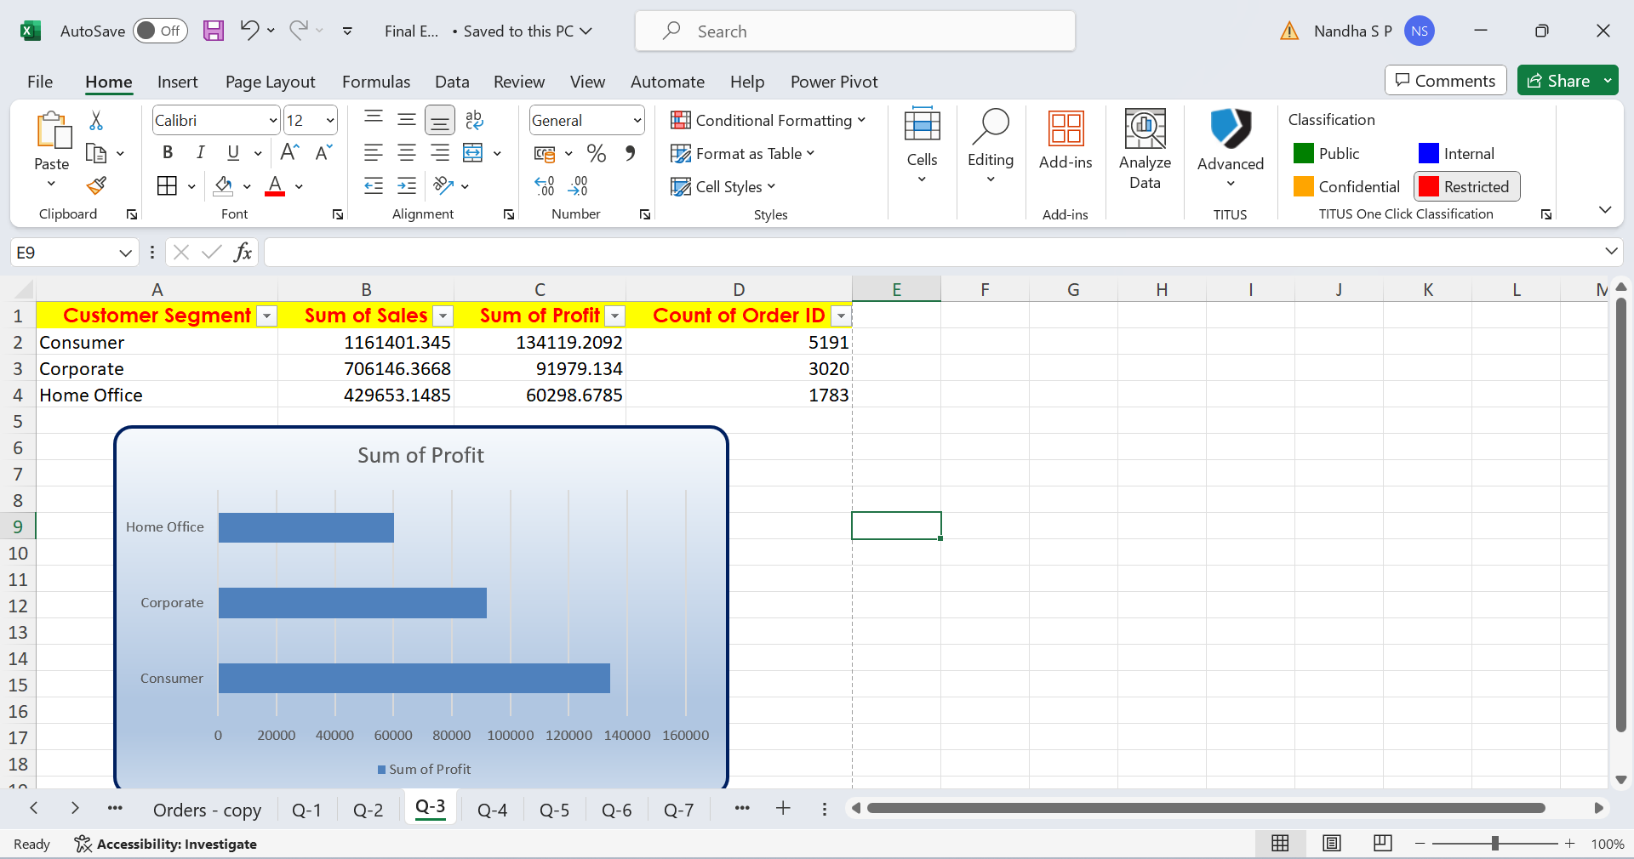
Q3
Insights-
Segmenting customers based on factors such as total sales, frequency of orders, average order value, or product preferences helps identify distinct groups with similar buying patterns.

Slide 5
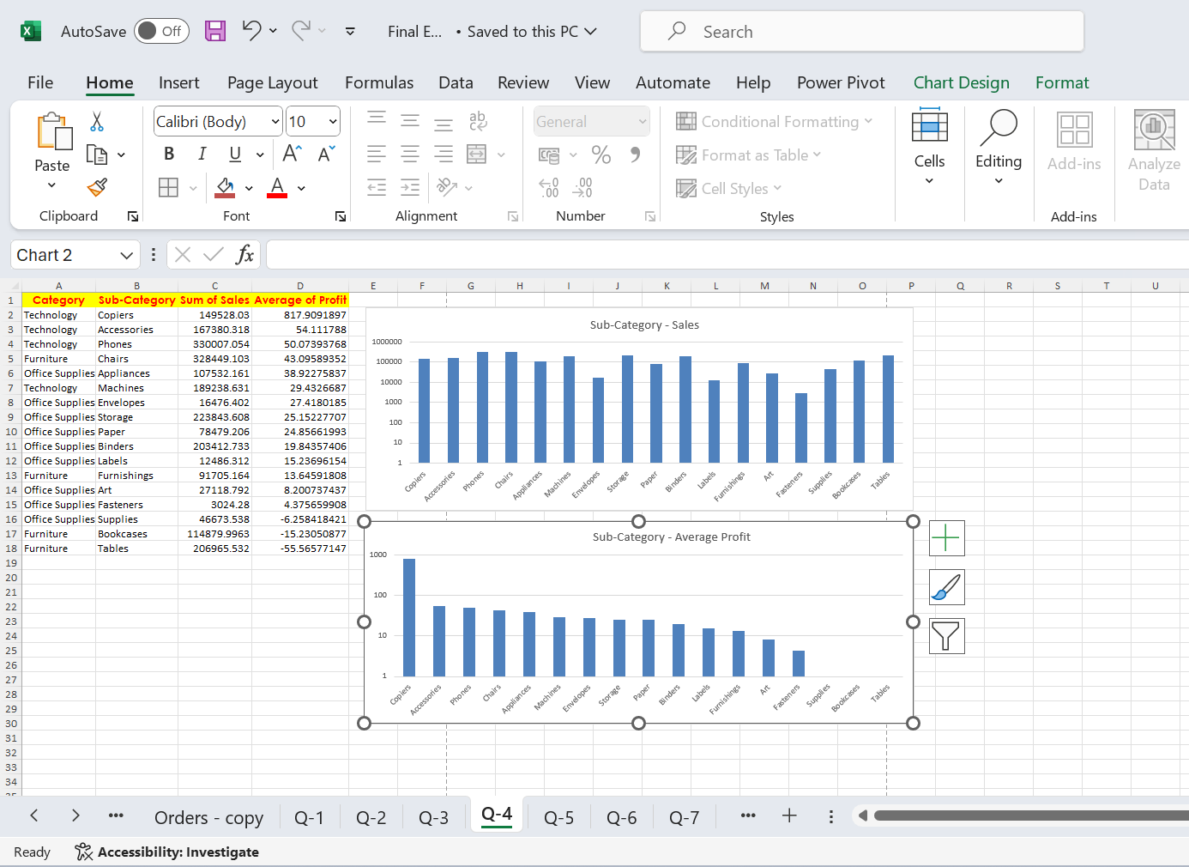
Q4
Insights –
The average profit margin provides insights into the profitability of products within each category and sub-category, taking into account variations in cost and pricing strategies.

Slide 6
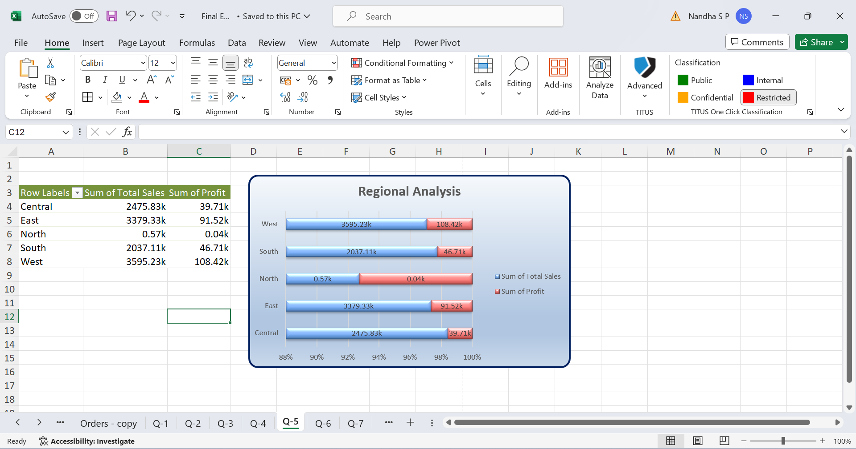
Q5
Insights-
Aggregate sales data by region to determine total sales volume for each region.
Compare sales performance across regions to identify regions with the highest and lowest sales. This comparison helps understand geographic variations in demand and market potential.

Slide 7
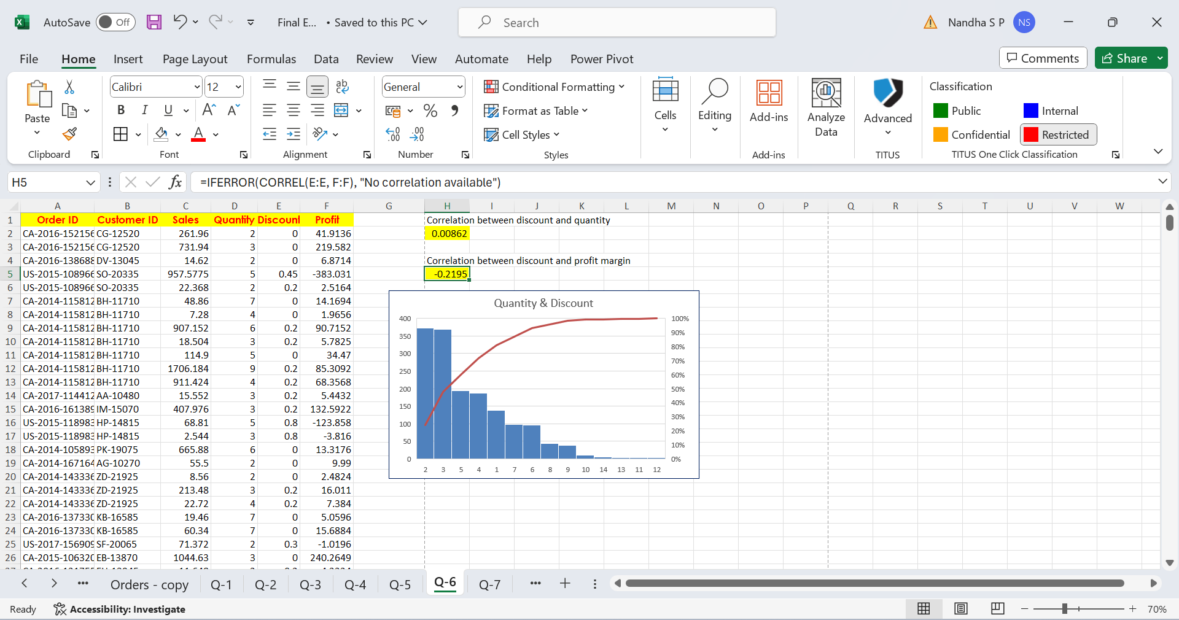
Q6
Insights
Calculating the correlation between the discount rate and the quantity sold provides insights into the relationship between discounts and sales volume. A positive correlation suggests that higher discounts are associated with increased sales, while a negative correlation indicates the opposite.

Slide 8
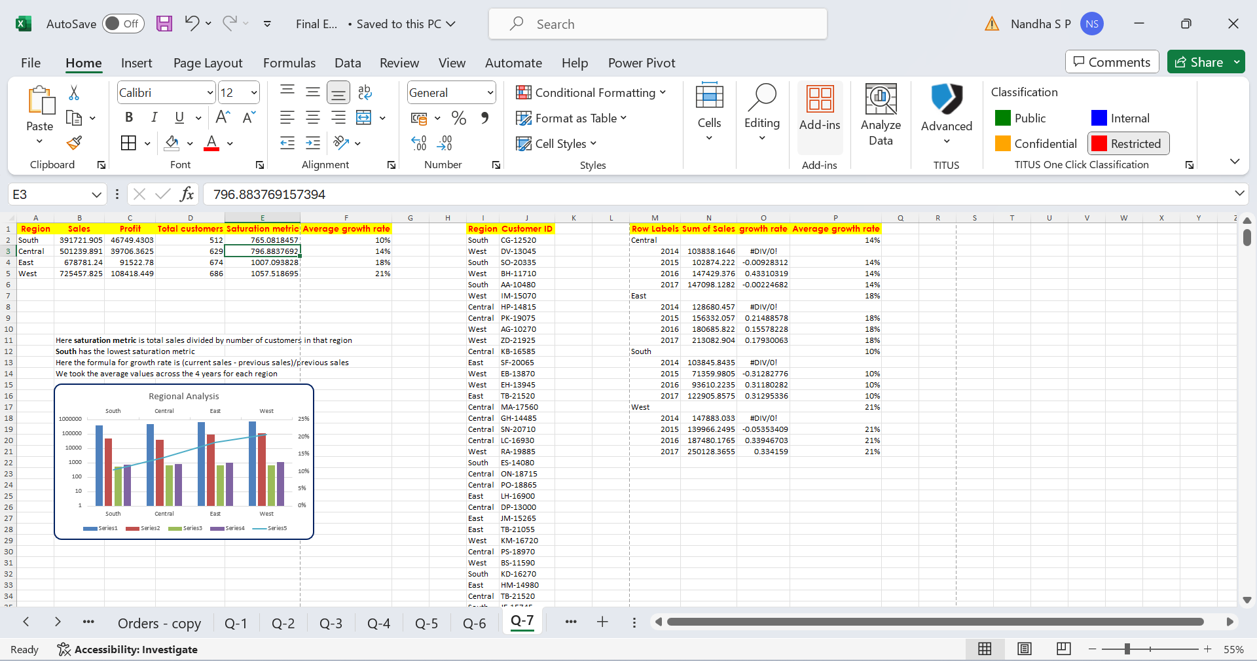
Q7
Insights
Conduct market research to identify regions where your products or services are underrepresented or where there is a growing demand for similar offerings.
Analyze demographic data, economic indicators, consumer behavior, and competitive landscape to assess market potential and identify regions with low market saturation and high growth potential.

Slide 9
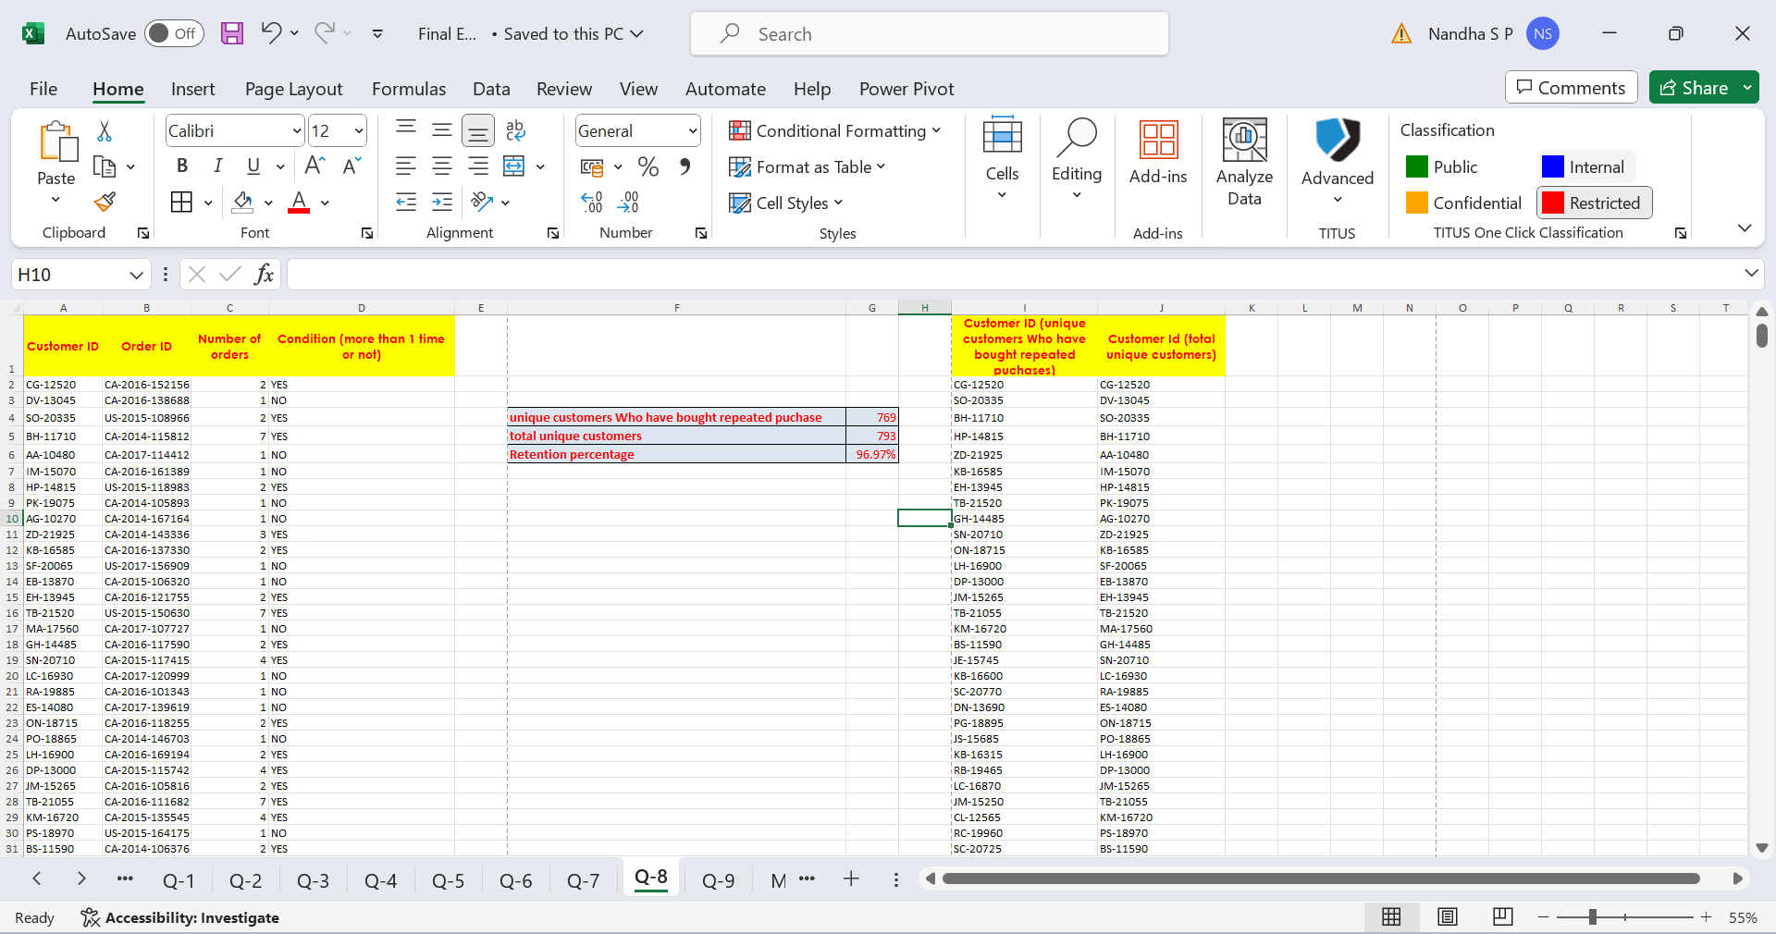
Q8
Insights
Analyzing repeat orders from existing customers allows businesses to calculate the customer retention rate, which represents the percentage of customers who continue to make purchases over time.

Slide 10
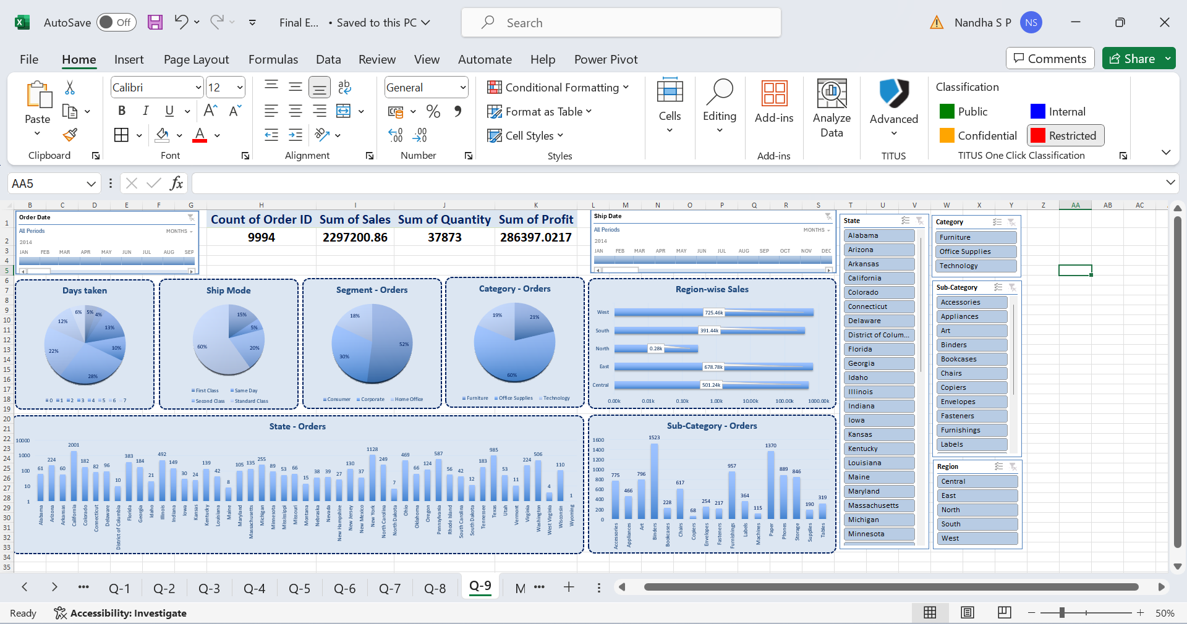
Q9
Insights-

Slide 11
Q9

