Slide 1


Evolving binary code
with GAs

Slide 2

Who am I
Jesús Olmos
sha0@badchecksum.net
https://github.com/sha0coder

Slide 3
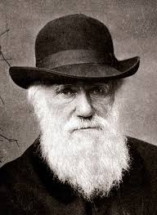
Genetic Algorithms (GAs)
From evolving data to evolving code.

Slide 4
Automatic logic creation
Two aproaches:
1. Providing all the details.
2. Providing a purpose. (test cases or evaluation function)

Slide 5
Measuring the evolution
Evolving trading strategy.
function buy(indicators) {
}
function sell(indicators) {
}

Slide 6
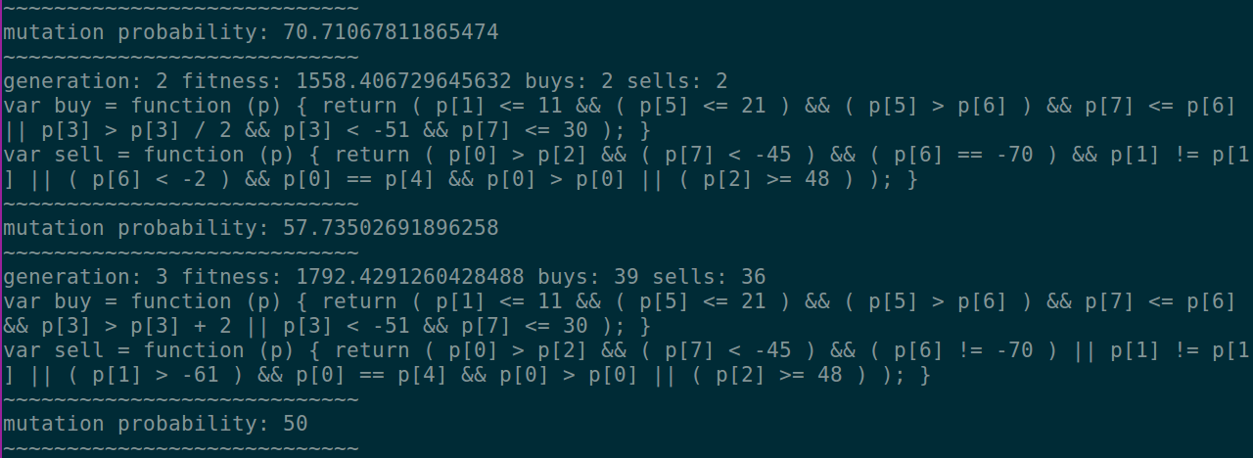
Measuring the evolution

Slide 7

Let's evolve ASM code!!
Genetic Algorithm powered by ESIL

Slide 8
Design
Genotype
Score
R2Pipe
Population
Sandbox
Eval
Esil

Slide 9
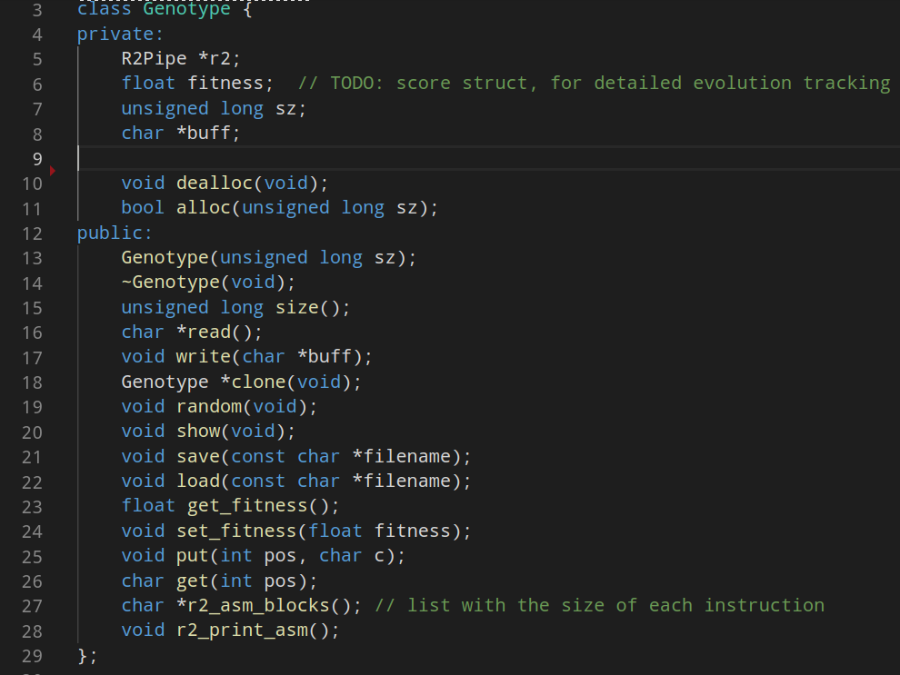
Genotype Definition

Slide 10
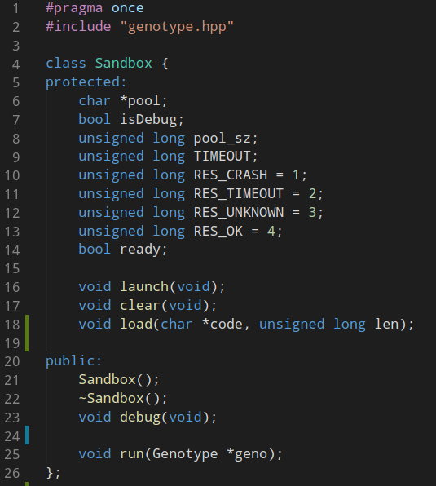
Sandbox definition

Slide 11
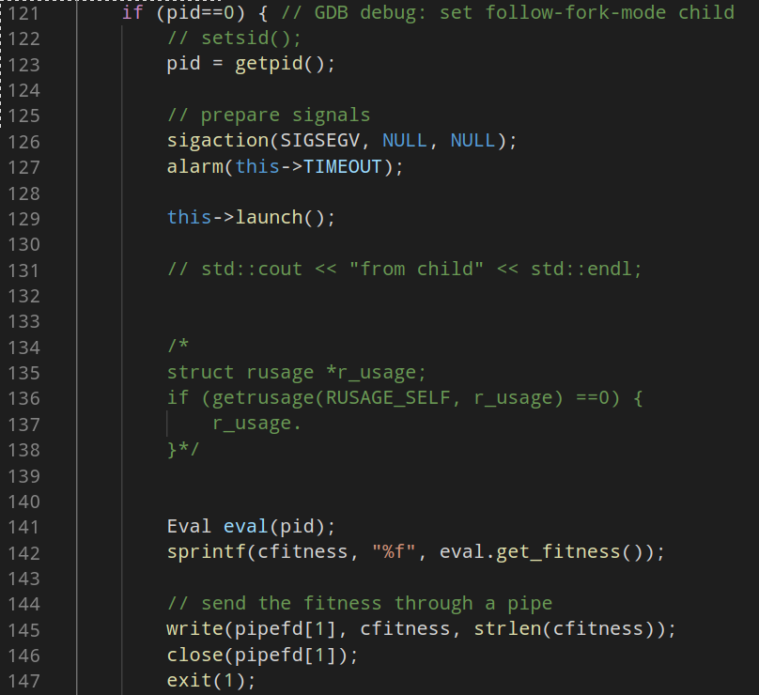
Sandbox child process

Slide 12
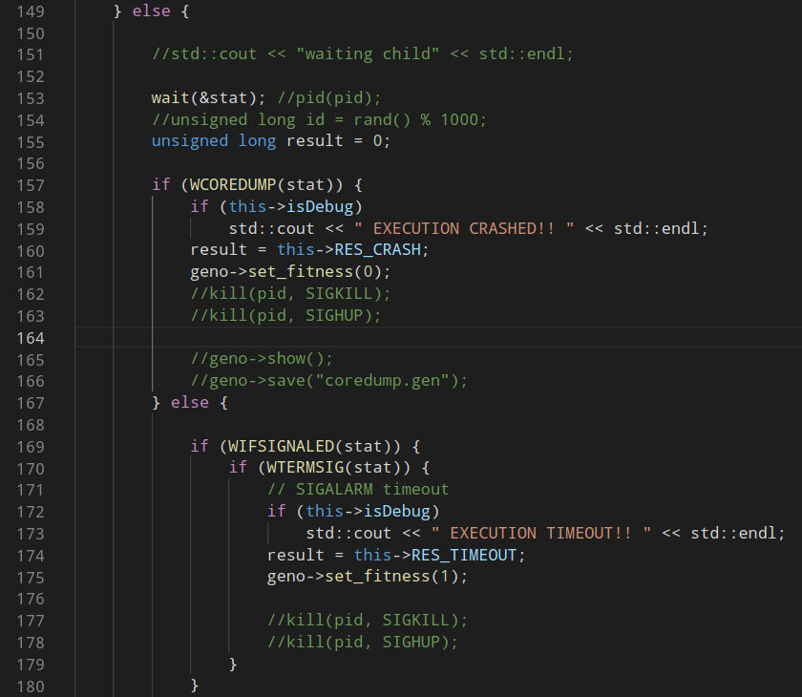
Sandbox parent process

Slide 13
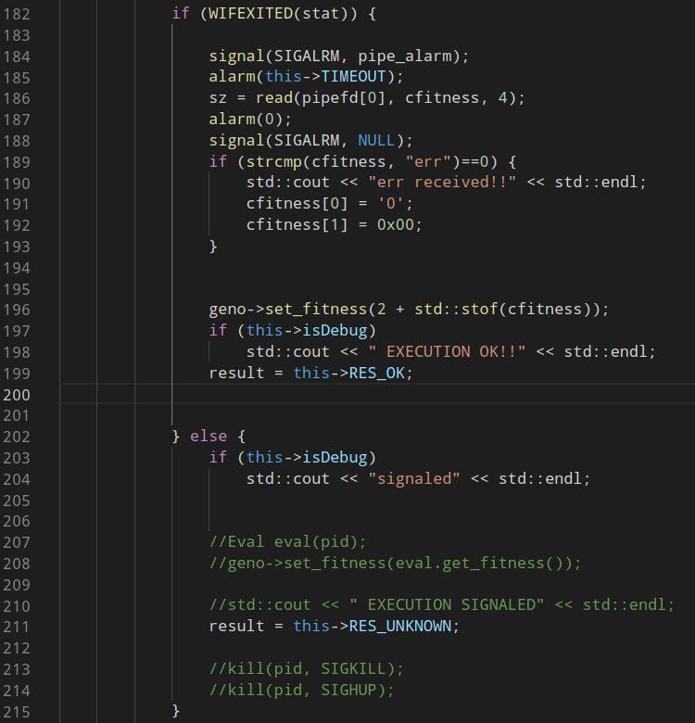
Sandbox parent process

Slide 14
Sandbox
sigtrap pool
Genotype code
Return pool
sigtrap pool

Slide 15
Mutation
- GAs must use very low mutation probability.
- Hight mutation = random search --> Don’t converge.
- Different probabilities: opcode, operads, inmediates.
- From exploration to optimization.

Slide 16


Crossover
Byte level crossover:

Slide 17
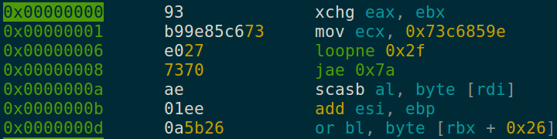

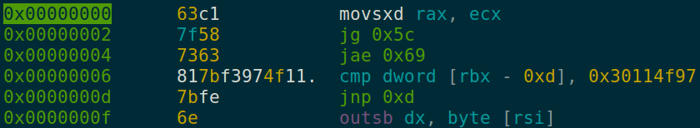
Crossover
Instruction level crossover: (also basic-block level)

Slide 18
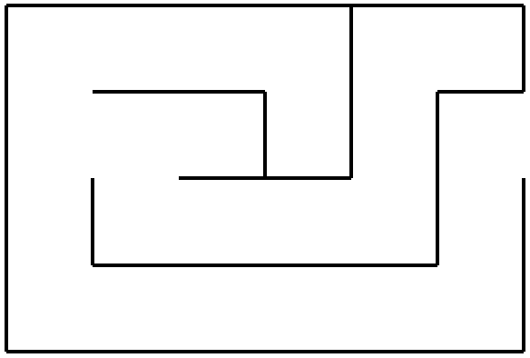


Evaluation
Error = distance (exploration vs optimization)

Slide 19
Evaluation
Error = distance (exploration vs optimization)

Slide 20
Evaluation
Dynamic evaluation.
- Must end the execution properly:
- No segfaults, traps, etc ...
- In less than TIMEOUT seconds.
- Measure process constants (oom, load, cpu, ram, ...)
- Fork + sandboxing vs emulation + esil

Slide 21
Evaluation
Static evaluation (r2pipe)
Proper sytax:
- only valid instructions
- no ret instructions
Radare branch prediction:
- avoid out of scope branches
Sys-calls increase the bonus

Slide 22
Validation
Dataset based problems requires a validation.

Slide 23
Use Cases?
- Triggering vulnerabilities? (requires a complex EF)
- The perfect r2wars warrior.
- Local DoS.
- Remote DoS.
- Search problems.
- Optimization problems.

Slide 24
Demo time
Genotype size: 0x20
Mutation probability: (8/g)%
Crossover rate: P*0.05

Slide 25
Github resources
Rust test-case solver:
https://github.com/sha0coder/spocky
C++ evolving assembly code:
https://github.com/sha0coder/predator

Slide 26
Thanks.

