Slide 1
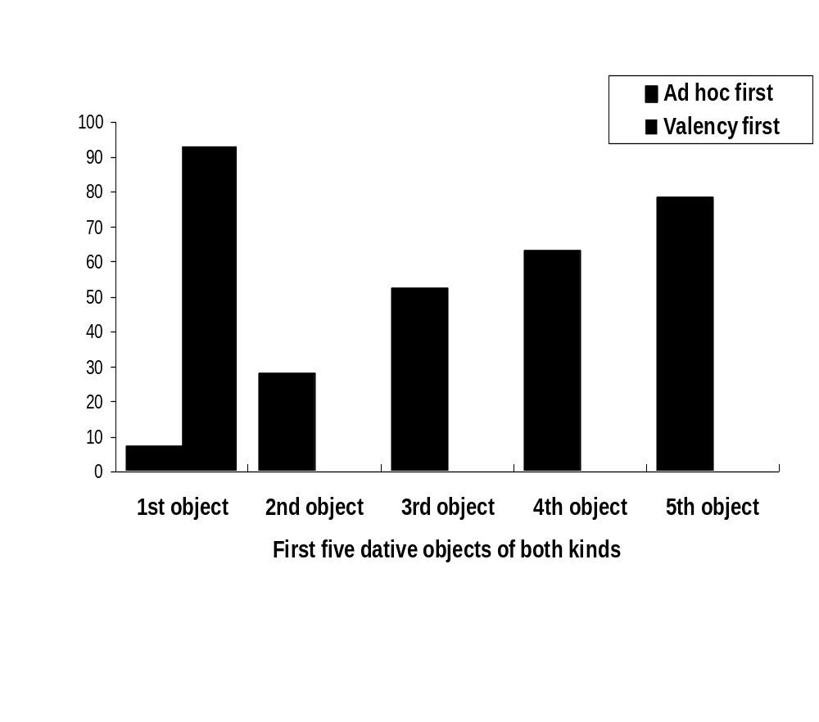
Semantic facilitation in the development of the dative object
Tamar Arnon and Anat Ninio
The Hebrew University, Jerusalem
Goal of study:
The reported study explored the function
of semantics in the development of the syntactic role of dative object.
In Hebrew, canonical datives are indirect objects with a le- preposition. The preposition is fixed for the relevant verbs, it cannot be dropped and it cannot be substituted by other prepositions.
Ad hoc versions of the dative indirect object in le- can be attached to practically any verb in Hebrew, transitive as well as intransitive. The preposition can be substituted by others expressing beneficiary semantics, such as bishvil 'for', avur 'for' or lema'an ’for the sake of‘.
1
The major semantic roles
of canonical datives are:
* Recipient of object (of the verbs natan 'give', hevi 'bring’)
* Benefactee (azar 'help', hilbish 'dress’)
* Addressee (higid 'tell', amar 'say', hera
'show’)
* Connectee (xiber 'attach', kara 'call', hictaref 'join’)
*Affectee-Malfactee (hirbic 'hit', hicik 'annoy’)
* Referent (hityaxes 'refer', hitkaven ‘allude’)
2
The semantics of ad hoc
datives is different:
The closest to the canonical meaning of
’recipient’ are ’ultimate recipient’ (kana le- 'buy for', sam le 'put for’), and 'loser of an object’ (nafal le- 'fall from', nishpak le- 'spilled from').
Other roles are: 'beneficiary’ (sider le- 'fix for', nika le- 'clean for'), 'ultimate possessor of a created object' (asa le- 'make/do for', ciyer le- 'draw for’), and 'recipient of information' (hicbia le- 'point for'), and 'affectee’ (histovev le- 'turn for', hitkalkel le- 'spoil for', ).
3
Hypothesis:
Semantic analogy
in learning
We hypothesized that children learn to produce dative objects on the basis of analogy and semantic similarity to the first-learned, prototypical, canonical, obligatory indirect objects.
First, ad hoc datives will be produced by analogy to canonical datives.
Second, all later datives are produced by semantic analogy to the first-
learned ones.
4
Method:
The spontaneous speech of 30 Hebrew-speaking children were analyzed, in
the age range 1;1-2;8. The children were observed longitudinally.
The observations took place about once a week at home, in naturalistic
circumstances, lasting 30 minutes each.
We focused on the children's first five different verbs getting dative objects.
5
First question: order of development of canonical and ad hoc datives
We found that in 89% of the children, the very first combination of verb and dative object was a valency-required combination. Ad hoc dative objects first appeared only after the children already produced obligatory datives to a mean of 1.2 different verbs.
The following graph compares the probability that the 1st required dative be learned before the 1st ad hoc dative, the second required dative be learned before the 2nd ad hoc dative, and so on until the 5th pair.
6
Pairwise comparison of
order of acquisition:
Valency vs ad hoc datives
7
Results 1:
After the first verb, the rate of learning of ad-hoc datives accelerates and that of obligatory datives slows down, until the number of different verbs getting an ad hoc dative passes that of the obligatory ones, already in the 5th dative object.
The factor giving priority to valency-datives over ad-hoc datives weakens once the children have learned their first verb or so with dative objects.
8
Second Question:
Analogy and transfer
in acquisition
According to our hypothesis, learning is by analogy and transfer from the already-learned datives. This hypothesis was tested by examining the effect of semantic similarity on order of acquisition.
We classified children's verb-dative combinations according to the semantics of the indirect object.
Results 2: Recipients first
The first verbs getting dative objects tended very strongly to be the verbs natan le- 'give to' and hevi le- 'bring to', 74% of all first verb-dative combinations. Altogether, 85% of all first-learned verb-dative combinations expressed the semantic role of the ‘recipient’.
9
Results 3:
The semantics of later-learned datives tends to be recipient or beneficiary.
Among the 2nd-to-fifth verbs with a dative object, recipients or ultimate recipients were 50.5% of all datives, e.g., lakax le- 'take from‘ or kana le- ‘buy for’.
The beneficiary of a service accounted for 17.8%, e.g., azar le- 'help‘ or patax le- 'open for‘.
The beneficiary of a created object accounted for another 10.3, e.g., asa le- 'make/do for‘ or ciyer le- 'draw for‘.
Altogether, 'beneficiary' semantics were expressed by 28.0% of the verb-phrases with a dative object.
10
Results 4:
Other semantic roles were less likely to be learned.
Some children expressed:
Affected entity: 13.1%
Connectee: 7.5%
Addressee: 0.9%
Some semantics were not learned by any of the children, at this stage of development. For instance, 'autonomous agent', 'recipient of information' and 'referent' are not apparently among the types of indirect objects learned early.
11
Conclusion:
It is possible that a major factor accounting for order of acquisition is semantic similarity: The closer the meaning of the verb-indirect object combination to the first-acquired semantics of 'give to X' and 'bring to X', the more likely the verb is to be learned with a dative object early in acquisition.
This doesn't mean that only indirect objects with identical semantics are learned early, but rather, semantics similar to the first-learned. The results point to the workings of semantics-based facilitation in syntactic acquisition.
12

