Slide 1
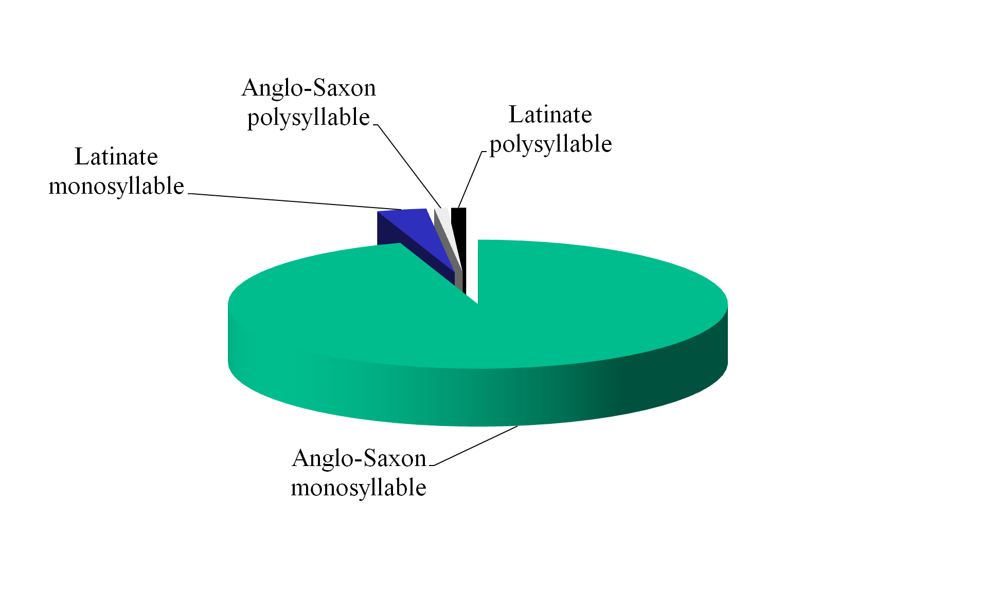
Parents' Speech to Young Children:
Additional Dimensions of Syntactic Simplicity
Anat Ninio
The Hebrew University, Jerusalem
IASCL 2011, UQAM, Montreal
Background
In a seminal study, Snow (1972) found that parents’ speech to young children is simpler in its syntax than speech to older children.
We explored two new features of syntactic simplicity concerning verbs in basic syntactic combinations: morpho-phonemic complexity and historical origin.
We focused on parental sentences in which the syntactic relations were:
Subject-Verb
Verb-Object
Verb-Indirect Object
Method -- Sample
We built a large corpus of parental sentences based on English‑speaking parents in the CHILDES archive, 1.5 million words. Parents from all English‑speaking countries and dialects were included.
A total of 506 parents contributed multiword sentences with these core grammatical relations to the pool. The children spoken to were less than 3;6, mean age 2;3.
The corpus
  Utterances were hand‑parsed for grammatical relations, and the verbs lemmatized.
The corpus consisted of over
  338,970 tokens,
produced with
  892 different verbs.
1
2
3
4
Coding
We classified all verbs according to number of syllables of the verb-stem, into one-syllable versus multiple-syllable
We classified all verbs according to their historical origin, as
(1) Native or Anglo‑Saxon
(2) Latinate
(3) other or unknown (mostly onomatopoeic)
95% of all tokens of the core grammatical relations used monosyllabic native verbs.
Results:
Length & Origin
.
5
6
Conclusions:
Anglo-Saxon verbs are useful for communication
Most of parents’ verbs in utterances with a basic syntax are native verbs.
These short verbs are apparently useful for communicating with young children.
Articulatory simplicity goes hand in hand with polysemy and polyvalent syntax in basic English verbs. This doesn’t appear to be a problem.
Conclusions:
Simplicity is a complex thing
Apparently, the major dimension of parental simplification is morpho-phonetic, not one-to-one mapping of form to function in syntactic use.
Further details and references are to be found in:
Ninio, A. (2011). Syntactic development, its input and output. Oxford: Oxford University Press.
7
8
A question:
Why is this important?
Some of the most frequent native verbs were be, do, go, want, give and get.
Being of native origin makes a difference to the syntax of verbs in English.
Native verbs are mostly polyvalent, their semantics is polysemous (Dixon, 1991).
Many native verbs have auxiliary or semi‑auxiliary versions besides the full version, and various specific constructions.

