Slide 1
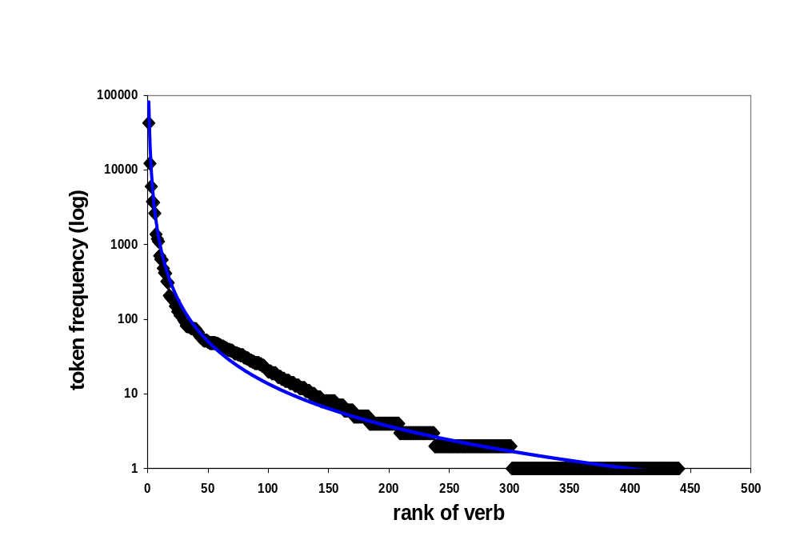
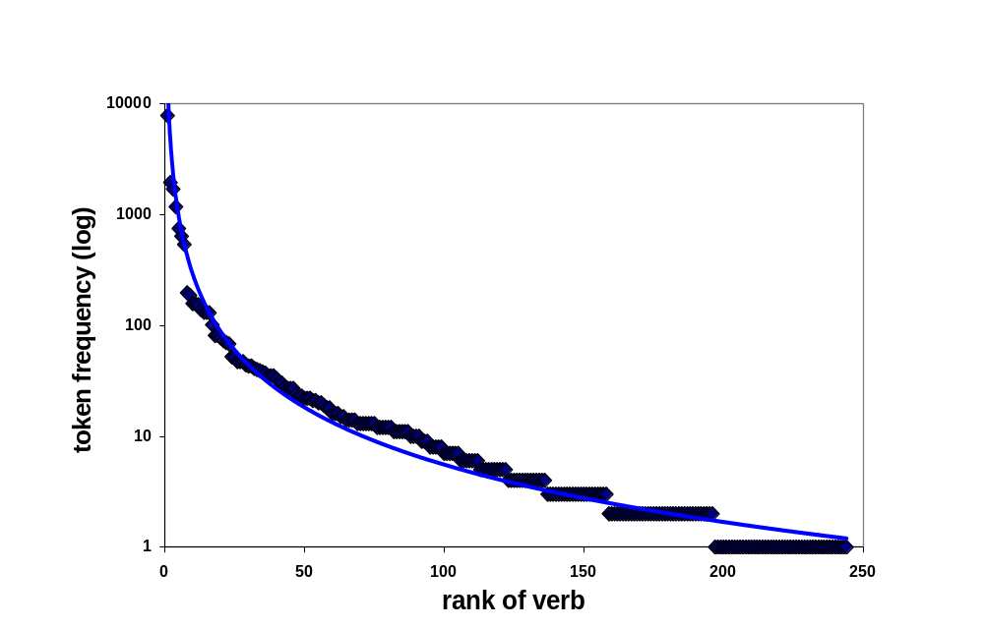
Input-Output Relations in Syntactic Development Reflected in Large Corpora
Anat Ninio
The Hebrew University, Jerusalem
The 2009 Biennial Meeting of SRCD, Denver, Colorado.
Background:
It is often claimed by researchers that young children's output is severely limited compared to the parental input.
Against this conception it has been said (Ninio, 2006) that children's choice of items to learn and produce is very much like their parents choice of items to say, and that, despite a smaller vocabulary, syntactic output is quite similar in its features to the input.
Prediction:
We thus predict that the token frequency distribution of different verbs participating in some syntactic combination will be quite similar in a corpus of parental speech and in child speech.
The reported study tests this claim in a large corpus of English child sentences expressing the grammatical relation of Subject-Verb, comparing it to a large corpus of English parental speech expressing the same grammatical relation.
Method-- Corpora:
We built a large corpus of parental sentences based on English-speaking parents transcribed and stored on the CHILDES archive. Parents addressing children under 3;6 were included, contributing no more than 3000 utterances each.
Similarly, a child corpus was built from the English-speakers of the CHILDES archive. No child passed age 3;6 and each child contributed up to 300 utterances from the start of their production of multiword combinations.
Method -- Sample:
In the parental sample reported here, there were 410 parents who produced at least one Subject-Verb combination, in the child sample there were 408 children. The mean age of the children was a little over 2;3.
Utterances were hand-parsed for grammatical relations, and the verbs lemmatized for statistical analysis. (For details see Ninio, in press).
1
2
3
4
Results -- parents:
Parents produced over 84,500 tokens of the Subject-Verb combination, using 440 different verbs.
The distribution of tokens produced with each verb is very skewed, so that a few verbs be, do, can, want, have and go, account for over 80% of all tokens.
However, they also used a large number of verbs with low frequency.
5
Parents’ verbs:
Rank-frequency distribution of verb tokens with a subject in parents’ corpus (N=84,689; fit of power-law function 97.3%)
6
Results - Children:
Children produced over 18,000 tokens of the Subject-Verb combination, using 219 different verbs.
As in the parents’ data, the distribution was very skewed: children used a few verbs be, do, can, want, have and go with very high frequency, accounting for the great majority of their sentences.
They also used a large number of verbs with low frequency.
Their results were extremely similar to the parents’.
Children’s verbs:
Rank-frequency distribution of verb tokens with a subject in children’s corpus. (N=18,437; fit of power-law function 97.4%)
7
8
9
10
11
12
Conclusions: Very similar
Comparison of the token distribution of different verbs in the two corpora revealed a high degree of similarity. In both cases, the distribution was extremely skewed, with a few verbs generating the large majority of the sentences and many verbs generating just a few tokens each.
These results reflect the self-organization of children's linguistic system along the same pragmatic lines as that of parents'.
Conclusions:
Linking into a complex network
Language is a complex network, consisting of linguistic items (such as words with their semantic and syntactic valency) as well as speakers who produce words and sentences when they speak.
Children acquiring language are just like new users linking into the World-Wide Web: by linking into the Web, users become part of it.
Conclusions:
Same choice of items
Producing some type of linguistic item -- whether by parents or by children -- means linking into the network alongside other speakers, obeying the same rationale guiding the choice of items to link to.
These are probably pragmatic principles of usefulness, least effort and wish for clarity (Zipf, 1949).
More publications:
Ninio, A. (2006). Language and the learning curve: A new theory of syntactic development. Oxford: Oxford University Press.
Ninio, A. (in press). Syntactic development: Its input and output. Oxford: Oxford University Press.
The poster can be downloaded from:
http://micro5.mscc.huji.ac.il/~msninio/

