Slide 1
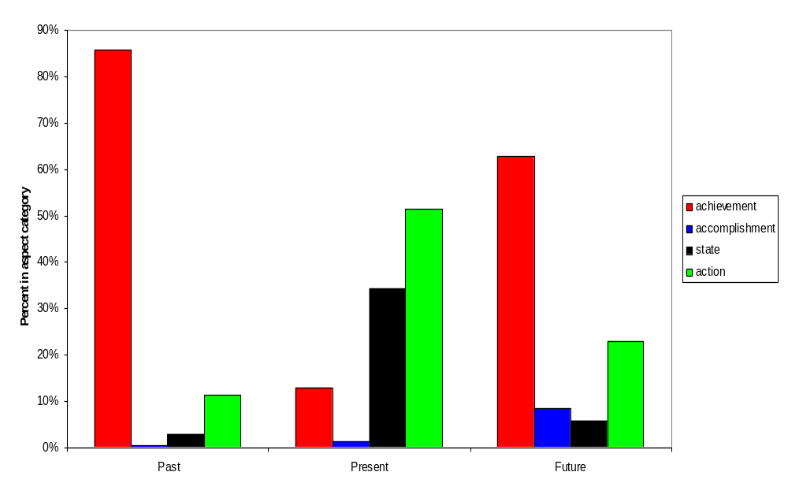
Aspect is not first: Children do not mistakenly map inherent lexical aspect to tense morphology
Galila Spharim and Anat Ninio
The Hebrew University, Jerusalem
The 11th International Congress for the Study of Child Language (IASCL), Edinburgh, 2008
Background: tense used for certain aspects only
It has been found that at the start of development, children's use of tense morphology is mostly under-extended to certain inherent lexical aspects:
PAST forms are mostly used with telic and punctual verbs.
PRESENT forms are mostly used with atelic and durative verbs.
.
Tense and aspect do not confound in Polish
The results of a study of Polish children (Weist, Pawlak & Carapella, 2004) do not support this hypothesis.
In Polish, tense and aspect are separately marked by morphology and children start to use verbs inflected for past and for future within the same perfective aspect category at about the same age. This demonstrates that, in Polish acquisition, grammatical aspect is not mapped onto tense morphology.
Hebrew replication of the Polish study
It is possible, however, that in the absence of aspectual marking in a language, children may map lexical or inherent aspect onto tense morphology.
Hebrew is a language in which aspect is not a grammatical category, and the present study is a replication of the Polish one.
1
2
3
4
Background: children mistake tense for aspect?
One interpretation of this semantic bias is that, initially, children mistake tense marking for aspect marking and map lexical aspect to the relevant morphology. In its extreme form, the bias is attributed to an innate bioprogram (Bickerton, 1981) or some similar "prewiring" of genetic or cognitive sources.
Method -- Corpus
Longitudinal naturalistic observations of 14 Hebrew-speaking children aged 1;6 to 2;3 were analyzed.
Spontaneous utterances were searched for the first five verbs each, inflected for past, present and future tense.
5
6
Aspect of Tenses. Distribution of children's first 5 verbs with past, present, and future morphology in 4 categories of lexical aspect (N=14)
Results - Aspect of Tenses.
Past-tense verbs almost inevitably had an achievement aspect, namely, they expressed punctual and telic semantics.
e.g., nigmar ‘finished, done’, nafal ‘fell’
Verbs in the present had mostly an atelic and durative aspect, and were mostly activity verbs and statives. This replicates the usual aspectual bias in tense marking.
e.g., ose ‘do’, rotze ‘want’
7
8
Results - Aspect of Tenses.
However, the majority of verbs in the future also had an achievement lexical aspect, namely, were punctual and telic, with a minority of activity verbs and others.
e.g., tavii “will-bring”, yipol ‘will fall’
9
Results - Ages at Tenses.
T-tests showed that the ages of emergence of the first 5 verbs in the three tenses were not significantly different.
10
Conclusions:
Aspect.
The results do not support a hypothesis by which children mistakenly map inherent lexical aspect to tense morphology.
They control the morphology of all three tenses, and use them correctly, even within the same aspectual category.
11
Conclusions:
Aspect.
The most likely explanation for the semantic bias of past and present verbs is pragmatic. Children talk about events that they can easily establish joint reference to.
In the past these are completed events that happened just prior to speaking. In the present these are ongoing events. These choices do not stem from errors about the function of tense morphology.
12
Results - Ages at Tenses.
Comparison of the age at which children produced their first 5 verbs in the three tenses showed that children were less than 2 years old in all three cases, the mean ages were very similar :
past: 1;9.12
present: 1;9.16
future: 1;10.22

