Slide 1
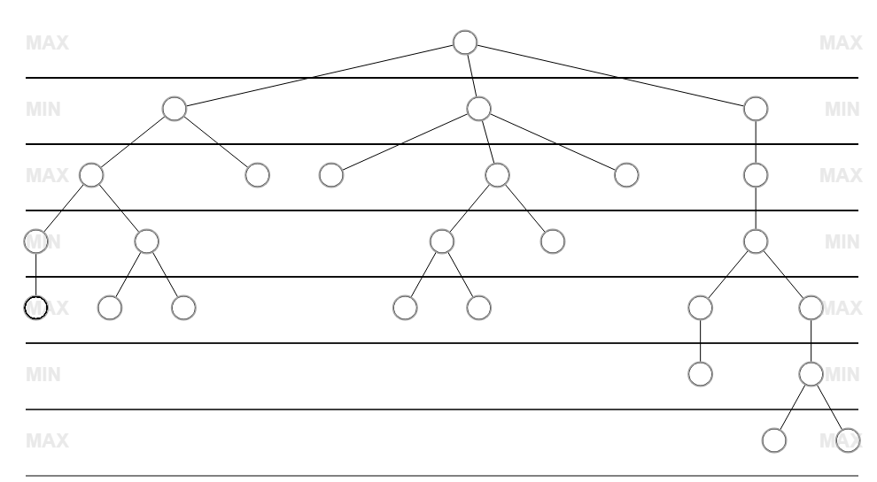
InvestmentOption:
name =
expected_return = , risk =
Node:
remaining_budget =
risk_tolerance =
investment_horizon = 5
value =
InvestmentOption:
name =
expected_return = , risk =
Node:
remaining_budget =
risk_tolerance =
investment_horizon = 4
value =
InvestmentOption:
name =
expected_return = , risk =
Node:
remaining_budget =
risk_tolerance =
investment_horizon = 3
value =
InvestmentOption:
name =
expected_return = , risk =
Node:
remaining_budget =
risk_tolerance =
investment_horizon = 2
value =
InvestmentOption:
name =
expected_return = , risk =
Node:
remaining_budget =
risk_tolerance =
investment_horizon = 1
value =
InvestmentOption:
name =
expected_return = , risk =
Node:
remaining_budget =
risk_tolerance =
investment_horizon = 1
value =

