Slide 1

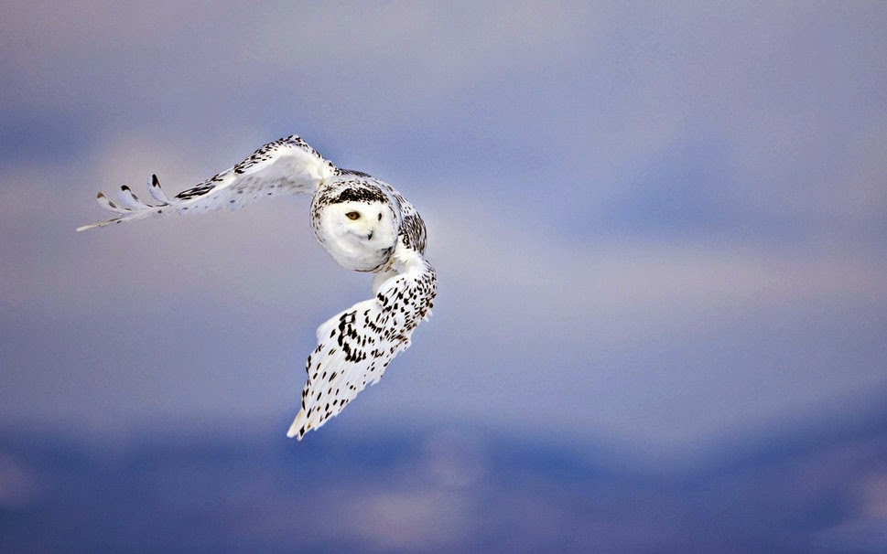
Control of Sensor-rich Flexible Airframe
Anatole Verhaegen
08/04/2015

Slide 2
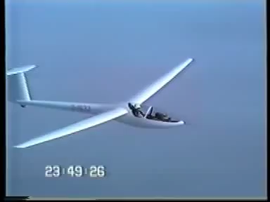

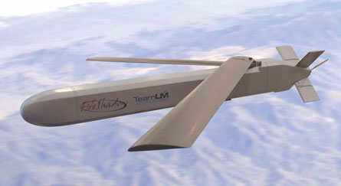
Applications
Vibration active suppression
Flutter
Large structures
Aggressive manoeuvers
Morphing monitoring
Flutter Phenomenon on a glider
Lockheed Martin Morphing Aircraft Structure
MBDA Fire Shadow

Slide 3

Methodology
Linearized system :
$$\left\{\begin{aligned}\dot{x}=Ax+Bu \\ y=Cx+Du\end{aligned}\right.$$
State matrix
Full order system
Reduced order system
Controller
A
A, B, C, D
A_{red}, B_{red}, C_{red}, D_{red}
K(s)
Sensors & Actuators placement
Balance Order Reduction
Controller Synthesis

Slide 4
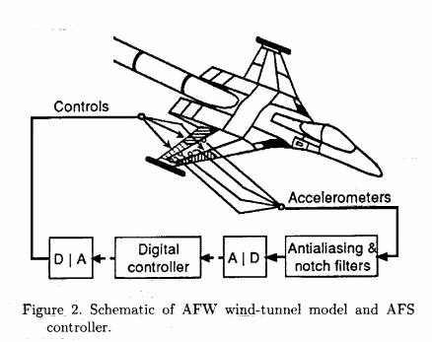
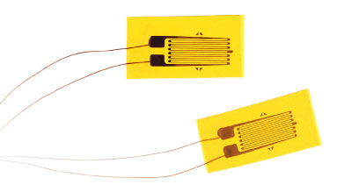
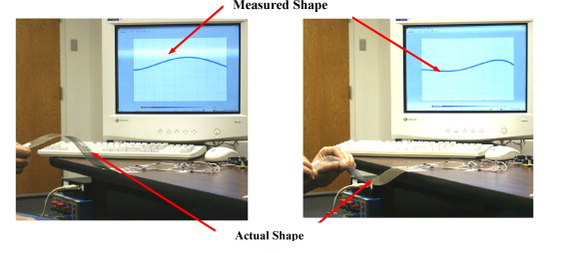
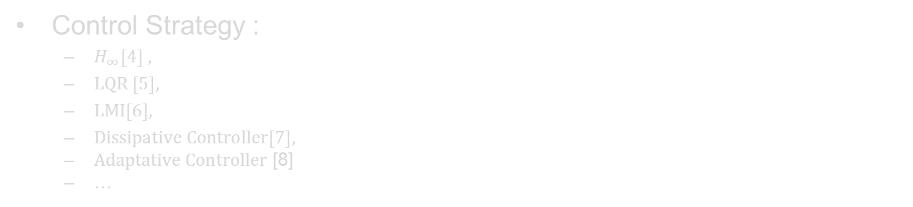
Requirements
Sensors :
Accelerometers [2]
Strain gages
Others [3]
Structural Model :
Finite Element Method
Model Identification
Balance order reduction
Control Strategy :
$H_{∞}\left[4\right] ,$
$LQR \left[5\right],$
$LMI\left[6\right],$
$Dissipative Controller\left[7\right],$
$Adaptative Controller$ [8]
…

Slide 5
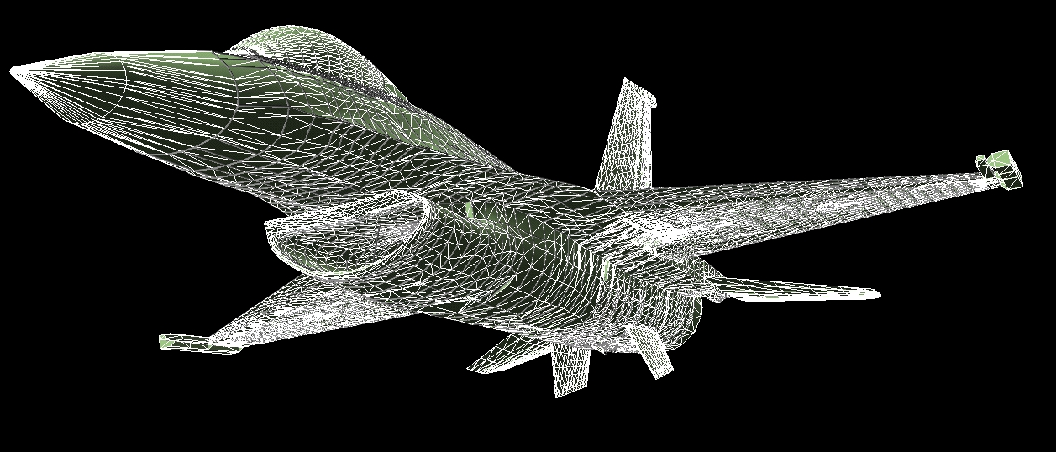
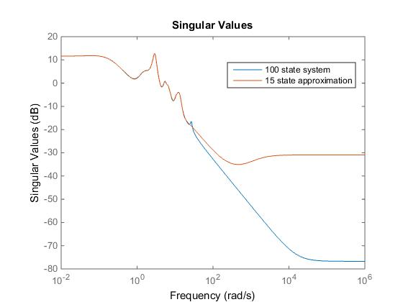

Requirements
Sensors :
Accelerometers [2]
Strain gages
Others [3]
Structural Model :
Finite Element Method
Model Identification
Balance order reduction
Control Strategy :
$H_{∞}\left[4\right] ,$
$LQR \left[5\right],$
$LMI\left[6\right],$
$Dissipative Controller\left[2\right],$
$Adaptative Controller$ [7]
…

Slide 6
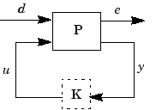

Requirements
Sensors :
Accelerometers [2]
Strain gages
Others [3]
Structural Model :
Finite Element Method
Model Identification
Balance order reduction
Control Strategy :
$H_{∞}\left[4\right] ,$
$LQR \left[5\right],$
$LMI\left[6\right],$
$Dissipative Controller\left[2\right],$
$Adaptative Controller$ [7]
…

Slide 7
Thank You
Anatole Verhaegen
a.verhaegen@cranfield.ac.uk

Slide 8
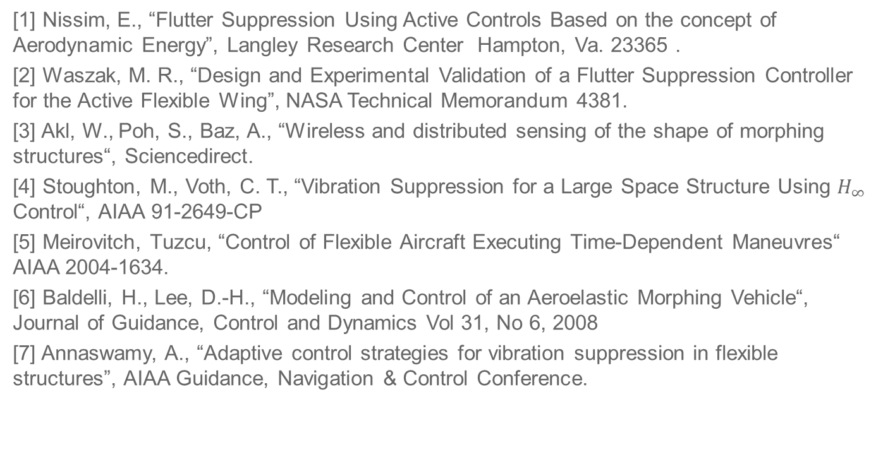
References
[1] Nissim, E., “Flutter Suppression Using Active Controls Based on the concept of Aerodynamic Energy”, Langley Research Center Hampton, Va. 23365 .
[2] Waszak, M. R., “Design and Experimental Validation of a Flutter Suppression Controller for the Active Flexible Wing”, NASA Technical Memorandum 4381.
[3] Akl, W., Poh, S., Baz, A., “Wireless and distributed sensing of the shape of morphing structures“, Sciencedirect.
[4] Stoughton, M., Voth, C. T., “Vibration Suppression for a Large Space Structure Using $H_{∞}$ Control“, AIAA 91-2649-CP
[5] Meirovitch, Tuzcu, “Control of Flexible Aircraft Executing Time-Dependent Maneuvres“ AIAA 2004-1634.
[6] Baldelli, H., Lee, D.-H., “Modeling and Control of an Aeroelastic Morphing Vehicle“, Journal of Guidance, Control and Dynamics Vol 31, No 6, 2008
[7] Annaswamy, A., “Adaptive control strategies for vibration suppression in flexible structures”, AIAA Guidance, Navigation & Control Conference.

