Slide 1
Flexible ASTER Latax Control
Structured & Hand Tuned
Anatole VERHAEGEN
Cranfield University, 01/07/2015
<numéro>
Notes:
<numéro>

Slide 2
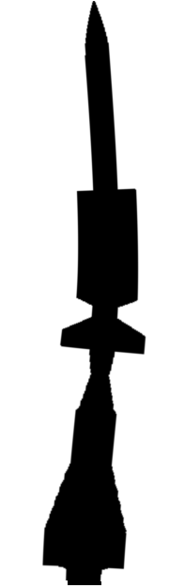
Missile Model
Strain gage
(ε)
IMU
(q, a_{z})
x
z
Thrust orientation
(θ_{T})
Flight Dynamics
Only short period pitch oscillations
Structure
Flexible body (5 first modes)
Actuator
1st order. Cutoff fq : 25Hz

Slide 3
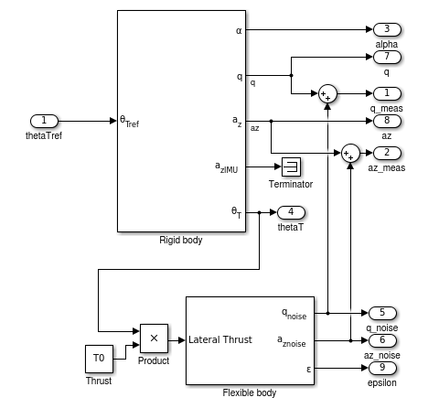
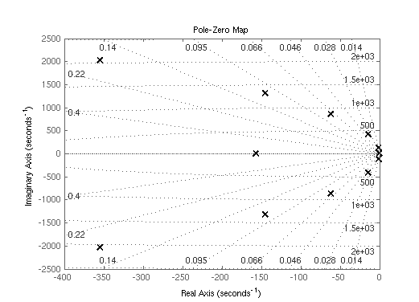
Missile Model

Slide 4
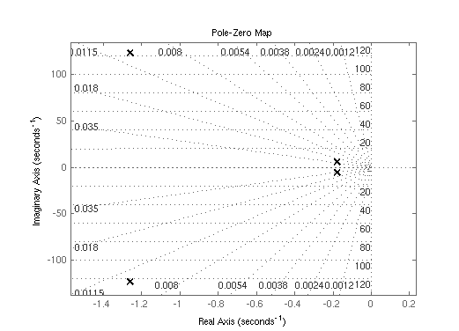
Missile Model

Slide 5
Modes and actuator bandwidth
Pitch Oscillation
0.9 Hz
1st bending mode
20 Hz
3d bending mode
140 Hz
4th bending mode
330 Hz
Mode frequency
(Hz)
2nd bending mode
70 Hz
4th bending mode
200 Hz
Actuator bandwidth

Slide 6
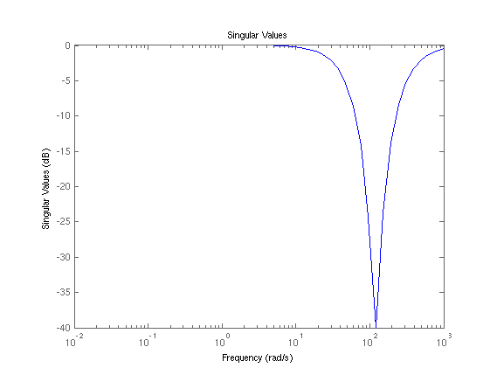
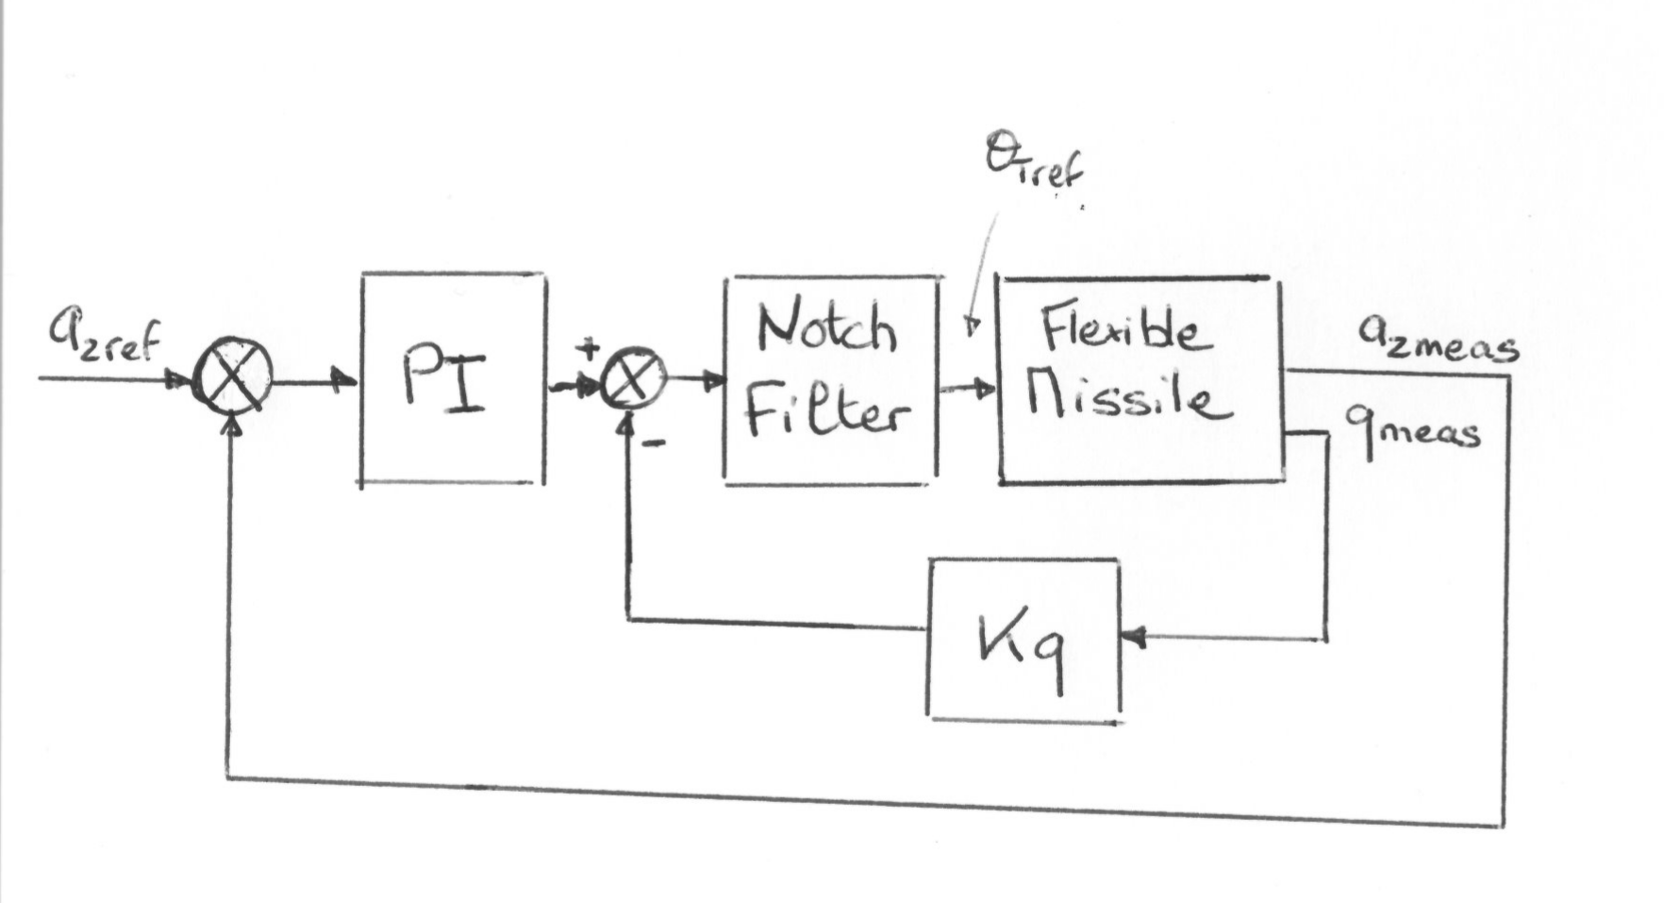
Conventional feedback loop
Notch filter : Avoids excitation of 1st mode
(4th order)
Pitch rate feedback : Damps pitch oscillation
PI corrector on latax : Brings latax to reference

Slide 7
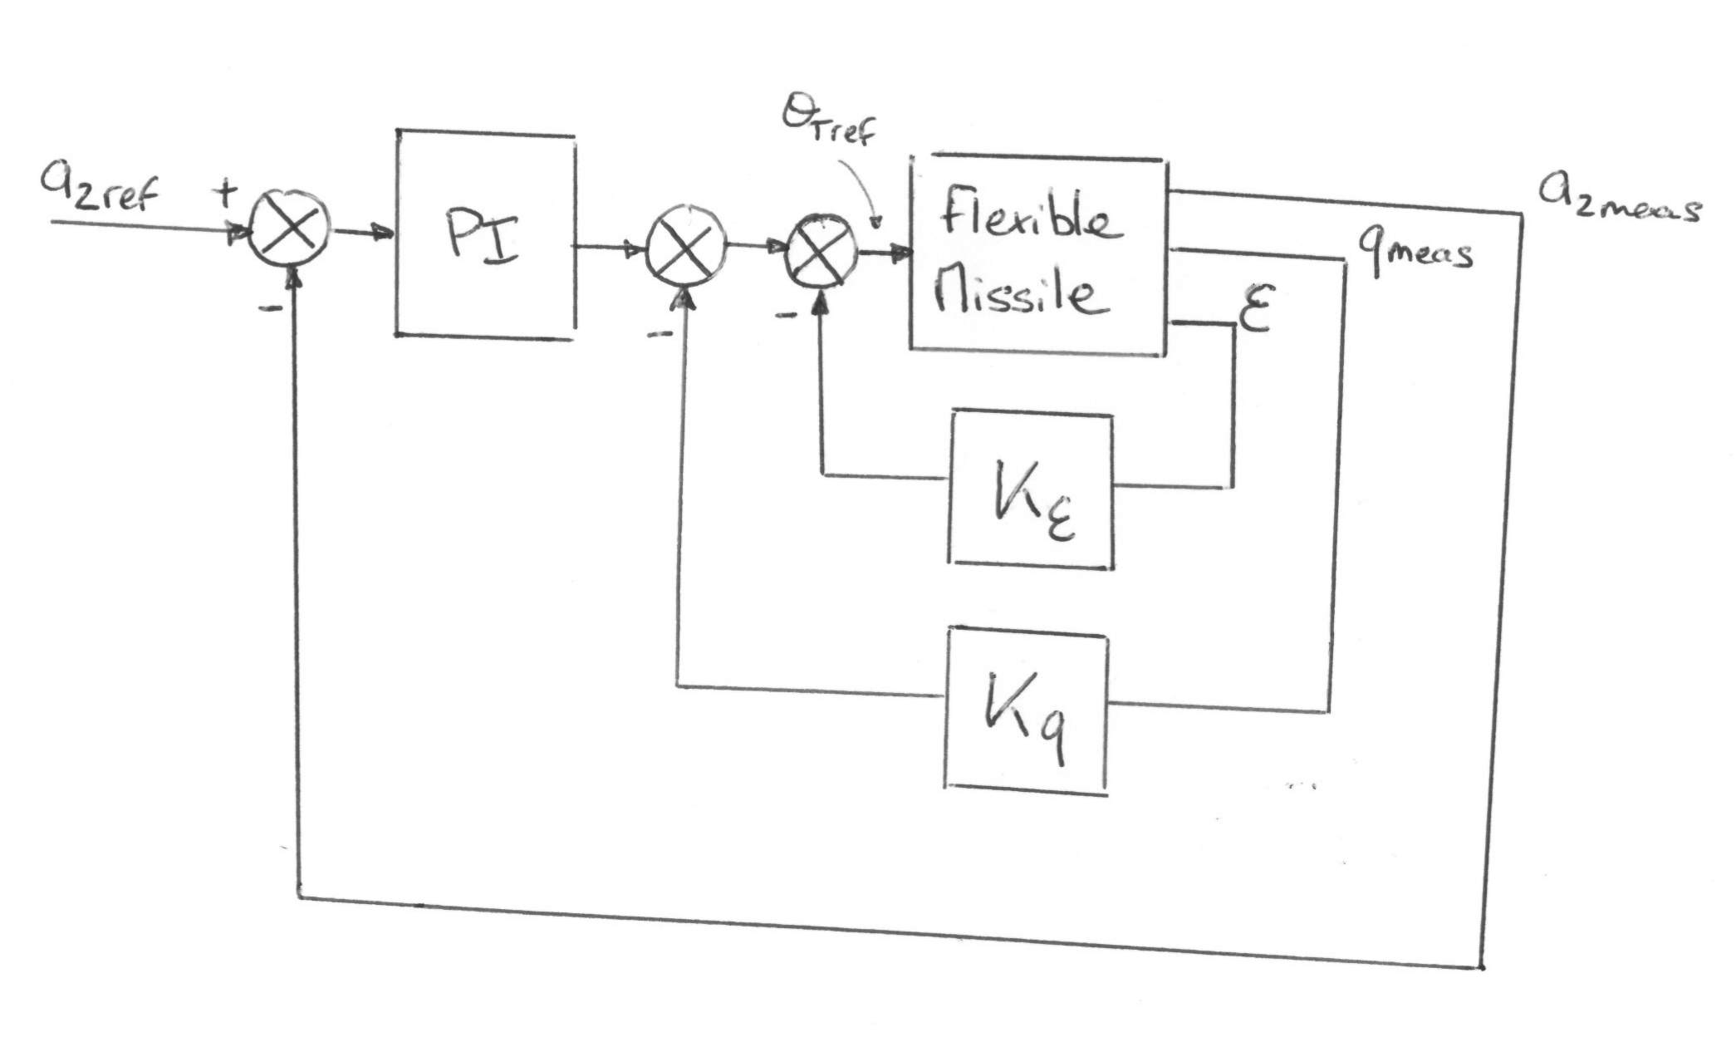
Conventional feedback loop Active damping
Strain feedback : Damps 1st mode
Pitch rate feedback : Damps pitch oscillation
PI corrector on latax : Brings latax to reference

Slide 8
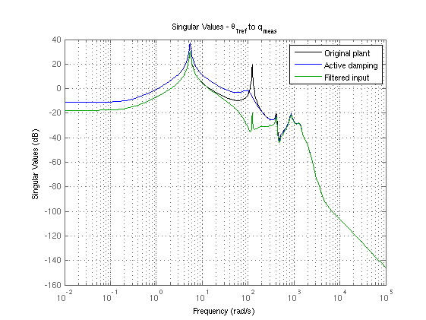
Notch filtering vs. Active damping Vibrations

Slide 9
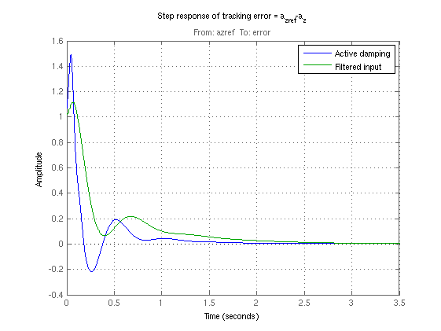
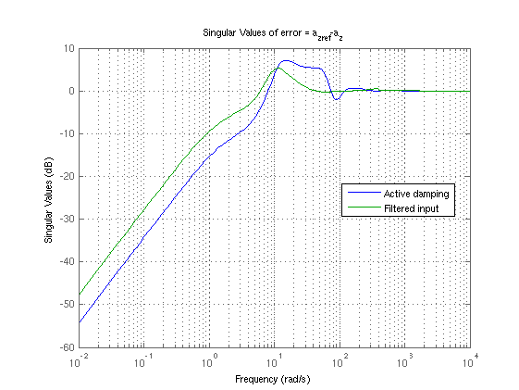
Notch filtering vs. Active damping Performance

Slide 10
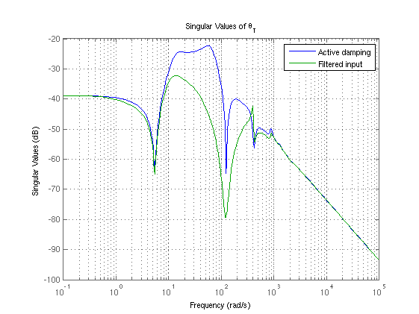
Notch filtering vs. Active damping Performance

Slide 11
Forthcoming
Noise rejection
Pitching moment disturbance rejection
Robustness to uncertainty
Optimal tuning (Hinfstruct)

