Slide 1
Custom “SEE tolerant” Aurora Gearbox
Anatoliy Martynyuk

Slide 2
Overview
The YARR rx from the RD53B receives serial data across multiple lanes with a 2 bit “delimiter” to identify individual data blocks.
SEEs can corrupt the data on the output of the RD53B so that bits are dropped, added or flipped within the data stream, resulting in a loss of synchronization between the RD53B and YARR.
THE YARR rx has a sync loss detection and recovery scheme… however, it suffers from inefficiencies which result in an unnecessary number of lost data and can be improved.
The new recovery scheme aims to remove redundancy and complexity as well add parallelism to improve sync recovery performance.
The new recovery scheme can provide moderate improvements at no cost in resources, upwards to drastic improvements with an investment in device resources.

Slide 3
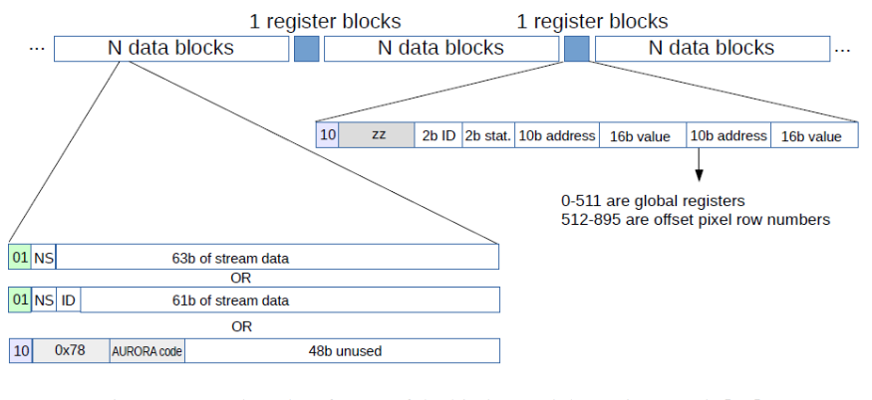
Context : Communication
The RD53B and YARR DAQ communicate via the 64b/66b Aurora encoding. Four Channels transmit data simultaneously.
Aurora encoding packs together 64 “scrambled” bits of scrambled data with 2 header bits, which can be either a “01” or a “10”.

Slide 4
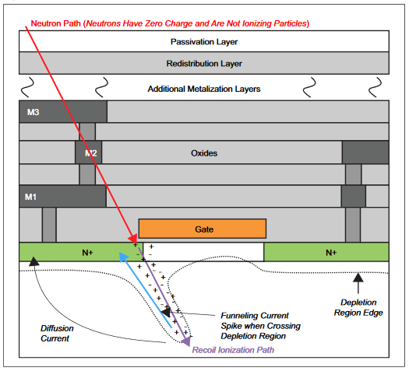
Context : Single Event Effects (SEEs)
Single Event Effects are radiation inflicted damage that can result in glitches or bit flips.
SEUs (Single Event Upsets) : A bit flip of a memory register.
SETs (Single Event Transients): A voltage glitch on a line, especially dangerous if on a clock or reset.

Slide 5
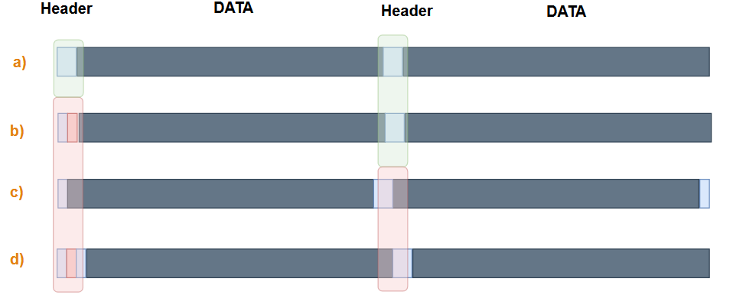
SEEs Consequences to the YARR
We can ignore the physics surrounding SEEs and represent them in digital logic as bit flips, bit drops, and bit adds:
Header bits are seen consistently, we’re in sync.
A bit flip causes a header to be invalid, ideally still in sync.
A bit drop resulting in the header bits “moving”, no longer in sync.
A bit add resulting in the header bits “moving”, no longer in sync.

Slide 6
Original Resync Scheme
Utilizes two bit slipping mechanisms simultaneously to shift headers back into correct position.
Slips in only a single direction.
Checks a single bit pair at a time for the header bits during recovery.
Offers no tolerance for header bit flips and would immediately start slipping even if there is no issue to resolve.

Slide 7
New and Improved Resync Scheme
Reduced to a single effective bit slip mechanism.
Offered limited tolerance to allow single bit flips but fail fast otherwise.

Slide 8
Fully Parallel Search Resync Scheme
No bit slipping mechanism whatsoever.
Checks 67 bits for 66 possible header locations simultaneously.
Reduced tolerance but increased consecutive valid block count synchronization requirement.

Slide 9
Resource Utilization of Schemes
Absolute Resource Utilization of Resync Schemes
% Resource Utilization with Kintex 7 T160 Target FPGA

Slide 10
Further Development
Parameterizable Partially Parallel Search:
A tradeoff can be made between the amount of parallel search occurring to maximize common case recovery while minimizing the additional resource required to support the search.
In this variation bit slips and parallel search are used together where the number of bits searched in parallel is equal to the number of bits slipped per bit slip.
Fail Fast Header Seekers:
Rather than search a consecutive block of bits, have seekers assigned to evenly spaced bit positions to which they rotate whenever their current position results in an invalid header.
Error Tolerance Algorithms:
At a relatively cheap cost in resources, various error tolerance schemes can strike a balance to avoid pointless and costly searches as a result of a bit flip, while remaining vigilant to bit adds and bit drops.
The resources used to track tolerance and evaluate whether sync is achieved can be merged with the parallel header checking to reduce resources.

