Slide 1
Tariff Impact Dashboard: ML for Commodity Price Analysis
Object: Price Forecasting, Clustering & Risk Classification Author: Anatoly Barabanov & Matthew Danese
Course: CMPSC 445
Professor: Janghoon Yang

Slide 2
Project Overview
Build an interactive dashboard to:
Forecast commodity prices (Regression).
Cluster commodities by price trends (KMeans).
Classify risk levels (Decision Tree).
Data Source: World Bank’s
CMO-Historical-Data-Monthly.xlsx (80+ commodities, 1980s–2025).
Tech Stack: Python, Scikit-learn, Streamlit.

Slide 3
Project Architecture
FinalProject-CMPSC-445-Tariff-ML/
├── models/ (*.pkl)
├── data/ (World Bank dataset)
└── CMO-Historical-Data-Monthly
├── scripts/
└── tariff_models.py
└── train_regression.py
└── train_kmeans.py
└── train_classifier.py
└── tariff_dashboard1.py (Streamlit App)

Slide 4
Key Features
Price Forecasting:
Predicts next month’s price using Linear Regression.
Commodity Clustering:
Groups similar commodities using KMeans.
Risk Classification:
Labels commodities as High/Medium/Low risk based on volatility.
Dashboard:
Interactive visualizations powered by Streamlit.

Slide 5
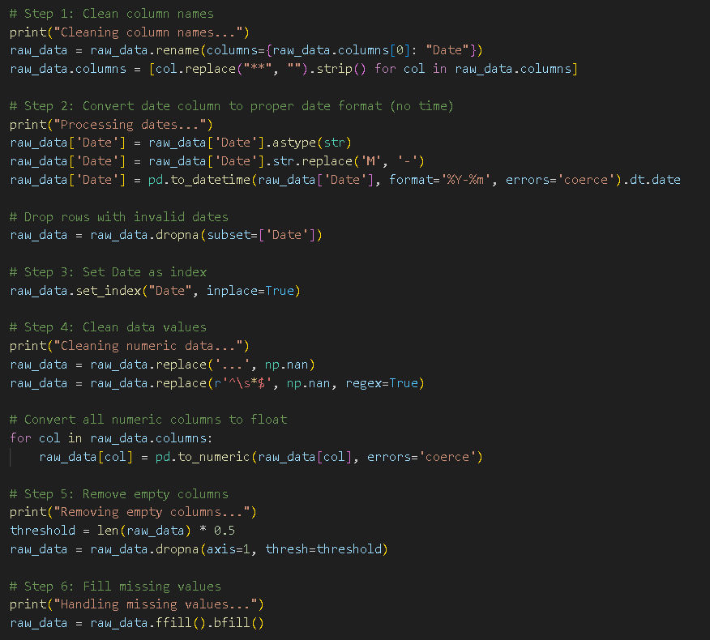
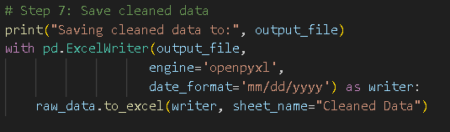
Data Pipeline
Raw Data: World Bank Excel file → Monthly prices.
Preprocessing:
Output: Cleaned dataset (CMO-Historical-Data-Monthly-CLEANED.xlsx).

Slide 6
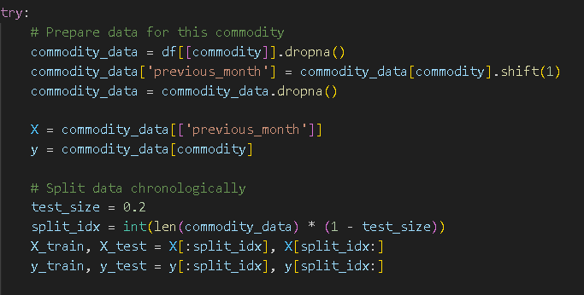
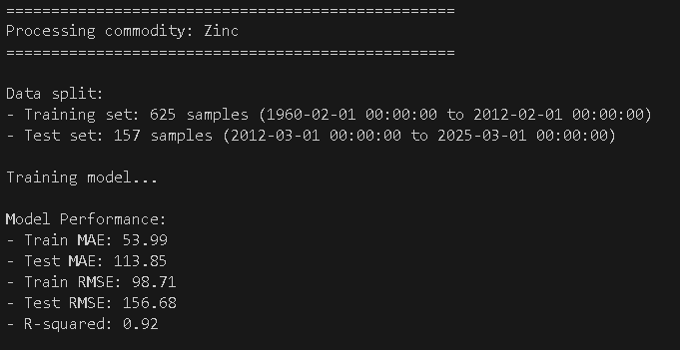
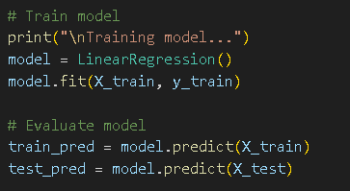

Price Forecasting (Regression)
Model: Linear Regression (1-month lag).
Code:
Result: Predicts next month’s price

Slide 7
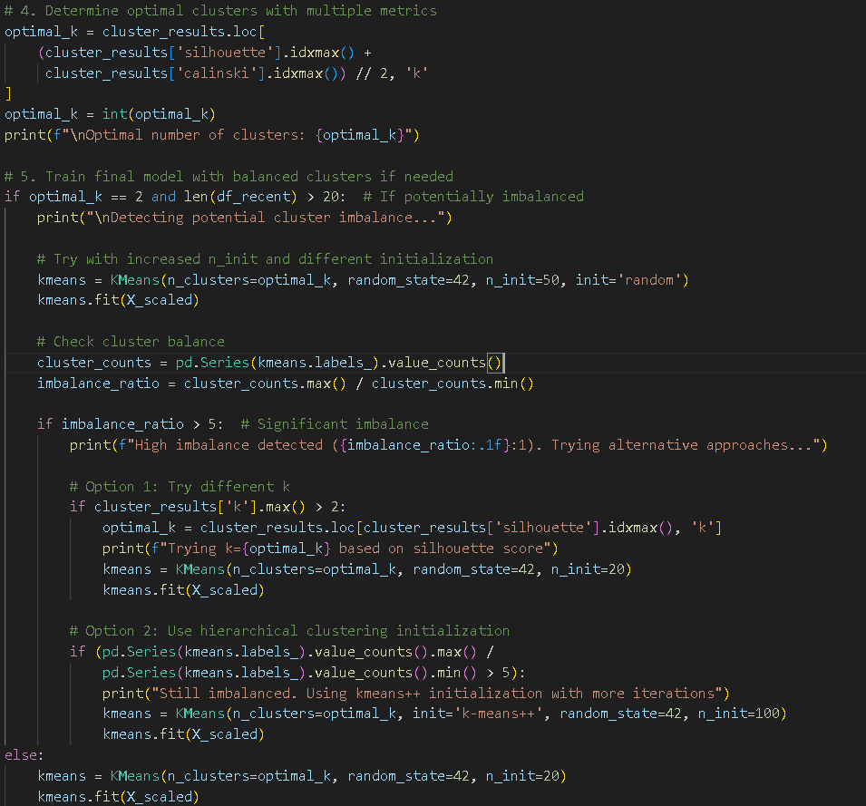
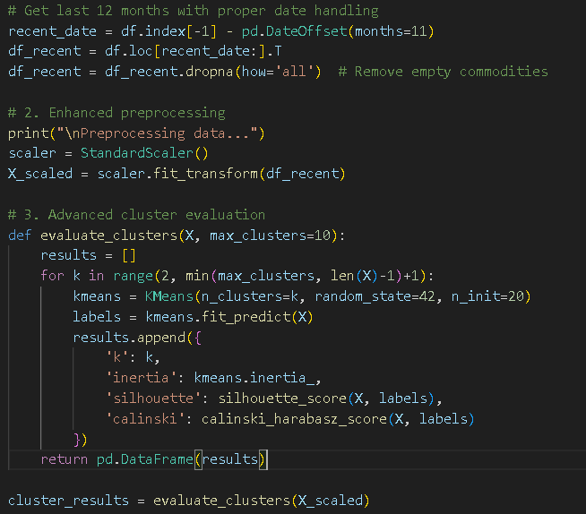
Commodity Clustering (KMeans)
Model: KMeans
Code:

Slide 8
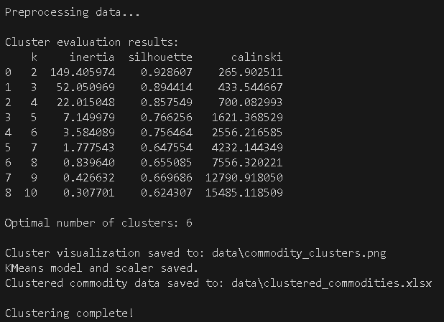
Result kmeans

Slide 9
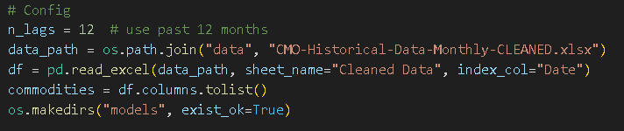
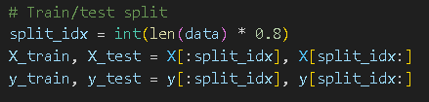
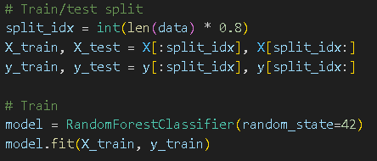
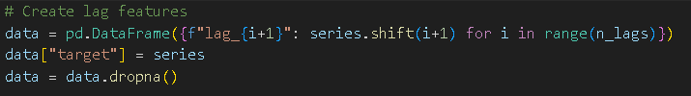
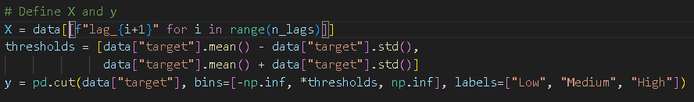
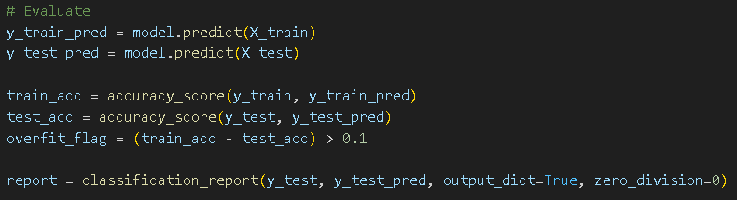
Risk Classification (Decision Tree)
Model: Random Forest Classifier
Configuration & Setup:
Split Data:
Train & Predict:
Prepare Time Series Features:
Define Classification Target:
Evaluate Model:

Slide 10
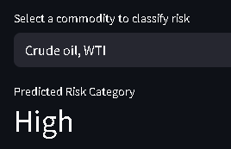
Result risk classification
Commodity | Train Accuracy | Test Accuracy | Overfitting? | Precision | Recall | F1-Score
Crude oil, WTI | 1 | 0.961 | No | 0.961 | 0.961 | 0.961
Coal, Australian | 1 | 0.955 | No | 0.955 | 0.955 | 0.955
Coal, South African | 1 | 0.774 | Yes | 0.777 | 0.774 | 0.775
Natural gas, US | 1 | 0.948 | No | 0.947 | 0.948 | 0.947
Natural gas, Europe | 1 | 0.826 | Yes | 0.854 | 0.826 | 0.811
Liquefied natural gas, Japan | 1 | 0.871 | Yes | 0.894 | 0.871 | 0.865
Natural gas index | 1 | 0.852 | Yes | 0.85 | 0.852 | 0.839
Cocoa | 1 | 0.916 | No | 0.915 | 0.916 | 0.916
Coffee, Arabica | 1 | 0.948 | No | 0.948 | 0.948 | 0.948
Coffee, Robusta | 1 | 0.987 | No | 0.987 | 0.987 | 0.987
Tea, avg 3 auctions | 1 | 0.897 | Yes | 0.907 | 0.897 | 0.901
Tea, Colombo | 1 | 0.916 | No | 0.839 | 0.916 | 0.876
Tea, Kolkata | 1 | 0.8 | Yes | 0.803 | 0.8 | 0.8
Tea, Mombasa | 1 | 0.8 | Yes | 0.809 | 0.8 | 0.799
Coconut oil | 1 | 0.897 | Yes | 0.904 | 0.897 | 0.897

Slide 11
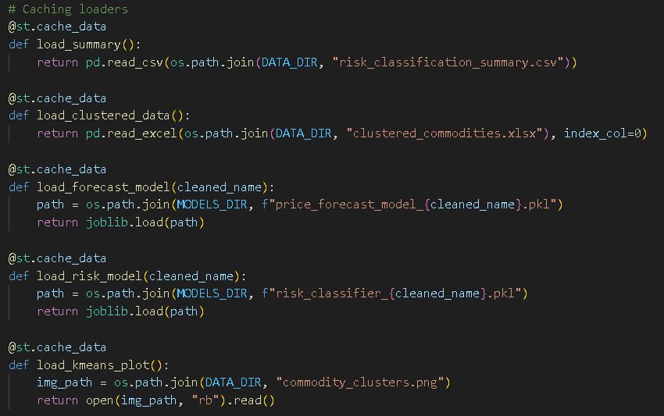
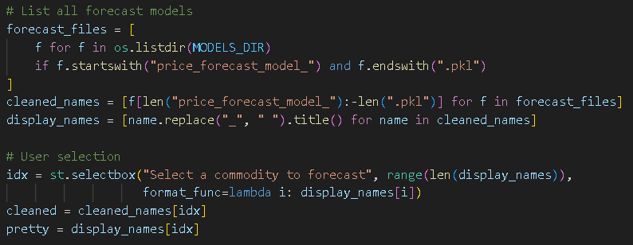

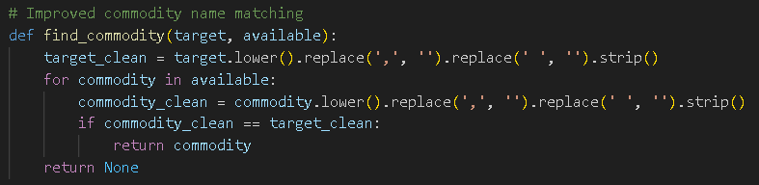
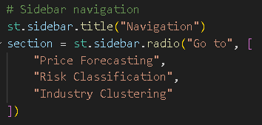
Streamlit Dashboard
Cached Data Loaders:
Price Forecasting:
Navigation Sidebar:
Takes latest known price and makes a prediction using the model:
last_value = clustered_df.loc[matched_name, last_col]
forecast = model.predict(np.array([[last_value]]))[0]

Slide 12


Clustering:
Shows the cluster label for each commodity.
Displays KMeans clustering plot.
Risk Classification:
Loads and displays a precomputed summary of risk classifications.
When user selects a commodity the corresponding model is loaded.
Uses all historical price features to classify the current risk category.
Displays predicted risk.

Slide 13
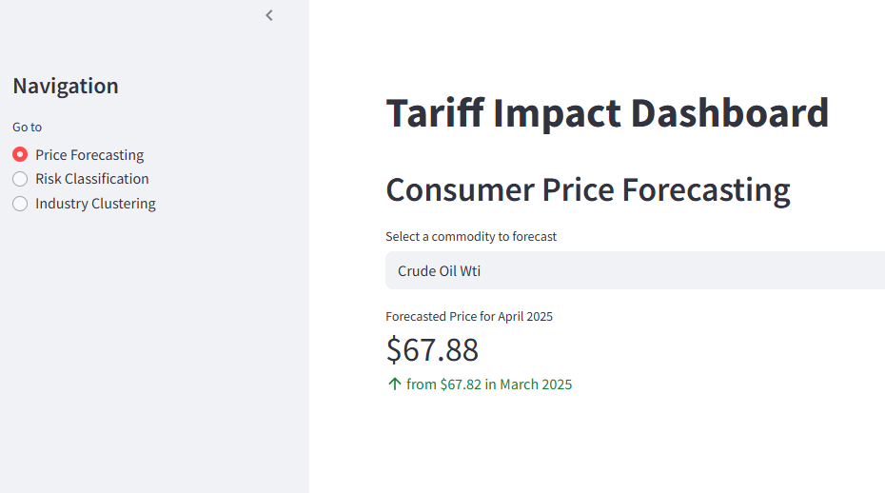
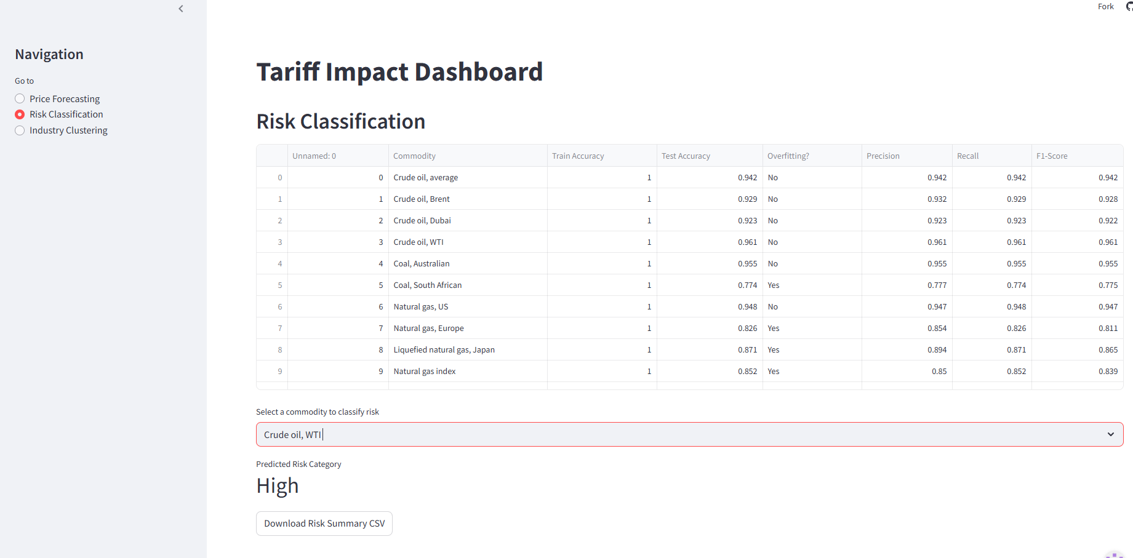
Outputs & Visuals

Slide 14
Final Summary
Conclusions:
Price forecasting works well for most stable commodities.
Clustering identifies logical groups such as precious metals, agriculture and energy.
Risk classification effectively identifies commodities with high volatility.

Slide 15
Thank You
GitHub:
https://github.com/AnatolyBarabanov/FinalProject-CMPSC-445-Tariff-ML

